Slide 1
OSG Fundamentals
Scot Kronenfeld - kronenfe@cs.wisc.edu
Marco Mambelli – marco@hep.uchicago.edu

Slide 2
Welcome!
This is the OSG Fundamentals session
Some of you have lots of experience
  Please chime in when I make mistakes!
  Or read your email
This should be an interactive session
  Please ask questions!
  If anything it too simple, tell me to move along.

Slide 3
What is OSG?
OSG provides high-throughput computing across the United States.
For August 2, 2010, a typical day in OSG:
  ~420,000 jobs for ~870,000 hours
  Used by 75 sites
  Jobs by about 30 VOs
  93% of jobs succeeded

Slide 4
What is OSG?
Abstraction
  Provides ways to refer, discover and use heterogeneous and distributed resources (Grid)
Software stack
  Implementation, supporting resources, processes
A community
  Virtual Organizations, developers, integrators, Site administrators

Slide 5
Who uses OSG?
About 230 virtual organizations
  High-energy physics uses a large chunk of OSG
  But several other sciences are actively using OSG.
    nanoHUB: nanotechnology simulations
    LIGO: detecting gravitational waves
    CHARMM: molecular dynamics
More at:
http://www.opensciencegrid.org/About/What_We're_Doing/Research_Highlights

Slide 6
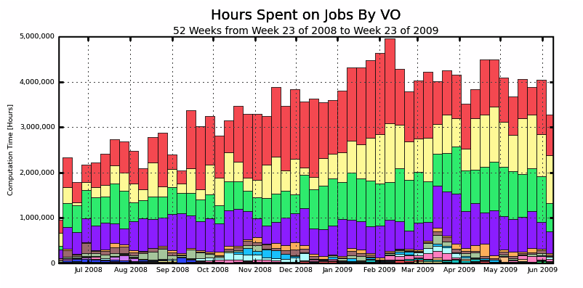
OSG is heavily used
CMS
CDF
DZero
ATLAS

Slide 7
Principle: Autonomy
Sites and VOs are autonomous
  You make decisions about your site
  We provide software
  You decide when to install, upgrade
  You make operational decisions
  We help out, but you are responsible for your site: we expect you to care about your site.

Slide 8
What is the role of an OSG site admin?
An OSG site administrator should:
  Keep in touch with OSG about
    Site contacts (Administrative and security)
    Problems you are encountering
    Downtime of your site
  Plan how your site works
  Attempt to keep up to date with software
  Be part of the OSG community

Slide 9
What does OSG do for site admins?
We should provide:
  Up to date grid software
  An easy installation and upgrade process
  Assistance in times of need
  A community of site administrators to share experiences with.
  Users who want to use your site
  An exciting, cutting-edge, 21st-century collaborative distributed computing grid cloud buzzword-compliant environment

Slide 10
A few definitions
VDT
Release cycle
OSG Software Stack
Computing Element (CE)
Storage Element (SE)
Worker Node

Slide 11
Definition: VDT
The Virtual Data Toolkit
A large set of software, mix and match
Used to install grid site, or client
Attempts to be grid-generic
http://vdt.cs.wisc.edu

Slide 12
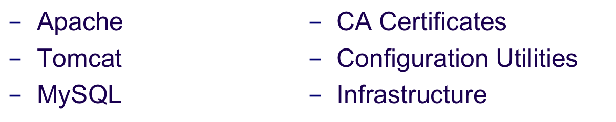
VDT Example
GUMS
  Authorizes users at a site
  Maps global user name to local UID
VDT includes dependencies. For example, GUMS needs:
/DC=org/DC=doegrids/OU=People/CN=Alain Roy 424511 ➔ roy

Slide 13
Definition: Release cycle
Software becomes available
Validation Testbed (VTB) checks that new components work with the current/new release
VDT and OSG prepare a release candidate
Integration Testbed (ITB) tests the release candidate (e.g. OSG 1.1) on a larger scale
OSG is released
Updates and support are available

Slide 14
Definition: OSG Software Stack
OSG Software Stack:
Subsets of VDT
+
OSG-specific bits
Example: OSG CE
  VDT Subset
    Globus
    RSV
    PRIMA
    … and another dozen
  OSG bits:
    Information about OSG VOs
    OSG configuration script (configure-osg)

Slide 15
Definition: CE, SE, Worker Node
CE: Computing Element
  The head node to your site.
  Users submit jobs to the CE
  Well-defined set of software
SE: Storage Element
  Manages large set of data at your site
  Multiple implementations
WN: Worker Node
  Runs jobs
  Some software installed here too

Slide 16
Bias towards CE
A lot of discussion in OSG is biased towards the CE.
It’s unfair: storage is important too!
As an organization, we have more experience and understanding of the CE and running job.
The CE is better developed than the SE.
This talk will mostly cover the CE
  With some discussion about SEs.

Slide 17
The CE software “big picture”
GRAM: Allow job submissions
GridFTP: Allow file transfers
CEMon/GIP: Publish site information
Gratia: Job accounting
Some authorization mechanism
  grid-mapfile: file that lists authorized users
  GUMS: service that maps users
RSV: Monitor health of CE
And a few other things…

Slide 18

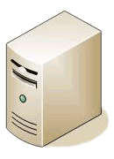
A Basic CE
GridFTP
?
Authorization
Test
RSV
GRAM
?
CEMon/GIP
Gratia
Query
Submit jobs

Slide 19
GRAM
GRAM comes in two flavors
  You’ll get both on your CE
  We support both
  The implementations are totally different
GRAM 2
  a.k.a pre-web services GRAM
  a.k.a “old GRAM”
  What most VOs currently use
GRAM 4
  a.k.a web services GRAM
  Not really used
GridFTP
Auth
RSV
GRAM
CEMon/GIP
Gratia

Slide 20
Gratia
Collects information about jobs run on your site
Hooks into GRAM
  Also a cron job to collect data
Stats sent to central OSG service
Optional: you can collect information locally.
GridFTP
Auth
RSV
GRAM
CEMon/GIP
Gratia

Slide 21
CEMon/GIP
These work together
  Essential for accurate information about your site
  End-users see this information
Generic Information Provider (GIP)
  Scripts to scrape information about your site
  Some information is dynamic (queue length)
  Some is static (site name)
CEMon
  Reports information to OSG GOC’s BDII
  Reports to OSG Resource Selector (ReSS)
GridFTP
Auth
RSV
GRAM
CEMon/GIP
Gratia

Slide 22
RSV
System for running tests
Goal: You should be the first to know when your site has grid problems
Doesn’t have to be run from the CE: large sites may prefer to use a separate computer.
Variety of tests, run periodically
GridFTP
Auth
RSV
GRAM
CEMon/GIP
Gratia

Slide 23
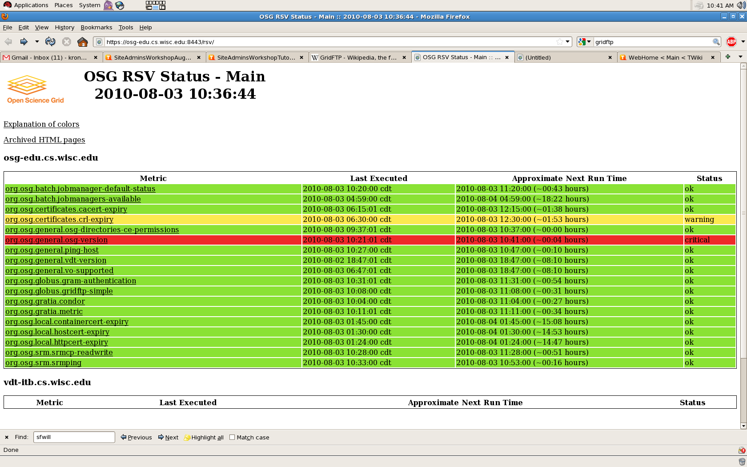
RSV HTML Page

Slide 24
RSV Error
metricName: org.osg.general.osg-version
metricType: status
timestamp: 2010-08-03 10:41:01 CDT
metricStatus: CRITICAL
serviceType: OSG-CE
serviceURI: osg-edu.cs.wisc.edu
gatheredAt: osg-edu.cs.wisc.edu
summaryData: CRITICAL
detailsData: FAILED Attempt to execute remote job:
[/opt/osg-1.2/globus/bin/globus-job-run osg-edu.cs.wisc.edu/jobmanager-fork /opt/osg-1.2/osg/bin/osg-version 2>&1 ]
ERROR: GRAM Job failed because the executable does not exist (error code 5)
EOT

Slide 25
Planning a CE
Now…
  Bureaucratic advance work
  What software goes where?
    How many computers?
  Disk layout
  Worker node software
  Authorization mechanism

Slide 26
Bureaucratic advance work
You’ll need a site name
  e.g. WISC-OSG-EDU
  You pick it, tell GOC.
  It’s used all over, so keep it consistent
You need site contacts
  Administrative contact
  Security contact
  These are important!!
  OSG will contact you sometimes
URL describing…
    Your site
    Policies about your site

Slide 27
What software goes where?
Simple case:
  Everything goes on CE
  Worker node software on NFS volume
  GRAM, GridFTP, etc. on CE

Slide 28
More advanced site
GridFTP
GUMS
(Authorization service)
RSV
(For Testing)
GRAM
CEMon/GIP
Gratia
NFS Server
Submit jobs

Slide 29
OSG Disk Layout for a CE
Required directories
OSG_APP: Store VO applications
  Must be shared (usually NFS)
  Must be writeable from CE, readable from WN
  Must be usable by whole cluster
OSG_GRID: Stores WN client software
  May be shared or installed on each WN
  May be read-only (no need for users to write)
  Has a copy of CA Certs & CRLs, which must be up to date
OSG_WN_TMP: temporary directory on worker node
  May be static or dynamic
  Must exist at start of job
  Not guaranteed to be cleaned by batch system

Slide 30
OSG Disk Layout for a CE
Optional directories
OSG_DATA: Data shared between jobs
  Must be writable from the worker nodes
  Potentially massive performance requirements
  Cluster file system can mitigate limitations with this file system
  Performance & support varies widely among sites
  1777 permission on OSG_DATA (like /tmp)
Squid server: HTTP proxy can assist many VOs and sites in reducing load
  Reduces VO web server load
  Efficient and reliable for site
  Fairly low maintenance
  Can help with CRL maintenance on worker nodes

Slide 31
Disk Usage
Varies between VOs
  Some VOs download all data & code per job (may be Squid assisted), and return data to VO per job.
  Other VOs use hybrids of OSG_APP and/or OSG_DATA
OSG_APP used by several VOs, not all.
  1 TB storage is reasonable
  Serve from separate computer so heavy use won’t affect other site services.
OSG_DATA sees moderate usage.
  1 TB storage is reasonable
  Serve it from separate computer so heavy use of OSG_DATA doesn’t affect other site services.
OSG_WN_TMP is not well managed by VOs and you should be aware of it.
  ~100GB total local WN space
  ~10GB per job slot.

Slide 32
NFS Lite
Modifications to Condor job manager to move data from CE to WN instead of using NFS to share data
  Only supports Condor
  Can be deployed after CE is successfully installed. (You can try it later)
  Will clean all job’s files on WN after job completion.
  With extra work, can make OSG_WN_TMP dynamic

Slide 33
Worker Node Storage
Provide about 12GB per job slot
Therefore 100GB for quad core, 2 socket machine
Not data critical, so can use RAID 0 or similar for good performance

Slide 34
Authorization
Two mechanisms for authorization:
  File with list of mappings
(GridMap: global user DN ➔ local user)
    Tool to generate list based on VO membership: edg-mkgridmap
    Too simplistic, doesn’t deal with users in multiple VOs
  Service with list of mappings (GUMS)
    One service for multiple computers
    Deals correctly with complex cases
    Preferred solution
    Best placed on separate computer

Slide 35
Installing a CE
Install session this afternoon for CE and GUMS:
  Act now! Special Offer! Limited supplies!
  Hands on!
  Go home with working CE!
  Impress your co-workers and lovers!
Tomorrow morning:
  SE install sessions
Now we’ll do a quick overview

Slide 36

But first…
Good time for questions
Ask us hard questions!!
  But only hard questions we have answers for.

Slide 37
Install Prereqs
Before installing:
Certificates
User accounts
Pacman package manager

Slide 38

Certificates
Your site needs PKI certificates
  Beyond this talk to discuss PKI
  I assume you understand basics
    You need a public cert
    You need a private key
Your site needs a few certificates:
  Host certificate
  HTTP certificate
  RSV certificate (recommended)
  Best to get these in advance
Online documentation on getting them
https://twiki.grid.iu.edu/bin/view/ReleaseDocumentation/GetGridCertificates

Slide 39
Users
You need a user for RSV
Daemon user used for many components.
  Some people like user for Globus
  User for batch system (e.g. condor)
User for each VO you support

Slide 40
Pacman
The OSG Software stack is installed with Pacman
  No, not RPM or deb (yet)
  Yes, custom installation software
Why?
  Mostly historical reasons
  Makes multiple installations and non-root installations easy
Why not?
  It’s different from what you’re used to
  It sometimes breaks in strange ways
Will we always use Pacman?
  Probably
  We are currently working on a set of native packages in parallel

Slide 41
More on Pacman
Easy installation
  Download
  Untar
  No root needed
Non-standard usage
  Pacman installs in current directory (unlike RPM/deb)

Slide 42
Online Documentation
Twiki
  OSG collaborative documentation
  Used throughout OSG
https://twiki.grid.iu.edu/
Installation documentation
https://twiki.grid.iu.edu/twiki/bin/view/ReleaseDocumentation/

Slide 43
Basic process for CE
Install Pacman
  Download
http://physics.bu.edu/pacman/sample_cache/tarballs/pacman-3.28.tar.gz
  Untar (keep in own directory)
  Source setup
Make OSG directory
  Example: /opt/osg symlink to /opt/osg-1.2
Run pacman commands
  Get CE
  Get job manager interface (e.g. Globus-Condor-Setup)
Install CA Certificates
Configure
  Edit config.ini
  Run configure-osg

Slide 44
CA Certificates
What are they?
  Public certificate for certificate authorities
  Used to verify authenticity of user certificates
Why do you care?
  If you don’t have them, users can’t access your site

Slide 45
More about CA Certificates
Where to get them:
  OSG provides in RPM and Deb format
  vdt-update-certs program
Further discussion later today by Igor

Slide 46
Configuring site
Configuration primarily done using configure-osg script
Configuration specified in $OSG_LOCATION/osg/etc/config.ini
[RSV]
enabled = %(enable)s
rsv_user = rsv
enable_ce_probes = %(enable)s
ce_hosts = osg-edu.cs.wisc.edu

Slide 47
Using configure-osg
Verification mode
  configure-osg –v
  This mode verifies settings and values but does not change or set any settings
Configuration mode
  configure-osg -c
  This mode makes changes and alters system

Slide 48
Updates
We periodically release updates to OSG software stack
Announced by GOC
  OSG-specific instructions

Slide 49
Two kinds of updates
Incremental updates - OSG 1.2.8, OSG 1.2.9
  Frequent (Every 1-6 weeks)
  Existing installations can be updated
  Process:
    Turn off services
    Backup installation directory
    Perform update
    Re-enable services
Major updates – OSG 1.0, OSG 1.2
  Irregular – next major update is not yet planned
  Must be a new installation
  Can copy configuration from old installation
  Process:
    Point to old install
    Perform new install
    Turn off old services
    Turn on new services

Slide 50
Incremental updates
To get the latest incremental update:
  Run the vdt-updater
  Updates with Pacman, preserves configuration
Not quite perfect
  Sometimes configuration is lost
  We’re actively improving it.

Slide 51
A few words about Storage Elements
A bit about SRM
A bit about dCache
A bit about BeStMan/Xrootd

Slide 52
A few words about Storage Elements
Tanya and Alex are the experts
  Install sessions for Storage Elements are tomorrow morning
OSG relies on SRM
  Well-defined storage management interface
  Manages storage:
    Who can store data?
    How much data can be stored?
    Does permission expire?

Slide 53
Multiple types of SEs
Unlike job submission (which uses Globus GRAM), there are two commonly used, very different SEs in OSG:
  dCache
    Scales very well
    Moderately complex installation
  BeStMan
    Lighter weight than dCache
    By itself, doesn’t scale as far as dCache
    May scale well with XRootd or Hadoop

Slide 54
dCache
dCache widely used by CMS
Scales well
Fairly complex installation
Requires multiple computers to install
Part of VDT, but NOT installed with Pacman, but with RPMs.
Well-supported by OSG's VDT Storage Group

Slide 55
BeStMan (with optional XRootd)
Becoming widely used in OSG
Relatively simple to install
Packaged with VDT using Pacman
May scale very well with Xrootd
  But then no longer as simple to install
May scale well with Hadoop FS
  This is work in progress

Slide 56
On the Horizon
Mainly evolutionary changes because stack is in production use
Native Packaging
  set of RPMs for LIGO
  “Monolithic” Glexec RPM
  Working on Glexec w/ RPM dependencies

Slide 57
On the Horizon (cont.)
CREAM
  Job management system from gLite
  Requested by ATLAS
Globus 5
  Not coming yet: no existing stakeholder requests
  Will probably take GridFTP from Globus 5 for CREAM
  GRAM 5 will come, but after CREAM

Slide 58
Upcoming Releases
Storage update:
  Update to Xrootd
  Adding Bestman 2 and Bestman-Client
  New Gratia probes including Xrootd probes
Next update:
  Updated Glexec/PRIMA
  Updated MyProxy, Fetch-CRL, Gratia Collector, OpenLDAP
  Possibly RSV update including rsv-control

Slide 59
Discussion, Questions
Questions? Thoughts? Comments?

Slide 60
Extra Slides
CA Certificates
Installing a CE

Slide 61
Installing CA Certificates
The OSG installation will not install CA certificates by default
  Users will not be able to access your site!
To install CA certificates:
vdt-ca-manage setupca \
–location local \
–url osg
  Can choose other locations and CA distributions, but this is a reasonable default.

Slide 62
Choices for CA certificates
You have two choices:
  Recommended: OSG CA distribution
    IGTF + some local changes (maybe)
  Optional: VDT CA distribution
    IGTF only
IGTF: Policy organization that makes sure that CAs are trustworthy
You can add or remove CAs
You can make your own CA distribution

Slide 63
Why all this effort for CAs?
Certificate authentication is the first hurdle for a user to jump through
Do you trust all CAs to certify users?
  Does your site have a policy about user access?
  Do you only trust US CAs? European CAs?
  Do you trust the IGTF-accredited Iranian CA?
    Does the head of your institution?

Slide 64
Updating CAs
CAs are regularly updated
  New CAs added
  Old CAs removed
  Tweaks to existing CAs
If you don’t keep up to date:
  May be unable to authenticate some user
  May incorrectly accept some users
Easy to keep up to date
  vdt-update-certs
    Runs once a day, gets latest CA certs

Slide 65
CA Certificate RPM
There is an alternative for CA Certificate installation: RPM
  We have an RPM and a Debian package for each CA cert distribution
  Install and keep up to date with yum/apt
See the docs for more details:
  https://twiki.grid.iu.edu/bin/view/ReleaseDocumentation/CADistribution

Slide 66
Certificate Revocation Lists (CRLs)
It’s not enough to have the CAs
CAs publish CRLs: lists of certificates that have been revoked
  Sometimes revoked for administrative reasons
  Sometimes revoked for security reasons
You really want up to date CRLs
CE provides periodic update of CRLs
  Program called fetch-crl
  Runs every 6 hours

Slide 67
Run Pacman commands
Install CE:
pacman –get http://software.grid.iu.edu/osg-1.2:ce
Get environment
source setup.sh
Install Job Manager
pacman –get http://software.grid.iu.edu/osg-1.2:Globus-Condor-Setup
  (Substitute PBS, LSF, or SGE)

Slide 68
Configuration File Format
Similar to windows ini file
Broken up into sections
Each section starts with a [Section Name] hear (e.g. [Site Information])
Each section has variables set using variable = value format
Variable substitution is supported
Lines starting with ; considered a comment

Slide 69
Example configure-osg.ini fragment
[GIP]
enable = True
home = /opt/osg
; this is used for something
my_dir = %(home)s
Variable Substitution

Slide 70
Variable Substitution
Variable substitution is done by referring to other variables using %(variable_name)s
Substitutions are recursive but limits to recursion
Special section called [DEFAULT] that contains variables used in other sections for substitution

Slide 71
Using configure-osg
Verification mode
  configure-osg –v
  This mode verifies settings and values but does not change or set any settings
Configuration mode
  configure-osg -c
  This mode makes changes and alters system

Slide 72
Troubleshooting
Logging is your friend
All actions, errors, and warnings logged to $OSG_LOCATION/vdt-install.log file
Can give –d flag to log debugging information to this file

