Slide 1





Lecture 1
Grid Intro and Fundamentals Review
Dr Gabrielle Allen
Center for Computation & Technology
Department of Computer Science
Louisiana State University
gallen@cct.lsu.edu
Grid Summer Workshop
June 26-30, 2006

Slide 2
Introduction to Grid Computing

Slide 3
Ian Foster’s Grid Checklist (2002)
A Grid is a system that:
  Coordinates resources that are not subject to centralized control
  Uses standard, open, general-purpose protocols and interfaces
  Delivers non-trivial qualities of service
Notes:
Grid computing has also been called metacomputing, scalable global computing, internet computing

Slide 4
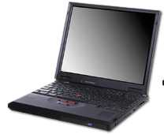
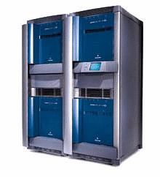
Components for Grid Computing
Distributed People
  Research communities who need to share data, or codes, or computers, or equipment to work on and understand common problems
  Astrophysics Network: relativists, astrophysicists, computer scientists, mathematicians, experimentalists, data analysts
Distributed Resources
  Computers: supercomputers, clusters, workstations, PDAs
  Storage devices, databases, networks
  Experimental equipment: telescopes/interferometers
Machine Network
CPU
CPU
CPU
CPU
DISK
Campus Network (LAN)
Machine Network
CPU
CPU
CPU
CPU
DISK
Campus Network (LAN)
Notes:
3

Slide 5
Components for Grid Computing
Software infrastructure
  Links all these together
  Low level: security, information, communication, …
  Middleware: data management, resource brokers, portlets, monitoring, workflow, …
Examples
  Globus (low level)
  Condor (higher level)

Slide 6
Virtual Organizations
Groups of organizations that use the Grid to share resources for specific purposes
  EU DataGrid, Alliance, TeraGrid, SC02 Global Grid Testbed, etc
Support a single community or multiple communities
Deploy compatible technology and agree on working policies
Deploy different network accessible services:
  Grid Information
  Grid Resource Brokering
  Grid Monitoring
  Grid Accounting
Authentication and Authorization

Slide 7
Components for Grid Computing
Don’t forget applications!
Application Level Utilities
  Standard toolkits
  SDKs
  Libraries
  User portals
Applications themselves
  Need to be highly portable and machine independent
Development tools (debuggers, profilers, …)
Example:
  Grid Application Toolkit

Slide 8
Nature of Large Scale Distributed Applications
Distributed data
  Naturally collected at multiple units of an organization
Distributed Resources
  Resources are distributed across multiple units
Data and Resource Ownership Issues
  Differential access and privacy issues

Slide 9
Examples of Distributed Applications
High Energy Physics applications
  Monte Carlo simulations
  CMS experiment
Finding interesting astronomical patterns
  Sloan Digital Sky Survey
Coastal ocean monitoring and predicting
  SURA Coastal Ocean Observing and Prediction (SCOOP)
Prime number generator
  Cracking DES
Divide the application and run it on a distributed and decentralized environment

Slide 10
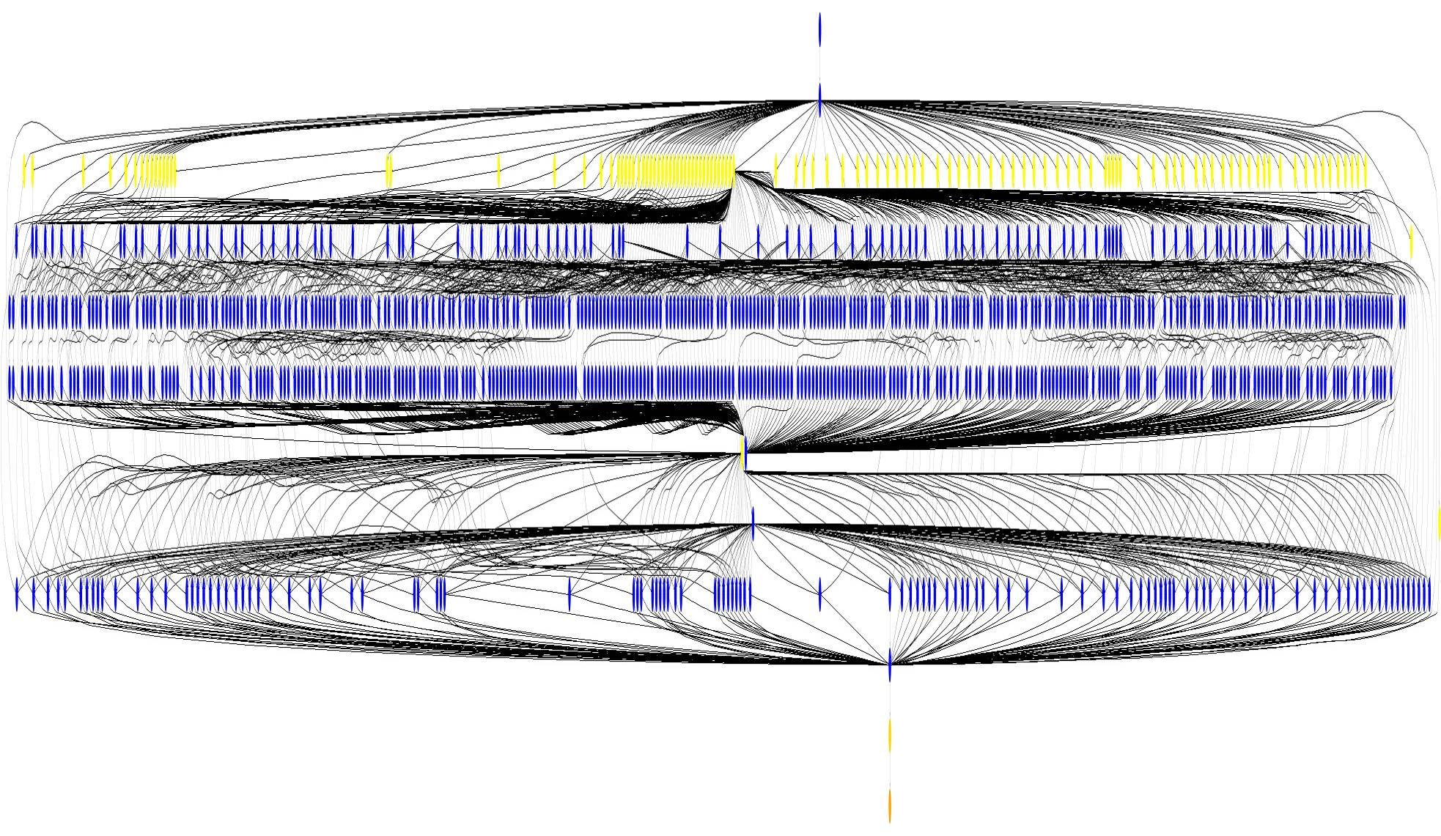
One typical application
Like many in HEP and Astronomy experiments, consist of:
  Large datasets as inputs (find datasets)
  “Transformations” which work on the input datasets (process)
  The output datasets (store and publish)
The emphasis is on the sharing of the large datasets
Transformations are usually long and can be parallelized
Montage Workflow: ~1200 node workflow, 7 levels

Slide 11

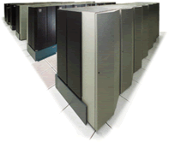
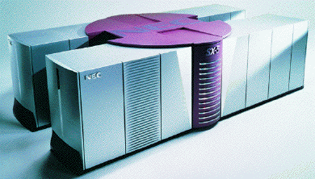
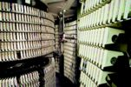
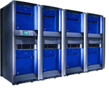
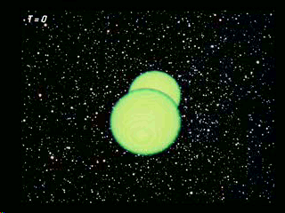
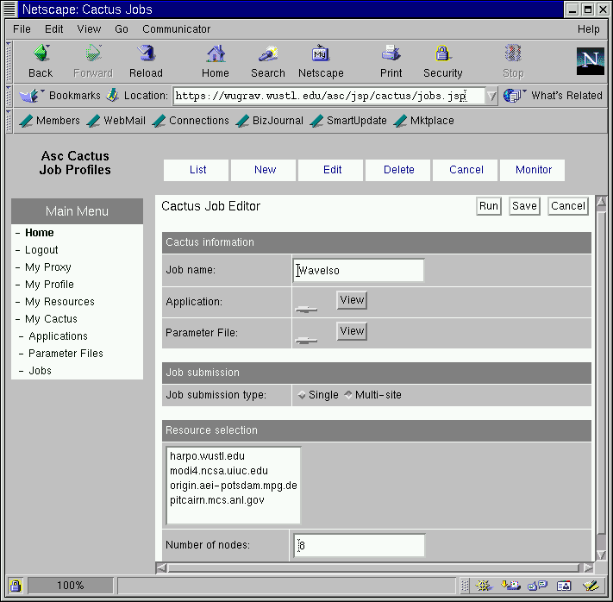
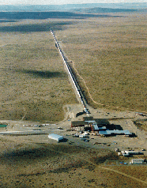
Grid Application Types
Minimal communication (embarrassingly parallel)
Staged/linked/workflow
Access to Resources
Fast throughput
Large scale
Adaptive
Data Tools
Real-time on demand
Speculative
More interesting: New dynamic scenarios
RZG
SDSC
SDSC
LRZ
AEI
NCSA

Slide 12
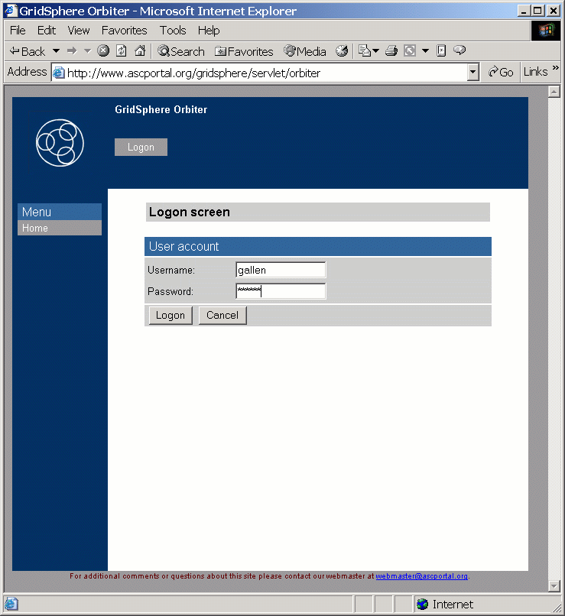
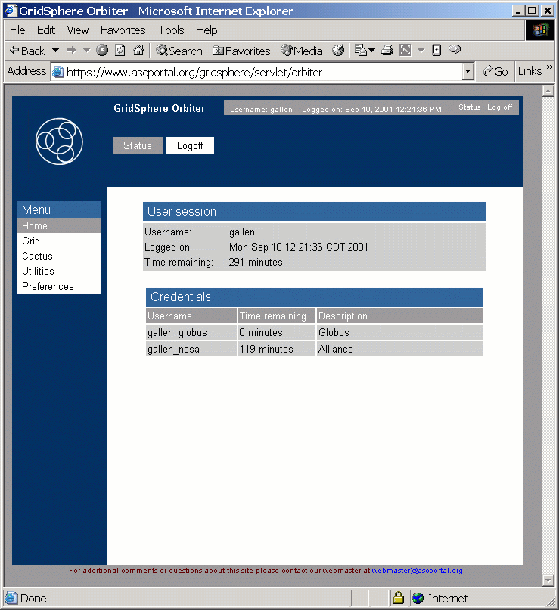
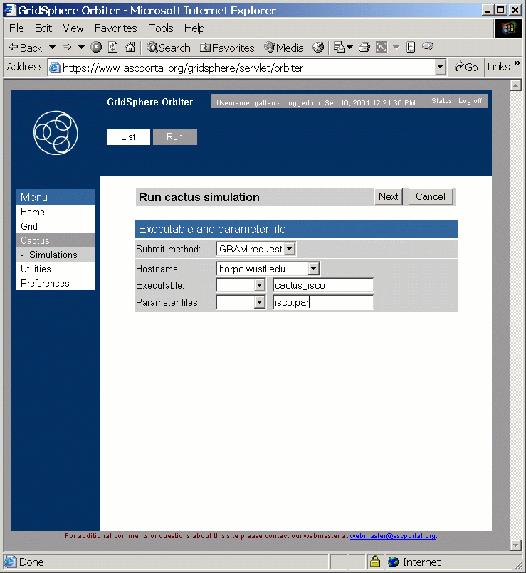
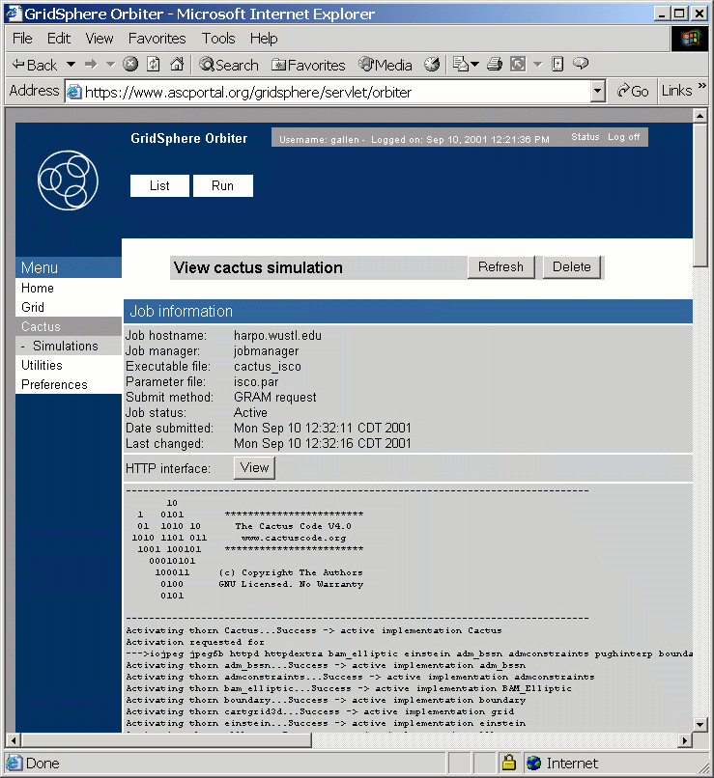
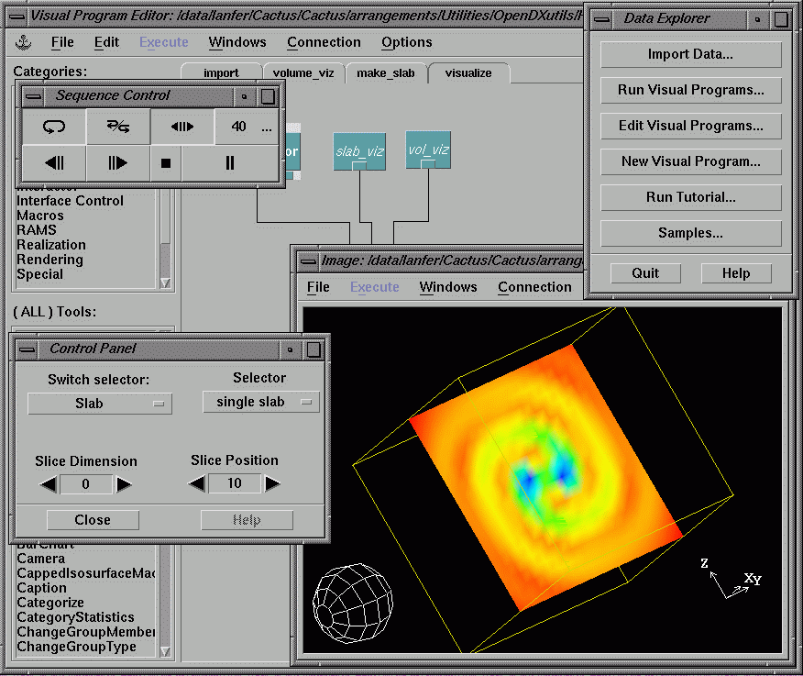
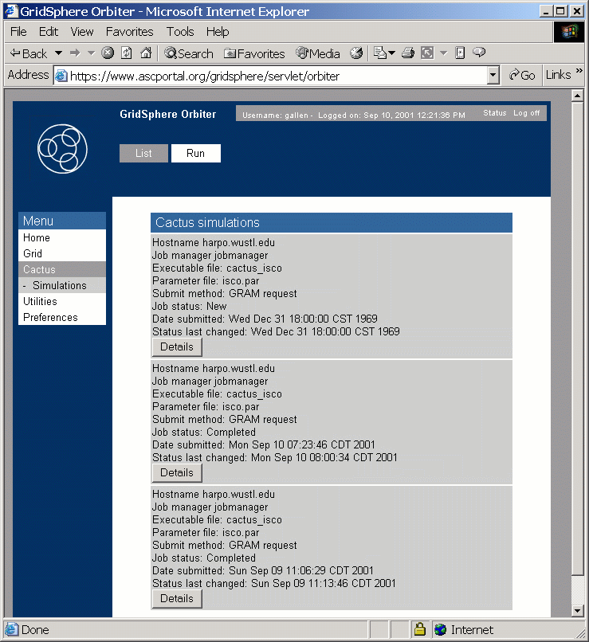
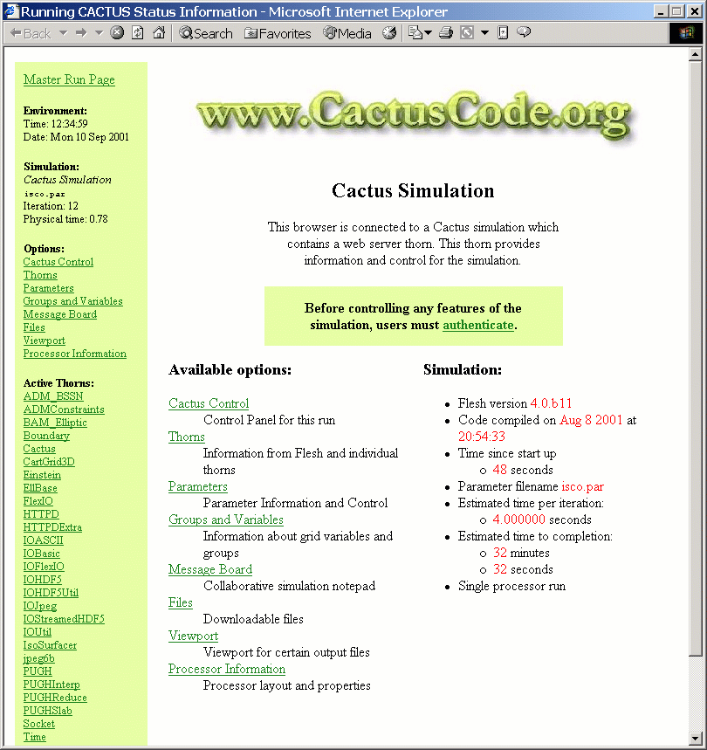
Simple View: Sit Here, Compute There

Slide 13
Common Infrastructure
Most common core Grid infrastructure deployed today is called “Globus”
Many higher level services are being researched and built using Globus
www.globus.org
Originally from ANL/ISI

Slide 14
The Global Grid Forum
Standards and best practices
Promoting Grid technologies and applications
Modeled around bodies such as IETF (internet engineering task force)
Working groups and research groups in many different areas
Meet 3 times a year

Slide 15
Basic Networking, Security and Other Definitions

Slide 16
Basic Networking Skills
Find out about Unix commands or tools using “man”
  > man nslookup
You should read up and practice basic networking, security, and Linux skills.
There is lots of information on the web
  “what is” with Google, www.wikipedia.org, www.webopedia.com

Slide 17
Use host, nslookup and dig commands get info on domains
> host www.amazon.com
    www.amazon.com has address 207.171.163.90
> nslookup -sil www.amazon.com
    Server: 10.0.1.1
    Address: 10.0.1.1#53
    Non-authoritative answer:
    Name: www.amazon.com
    Address: 207.171.166.102
> dig www.amazon.com
    ;; ANSWER SECTION:
    www.amazon.com. 20 IN A 207.171.166.102
    ;; Query time: 4 msec
    ;; SERVER: 10.0.1.1#53(10.0.1.1)
    ;; WHEN: Sat Jun 24 08:59:00 2006
    ;; MSG SIZE rcvd: 48

Slide 18
Use ping to discover if a computer is on the network
  % ping cu.ncsa.uiuc.edu
  PING cu12.ncsa.uiuc.edu (141.142.30.77): 56 data bytes
  64 bytes from 141.142.30.77: icmp_seq=0 ttl=233 time=53.663 ms
  64 bytes from 141.142.30.77: icmp_seq=1 ttl=233 time=55.615 ms
  64 bytes from 141.142.30.77: icmp_seq=2 ttl=233 time=55.153 ms
  64 bytes from 141.142.30.77: icmp_seq=3 ttl=233 time=57.184 ms
  ^C
  --- cu12.ncsa.uiuc.edu ping statistics ---
  4 packets transmitted, 4 packets received, 0% packet loss
  round-trip min/avg/max/stddev = 53.663/55.404/57.184/1.256 ms
Some sites block the use of ping :(

Slide 19
Between you and a computer on the network, there is an often complex route
% traceroute www.cs.uwm.edu
traceroute to miller.cs.uwm.edu (129.89.143.24), 30 hops max, 40 byte packets
1 svi-121.cisco1.cs.wisc.edu.105.128.in-addr.arpa
(128.105.121.248) 0.423 ms 0.242 ms 0.227 ms
2 rh-cssc-b280c-2-core-vlan-492.net.wisc.edu
(144.92.128.186) 0.404 ms 4.985 ms 0.489 ms
… snip…
6 r-uwmilwaukee-isp-atm1-0-1.wiscnet.net
(140.189.8.2) 2.730 ms 2.603 ms 2.689 ms
7 space-needle-mke.csd.uwm.edu
(216.56.1.194) 2.836 ms 2.718 ms 2.748 ms
8 miller.cs.uwm.edu (129.89.38.24) 2.754 ms * 2.796 ms
Notes:
Add that a number of sites block “ping” requests, such firewalls are a problem for grid computing …

Slide 20
A port number indicates which program to talk to on a computer
Some port numbers are standard:
  http (web): port 80
  smtp (mail): port 25
  ping: port 7
Some port numbers are assigned dynamically when you run a server

Slide 21
Use netstat to see what’s running on a local port
Listen for connections with the -l option.
% netstat --protocol=inet –l
tcp 0 0 *:finger *:* LISTEN
Look for active connections:
% netstat --protocol=inet | grep ssh
tcp 0 0 chopin.cs.wisc.edu:ssh ppp-67-38-160-108:20715 ESTABLISHED
tcp 0 0 chopin.cs.wisc.edu:ssh 68.185.181.47:1176 ESTABLISHED
…

Slide 22
Use telnet to discover if the remote computer is running ssh.
Find ssh port number in /etc/services (port 22).
Example:
  > telnet beak.cs.wisc.edu 22
  Trying 128.105.146.14...
  Connected to beak.cs.wisc.edu (128.105.146.14).
  Escape character is '^]'.
  SSH-1.99-OpenSSH_3.6.1p2
  ^] (That is control+right bracket)
  telnet> quit

Slide 23
Application Programming Interface (API) defines the interface.
Refers to definition, not implementation
  For example, there are many implementations of MPI
Spec often language-specific (or IDL)
  Routine name, number, order and type of arguments; mapping to language constructs
  Behavior or function of routine
Examples
  GSS API (security), MPI (message passing)

Slide 24
A Software Development Kit (SDK) is a particular instantiation of an API
An SDK consists of libraries and tools
  Provides implementation of API specification
One API can have multiple SDKs
Examples of SDKs
  MPICH, Motif Widgets

Slide 25
Syntax is the rules for encoding information.
Examples:
  XML, Condor ClassAds, Globus RSL
  X.509 certificate format (RFC 2459)
  Cryptographic Message Syntax (RFC 2630)
Distinct from protocols!
  One syntax may be used by many protocols
Syntaxes may be layered
  Condor ClassAds → XML → ASCII

Slide 26
Protocols can have multiple APIs.
TCP/IP APIs include BSD sockets, Winsock, System V streams, …
The protocol provides interoperability
  Programs using different APIs can exchange information
  I don’t need to know remote user’s API
Application
Application
WinSock API
Berkeley Sockets API
TCP/IP Protocol: Reliable byte streams

Slide 27
An API can have multiple protocols
MPI provides portability: any correct program compiles & runs on a platform
Does not provide interoperability: all processes must link against same SDK
  E.g., MPICH and LAM versions of MPI
Application
Application
MPI API
MPI API
LAM SDK
MPICH-P4 SDK
LAM protocol
MPICH-P4 protocol
Different message formats, exchange sequences, etc.
TCP/IP
TCP/IP

Slide 28
APIs and protocols are both important
Standard APIs/SDKs are important
  They enable application portability
  But w/o standard protocols, interoperability is hard (every SDK speaks every protocol?)
Standard protocols are important
  Enable cross-site interoperability
  Enable shared infrastructure
  But w/o standard APIs/SDKs, application portability is hard (different platforms access protocols in different ways)

Slide 29
Secure Sockets Layer SSL (TLS)
Encrypted communications over Internet
  Ensures that the information is sent unchanged, and only to the server you intended
SSL uses a private key to encrypt data
  Netscape and Internet Explorer support SSL
  Web sites use SSL to obtain confidential user information, such as credit card numbers.
  By convention, URLs that require an SSL connection start with https: instead of http:.
Newest version of SSL is called Transport Later Security (TLS)
HTTP
FTP
Secure Socket Layer
(SSL)
TCP
IP

Slide 30
OpenSSL is an open source implementation of SSL and TLS
OpenSSL is used by:
  Apache HTTP Server for https support
  MySQL to provide secure database access.

Slide 31
OpenSSH is an implementation of the SSH protocol suite of tools
Encrypts all traffic, including passwords
Provides a variety of authentication methods.
Includes:
  ssh program which replaces rlogin and telnet,
  scp which replaces rcp
  sftp which replaces ftp
Also other basic utilities: ssh-add, ssh-agent, ssh-keygen

Slide 32
Security: Terminology
Authentication: Establishing identity
Authorization: Establishing rights
Message protection
  Message integrity
  Message confidentiality
Non-repudiation
Digital signature
Accounting
Delegation

Slide 33
Authentication means identifying that you are whom you claim to be
Authentication stops imposters
Examples of authentication:
  Username and password
  Passport
  Driver’s license
  Public keys or certificates
  Fingerprint

Slide 34
Authorization is what you are allowed to do
Is this device allowed to access to this service?
Read, write, execute permissions in Unix
ACLs provide more flexible control

Slide 35
Digital Signature
An electronic signature that authenticates the identity of the sender of a message, the signer of a document, or ensures that the contents of a message are intact.
Digital signatures are easily transportable, cannot be imitated by someone else, and can be automatically time-stamped.
The ability to ensure that the original signed message arrived means that the sender cannot easily repudiate it later.
A digital certificate contains the digital signature of the certificate-issuing authority so that anyone can verify that the certificate is real.

Slide 36
Digital Certificate
The signer of a digital certificate says something like “I attached G.Allen’s public key to this digital certificate and then signed it with my private key”
Any user of G.Allen’s digital certificate must completely trust the competency and honesty of the person/organization who signed the certificate
For anyone to confidently use G.Allen’s digital certificate they must also trust that they have a validated copy of the signers public key
There is nothing secret about the contents of a digital certificate
Has expiration date
Analogy: Driving License issued by DMV (+ other countries)

Slide 37
Managing Digital Certificates
Digital certificate administrative frameworks are called “public key infrastructures” (PKIs).
Two major ones (sometime interoperable)
  X.509 (standardized by IETF)
  Pretty Good Privacy (PGP)
Centrally controlled system for managing digital certificates in X.509 talk is a “certificate authority”

Slide 38
Certificate Authorities (CAs) exist only to sign user certificates
A small set of trusted entities
A CA signs its own certificate
The CA’s certificate is distributed in a trusted manner
Name: CA
Issuer: CA
CA’s Public Key
CA’s Signature

Slide 39
Hardware Components & Grids

Slide 40
Basic Elements
Distributed systems built from
  Computing elements (processors)
  Communication elements (networks)
  Storage elements (disk, attached or networked)
New elements
  Visualization/interactive devices
  Experimental and operational devices

Slide 41
Distributed Resources
Local workstations
Site Resources
Campus Resources
State Resources
National Centers
National Grids (OSG, TeraGrid)
International Grids (GGTC)

Slide 42
Compute Elements
Clock speed
Cache hierarchy
Floating point registers
Main memory
Internal bandwidths
Etc, etc
Need powerful operating systems, compilers, applications to leverage all this

Slide 43
Communication Elements
Links, routers, switches, name servers, protocols
Infrastructure evolves slowly (politics, large scale changes, money)
Gilder's Law: total bandwidth of communication systems doubles every six months
Change in LAN to desktops
  100 mbps shared
  100 mbps switched
  1 gbps
  10 gbps
Clusters: GigE (TCP/IP and MPICH/LAM) standard, Myricom/Quadrics (own MPI drivers) better performance, infiniband/fibrechannel different architecture

Slide 44
Network Speeds
Analog modem: 57 kbps
GPRS: 114 kbps
Bluetooth: 723 kbps
T-1: 1.5 Mbps
Eth 10Base-X: 10Mbps
802.11b (WiFi) 11 Mbps
T-3: 45 Mbps
OC-1: 52 Mbps
Fast Eth 100Base-X: 100 Mbps
OC-12: 622 Mbps
GigEth 1000Base-X: 1 Gbps
OC-24: 1.2 Gbps
OC-48: 2.5 Gbps
OC-192: 10 Gbps
10 GigEth: 10 Gbps
OC-3072: 160 Gbps
My Cox Cable
  Upload: 35 KB/s
  Download 250 KB/s
CCT “is” to supermike
  Up/down: 5000 KB/s

Slide 45
Storage Elements
Magnetic tape/Magnetic disk
Magnetic disk
  Properties: density/rotation/cost
  1970-1988 density improvements 29% per year
  1988-now density improvements 60% per year
  Standard in PCs: 500mb (1995), 2gb(1997), 100gb (2002)
  Performance not increasing so fast
    Peak transfer (~100mbs)
    Seek times (3-5ms) [bottleneck]
Grids: cost of storage negligible, high speed networks make large data libraries attractive

Slide 46
Supercomputers
www.webopedia.com
The fastest type of computer. Supercomputers are very expensive and are employed for specializedapplications that require immense amounts of mathematical calculations. For example, weather forecasting requires a supercomputer. Other uses of supercomputers include animated graphics, fluid dynamic calculations, nuclear energy research, and petroleum exploration.The chief difference between a supercomputer and a mainframe is that a supercomputer channels all its power into executing a few programs as fast as possible, whereas a mainframe uses its power to execute many programs concurrently.
Definition of supercomputer
  Machine on Top500.org?
  Machine costing over $1M?
  Basically highest-end machines
Top 3 (2006)
  BlueGene/L (US) 131k procs, 280 TF
  Cray Red Storm (US) 26k procs, 101 TF
  BGW (US) 40k procs, 91 TF
Top 3 (2003)
  Earth Simulator (JAPAN) 5K procs/36 TF (6)
  ASCI Q (USA) 8K procs/14 TF (12)
  G5 Cluster (USA) 2k procs/12 TF (14)

Slide 47
Open Science Grid (OSG) provides shared computing resources, benefiting a broad set of disciplines
A consortium of universities and national laboratories, building a sustainable grid infrastructure for science.
OSG incorporates advanced networking and focuses on general services, operations, end-to-end performance
http://www.opensciencegrid.org/

Slide 48
TeraGrid

Slide 49
Introduction to Grid Middleware

Slide 50
Globus Toolkit and Condor
We will focus on Globus components as well as Condor in this workshop
Globus tools can be used in different ways:
  Client tools which you can use from a command line
  APIs (scripting languages, C, C++, Java, …) to build your own tools, or use direct from applications
  Web service interfaces
  Higher level tools built from these basic components, e.g. RFT, GRMS, …

Slide 51
Grid Security is hard but crucial
Resources may be valuable & the problems being solved sensitive
Resources are located in distinct administrative domains
  Each resource has own policies, procedures, security mechanisms, etc.
Implementation must be broadly available & applicable
  Standard, well-tested, well-understood protocols; integrated with wide variety of tools

Slide 52
Security Services
Forms the underlying communication medium for all the services
Secure Authentication and Authorization
Single Sign-on
  User need not explicitly authenticate himself every time a service is requested
Uniform Credentials
Ex: GSI (Globus Security Infrastructure)

Slide 53
Grid Security Infrastructure (GSI)
Users:
  Easy to use
  Single sign-on: only type your password once
  Delegate proxies
Administrators
  Can specify local access controls
  Have accounting

Slide 54
We get the GSI features from the Public Key Infrastructure (PKI)
PKI allows you to know that a given key belongs to a given user
PKI builds off of asymmetric encryption:
  Each entity has two keys: public and private
  Data encrypted with one key can only be decrypted with other
  The public key is public
  The private key is known only to the entity
The public key is given to the world encapsulated in a X.509 certificate (Grid Certificate)

Slide 55
A GSI certificate includes four primary pieces of information:
Subject name
  Identifies the person or object that the certificate represents
The subject’s Public Key
Identity of the CA that signed the certificate
  Certifies that the public key and the identity belong to the subject
  Uses the digital signature of the named CA

Slide 56
Another CA certifies the link between the public key and the subject.
To trust the certificate and its contents, the CA's certificate must be trusted.
The link between the CA and its certificate must be established via a non-cryptographic method.

Slide 57

A Certificate is similar to a passport of driver’s license
Identity is signed by a trusted party
State of Illinois
Name
Issuer
Public Key
Signature
John Doe
755 E. Woodlawn
Urbana IL 61801
State of
Illinois
Seal
BD 08-06-65
Male 6’0” 200lbs
GRN Eyes

Slide 58

How Do You Get a Certificate?
User generates
public/private
key pair
User send public key to CA along with proof of identity
CA confirms identity, signs certificate and sends back to user
Cert
Request
Public Key
Cert
Certificate
Authority
State of Illinois
ID
Private Key encrypted on local disk

Slide 59
All of Globus uses GSI, as does many of the grid applications.
Use GSI in Globus for:
  Submitting jobs
  Transferring data
  Querying information services (often turned off)
Other software using GSI:
  Condor
  GSI OpenSSH
  MyProxy
  Grid CVS

Slide 60
Grid Monitoring & Information Services

Slide 61
To efficiently use a Grid, you must monitor its resources.
Check the availability of different grid sites
Discover different grid services
Check the status of “jobs”
Make better scheduling decisions with information maintained on the “health” of sites

Slide 62
Monitoring provides information for several purposes
Operation of Grid
  Monitoring and testing Grid
Deployment of applications
  What resources are available to me? (Resource discovery)
  What is the state of the grid? (Resource selection)
  How to optimize resource use? (Application configuration and adaptation)
Information for other Grid Services to use

Slide 63
Monitoring information is either static or dynamic, broadly.
Static information about a site:
  Number of worker nodes, processors
  Storage capacities
  Architecture and Operating systems
Dynamic information about a site
  Number of jobs running on each site
  CPU utilization of different worker nodes
  Overall site “availability”
Time-varying information is critical for scheduling of grid jobs
More accurate (pertinent) info costs more processor time: it’s a tradeoff.

Slide 64
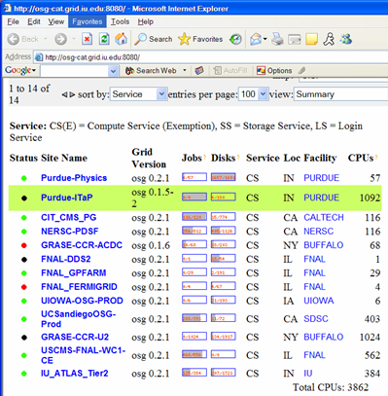
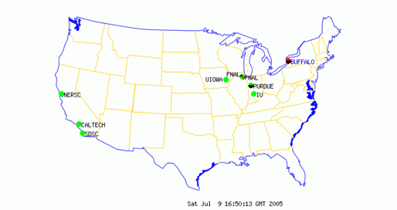

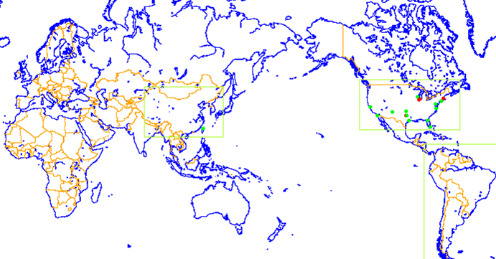

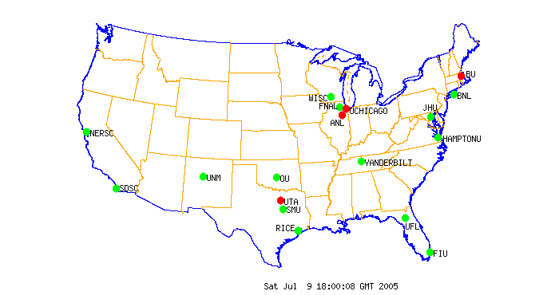
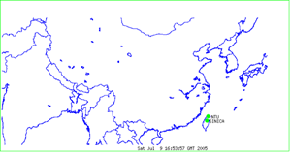
GridCat
http://osg-cat.grid.iu.edu
http://www.ivdgl.org/grid3/gridcat
http://www.ivdgl.org/gridcat/home/

Slide 65
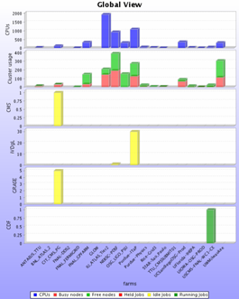
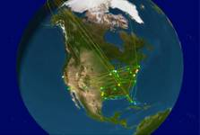
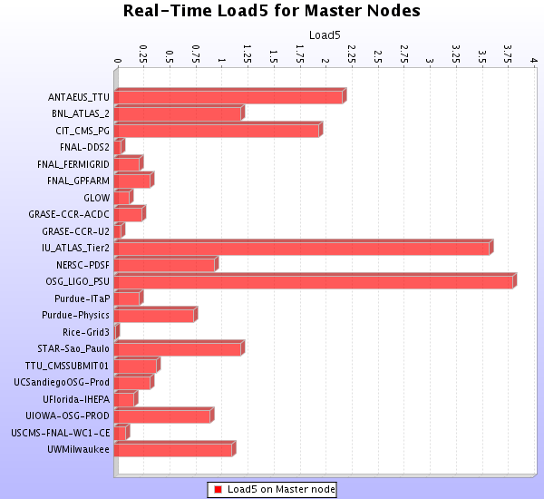
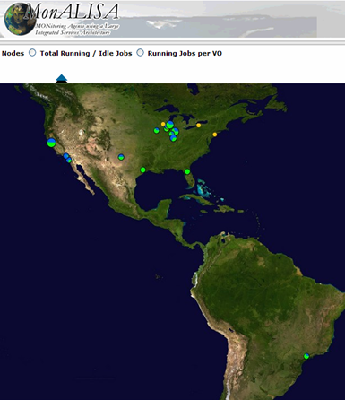
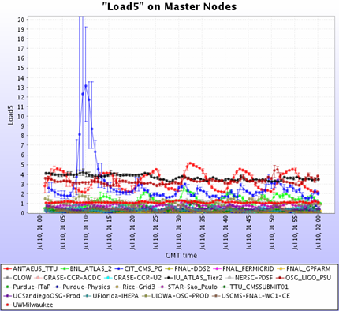
MonALISA
http://monalisa.caltech.edu/

Slide 66
Globus Monitoring and Discovery Service
MDS is a grid information service
It provides:
  Uniform, flexible access to information
  Scalable, efficient access to dynamic data
  Access to multiple information sources
  Decentralized maintenance
Based on LDAP

Slide 67
Globus MDS
Handles static (e.g OS type) and dynamic (e.g current load) data
Access to data can be restricted with GSI (Grid Security Infrastructure) credentials and authorization features

Slide 68
MDS Hierachy
QUERY
GIIS
Virtual Organization
Level
QUERY
GIIS
GIIS
Site Level
QUERY
GRIS
GRIS
GRIS
IP
IP
IP
IP
IP
IP
Resource Level
Germany
Baton Rouge

Slide 69
Data Management

Slide 70
Data management services provide a flexible mechanism to move and share data
Grids are used for analyzing and manipulating large amounts of data
  Metadata (data about data): What is the data?
  Data location: Where is the data?
  Data transport: How to move the data?

Slide 71
Data Movement
Issues
  How to move data
    Robustly
    Securely
    Faster
Solutions
  scp, globus-url-copy, wget
  GridFTP

Slide 72
GridFTP is a secure, efficient and standards-based data transfer protocol
Robust, fast and widely accepted
Globus GridFTP server
Globus globus-url-copy GridFTP client
Other clients exist (e.g., uberftp)

Slide 73
GridFTP is secure, reliable and fast
Security through GSI
  Authentication and authorization
  Can also provide encryption
Reliability by restarting failed transfers
Fast
  Can set TCP buffers for optimal performance
  Parallel transfers
  Striping (multiple endpoints)
Not all features easily accessible from basic client

Slide 74
File catalogues tell you where the data is
Replica Location Service (RLS)
Phedex
RefDB / PupDB

Slide 75
Requirements from a File Catalogue
Abstract out the logical file name (LFN) for a physical file
  maintain the mappings between the LFNs and the PFNs (physical file names)
Maintain the location information of a file
  Or at least the information of the site on which it can be found in case of remote file

Slide 76
In order to avoid “hotspots”, replicate data files in more than one location
Effective use of the grid resources
Each LFN can effectively have more than 1 PFN
Avoids single point of failure
Manual or automatic replication
  Automatic replication considers the demand for a file, transfer bandwidth, etc.

Slide 77
The Globus Replica Location Service (RLS)
Each RLS server usually runs
  Local Replica Catalog (LRC)
    What files do you have (directly know physical location), mapped to URLs or physical file names (PFN)
and/or
  Replica location index (RLI)
    Catalog of what LFNs other LRCs know about

Slide 78
Job Management

Slide 79
Job Management Services provide a standard interface to remote resources
Includes CPU, Storage and Bandwidth
Main component is the remote job manager
  Globus Resource Allocation Manager (GRAM)
Other needs:
  scheduling
  monitoring
  job migration
  notification

Slide 80
Job Management on a Grid
GRAM
Condor
VO
LSF
VO
User
Site A
Site C
PBS
fork
VO
VO
Site B
Site D
The Grid
Narration: note the different local schedulers

Slide 81
GRAM: What is it?
Globus Resource Allocation Manager
Given a job specification:
  Create an environment for a job
  Stage files to and from the environment
  Submit a job to a local resource manager
  Monitor a job
  Send notifications of the job state change
  Stream a job’s stdout/err during execution

Slide 82
A “Local Resource Manager” is a batch system for running jobs across a computing cluster
In GRAM
Examples:
  Condor
  PBS
  LSF
  Sun Grid Engine
Most systems allow you to access “fork”
  Default behavior
  It runs on the gatekeeper:
    A bad idea in general, but okay for testing

Slide 83
The client describes the job in with GRAM’s Resource Specification Language (RSL)
Example:
  & (executable = a.out)
  (directory = /home/nobody )
  (arguments = arg1 "arg 2")
Use higher level tools (such as portals) to construct anything but simple RSL
See http://www.globus.org/gram/rsl_spec1.html

Slide 84
Managing your jobs
We need something more than just the basic functionality of the globus job submission commands
Some desired features
  Job tracking
  Submission of a set of inter-dependant jobs
  Check-pointing and Job resubmission capability
  Matchmaking for selecting appropriate resource for executing the job
Options: Condor, GRMS, …

Slide 85
The Problem of Grid Scheduling
Decentralised ownership
  No one controls the grid
Heterogeneous composition
  Difficult to guarantee execution environments
Dynamic availability of resources
  Ubiquitous monitoring infrastructure needed
Complex policies
  Issues of trust
  Lack of accounting infrastructure
  May change with time

