Slide 1
Working Meeting at FermiLab
University of California Grid (UC Grid)
January 19-20, 2010
Fermi Lab, Chicago, IL

Slide 2








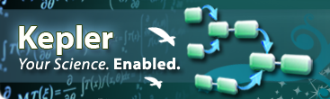

LBNL
Krishna Muriki, Jackie Scoggins, Tammy Welcome, Shreyas Chola, Doug Olson, Gary Jung, Greg Kurtzer
Lawrence Berkeley National Laboratory
William Strossman, Russ Harvey, Bob Grant
University of California, Riverside
Harry Mangalam, Joseph Farran, Frank Wessel
University of California, Irvine
Kejian Jin, Shao-Ching Huang, TV Singh, Sveta Mazurkova, Bill Labate, Qiyang Hu, Prakashan Korambath, Seonah Kim, Scott Johnson, Puneet Souda
Paul Weakliem, Arlene Allen
University of California, Santa Barbara
David Walker, Bill Broadley, Russ Hobby
University of California, Davis
Shava Smallen, Jianwu Wang, Ilkay Altinas, Richard Moore, David Hutches
San Diego Super Computing Center

Slide 3
UC Grid Architecture
UC MyProxy
UC Grid Portal
UC Grid CA
UC Register Service
UC Sync Service
UCLA Portal
UCSB Portal
UCI Portal
UCSD Portal
UCR Portal
C1
C2
…
C1
C2
…
C1
C2
…
C1
C2
…
C1
C2
…
Gaussian, Q-Chem,
Matlab, Mathematica
R, Stata, NWChem,
CPMD, GAMESS
Omssa, LAMMPS,
Amber, Migrate
Generic-Serial,
Generic-Parallel
Xmd,Octave
Interactive-VNC

Slide 4

Single Campus Architecture
Head node Cluster I
Credential mapped to local ID
Grid Portal
Grid Appliance
https
Uniform browser based interface
Head node Cluster II
Credential mapped to local ID
MyProxy Server
Storage Server
ION Visualization Server
Grid Appliance

Slide 5
The UC Grid Portal
Provides Register Service (SOA):
  user portal account creation and uniqueness of user name in the UC Grid, automatic CA sign, MyProxy push.
Provides Sync Service (SOA) between campus portal and UC Grid portal:
  Any change of an user account at a campus Grid Portal is automatically propagated to the UC Grid Portal.
  Any change of new resources at a campus Grid Portal will also be reflected at UC Grid Portal
From the UC Grid Portal, users can:
  work with clusters from all the campuses those users are authorized to use.
  transfer files across the campuses.
  Use pooled resources across the campuses.

Slide 6
Campus Grid Portal
Features:
  Resource Discovery
    Cluster load, usage, queue information, job details
  Data Manager
    File management such as create, remove, rename, edit, transfer etc.
  Job Services
    Submit job as a cluster user
    Submit job as a pool user
  Interactive X window for applications
    Matlab, Mathematica, Maple, Xstata etc.
  Access to Teragrid

Slide 7
Job Submission
General Job submission
  Any user created executable
Application job submission
  Predefined executable
    As Cluster user
    As Pool user
Pool user application job submission
  UGP Chooses the target cluster for the application job.
  Stages the input files to a guest user login id at the target cluster
  Submits the job to run under a guest login id at the target cluster.
  Local scheduler determines when those jobs are run.
  UGP facilitates the transfer of the output files back to the Pool User.
  Provide job monitoring and auditing

Slide 8
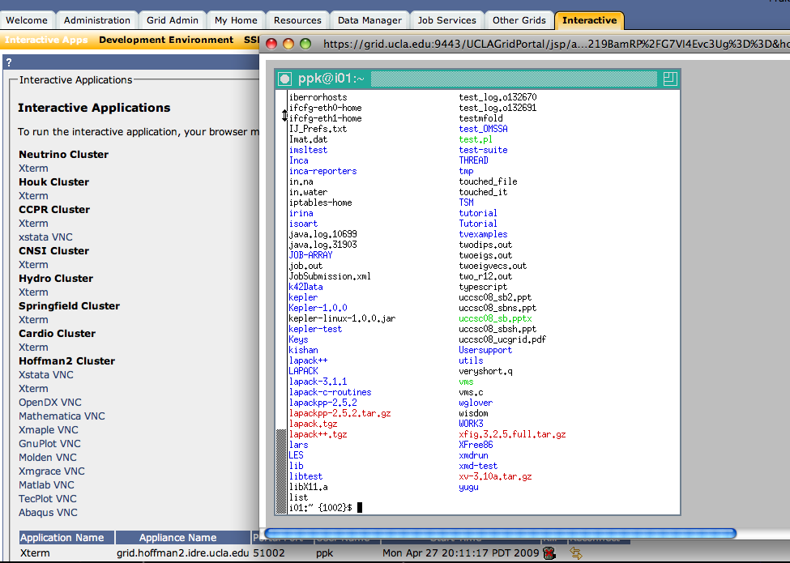
Interactive Xterm through VNC

Slide 9
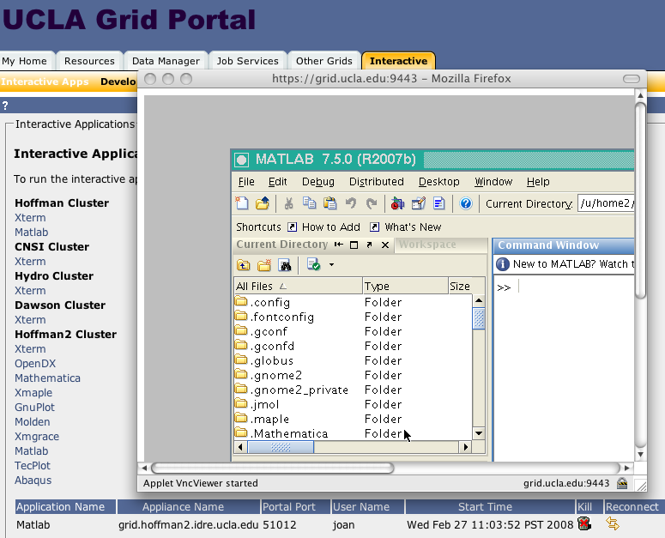
Interactive GUI Application through VNC

Slide 10
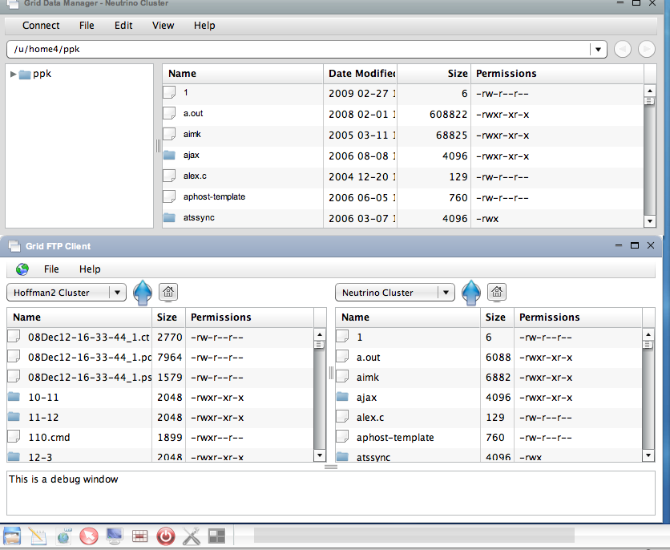
File Transfer using grid-ftp

Slide 11
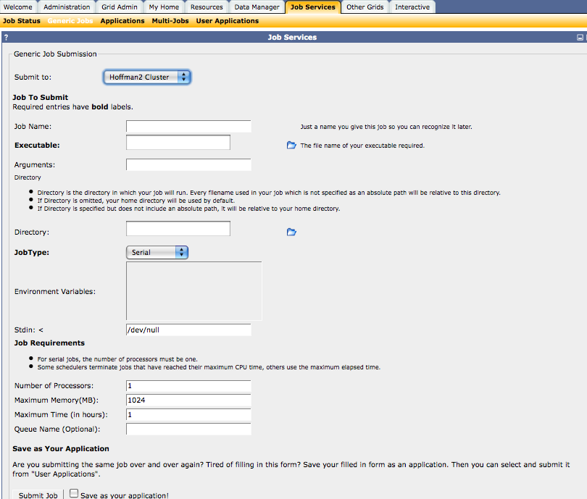
Generic Batch Job Submission Interface

Slide 12
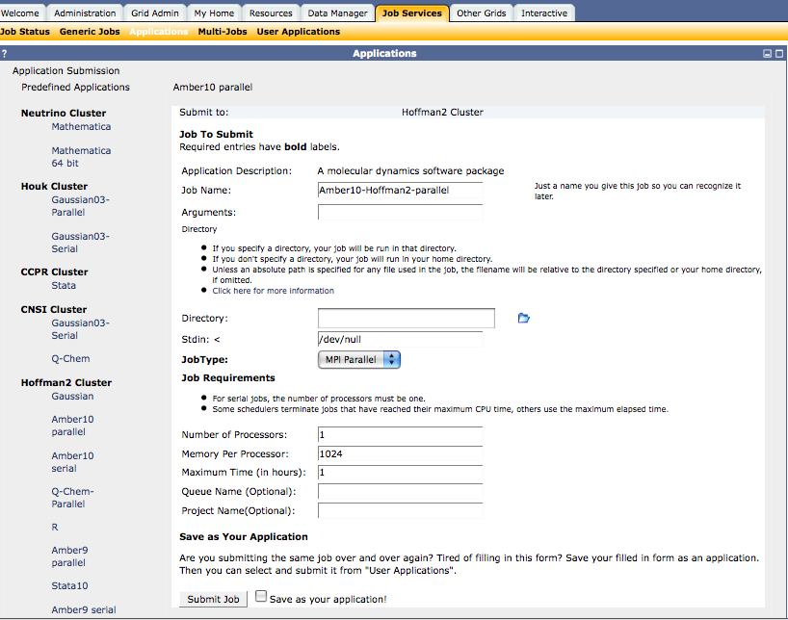
Predefined Application Submission

Slide 13
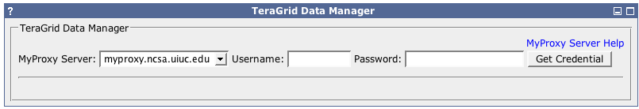
Job Submission to Other Grid Resources
User interface to fill in username and password to retrieve short lived credential for submitting jobs to Teragrid

Slide 14
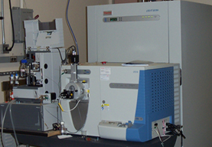




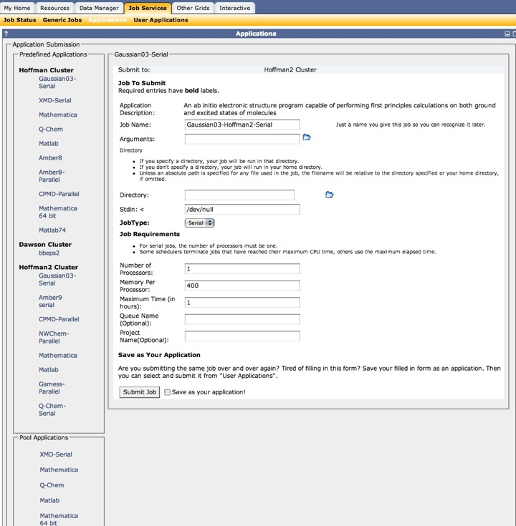



Proteomics Workflow Project
Pre-Processed Data
(OMSSA/InsPect Format,
Commercial Application)
Binary Data/
Converter
Mass Spectrometer
Grid Temp
Storage
User
Generated
Query
Grid Portal
NIH BLAST Library
(Downloaded to Cluster)
OMSSA/InsPect
Run
Cluster A
Cluster B
OMSSA Output
to user’s desktop,
OMSSA Viewer
InsPect Output
to user’s desktop,
Web Viewer
Meta-scheduler
Data Merge/Split
(based on job type)
Cluster C
1. Single job or job array
2. Output collection

Slide 15

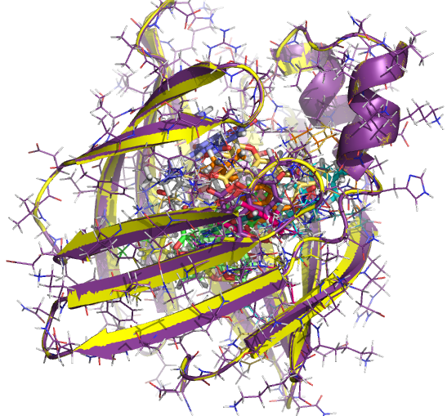
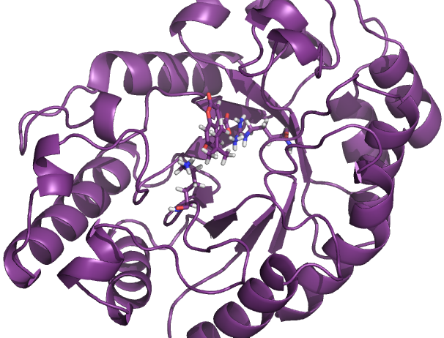
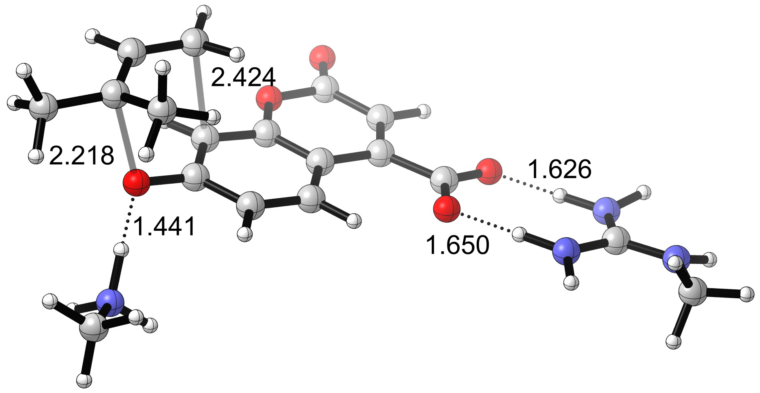
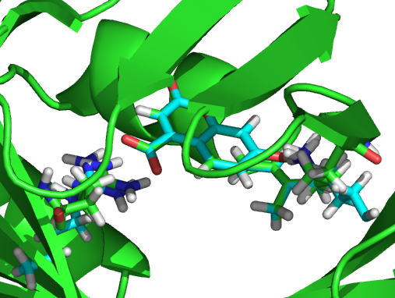
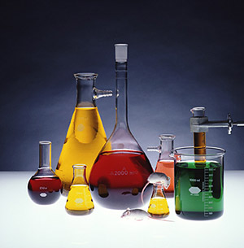
Protein Design Processes
Inside-out protocol to design novel enzyme catalysts
Baker - Houk collaboration
Transition structure
(QM theozyme)
Match theozyme geometry to protein scaffold
(RosettaMatch)
EDGE
(Rank and Filter)
Redesign and repack
Active site
(RosettaDesign)
&
MD/EDGE
Experiments

Slide 16
Enzyme Design Using Kepler Workflow
RosettaMatch
  Goal: Finds the enzyme Scaffolds for the input theozyme
  Approximately 250 Jobs per submission – Each creates around 2000 outputs
  Workflow Distribute the Jobs through Scheduler/Grid
Edge
  Goal: Filter out Match results that are out of user defined range
  Least time consuming – Single node job
RosettaDesign
  Goal: Repacks and Optimize the side chains
  Workflow Distribute 5 million jobs from Match run through Scheduler/Grid

Slide 17
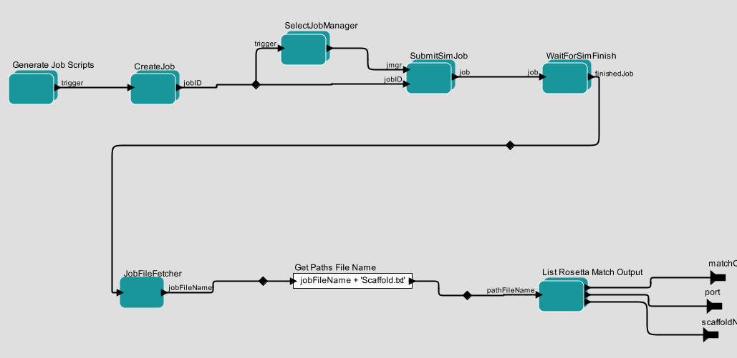
Rosetta Match SGE Composite Actor
Create Sun Grid Engine Jobs
Submit Jobs and Wait for Finish
Job Output Processing

Slide 18
Command line instructions for two cluster workflow
(Hoffman2 and Hydro)
Retrieve proxy from myproxy.ucgrid.org
/u/local/apps/kepler/kepler.modules/build-area/kepler.sh
-MyProxyFilePath /tmp/x509up_uid
-GlobusTaskPath4Hoffman2
/u/scratch/ppk/rosetta/rosetta-grid-workflow-hoffman2
-GlobusTaskPath4Hydro
/u/scratch/ppk/rosetta/rosetta-grid-workflow-hydro
-ScaffoldPath4Hoffman2
/u/home2/ppk/rosettatest/scaffold-hoffman2-one-scaffold
-ScaffoldPath4Hydro
/u/home2/ppk/rosettatest/scaffold-hydro-one-scaffold
/u/local/apps/kepler/rosetta-workflow/Rosetta-Match-BChain-Design-Globus-TopLevel-Parallel-v1-18.xml
TaskPaths are scratch directories for the run and ScaffoldPath is the location of input files for each cluster pre-divided by the user. Workflow directives are in the xml file

Slide 19
Experimental data on Hoffman2 cluster
Workflow name | Workflow Structure | Inputs | Main configurations | Job number | Execution time
Rosetta-MatchSGE-v2-4.xml | MatchSGEJob | 226 Scaffold | 1) Match command number for each job: 5 Generate 108,012 pdb files. | 46 Match SGE jobs. | 5.36 hours
Rosetta-MatchSGE-BChain-v1-6.xml | MatchSGEJob + BChain | 226 Scaffold | 1) Match command number for each job: 5 Generate 216,024 pdb files. | 46 Match SGE jobs. | 5.19 hours
Rosetta-DesignSGE-v1-8.xml | DesignSGEJob (each design includes cst, des and min) | 10 Scaffold | 1) Structure Number for Design Calculation: 10. 2) Command number for each job: 5 (cst) + 5 (des) + 50 (min) = 60. Generate 14691 pdb files. | 286 Design SGE jobs | 10.73 hours
Rosetta-MatchSGE-BChain-DesignSGE-v1-9.xml | SGEMatch, BChain, SGEDesign | 10 scaffold | 1) Command number for each Match job: 1. 2) Structure Number for Design Calculation: 10. 3) Command number for each Design job: 5 (cst) + 5 (des) + 50 (min) = 60. | 10 Match Jobs and 286 Design Jobs. | 6.70-17.01 hours.
Rosetta-DesignSGE-v1-8.xml | DesignSGEJob (each design includes cst, des and min) | 226 Scaffold | 1) Structure Number for Design Calculation: 100. 2) Command number for each job: 10 (cst) + 10 (des) + 1000 (min) = 1100. The whole cmd number could be 50 million and the whole execution could generate 7 million files: * 14691 * 10 = = 7,793,734,24. (2036 is the pdb file number for 10 Scaffold of Rosetta-MatchSGE-v2-4.xml) | Over 11,000 Design SGE jobs. | One job may last for over 18 hours. Estimated whole execution time : (108012/2036) * 10.73 * 10 = 7.79 months.

Slide 20
Workflow to Use Shibboleth Authentication to Sign X509 Certificate
Web Service
Username:
Password:
Certificate exist for the ePPN
Identity Provider
YES
ePPN/SP-ID
NO
Encrypt (RandomPassword, ePPN + SP-ID))
Two ways encryption/decryption
Store the encrypted password to DB
Retrieve password from DB Decrypt (DBPassword, ePPN + SP-ID))
Two ways encryption/decryption
Service Provider
SLC
Create Certificate
Generate proxy
ePPN provides FN: LN: Org: Role:
Username/password
Push
MyProxy Server

Slide 21
UC Cloud Architecture
Public Network
UC Cloud Controller
Cloud
Cluster controller
Node controller
Campus Resource
Off Campus Resource
Virtual OS

Slide 22
UC Grid Portal Contact Information
http://www.ucgrid.org
http://inca.ucgrid.org
atshpc@ats.ucla.edu
Kepler: Jianwu Wang, SDSC, jianwu@sdsc.edu
INCA, SDSC: Shava Smallen, ssmallen@sdsc.edu
UGP: Kejian Jin kjin@ats.ucla.edu
Rosetta: Seonah@chem.ucla.edu
Proteomic: psouda@chem.ucla.edu
UCLA: Prakashan Korambath, ppk@ats.ucla.edu
UCSB: Paul Weakliem, weakliem@cnsi.ucsb.edu
UCR: Bill Strossman, wlliam.strossman@ucr.edu
UCI: Harry Mangalam, harry.mangalam@uci.edu

