Slide 1
State of VDT 1.3.8
Alain Roy
University of Wisconsin - Madison
roy@cs.wisc.edu
OSG ITB Workshop
November 30, 2005

Slide 2

First Things First: “New” VDT Member
Tim Cartwright

Slide 3
New Supported Platforms
}
RHEL3 x86-64
RHEL3 IA64 No PRIMA yet
SUSE 9 IA64

Slide 4
New Software
jClarens publication scripts
pyGridWare
Job-Environment

Slide 5
Improved Globus
Still GT 4.0.1
Can run Globus as daemon user
  Pre-requisite to running in Tomcat
  Make web-services PRIMA work
  Improve Condor job submission

Slide 6
Improved Apache
Now accepts new & RFC proxies
Not all software accepts them, but at least it’s not Apache’s fault.

Slide 7
Other Stuff
Many bug fixes
Upgraded software:
  Condor
  Java
  jClarens
  MonaLisa
  VOMS Admin (web interface for VOMS)
  And several more…

Slide 8
Known Problems
Globus not yet in Tomcat
MDS on 64-bit platforms is wonky
No 64-bit PRIMA
A few other small things

Slide 9
What’s Next?
VDT 1.3.9
  Really soon
  Bug fixes for things we find at this meeting
VDT 1.3.10
  In which we solve the world’s problems…
  Or at least make progress on known problems, missing software, and all that good stuff.

Slide 10
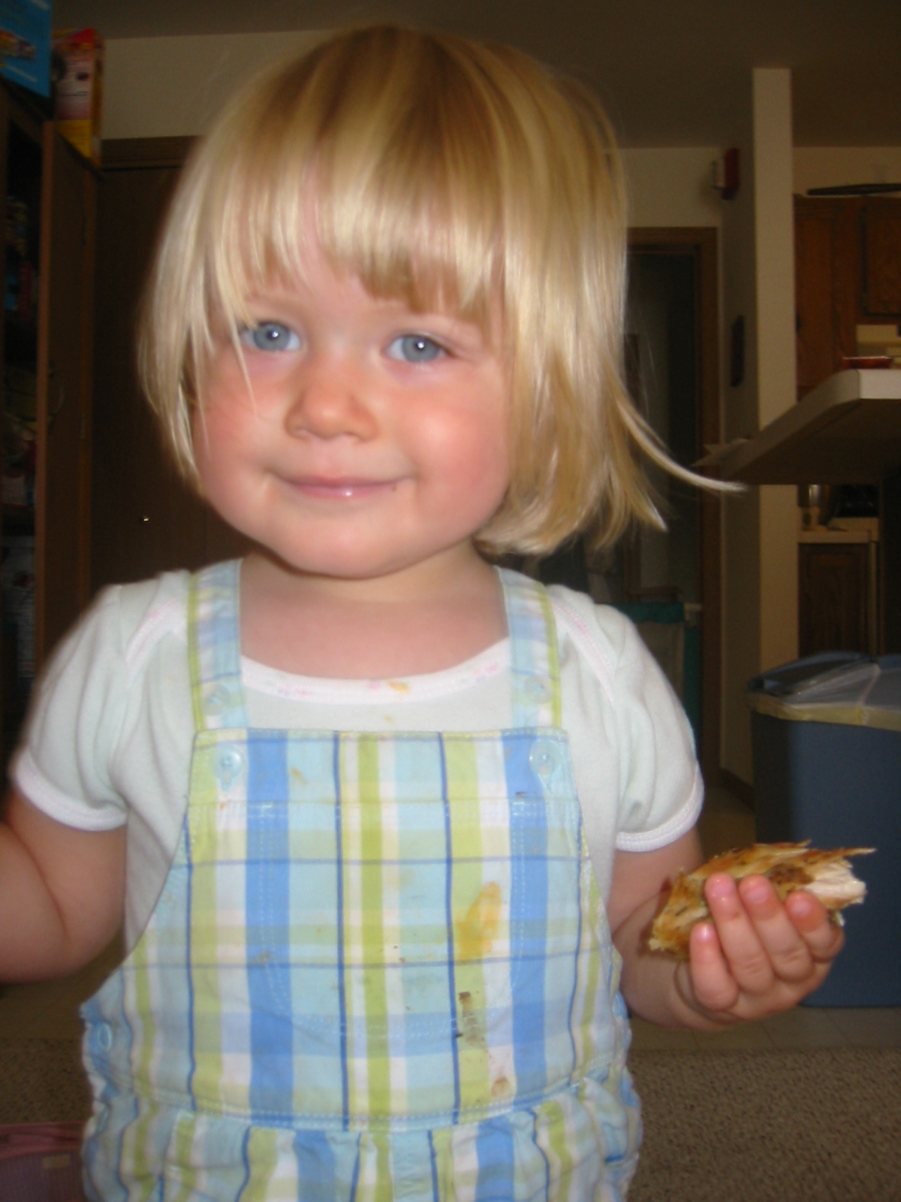
Questions? Comments?

