Slide 1


Slide 2
Presentation Two:
Grid Security

Slide 3
Part Two: Grid Security
A: Grid Security Infrastructure (GSI)
B: PKI and X.509 certificates
C: Proxy certificates
D: The grid-mapfile
E: Gsi-SSH

Slide 4
A: Grid Security Infrastructure (GSI)

Slide 5
GSI
Part of the Globus Toolkit (GTK)
Based on
  PKI: Public Key Infrastructure
  X.509 Certificates
  SSL (Secure Sockets Layer) protocol
Reference: www.globus.org/security

Slide 6
Why GSI?
To provide secure communication (authenticated and perhaps confidential) between elements of a computational Grid.
To support security across organizational boundaries, thus prohibiting a centrally-managed security system.
To support "single sign-on" for users of the Grid, including delegation of credentials for computations that involve multiple resources and/or sites.

Slide 7
B: PKI and X.509 Certificates

Slide 8
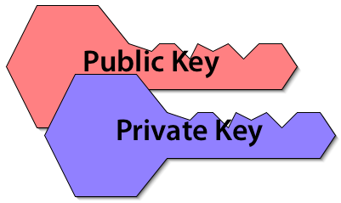
PKI: Public Key Infrastructure
User (or entity) gets a related key pair:
  one private key, known only to the user
  one public key, distributable to the world
A message encrypted with one key requires the other key for decryption
Notes:
Do the math. If I want only you to see some data, I can encrypt it using your public key, and it’s guaranteed that only you have the private key to decrypt it.
On the other hand, if I have some encrypted message, and your public key decrypts it, then it’s guaranteed that you’re the person who sent it, because only you have the private key that’s the counterpart of that public key.

Slide 9
Key Reciprocity
Data encrypted using the public key requires the private key for decryption.
  If you know my public key, you can send me via an open channel a message only I can read.
Data encrypted using the private key requires the public key for decryption.
  If my public key decrypts an encrypted message I have sent via an open channel, then only I could have sent it.

Slide 10
How Keys Get Around
Public keys can be freely distributed
  Allows messages to be encrypted just for you.
Your private key doesn’t get around.
  Period. That’s why it’s private.

Slide 11
X.509 Certificates
Keys can be distributed as encapsulated in an X.509 certificate.
The X.509 certificate associates the public key with a qualified name.
The X.509 certificate is also signed by a trusted issuer.
You saw one in Lab 1.

Slide 12
Who Issues a Certificate?
A certificate authority (CA) is a trusted entity who signs and issues X.509 credentials
Examples: NCSA Alliance, DOEgrid CA
In the so-called “real world”: VeriSign
Each credential identifies its CA

Slide 13
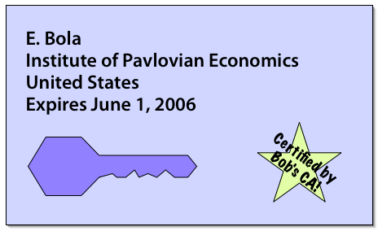
X.509 Certificate = “License”
Identifies you and your institution
Can’t be self-created
Created for you by your institution
Getting one isn’t an instantaneous process

Slide 14
What’s in an X.509 Certificate?
Entity’s qualified name
Entity’s public key
Name of the issuing CA
Signature of issuing CA
Validity dates (start and end dates)
Other stuff — version information, etc.
Notes:
“entity” meaning, maybe you, or your computer, or cluster node 17, or whatever.

Slide 15
Qualified Name
Person’s name
Institution
Country
C=US, O=National Center for Supercomputing Applications, CN=Edward N. Bola

Slide 16
Variations on the Theme
Qualified Name
Distinguished Name
Subject Name, Subject
  You say “eether” I say “eyether”
Note that there are variations on the syntax; your format may not exactly match this
  You say “potato” I say “potahto”

Slide 17
How do you inspect a certificate?
Utility for seeing information encapsulated in a certificate: grid-cert-info

Slide 18
The Certificate File Itself
Is stored in your ~/.globus directory
“usercert.pem” is the public key
  File permissions = -rw-r-----
“userkey.pem” is the private key
  File permissions = -r--------
Don’t chmod these, by the way; utilities like GSI-SSH check them out

Slide 19
Host Certificates
Certs aren’t just for users any more
Grid hosts also have certificates
Stored in /etc/grid-security
  “hostcert.pem”
  “hostkey.pem”

Slide 20
C: Proxy Certificates

Slide 21
Why Use Proxy Certificates?
A certificate usually lasts a year
  If it’s stolen, it’s still good for the rest of the year
    unless it’s revoked by being placed on a certificate revocation list (CRL)
      And your utility actually checks the CRL.
        With any frequency
A proxy certificate usually lasts 12 hours
  Minimizes the possible mischief

Slide 22
grid-proxy-init
Asks for your grid passphrase
Stored in /tmp/x509up_uXXXX
  Where XXXX is your uid.
You’ve already seen this in Lab 1.
Notes:
Grid passphrase = private key passphrase

Slide 23
grid-proxy-info
Queries the proxy certificate, not the “real” certificate
  subject : […]
  issuer : […]
  identity : […]
  type : full legacy globus proxy
  strength : 512 bits
  path : /tmp/x509up_u506
  timeleft : 11:57:31

Slide 24
grid-proxy-destroy
Destroys the proxy.
That’s about as simple as it gets.

Slide 25
D: grid-mapfile

Slide 26
grid-mapfile
Text file residing on a given host
  /etc/grid-security/grid-mapfile
Associates accounts on that host to qualified names as they appear in the X.509 certificates

Slide 27
Example gridmap-file entry
"/O=Grid/OU=GlobusTest/OU=simpleCA-grids3.ncsa.uiuc.edu/OU=localdomain/CN=Bob Test" btest

Slide 28
gsi-ssh
Grid-secure ssh utility
Modified version of OpenSSH using GSI

Slide 29
E: Lab 2 — Security

Slide 30
Lab 2 — Security
In this lab:
  How to get information about your certificate
  How to create (and destroy) proxy certificates
  How to use SSH without a password via GSI-SSH
  How to use MyProxy to register a proxy certificate

Slide 31
Credits
Portions of this presentation were adapted from the following sources:
  GryPhyN Grid Summer Workshop
  NEESgrid Sysadmin Workshop

