Slide 1
OSG
Area Coordinator’s Report:
Workload Management
October 6th, 2010
Maxim Potekhin
BNL
631-344-3621
potekhin@bnl.gov

Slide 2
Workload Management: Overview
Areas of Activity: ITB, Engagement, Panda Monitoring Upgrade
Status of current initiatives
  Panda/ITB:
    Continued use of “ITB robot” to run test suite via Panda, Web service implemented for data archiving (Suchandra)
    Integration with CERN Analysis Dashboard: Panda information is now collected and fed to the Dashboard
  Engagement:
    DUSEL Long Base Neutrino Experiment (LBNE), and Daya Bay:
      First round of testing completed with real jobs
      Currently, preparations underway for a production run using Panda (solving data validation, error reporting and other issues)
      Will expand to NERSC
    CHARMM: expansion of job submission to more sites
      Multiple sites have been set up (Jose, Tim, Alden)
      15 sites are working for CHARMM (automatic load distribution due to pilot framework)
      43k CPU-hours utilized monthly
      Fresh runs are planned for near future with more models to compute
  Upgrade of Panda monitoring system (Maxim)
    Migration of Panda monitoring system to the new platform
      New sections added to the Django/AJAX/jQuery prototype
      Code re-factored for cooperative development with CERN team (1.5 ATLAS developers joining the project)
      Server-side caching implemented with a few types of back-end (e.g. memcached server)
      Oracle-specific optimization integrated into Django server code
      Beta-testing to commence late in the year
    Presented at Atlas Monitoring Meetings

Slide 3
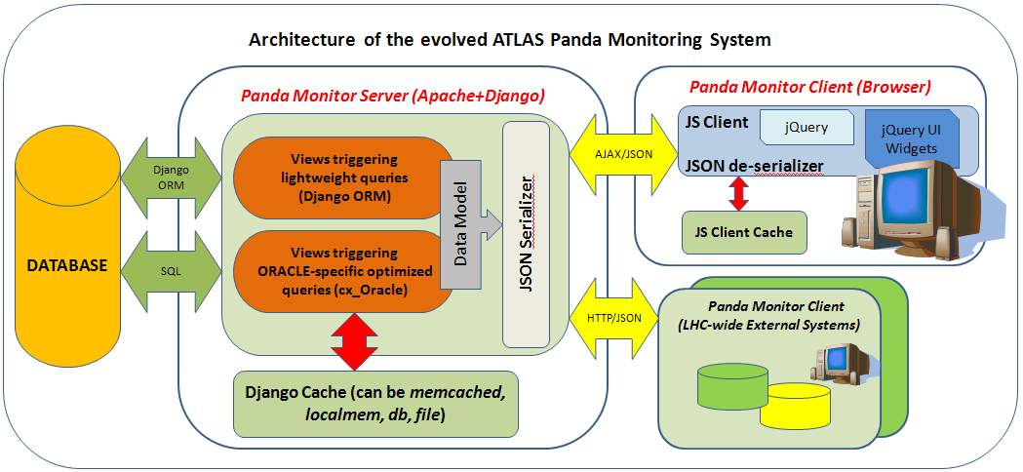
Panda Monitor

Slide 4
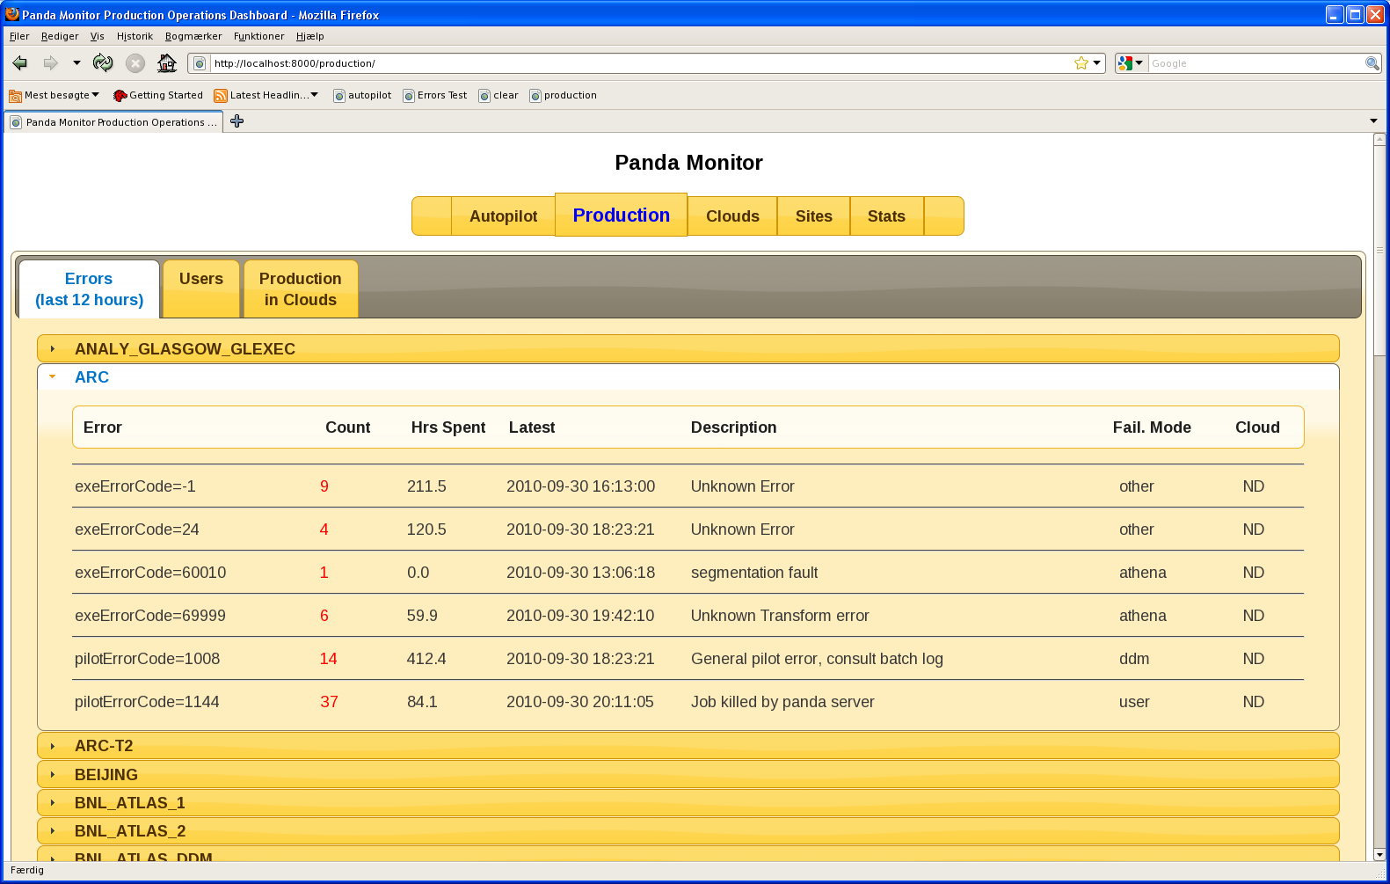
Continued Development of Panda Monitoring Client

Slide 5
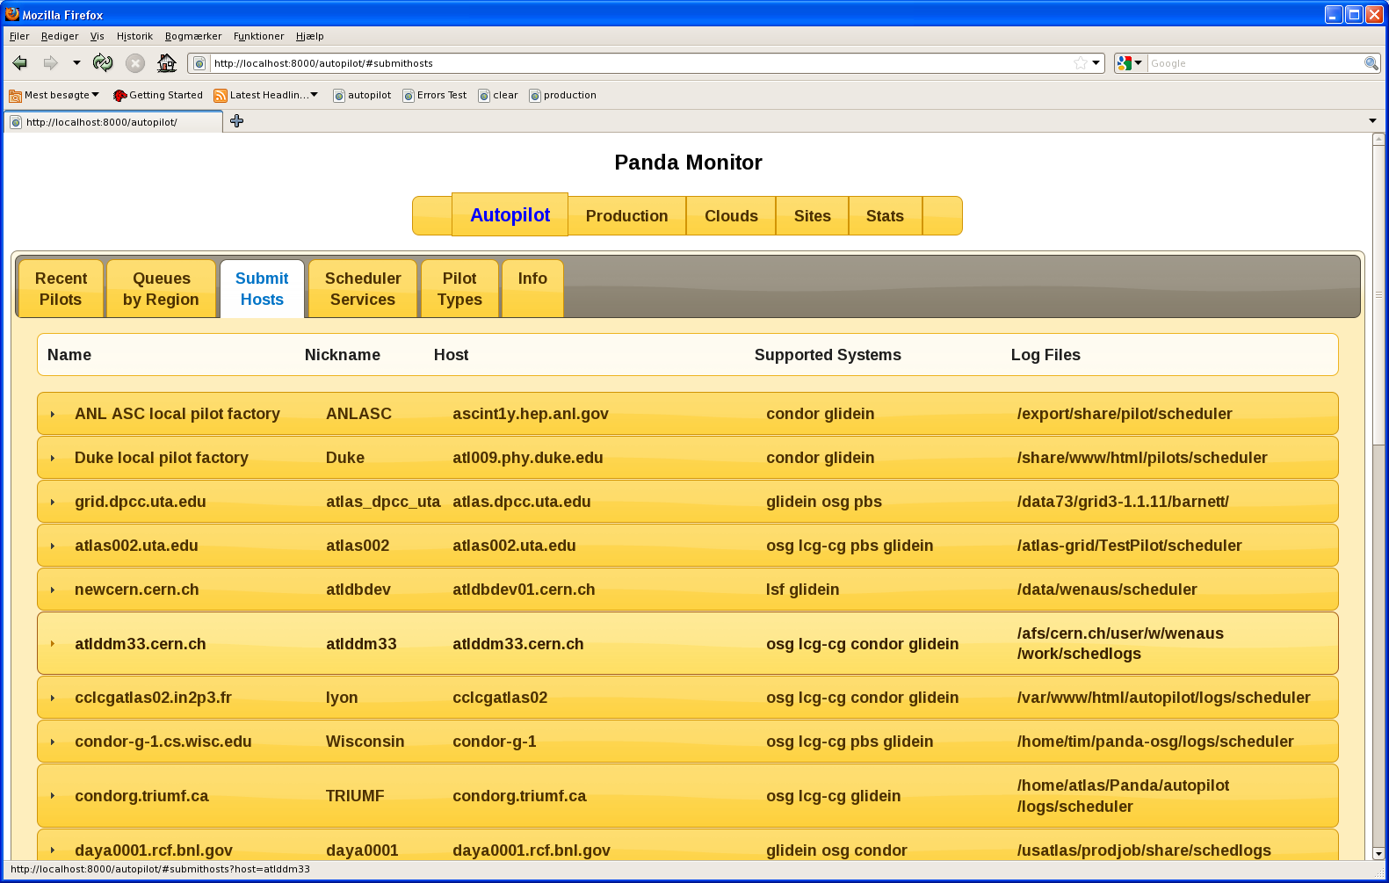
Continued Development of Panda Monitoring Client

Slide 6
Overview
Workload Management
Issues / Concerns
  Panda monitoring upgrade is a labor-intensive project due to a large amount of legacy code
  Looking forward to conducting LBNE simulation run at BNL and expanding LBNE runs to more sites

