Slide 1
Data and Software Preservation for Open Science (DASPOS)
Preservation in this context: “Ensuring the continued usability of the data and software necessary to conduct science.”
Project to
  provide appropriate data, software, and algorithmic preservation for HEP
  Address importance of preserving the contexts necessary to understand, trust, and re-use data
Proposal, written under leadership of M. Hildreth (ND), was submitted to NSF/MPS as a PIF
  Participants from HEP (LHC and Tevatron), Digital Libraries and Computer Science
  Endorsed by OSG (initial white paper by Ruth)
  Funded for 3 years at requested level (details to follow)

Slide 2
Broader Impact
Archiving of HEP data may require some HEP-specific technical solutions
The broader activity of curating data includes
  data management, appraisal processes, policy development, and discovery and access services
  will have commonalities with other disciplines
DASPOS will create a template for preservation
  useful across many different disciplines, leading to a broad, coordinated effort

Slide 3
The Project …
… is divided into two distinct but mutually-informing activities
  The discovery and coordination activity will bring together a broad community of experts and stakeholders to define, discuss, and document the details of data and software preservation for high energy physics and other fields. This activity will be organized as a series of highly structured public workshops.
  The prototyping and experimenting activity will address two essential problems in preservation by constructing prototype software and gaining experience through experimentation. The two key areas of research are the data and query models and the software sustainability models.

Slide 4
Goal of DASPOS
“scout out” solutions to the most pressing technical problems, and make them available to those constructing preservation systems
  Establish a dialogue with other fields facing preservation and re-use issues with Big Data.
  Identify areas of commonality and outline where solutions diverge due to specific needs.
  Develop metadata to support the preservation and re-use of HEP data, and its related software and computational algorithms. Design the metadata so as to meet the needs of as many other fields as possible for wide re-use.
  Define a reference architecture for a data preservation system targeted for HEP but coordinated with other fields. Include decision points where policy choices impact the architectural structure.
  Develop a preservation validation test-bed on which a technical implementation of the reference architecture can be developed and constructed.
  Perform a Curation Challenge, where a physics data analysis is conducted based solely on curated and archived data.

Slide 5
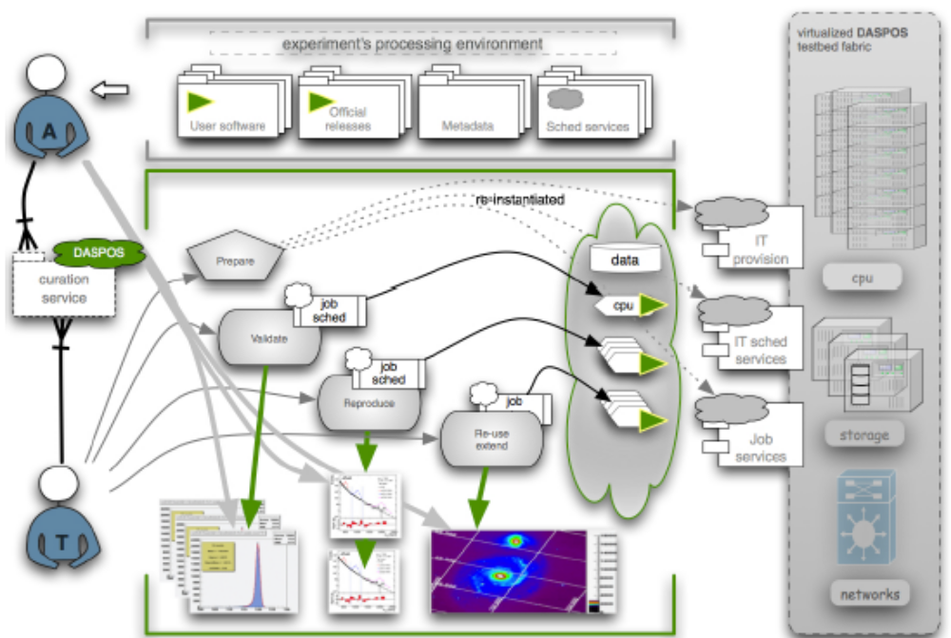
Curation Challenge
The auditing team (A) prepares the prototype DASPOS curation service with necessary semantic description of the tasks, software and processing environment; a technical execution team (T) uses these data to marshal the processing environment from the DASPOS testbed fabric, and performs successively a validation, reproduction, and an extended analysis which is later audited for accuracy by the A-team.

Slide 6
Management Plan
Project Coordination
  PI Mike Hildreth (Notre Dame)
  Co-PI Mark Neubauer (UIUC)
  Kyle Cranmer (NYU)
Data and Query model
  Co-PI Doug Thain and Co-PI Jarek Nabrzyski (ND)
Software and processing sustainability
  Co-PI Rob Gardner and Bob Grossman (UC)
Coordination of Curation Challenge
  Co-PI Mark Neubauer and Rob Gardner

Slide 7
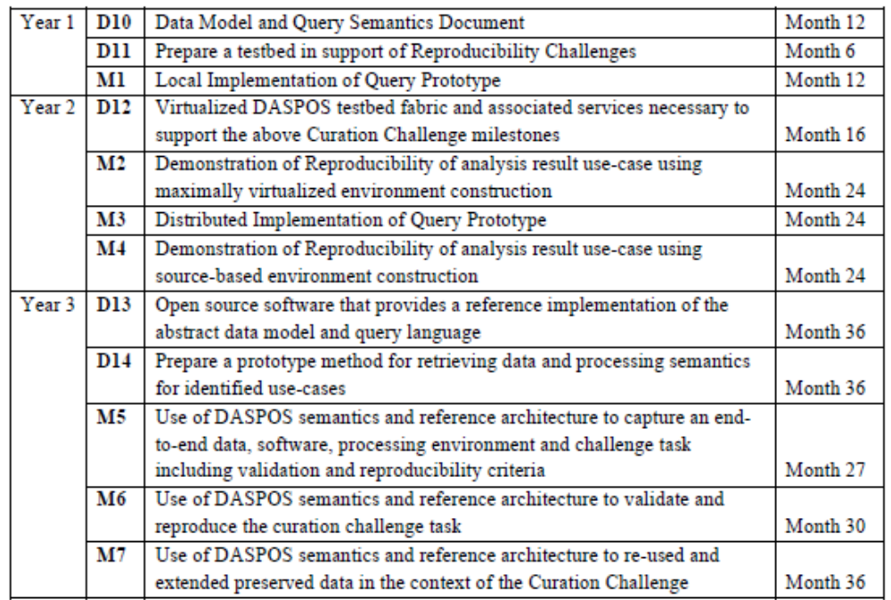
Prototyping and Experimentation Activity

Slide 8
Participation and Funding
Institutions getting Funding
  Notre Dame, U of C, UIUC, UNL, UW
    ND: part of Computing Director, 0.5 FTE Comp Scientist, 0.5 FTE programmer, 2.5 yr x 2 grad stud.
    UofC: part of Rob, 2 yr of Comp Scientist, 2.5 yr grad student
    UIUC: 2.5 yr grad student
    UNL: 2.5 yr grad student
    UW: 3 yr grad student
  Sustained total of 2 FTE Comp Professionals and 5 FTE students
  Funding starts in FY 2012 (~now)

