Slide 1




Lecture 3
Grid Resources and Job Management
Jaime Frey
Condor Project,
University of Wisconsin-Madison
jfrey@cs.wisc.edu
Grid Summer Workshop
June 21-25, 2004

Slide 2
Question For Today
How do you manage jobs on a Grid?
Recall globus-job-run yesterday
  No job tracking: what happens when you hit control-c?
  No way to run sets of jobs
Clearly we need something better!
  Condor-G for reliable job management
  DAGMan for controlling sets of jobs
  First we’re going to tell you a little bit about Condor

Slide 3
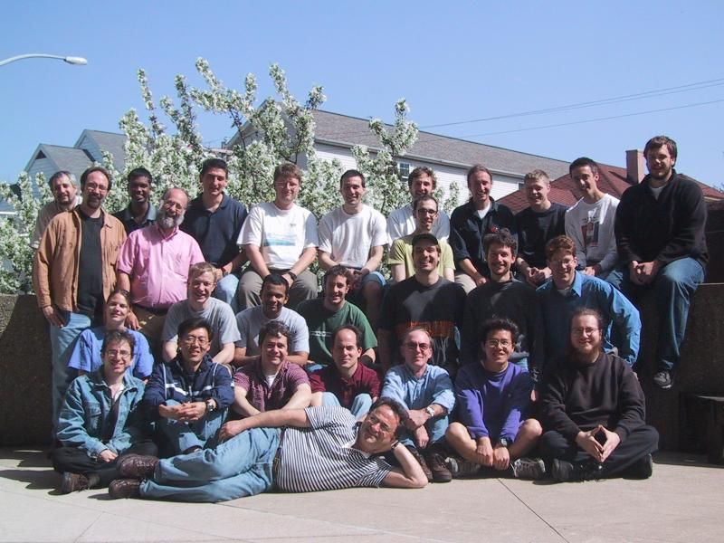
The Condor Project (Established ‘85)
Distributed High Throughput Computing research performed by a team of ~35 faculty, full time staff and students.

Slide 4
What is Condor?
Condor converts collections of distributively owned workstations and dedicated clusters into a distributed high-throughput computing (HTC) facility.
Condor manages both resources (machines) and resource requests (jobs)
Condor has several unique mechanisms such as :
  ClassAd Matchmaking
  Process checkpoint/ restart / migration
  Remote System Calls
  Grid Awareness

Slide 5
Condor can manage a large number of jobs
Managing a large number of jobs
  You specify the jobs in a file and submit them to Condor, which runs them all and keeps you notified on their progress
  Mechanisms to help you manage huge numbers of jobs (1000’s), all the data, etc.
  Condor can handle inter-job dependencies (DAGMan)
  Condor users can set job priorities
  Condor administrators can set user priorities

Slide 6
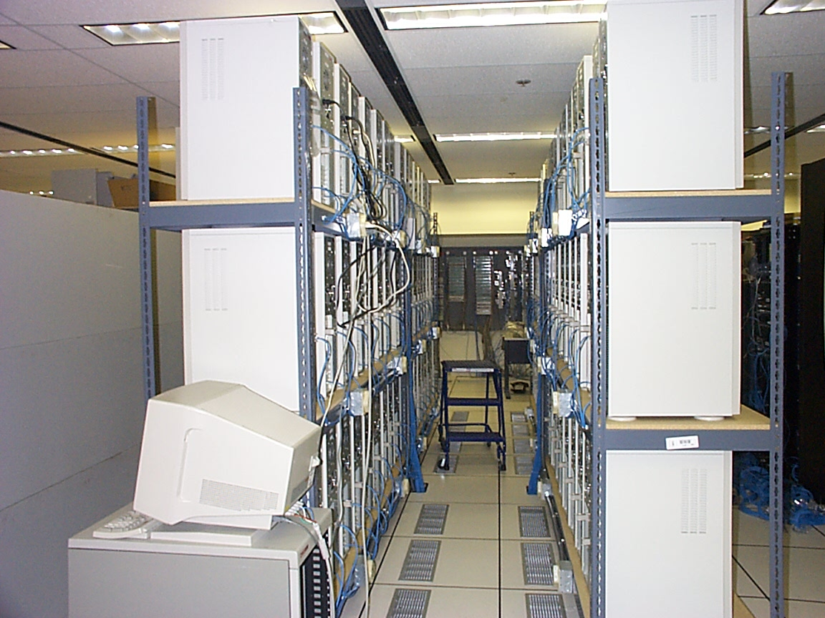
Condor can manage Dedicated Resources…
Dedicated Resources
  Compute Clusters
Manage
  Node monitoring, scheduling
  Job launch, monitor & cleanup

Slide 7
…Condor can manage non-dedicated resources…
Non-dedicated resources examples:
  Desktop workstations in offices
  Workstations in student labs
Non-dedicated resources are often idle --- ~70% of the time!
Condor can effectively harness the otherwise wasted compute cycles from non-dedicated resources

Slide 8
… and Condor Can Manage Grid jobs
Condor-G is a specialization of Condor. It is also known as the “Globus universe” or “Grid universe”.
Condor-G can submit jobs to Globus resources, just like globus-job-run.
Condor-G benefits from all the wonderful Condor features, like a real job queue.

Slide 9
Some Grid Challenges
Condor-G does whatever it takes to run your jobs, even if …
  The gatekeeper is temporarily unavailable
  The job manager crashes
  The network goes down

Slide 10
Remote Resource Access: Globus
Globus
JobManager
Globus GRAM Protocol
“globusrun
myjob …”
fork()
Organization A
Organization B

Slide 11
Remote Resource Access: Globus
Globus
JobManager
Globus GRAM Protocol
“globusrun
myjob …”
fork()
Organization A
Organization B

Slide 12
Remote Resource Access: Globus + Condor
Globus GRAM Protocol
Globus
JobManager
“globusrun
myjob …”
Submit to Condor
Condor Pool
Organization A
Organization B

Slide 13
Remote Resource Access: Globus + Condor
Globus GRAM Protocol
Globus
JobManager
“globusrun …”
Submit to Condor
Condor Pool
Organization A
Organization B

Slide 14
Remote Resource Access: Condor-G + Globus + Condor
Condor-G
Globus GRAM Protocol
Globus
JobManager
myjob1
myjob2
myjob3
myjob4
myjob5
…
Submit to Condor
Condor Pool
Organization A
Organization B

Slide 15
Just to be fair…
The gatekeeper doesn’t have to submit to a Condor pool.
  It could be PBS, LSF, Sun Grid Engine…
Condor-G will work fine whatever the remote batch system is.

Slide 16
The Idea
Computing power
is everywhere,
Condor tries to make it usable by anyone.

Slide 17
First Condor, then Condor-G
We’re going to learn the basics of Condor first…
Almost everything you learn about Condor applies to Condor-G as well.

Slide 18
Meet Frieda.
She is a scientist. But she has a big
problem.

Slide 19
Frieda’s Application …
Simulate the behavior of F(x,y,z) for 20 values of x, 10 values of y and 3 values of z (20*10*3 = 600 combinations)
  F takes on the average 3 hours to compute on a “typical” workstation (total = 1800 hours)
  F requires a “moderate” (128MB) amount of memory
  F performs “moderate” I/O - (x,y,z) is 5 MB and F(x,y,z) is 50 MB

Slide 20
I have 600 simulations to run.
Where can I get help?

Slide 21
Install a
Personal Condor!

Slide 22
Installing Condor
Download Condor for your operating system
Available as a free download from
http://www.cs.wisc.edu/condor
Stable –vs- Developer Releases
  Naming scheme similar to the Linux Kernel…
Available for most Unix platforms and Windows NT
It’s already installed on your computers

Slide 23
So Frieda Installs Personal Condor on her machine…
What do we mean by a “Personal” Condor?
  Condor on your own workstation, no root access required, no system administrator intervention needed
So after installation, Frieda submits her jobs to her Personal Condor…

Slide 24
600 Condor
jobs
your
workstation
personal
Condor

Slide 25
Personal Condor?!
What’s the benefit of a Condor “Pool” with just one user and one machine?

Slide 26
Your Personal Condor will ...
… keep an eye on your jobs and will keep you posted on their progress
… implement your policy on the execution order of the jobs
… keep a log of your job activities
… add fault tolerance to your jobs
… implement your policy on when the jobs can run on your workstation

Slide 27
Getting Started: Submitting Jobs to Condor
Choosing a “Universe” for your job
  Just use VANILLA for now
  This isn’t a grid job, but almost everything applies, without the complication of the grid
Make your job “batch-ready”
Creating a submit description file
Run condor_submit on your submit description file

Slide 28
Making your job ready
Must be able to run in the background: no interactive input, windows, GUI, etc.
Can still use STDIN, STDOUT, and STDERR (the keyboard and the screen), but files are used for these instead of the actual devices
Organize data files

Slide 29
Creating a Submit Description File
A plain ASCII text file
Tells Condor about your job:
  Which executable, universe, input, output and error files to use, command-line arguments, environment variables, any special requirements or preferences (more on this later)
Can describe many jobs at once (a “cluster”) each with different input, arguments, output, etc.

Slide 30
Simple Submit Description File
# Simple condor_submit input file
# (Lines beginning with # are comments)
# NOTE: the words on the left side are not
# case sensitive, but filenames are!
Universe = vanilla
Executable = my_job
Queue

Slide 31
Running condor_submit
You give condor_submit the name of the submit file you have created
condor_submit parses the file, checks for errors, and creates a “ClassAd” that describes your job(s)
Sends your job’s ClassAd(s) and executable to the condor_schedd, which stores the job in its queue
  Atomic operation, two-phase commit
View the queue with condor_q

Slide 32
Running condor_submit
% condor_submit my_job.submit-file
Submitting job(s).
1 job(s) submitted to cluster 1.
% condor_q
-- Submitter: perdita.cs.wisc.edu : <128.105.165.34:1027> :
ID OWNER SUBMITTED RUN_TIME ST PRI SIZE CMD
1.0 frieda 6/16 06:52 0+00:00:00 I 0 0.0 my_job
1 jobs; 1 idle, 0 running, 0 held
%

Slide 33
Another Submit Description File
# Example condor_submit input file
# (Lines beginning with # are comments)
# NOTE: the words on the left side are not
# case sensitive, but filenames are!
Universe = vanilla
Executable = /home/wright/condor/my_job.condor
Input = my_job.stdin
Output = my_job.stdout
Error = my_job.stderr
Arguments = -arg1 -arg2
InitialDir = /home/wright/condor/run_1
Queue

Slide 34
“Clusters” and “Processes”
If your submit file describes multiple jobs, we call this a “cluster”
Each job within a cluster is called a “process” or “proc”
If you only specify one job, you still get a cluster, but it has only one process
A Condor “Job ID” is the cluster number, a period, and the process number (“23.5”)
Process numbers always start at 0

Slide 35
Example Submit Description File for a Cluster
# Example condor_submit input file that defines
# a cluster of two jobs with different iwd
Universe = vanilla
Executable = my_job
Arguments = -arg1 -arg2
InitialDir = run_0
Queue ← Becomes job 2.0
InitialDir = run_1
Queue ← Becomes job 2.1

Slide 36
% condor_submit my_job.submit-file
Submitting job(s).
2 job(s) submitted to cluster 2.
% condor_q
-- Submitter: perdita.cs.wisc.edu : <128.105.165.34:1027> :
ID OWNER SUBMITTED RUN_TIME ST PRI SIZE CMD
1.0 frieda 6/16 06:52 0+00:02:11 R 0 0.0 my_job
2.0 frieda 6/16 06:56 0+00:00:00 I 0 0.0 my_job
2.1 frieda 6/16 06:56 0+00:00:00 I 0 0.0 my_job
3 jobs; 2 idle, 1 running, 0 held
%

Slide 37
Submit Description File for a BIG Cluster of Jobs
The initial directory for each job is specified with the $(Process) macro, and instead of submitting a single job, we use “Queue 600” to submit 600 jobs at once
$(Process) will be expanded to the process number for each job in the cluster (from 0 up to 599 in this case), so we’ll have “run_0”, “run_1”, … “run_599” directories
All the input/output files will be in different directories!

Slide 38
Submit Description File for a BIG Cluster of Jobs
# Example condor_submit input file that defines
# a cluster of 600 jobs with different iwd
Universe = vanilla
Executable = my_job
Arguments = -arg1 –arg2
InitialDir = run_$(Process)
Queue 600

Slide 39
Using condor_rm
If you want to remove a job from the Condor queue, you use condor_rm
You can only remove jobs that you own (you can’t run condor_rm on someone else’s jobs unless you are root)
You can give specific job ID’s (cluster or cluster.proc), or you can remove all of your jobs with the “-a” option.

Slide 40
Temporarily halt a Job
Use condor_hold to place a job on hold
  Kills job if currently running
  Will not attempt to restart job until released
Use condor_release to remove a hold and permit job to be scheduled again

Slide 41
A Job’s life story: The “User Log” file
A UserLog must be specified in your submit file:
  Log = filename
You get a log entry for everything that happens to your job:
  When it was submitted, when it starts executing, preempted, restarted, completes, if there are any problems, etc.
Very useful! Highly recommended!

Slide 42
Sample Condor User Log
000 (8135.000.000) 05/25 19:10:03 Job submitted from host: <128.105.146.14:1816>
...
001 (8135.000.000) 05/25 19:12:17 Job executing on host: <128.105.165.131:1026>
...
005 (8135.000.000) 05/25 19:13:06 Job terminated.
(1) Normal termination (return value 0)
Usr 0 00:00:37, Sys 0 00:00:00 - Run Remote Usage
Usr 0 00:00:00, Sys 0 00:00:05 - Run Local Usage
Usr 0 00:00:37, Sys 0 00:00:00 - Total Remote Usage
Usr 0 00:00:00, Sys 0 00:00:05 - Total Local Usage
9624 - Run Bytes Sent By Job
7146159 - Run Bytes Received By Job
9624 - Total Bytes Sent By Job
7146159 - Total Bytes Received By Job
...

Slide 43
Uses for the User Log
Easily read by human or machine
  C++ library and Perl Module for parsing UserLogs is available
  log_xml=True – XML formatted
Event triggers for schedulers
  DAGMan runs sets of jobs in a specified order.
  It watches the UserLog to learn when jobs finish
Visualizations of job progress
  Condor JobMonitor Viewer

Slide 44
What if each job needed to run for 20 days?
Something might crash…

Slide 45
Condor’s Standard Universe to the rescue!
Wouldn’t it be nice if when your job crashed, you could roll-back to where you job was an hour ago, instead of completely restarting it?
The Standard universe supplies checkpointing, to give you this functionality.

Slide 46
Process Checkpointing
Condor’s Process Checkpointing mechanism saves all the state of a process into a checkpoint file
  Memory, CPU, I/O, etc.
The process can then be restarted from right where it left off.
Typically no changes to your job’s source code needed – however, your job must be relinked with Condor’s Standard Universe support library
We will say no more today, since we are concentrating on Grid jobs.

Slide 47
Happy Day! Frieda’s organization purchased a Beowulf Cluster!
Frieda Installs Condor on all the dedicated Cluster nodes, and configures them with her machine as the central manager…
Now her Condor Pool can run multiple jobs at once

Slide 48
600 Condor
jobs
your
workstation
personal
Condor
Condor Pool

Slide 49

Back to the Story…
Frieda Needs Remote Resources…

Slide 50


Condor-G: Access non-Condor Grid resources
Globus
middleware deployed across entire Grid
remote access to computational resources
dependable, robust data transfer
Condor
job scheduling across multiple resources
strong fault tolerance with checkpointing and migration
layered over Globus as “personal batch system” for the Grid

Slide 51
Condor-G
Job Description (Job ClassAd)
Condor-G
GT2 [.1|2|4]
Condor
PBS/LSF
NorduGrid
GT4
Unicore
HTTPS
WSRF

Slide 52
Frieda Submits a Globus Universe Job
In her submit description file, she specifies:
  Universe = grid
  Grid_type = gt2
  Which Globus Gatekeeper to use
  Optional: Location of file containing your Globus certificate
  universe = grid
  grid_type = gt2
  globusscheduler = beak.cs.wisc.edu/jobmanager
  executable = progname
  queue

Slide 53
How It Works
Personal Condor
Globus Resource
Schedd
LSF

Slide 54
How It Works
600 Globus
jobs
Personal Condor
Globus Resource
Schedd
LSF

Slide 55
How It Works
600 Globus
jobs
Personal Condor
Globus Resource
Schedd
LSF
GridManager

Slide 56
How It Works
600 Globus
jobs
Personal Condor
Globus Resource
JobManager
Schedd
LSF
GridManager

Slide 57
How It Works
600 Globus
jobs
Personal Condor
Globus Resource
JobManager
Schedd
LSF
GridManager
User Job

Slide 58
Globus Universe Concerns
What about Fault Tolerance?
  Local Crashes
    What if the submit machine goes down?
  Network Outages
    What if the connection to the remote Globus jobmanager is lost?
  Remote Crashes
    What if the remote Globus jobmanager crashes?
    What if the remote machine goes down?

Slide 59
Changes to the Globus JobManager for Fault Tolerance
Ability to restart a JobManager
Enhanced two-phase commit submit protocol

Slide 60
Globus Universe Fault-Tolerance: Submit-side Failures
All relevant state for each submitted job is stored persistently in the Condor job queue.
This persistent information allows the Condor GridManager upon restart to read the state information and reconnect to JobManagers that were running at the time of the crash.
If a JobManager fails to respond…

Slide 61
Globus Universe Fault-Tolerance:
Lost Contact with Remote Jobmanager
Can we contact gatekeeper?
Yes - jobmanager crashed
No – retry until we can talk to gatekeeper again…
Can we reconnect to jobmanager?
No – machine crashed or job completed
Yes – network was down
Restart jobmanager
Has job completed?
No – is job still running?
Yes – update queue

Slide 62
Globus Universe Fault-Tolerance: Credential Management
Authentication in Globus is done with limited-lifetime X509 proxies
Proxy may expire before jobs finish executing
Condor can put jobs on hold and email user to refresh proxy
Todo: Interface with MyProxy…

Slide 63
Can Condor-G decide where to run my jobs?

Slide 64
Condor-G Matchmaking
Use Condor-G matchmaking with globus universe jobs
Allows Condor-G to dynamically assign computing jobs to grid sites
An example of lazy planning

Slide 65
Condor-G Matchmaking, cont.
Normally a globus universe job must specify the site in the submit description file via the “globusscheduler” attribute like so:
Executable = foo
Universe = grid
Grid_type = gt2
Globusscheduler = beak.cs.wisc.edu/jobmanager-pbs
queue

Slide 66
Condor-G Matchmaking, cont.
With matchmaking, globus universe jobs can use requirements and rank:
Executable = foo
Universe = grid
Grid_type = gt2
Globusscheduler = $$(GatekeeperUrl)
Requirements = arch == LINUX
Rank = NumberOfNodes
Queue
The $$(x) syntax inserts information from the target ClassAd when a match is made.

Slide 67
Condor-G Matchmaking, cont.
Where do these target ClassAds representing Globus gatekeepers come from? Several options:
  Simple script on gatekeeper publishes an ad via condor_advertise command-line utility (method used by D0 JIM, USCMS)
  Program to query Globus MDS and convert information into ClassAd (method used by EDG)
  Run HawkEye with appropriate plugins on the gatekeeper
For explanation of Condor-G matchmaking setup for USCMS, see http://www.cs.wisc.edu/condor/USCMS_matchmaking.html

Slide 68
But Frieda Wants More…
She wants to run standard universe jobs on Globus-managed resources
  For matchmaking and dynamic scheduling of jobs
  For job checkpointing and migration
  For remote system calls

Slide 69
One Solution: Condor-G GlideIn
Frieda can use the Globus Universe to run Condor daemons on Globus resources
When the resources run these GlideIn jobs, they will temporarily join her Condor Pool
She can then submit Standard, Vanilla, PVM, or MPI Universe jobs and they will be matched and run on the Globus resources

Slide 70
Globus Grid
600 Condor
jobs
PBS
LSF
your
workstation
personal
Condor
Condor Pool
glide-in jobs
Friendly Condor Pool
Condor

Slide 71
How It Works
600 Condor
jobs
Personal Condor
Globus Resource
Schedd
LSF
Collector

Slide 72
How It Works
600 Condor
jobs
Personal Condor
Globus Resource
Schedd
LSF
Collector
GlideIn jobs

Slide 73
How It Works
600 Condor
jobs
Personal Condor
Globus Resource
Schedd
LSF
GridManager
Collector
GlideIn jobs

Slide 74
How It Works
600 Condor
jobs
Personal Condor
Globus Resource
JobManager
Schedd
LSF
GridManager
Collector
GlideIn jobs

Slide 75
How It Works
600 Condor
jobs
Personal Condor
Globus Resource
JobManager
Schedd
LSF
GridManager
Startd
Collector
GlideIn jobs

Slide 76
How It Works
600 Condor
jobs
Personal Condor
Globus Resource
JobManager
Schedd
LSF
GridManager
Startd
Collector
GlideIn jobs

Slide 77
How It Works
600 Condor
jobs
Personal Condor
Globus Resource
JobManager
Schedd
LSF
GridManager
Startd
Collector
User Job
GlideIn jobs

Slide 78
GlideIn Concerns
What if a Globus resource kills my GlideIn job?
  That resource will disappear from your pool and your jobs will be rescheduled on other machines
  Standard universe jobs will resume from their last checkpoint like usual
What if all my jobs are completed before a GlideIn job runs?
  If a GlideIn Condor daemon is not matched with a job in 10 minutes, it terminates, freeing the resource

Slide 79
DAGMan
Directed Acyclic Graph Manager
DAGMan allows you to specify the dependencies between your Condor jobs, so it can manage them automatically for you.
  By default, Condor may run your jobs in any order, or everything simultaneously, so we need DAGMan to enforce an ordering when necessary.
(e.g., “Don’t run job “B” until job “A” has completed successfully.”)
Notes:
In the simplest case…

Slide 80
What is a DAG?
A DAG is the data structure used by DAGMan to represent these dependencies.
Each job is a “node” in the DAG.
Each node can have any number of “parent” or “children” nodes – as long as there are no loops!
Job A
Job B
Job C
Job D
Notes:
a DAG is the best data structure to represent a workflow of jobs with dependencies
children may not run until their parents have finished – this is why the graph is a directed graph … there’s a direction to the flow of work
In this example, called a “diamond” dag, job A must run first; when it finishes, jobs B and C can run together; when they are both finished, D can run; when D is finished the DAG is finished
Loops, where two jobs are both descended from one another, are prohibited because they would lead to deadlock – in a loop, neither node could run until the other finished, and so neither would start – this restriction is what makes the graph acyclic

Slide 81
Defining a DAG
A DAG is defined by a .dag file, listing each of its nodes and their dependencies:
  # diamond.dag
  Job A a.sub
  Job B b.sub
  Job C c.sub
  Job D d.sub
  Parent A Child B C
  Parent B C Child D
each node will run the Condor job specified by its accompanying Condor submit file
Job A
Job B
Job C
Job D
Notes:
This is all it takes to specify the example “diamond” dag.
DAGMan will output the log file for each job to determine what to do next.

Slide 82
Submitting a DAG
To start your DAG, just run condor_submit_dag with your .dag file, and Condor will start a personal DAGMan daemon which to begin running your jobs:
  % condor_submit_dag diamond.dag
condor_submit_dag submits a job with DAGMan as the executable.
  This job happens to run on the submitting machine, not any other computer.
Thus the DAGMan daemon itself runs as a Condor job, so you don’t have to baby-sit it.
Notes:
Just like any other Condor job, you get fault tolerance in case the machine crashes or reboots, or if there’s a network outage
And you’re notified when it’s done, and whether it succeeded or failed
% condor_q
-- Submitter: foo.bar.edu : <128.105.175.133:1027> : foo.bar.edu
ID OWNER SUBMITTED RUN_TIME ST PRI SIZE CMD
2456.0 user 3/8 19:22 0+00:00:02 R 0 3.2 condor_dagman -f -

Slide 83
Running a DAG
DAGMan acts as a “meta-scheduler”, managing the submission of your jobs to Condor based on the DAG dependencies.
DAGMan
A
Condor
Job
Queue
.dag
File
A
B
C
D
Notes:
First, job A will be submitted alone…

Slide 84
Running a DAG (cont’d)
DAGMan holds & submits jobs to the Condor queue at the appropriate times.
DAGMan
A
Condor
Job
Queue
B
B
C
C
D
Notes:
Once job A completes successfully, jobs B and C will be submitted at the same time…

Slide 85
Running a DAG (cont’d)
In case of a job failure, DAGMan continues until it can no longer make progress, and then creates a “rescue” file with the current state of the DAG.
DAGMan
A
Condor
Job
Queue
Rescue
File
B
X
D
Notes:
If job C fails, DAGMan will wait until job B completes, and then will exit, creating a rescue file. Job D will not run.
In its log, DAGMan will provide additional details of which node failed and why.

Slide 86
Recovering a DAG
Once the failed job is ready to be re-run, the rescue file can be used to restore the prior state of the DAG.
DAGMan
A
Condor
Job
Queue
Rescue
File
B
C
C
D
Notes:
Since jobs A and B have already completed, DAGMan will start by re-submitting job C

Slide 87
Recovering a DAG (cont’d)
Once that job completes, DAGMan will continue the DAG as if the failure never happened.
DAGMan
A
Condor
Job
Queue
B
C
D
D

Slide 88
Finishing a DAG
Once the DAG is complete, the DAGMan job itself is finished, and exits.
DAGMan
A
Condor
Job
Queue
B
C
D

Slide 89
Additional DAGMan Features
Provides other handy features for job management…
  nodes can have PRE & POST scripts
  failed nodes can be automatically re-tried a configurable number of times
  job submission can be “throttled”
Notes:
PRE and post scripts are commonly used to stage data files before/after the job.
DAGMan takes note of the exit value of the scripts as well as the program. If the PRE scriptfails (exit value != 0), then neither the program nor the POST script runs, and the node is marked as failed.
If the PRE script succeeds, the program is submitted to Condor. If the program fails and there is no POST script, the DAG node is marked as failed. An exit value not equal to 0 indicates program failure. It is therefore important that the program returns the exit value 0 to indicate the program did not fail.
If the program fails and there is a POST script, node failure is determined by the exit value of the POST script. A failing value from the POST script marks the node as failed. A succeeding value from the POST script (even with a failed program) marks the node as successful.

Slide 90
Another sample DAGMan submit file
# Filename: diamond.dag
Job A A.condor
Job B B.condor
Job C C.condor
Job D D.condor
Script PRE A top_pre.csh
Script PRE B mid_pre.perl $JOB
Script POST B mid_post.perl $JOB $RETURN
Script PRE C mid_pre.perl $JOB
Script POST C mid_post.perl $JOB $RETURN
Script PRE D bot_pre.csh
PARENT A CHILD B C
PARENT B C CHILD D
Retry C 3
Job A
Job B
Job C
Job D

Slide 91
DAGMan, cont.
DAGMan works with all kinds of Condor jobs.
This means that it works fine with Grid jobs.
In your exercises, you will submit Condor-G jobs by themselves, and using DAGMan.
Notes:
Why not just use make?
You could. But DAGMan is easier---
Make relies on evidence left behind on the filesystem. What if a jobs side effect is to impact a third party database, thereby not leaving any “result” behind?
Also : Features like retries w/ exponential backoff, better info about where the dag failed (in the rescue file), throttling (helps w/ limited staging space, etc), and also where we are taking DAGMan: dynamic dags, where the workflow can change as the job evolves. Hawk == Research DAGMan that incorporates data placement considerations in the workflow.
So Oracle Corp uses DAGMan + Condor for its nightly build and regression test of Oracle Server.

