Slide 1
Introduction
to
HTC
2014 OSG User School, Monday, Lecture
1
Greg Thain
University of Wisconsin–Madison
Center For High Throughput Computing

Slide 2

Welcome!
2

Slide 3
Why
Are
We
Here?
3

Slide 4
Transform
Your Research
With
Computing
4

Slide 5
Overview
5

Slide 6
Overview of Week
Monday
•
•
High Throughput Computing locally
Miscellaneous
‣
‣
‣
Survey
UW reimbursement form
Certificate
Tuesday
•
Distributed High Throughput Computing
•
Security
• Tour of Wisconsin Institutes for Discovery
Wednesday
•
Distributed storage
• Practical issues with DHTC
Thursday
•
•
From science to production
Principles of HTC
•
HTC Showcase
• Next steps
6

Slide 7
Overview of a Day
•
•
•
•
Short introductory lectures
Lots of hands-on exercises
Some demos, interactive sessions, Optional evening sessions
etc.
‣
‣
Monday – Wednesday, 7–9 p.m.
Union South (check TITU)
School staff on hand
‣
7

Slide 8
Keys
to
Success
•
•
Work hard
Ask questions!
… during lectures
…
…
…
…
during
during
during
exercises
breaks
meals
in person is best,
email is OK
•
If we do not know an answer,
the person who does
we will
try to find
8

Slide 9
Ready?
9

Slide 10
One Thing

Slide 11
Computing is Cheap!

Slide 12
Goals For This Session
•
•
•
•
Understand the basics of High Throughput
Computing
Understand a few things about HTCondor,
which is one kind of
HTC system
commands
Use basic
HTCondor
locally!
Run
a
job
10

Slide 13
Why
HTC?
11

Slide 14


Computing in Science
S
c i e n c e
Theory
Experiments
12

Slide 15
Computing in Science
S
c i e n c e
Theory
Computing
Experiments
12

Slide 16
Example Challenge
•
•
•
•
•
You have a program to run (simulation, Monte
Carlo, data analysis, image analysis, stats, …)
Each run takes about 1 hour
You want to run the program 8 × 12 × 100 times
9600 hours ≈ 1.1 years
…
running
nonstop!
Conference is
next week
13

Slide 17
Distributed Computing
•
•
Use many computers to perform 1 computation
Example:
‣
‣
‣
‣
^{2 computers => 4,800 hours} ≈ ½ ^{year}
8 computers => 1,200 hours ≈ 2 months
100 computers => 96 hours
9,600 computers => 1 hour!
=
4 days
(but …)
These computers are no faster than your laptop!
14

Slide 18
Performance vs. Throughput
•
High Performance Computing (HPC)
‣
‣
‣
‣
Focus on biggest, fastest systems (supercomputers)
Maximize operations per second
Often requires special code
Often must request and wait for access
•
High Throughput Computing (HTC)
‣
‣
‣
‣
‣
Focus on using all resources, reliably, all the time
Maximize operations per year
Use any kind of computer, even old, slow ones Must break task into separate, independent parts Access varies by availability, usage, etc.
15

Slide 19
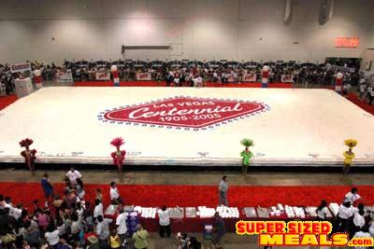
HPC
vs
HTC:
An
Analogy
16

Slide 20
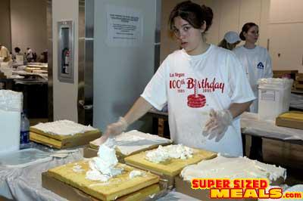
HPC
vs
HTC:
An
Analogy
16

Slide 21
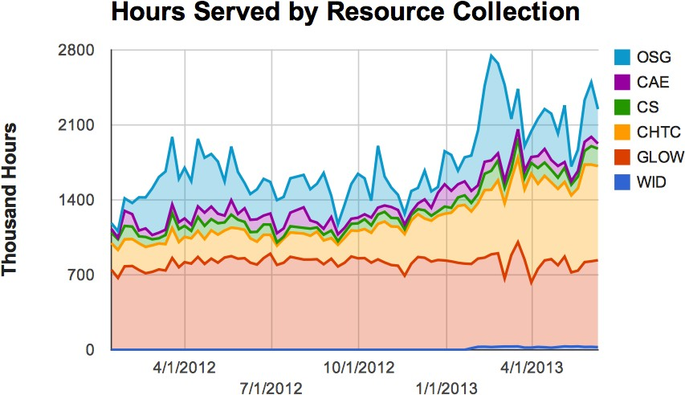
Example HTC
Site
(Wisconsin)
•
•
Our local HTC systems
Recent CPU hours:
~
~
~
280,000 / day
8.3 million / month
78
million
/
year
17

Slide 22
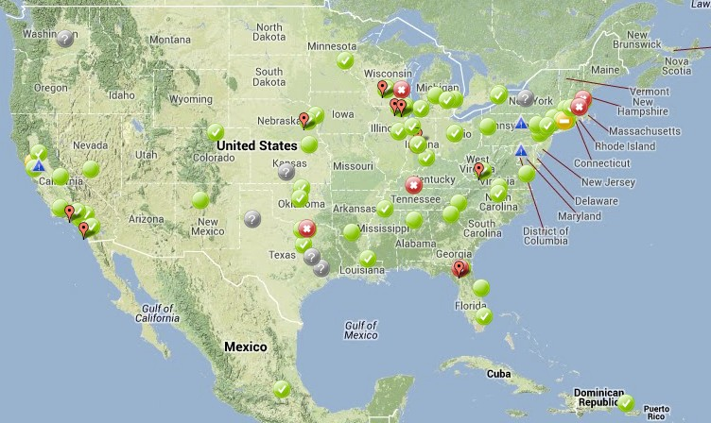
Open
Science
Grid
•
HTC scaled way up
‣
‣
‣
‣
Over 110 sites
Mostly U.S. Some others Past year:
~170 million
~770 million
jobs
CPU
hours
~372 petabytes transferred
Can submit jobs locally, move to OSG
http://www.opensciencegrid.org/
•
•
2013 OSG User School
Cartwright – Intro to HTC
18

Slide 23
Other Distributed Computing
•
Other systems to manage a local cluster:
‣
‣
‣
‣
PBS/Torque
LSF
Sun Grid Engine/Oracle Grid Engine
SLURM
•
Other wide-area systems:
‣
‣
‣
European Grid Infrastructure
Other national and regional grids
Commercial cloud systems used to augment
grids
•
HPC
‣
‣
Various supercomputers (e.g., TOP500 list)
XSEDE
19

Slide 24
HTCondor
20

Slide 25
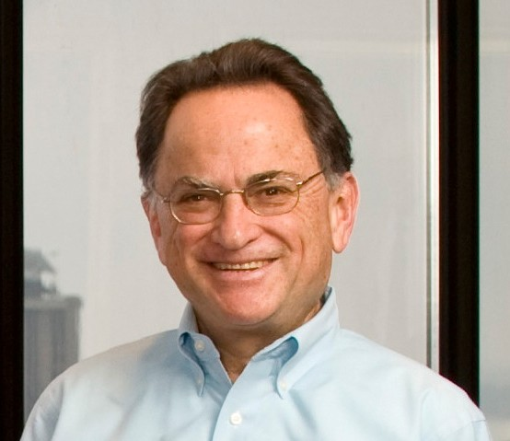
HTCondor History and Status
•
History
‣
‣
Started in 1988 as a “cycle scavenger”
Protected interests of users and machine owners
•
Today
‣
‣
‣
Expanded to become CHTC team: 20+ full-time staﬀ
Current production release: HTCondor 8.0.0
HTCondor software: ~700,000 lines of
C/C++
code
•
Miron Livny
‣
‣
‣
‣
Professor, UW–Madison CompSci
Director, CHTC
Dir. of Core Comp. Tech., WID/MIR Tech. Director & PI, OSG
21

Slide 26
HTCondor Functions
•
Users
‣
‣
‣
‣
Define jobs, their requirements, and preferences
Submit and cancel
Check on the state
Check on the state
jobs
of a job
of the machines
•
Administrators
‣
‣
Configure and control the HTCondor system
Declare policies on machine use, pool use, etc.
•
Internally
‣
‣
‣
Match jobs to machines (enforcing all policies)
Track
Track
and
and
manage machines
run jobs
22

Slide 27
Terminology: Job
•
•
Job: A computer program or one run of it
Not interactive, no GUI (e.g., not Word or email)
(How could you interact with 1,000 programs running at
1. Input: command-line arguments and/or files
2. Run: do stuﬀ
3. Output: standard output & error and/or files
once?)
•
Scheduling
‣
‣
User decides when to submit job to be run
System decides when to run job, based on policy
23

Slide 28
Terminology: Machine, Slot
•
Machine
‣
‣
‣
A machine is a physical computer (typically)
May have multiple processors (computer chips) One processor may have multiple cores (CPUs)
•
HTCondor: Slot
‣
‣
‣
One assignable unit of a machine (i.e., 1 job per
Most often, corresponds to one core
Thus, typical machines today have 4–40 slots
slot)
•
Advanced HTCondor feature: Can get 1 slot with
many cores on 1 machine, for MPI(-like) jobs
24

Slide 29
Terminology: Matchmaking
Two-way process of finding a slot for a job
Jobs have requirements and preferences
E.g.: I need Red Hat Linux 6 and 100 GB of disk space, and
prefer to get as much memory as possible
Machines have requirements and preferences E.g.: I run jobs only from users in the Comp. Sci. dept., and prefer to run ones that ask for a lot of memory
I
I
Important jobs
Thus: Not as
may replace less important ones
simple as waiting in a line!
25

Slide 30
Running
a
Job
26

Slide 31
Viewing Slots
condor_status
•
•
•
With no arguments, lists all slots currently in pool
Summary info is printed
at the end of the
list
lecture
For
more
info:
exercises,
-h,
manual,
next
slot6@opt-a001.cht LINUX X86_64 Claimed Busy 1.000 1024 0+19:09:32
slot7@opt-a001.cht LINUX X86_64 Claimed Busy 1.000 1024 0+19:09:31
slot8@opt-a001.cht LINUX X86_64 Unclaimed Idle 1.000 1024 0+17:37:54
slot9@opt-a001.cht LINUX X86_64 Claimed Busy 1.000 1024 0+19:09:32
slot10@opt-a002.ch LINUX X86_64 Unclaimed Idle 0.000 1024 0+17:55:15
slot11@opt-a002.ch LINUX X86_64 Unclaimed Idle 0.000 1024 0+17:55:16
Total Owner Claimed Unclaimed Matched Preempting Backfill
INTEL/WINNT51 2 0 0 2 0 0 0
INTEL/WINNT61 52 2 0 50 0 0 0
X86_64/LINUX 2086 544 1258 284 0 0 0
Total 2140 546 1258 336 0 0 0
27

Slide 32
Viewing Jobs
condor_q
•
•
With no args, lists all jobs waiting or running here
For
more
info:
exercises,
-h,
manual,
next
lecture
-- Submitter: osg-ss-submit.chtc.wisc.edu : <...> : ...
ID OWNER SUBMITTED RUN_TIME ST PRI SIZE CMD
6.0 cat 11/12 09:30 0+00:00:00 I 0 0.0 explore.py
6.1 cat 11/12 09:30 0+00:00:00 I 0 0.0 explore.py
6.2 cat 11/12 09:30 0+00:00:00 I 0 0.0 explore.py
6.3 cat 11/12 09:30 0+00:00:00 I 0 0.0 explore.py
6.4 cat 11/12 09:30 0+00:00:00 I 0 0.0 explore.py
5 jobs; 5 idle, 0 running, 0 held
28

Slide 33
Basic
Submit
File
executable = word_freq.py
universe = vanilla
arguments = "words.txt 1000"
output = word_freq.out
error = word_freq.err
log = word_freq.log
should_transfer_files = YES
when_to_transfer_output = ON_EXIT
transfer_input_files = words.txt
queue
29

Slide 34
Basic
Submit
File
executable = word_freq.py
universe = vanilla
arguments = "words.txt 1000" Command-line arguments to pass
^{output = word_freq.out} to executable
log = word_freq.log double quotes [
should_transfer_files = YES
when_to_transfer_output = ON_EXIT
transfer_input_files = words.txt
queue
output
=
word_freq.out
to executable
run; surround
when
error
=
word_freq.err
with
log
=
word_freq.log
double
quotes
[opt]
29

Slide 35
Basic
Submit
File
executable = word_freq.py
universe = vanilla
arguments = "words.txt 1000"
output = word_freq.out Local files that will
error = word_freq.err ^{receive the contents o}
error from the run [
should_transfer_files = YES
when_to_transfer_output = ON_EXIT
transfer_input_files = words.txt
queue
f
log
=
word_freq.log
standard
output and
error
from
the
run
[opt]
2013 OSG User School
Cartwright – Intro to HTC
29

Slide 36
Basic Submit
File
executable = word_freq.py
universe = vanilla
arguments = "words.txt 1000"
output = word_freq.out Condor’s log file
error = word_freq.err from running the
log = word_freq.log job; very helpful,
do not omit!
when_to_transfer_output = ON_EXIT
transfer_input_files = words.txt
queue
should_transfer_files
=
YES
29

Slide 37
Basic
Submit
File
executable = word_freq.py
universe = vanilla
arguments = "words.txt 1000"
output = word_freq.out
error = word_freq.err
log = word_freq.log
should_transfer_files = YES _{separated list}
when_to_transfer_output = ON_EXIT of input files t
transfer_input_files = words.txt transfer to
machine [
Comma-
o
machine [opt]
queue
29

Slide 38
Basic
Submit
File
executable = word_freq.py
universe = vanilla
arguments = "words.txt 1000"
output = word_freq.out
error = word_freq.err
log = word_freq.log
should_transfer_files = YES
when_to_transfer_output = ON_EXIT
transfer_input_files = words.txt
_{queue}
29

Slide 39
Submit a Job
condor_submit submit-file
•
•
Submits job to local submit machine
Use condor_q to track
Submitting job(s).
1 job(s) submitted to cluster NNN.
Each condor_submit creates one Cluster
A job ID is written as cluster.process (e.g., 8.0)
We will see how to make multiple processes later
30

Slide 40
Remove a Job
condor_rm cluster [...]
condor_rm cluster.process [...]
•
•
•
Removes one or more jobs from the
queue
Identify jobs by whole cluster or single job
ID
Only
you
(or admin) can
remove
your
jobs
Cluster NNN has been marked for removal.
31

Slide 41
Your
Turn!
32

Slide 42
Thoughts on Exercises
•
•
Copy-and-paste is quick, but you may learn more by typing out commands yourself
Experiment!
‣
‣
Try your own variations on the exercises
If you have time, try to apply to your own work
•
•
If you do not finish, that’s OK — you can make up work later or during evenings, if you like
If you finish early, try any extra challenges or optional sections, or move ahead to the next section if you are brave
33

Slide 43
Sometime Today …
•
•
•
•
Sometime today, do the exercise on getting
X.509 personal certificate
an
It
It
It
is not required today
will be required tomorrow
afternoon
early
is
best
to
start
the
process
34

Slide 44
Exercises!
•
•
•
Ask questions!
Lots of instructors around
Coming next:
Now – 10:30
10:30–10:45
10:45–11:15
11:15–12:15
Hands-on
Break Lecture Hands-on
exercises
exercises
35

