Slide 1
Lecture 2: Security
Rachana Ananthakrishnan
Argonne National Lab

Slide 2






Typical Grid Scenario
Resources
Users
Notes:
Large resources
Shared across various domain
User pool
Restrict access to the resource, yet allow for collaboration

Slide 3

Grid Security: Identity
Notes:
Who is accessing, a way to identify them
To restrict access, a way to know who is accessing

Slide 4
Grid Security: Authentication
Notes:
- Claim to be someone else

Slide 5
Identity & Authentication
Each entity should have an identity
Authenticate: Establish identity
Is the entity who he claims he is ?
Examples:
  Driving License
  Username/password
Stops masquerading imposters

Slide 6

Grid Security: Privacy
Medical Record
Patient no: 3456
Notes:
- Real life: sensitive data : caBig cancer research; proprietary data.

Slide 7


Grid Security: Integrity
Run myHome/rm –f *
Run myHome/whoami

Slide 8
Message Protection
Sending message securely
Integrity
  Detect whether message has been tampered
Privacy
  No one other than sender and receiver should be able to read message
Authentication and Integrity

Slide 9
Grid Security: Authorization

Slide 10
Authorization
Establishing rights
What can a said identity do ?
Examples:
  Are you allowed to be on this flight ?
  Unix read/write/execute permissions
Must authenticate first

Slide 11
Grid Security: Single Sign On
Varied Credentials
Notes:
- Various resources, different ways of proving your identity
- Different password files.

Slide 12


Grid Security: Single Sign On
Authenticate Once
Notes:
Long running jobs
Jobs require access to different things

Slide 13
Grid Security: Single Sign On
Delegation
Notes:
Long running jobs
Jobs require access to different things

Slide 14
Single Sign-on
Important for complex applications that need to use Grid resources
  Enables easy coordination of varied resources
  Enables automation of process
  Allows remote processes and resources to act on user’s behalf
  Authentication and Delegation

Slide 15
Solutions

Slide 16
Secure Message Solution
Encryption and Signature

Slide 17

Cryptography
Key
  Collection of bits
  Building block of cryptography
  More bits, the stronger the key
0 1 0 1 0 0 1 1 1 0
1 0 1 1 1 1 0 1 1 1
Notes:
Keys are building blocks
256 bits key is stronger than 128 bits
Computing things using larger key also takes more time.
Most algorithms are well established and tools have been already developed for performing the computations

Slide 18

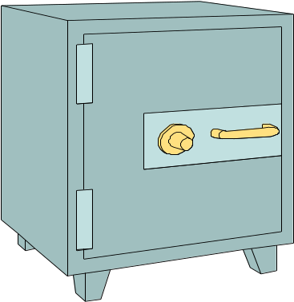
Encryption
Encryption is the process of taking some data and a key and feeding it into a function and getting encrypted data out
Encrypted data is, in principal, unreadable unless decrypted
Data
Encryption
Function
Notes:
Data is treated as bit streams.

Slide 19
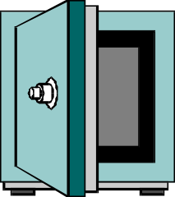
Decryption
Decryption is the process of taking encrypted data and a key and feeding it into a function and getting out the original data
  Encryption and decryption functions are linked
Decryption
Function
Data
Notes:
Decryption again is a mathematical function of taking the encrypted data and key and getting original data
If you encrypt with a particular algorithm, you want to decrypt with the same one

Slide 20
Symmetric Encryption
Encryption and decryption functions use same key
Data
Encrypt
Decrypt
Data

Slide 21

Asymmetric Encryption
Encryption and decryption functions that use a key pair are called asymmetric
  Keys are mathematically linked

Slide 22

Asymmetric Encryption
When data is encrypted with one key, the other key must be used to decrypt the data
  And vice versa
Data
Data
Decrypt
Encrypt
Encrypt
Decrypt
Data
Data
Notes:
Asymmetric vs. symmetric encryptions –
symmetric is cheaper computationally
Symmetric less secure
Real world assymentric
Next: Public/Private

Slide 23

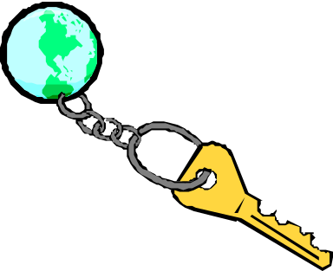
Public and Private Keys
With asymmetric encryption each user can be assigned a key pair: a private and public key
Private key is known only to owner
Public key is given away to the world
Notes:
Grid scenario

Slide 24

Public and Private keys
Anything encrypted with the public key can only be decrypted with the private key
And vice versa
Since the private key is known only to the owner, this is very powerful.
Message Privacy!
Data
Encrypt
Decrypt
Data
Notes:
Grid scenario: So provact

Slide 25
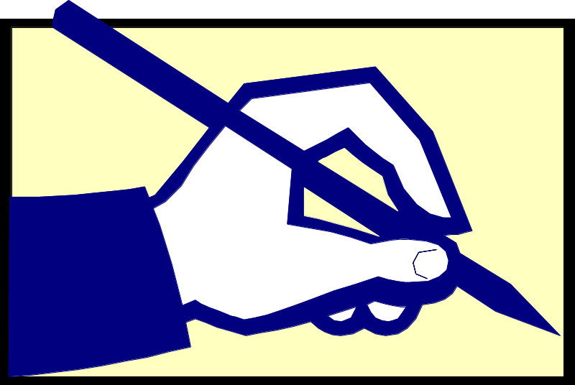
Digital Signatures
Digital signatures allow the world to
  verify who created a hunk of data
  determine of the data has been tampered
Notes:
Generated and sent with the message

Slide 26

Digital Signatures
Run whoami
Digital signatures are generated by
  Creating hash of the data
  encrypting the hash with my private key
The resulting encrypted data is the signature
This hash can then be decrypted only by my public key
Hash
Encrypt
Signature
Notes:
Hash is a mathematical operation on the data that generates a unique value that represents the data (SHA-1, MDS)
If the hash is computed using the same hash algorithm on the data any number of times, the same value is returned
If data is altered the hash is not the same
When the hash is encrypted, then it is assured that it cannot be tampered with
The signature is sent along with the data for the other end to verify it

Slide 27
Digital Signature
Recipient of data and signature:
  Compute hash of data
  Decrypt signature to get hash
  Compare hash to see if they match
Compute
Hash
Hash
Run whoami
=?
Decrypt
Signature
Hash
Notes:
Given some data with my signature, if you decrypt a signature with my public key and get the hash of the data, you know it was encrypted with my private key
Since you used my public key, only I could have encrypted it, since encryption requires my private key
Since the hash computed resulted in same data, the data has not been tampered with.

Slide 28



Digital Signature
Sender
!=
Run whoami
Hash
Hash
Signature
Message
Compute
Hash
Decrypt
Run rm -rf *
Signature
Run rm -rf *
Signature
Message
Recipient

Slide 29
Digital Signature
Since I’m the only one with access to my private key, you know I signed the hash and the data associated with it
But, how do you know that you have my correct public key?
?

Slide 30
Entity Identity Solution
Public Key Infrastructure

Slide 31
Public Key Infrastructure (PKI)
PKI allows you to know that a given public key belongs to a given user
PKI builds off of asymmetric encryption:
  Each entity has two keys: public and private
  The private key is known only to the entity
The public key is given to the world encapsulated in a X.509 certificate
Owner
Notes:
Provides a owner tag
Any entity that possess the private key, assumes that entity. So if you have my private key, you are me as far as PKI fabric is concerned.

Slide 32
Certificates
A X.509 certificate binds a public key to a name
It includes a name and a public key (among other things) bundled together and signed by a trusted party (Issuer)
Name
Issuer
Public Key
Validity
Signature
Notes:
Name: is also called Subject Name or Distinguished name

Slide 33

Certificates
Similar to passport or driver’s license
State of Illinois
Name
Issuer
Public Key
Validity
Signature
John Doe
755 E. Woodlawn
Urbana IL 61801
State of
Illinois
Seal
BD 08-06-65
Male 6’0” 200lbs
GRN Eyes
Valid Till: 01-02-2008

Slide 34
Certificates
By checking the signature, one can determine that a public key belongs to a given user.
Hash
Hash
Name
Issuer
Public Key
Validity
Signature
=?
Decrypt
Hash
Public Key from
Issuer
Notes:
Chain of trust: completely trust issuer
No private information in the certificate.
Expiration time on certificate

Slide 35

Certificates
Question: Who signs certificates?
Answer: A small set of trusted entities known as Certification Authorities (CAs)
Name
Validity
Public Key
Issuer?

Slide 36
Certification Authorities (CAs)
A Certification Authority is an entity that exists only to sign user certificates
The CA signs it’s own certificate which is distributed in a trusted manner
Name: CA
Issuer: CA
CA’s Public Key
Validity
CA’s Signature
Notes:
The CA private key is again a protected key
But the CA public key is distributed widely

Slide 37
Certification Authorities (CAs)
The public key from the CA certificate can then be used to verify issued certificates
Name
Issuer
Validity
Public Key
Signature
Hash
Hash
=?
Decrypt
Hash
Name: CA
Issuer: CA
CA’s Public Key
Validity
CA’s Signature
Notes:
Hash of “Name + Issuer + PK + validity ” for verification using CA’s public key
Next: Trust

Slide 38
Certificate Policy (CP)
Each CA has a Certificate Policy (CP) which states
  who it will issue certificates to
  how it identifies people to issue certificates to
Lenient CAs don’t pose security threat, since resources determine the CAs they trust.

Slide 39

Requesting a Certificate
To request a certificate a user starts by generating a key pair

Slide 40
Certificate Request
The user then signs their own public key to form what is called a Certificate Request
Email/Web upload
Sign
Certificate
Request
Public Key
Notes:
Private key never sent anywhere.

Slide 41
Registration Authority (RA)
The user then takes the certificate to a Registration Authority (RA)
Vetting of user’s identity
Often the RA coexists with the CA and is not apparent to the user
Registration
Authority
Certificate
Request
Public Key
State of Illinois
ID

Slide 42
Certificate Issuance
Certificate
Request
Public Key
The CA then takes the identity from the RA and the public key from the certificate request
It then creates, signs and issues a certificate for the user
Registration
Authority
Name
CA
Name
Issuer
Validity
Public Key
Signature
Notes:
CA trusts RA
How do you revoke ?

Slide 43
Authentication Solution
Secure Socket Layer

Slide 44
Secure Socket Layer (SSL)
Protocol above a standard TCP/IP socket to provide security in the forms of:
  Authentication
  Message protection
    Privacy
    Integrity
Notes:
A means to send message back and forth in a secure manner

Slide 45
SSL Authentication
Both sides have certificate and private key
Start by exchanging X.509 certificates
Notes:
Not protocol, just explanation

Slide 46
SSL Authentication
Challenge
Each side then sends over a challenge
Challenge is signed with private key and sent back over
Sign
Signature
Challenge
Sign
Signature

Slide 47
SSL Authentication
CA
Each side then
  verifies certificate using PKI
  Validates challenge signature using certificate
If everything checks then the identity from the certificate can be trusted
Check Certificate
Challenge
Check Signature
Signature
Notes:
Explain PKI verification
Next how do we secure messages between orange and green side ?

Slide 48
SSL Handshake
Creating session key:
  Both sides agree on some algorithm to generate keys.
  One side sends over some random data encrypted with other side’s public key
  The other side decrypts it with its private key
Encrypt
Encrypted Data
Random Data
Decrypt
Random Data
Notes:
Handshake establishes a session
End of handshake both want to agree on a session key – symmetric key they will use.

Slide 49
SSL Handshake
  Both sides use agreed algorithm to generate session key from the random data.
  Now all messages between the two sides are protected using session key
Random Data
Random Data
Agreed Algorithm
Agreed Algorithm
Session Key
Session Key

Slide 50


SSL Message Protection
Session key
  Symmetric
  Signature and Encryption
  Short-lived
Example:
  Web servers
  Globus Toolkit services
Data
Encrypt
Sign
Session Key
Encrypted Data
Signature
Message
Notes:
Infrastructure, protocol. How is it used in grid context.
Next: GSI

Slide 51
Solution Single Sign-on
Delegation
Authenticate
Once
Varied Resources
Grid Security Infrastructure

Slide 52
Globus Security:
The Grid Security Infrastructure
The Grid Security Infrastructure (GSI) is a set of tools, libraries and protocols used in Globus to allow users and applications to securely access resources.
Based on PKI
Uses SSL for authentication and message protection
Adds features needed for Single-Sign on
  Proxy Credentials
  Delegation

Slide 53
GSI: Credentials
In the GSI system each user has a set of credentials they use to prove their identity on the grid
  Consists of a X509 certificate and private key
Long-term private key is kept encrypted with a pass phrase
  Good for security, inconvenient for repeated usage

Slide 54
GSI: Single Sign-on
To support single sign-on GSI adds the following functionality to SSL:
  Proxy credentials
  Credential delegation
Support for long running processes:
  Allow easy repeated access to credentials
  Limit risk of misuse on theft
  Allow process to perform jobs for user

Slide 55
GSI: Proxy Credentials
Proxy credentials are short-lived credentials created by user
  Short term binding of user’s identity to alternate private key
  Same effective identity as certificate
  Stored unencrypted for easy repeated access
  Short lifetime in case of theft
Notes:
Motivation:
- Encrypted private key requires some warm body,
- long term credential – prevent theft.
Same identity as the certificate proxy is created off
New key pair signed by your certificate
Clock synchronization issues

Slide 56
GSI: Delegation
Enabling another entity to run as you.
Authenticate before delegation
Attempt to ensure that entity can run as you
  only for limited time
  for specific purpose

Slide 57
GSI Delegation
User green wants to delegate to User orange
  User orange generates public/private key
  Private key is kept with User orange and never sent on wire
  A certificate request with public key is generated and sent to User green
  User green signs that as a certificate and sends it back
  Now User orange has a delegated proxy from User green.
  Signature chain: Orange’s Delegated proxy -> Green’s proxy -> Green’s certificate -> CA

Slide 58
Authorization Solution
GSI Authorization

Slide 59
Authorization
Types
  Server side authorization
  Client side authorization
Examples
  Self authorization
  Identity authorization
Chaining authorization schemes
  Client must be User Green and have a candle stick and be in the library!

Slide 60
Gridmap Authorization
Commonly used in Globus for server side
Gridmap is a list of mappings from allowed DNs to user name
ACL + some attribute
Controlled by administrator
Open read access
"/C=US/O=Globus/O=ANL/OU=MCS/CN=Ben Clifford” benc
"/C=US/O=Globus/O=ANL/OU=MCS/CN=MikeWilde” wilde

Slide 61
Summary
Identity
Authentication
Message integrity
Message Privacy
Single Sign On
  Proxy Certificates
  Delegation
Authorization

Slide 62
MyProxy
Developed at NCSA
Credential Repository with different access mechanism (e.g username/pass phrase)
Can act as a credential translator from username/pass phrase to GSI
Online CA
Supports various authentication schemes
  Passphrase, Certificate, Kerberos

Slide 63
MyProxy: Use Cases
Credential need not be stored in every machine
Used by services that can only handle username and pass phrases to authenticate to Grid. E.g. web portals
Handles credential renewal for long-running tasks
Can delegate to other services

Slide 64
Lab Session
Focus on tools
  Certificates
  Proxies
  Gridmap Authorization
  Delegation
  MyProxy

