Slide 1
OSG Site installation and Maintenance
Suchandra Thapa
Computation Institute
University of Chicago

Slide 2
Introduction to OSG Terms and Operations
Introduction to OSG terms and operations
The OSG compute element
Installing an OSG site
Maintaining a site
Q&A time

Slide 3
Introduction to OSG
OSG stands for Open Science Grid
Provides high-throughput computing across US
Currently more than 75 sites
Recent stats:
282,912 jobs for 433,051 hours
Used 75 sites
Jobs by ~20 different virtual organizations
92% of jobs succeeded
Underestimate: 4 sites didn’t report anything
Provides opportunistic computing for VOs
Focus on high-throughput computing rather than high performance computing

Slide 4
Basic Terms
CE – Compute Element
SE – Storage Element
VO – Virtual Organization
WN – Worker Node
GOC – Grid Operations Center
VDT – Virtual Data Toolkit
DN – Distinguished name
VOMS – Virtual Organization Management Server
GUMS – Grid User Management Server

Slide 5
OSG Organization: Virtual Organizations (VO)
OSG is organized by Virtual Organizations
A VO allows members of a collaboration or group to retain that same grouping on the OSG
Each VO has different policies as to group membership and runs a VOMS server to track membership
VOs are typically the owner of the various resources found on the OSG

Slide 6
Overriding principle: Autonomy
Sites and VOs are autonomous
Admins are free to make decisions about site
OSG provides software and recommendations about configuration
Admins are allowed to decided when and if to upgrade
Admins are responsible for site but OSG provides operational support
VOs run and maintain own membership lists (on VOMS server)

Slide 7
Your role as an admin
As a site admin, you should:
Keep in touch with OSG (downtime, security, etc.)
Respond to trouble tickets or inquiries from GOC
Plan your site’s layout
Update software as needed (within limits)
Participate and be a good community member

Slide 8
Support provided for admins
OSG provides:
Software and ancillary information (configuration tools, documentation, recommendations)
Assistance in keeping site running smoothly
Help in troubleshooting and installing software
Users for your site
An exciting, cutting-edge, 21st-century collaborative distributed computing grid cloud buzzword-compliant environment

Slide 9
The OSG Compute Element
Introduction to OSG terms and operations
The OSG compute element
Installing an OSG site
Maintaining a site
Q&A time

Slide 10
OSG Software Stack
Consists of:
VDT Software
PLUS
Additional OSG Specific bits
E.g. CE
VDT Subset
Globus
RSV
PRIMA
… and another dozen
OSG bits:
Information about OSG VOs
OSG configuration script (configure_osg.py)

Slide 11
Overview of OSG components
CE – Compute Element
Provides point of interface for tools attempting to run jobs or work on a cluster
Users submit jobs to this system
OSG provides a package that installs all software needed for this component
SE – Storage Element
Several implementations
dCache
Bestman
Manages data and storage services on cluster
WN – Worker Node
Software found on each compute node on grid
Provides software that incoming jobs may depend on (e.g. curl, srmcp, gsiftp, etc.)
Client – Client Software
Provides software that users can use to submit and manage jobs and data on OSG
May be superseded by VO specific software
Other tools (more specific and not necessarily used by many people)

Slide 12
5000 meter overview of CE
GRAM : Allows job submissions and passes them on to local batch manager
Gridftp : Provides data transfer services into and out of cluster
CEMon / GIP : Provides information to central services
Gratia : Sends accounting information on jobs run to central server
RSV : Provides probes to monitor health of the CE
User authorization : Needed to connect certificates to user accounts

Slide 13

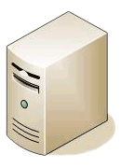
Basic CE
GridFTP
?
Authorization
Test
RSV
GRAM
?
CEMon/GIP
Gratia
Query
Submit jobs

Slide 14
GRAM
Two different flavors
OSG provides and supports both
Very different implementations
GT2
What most users and VOs use
Very stable and well understood
On the other hand, fairly old
GT4 (aka ws-gram)
Web services enabled job submission
Currently in transition
Used primarily by LIGO

Slide 15
Gratia
Collects information about what jobs have run on your site and by whom
Hooks into GRAM and/or job manager
Sends information to a central server
Can connect and query central service to get reports and graphs
Option exists for a local server

Slide 16
CEMon / GIP
These work together
Essential for accurate information about your site
End-users see this information
Generic Information Provider (GIP)
Scripts to scrape information about your site
Some information is dynamic (queue length)
Some is static (site name)
CEMon
Reports information to OSG GOC’s BDII
Reports to OSG Resource Selector (ReSS)

Slide 17
RSV
System to run tests on various components of your site
Presents a web page with red/green overview and links to more specific information on test results
Optional interface to nagios
Can be run on a server other than CE

Slide 18
Installing an OSG Site
Introduction to OSG terms and operations
The OSG compute element
Installing an OSG site
Maintaining a site
Q&A time

Slide 19
Site planning
Bureaucratic details
Cluster layout
Disk layout / sharing
Authorization

Slide 20
Bureaucracy
Certificates (personal/host)
VO registrations
Registration with OSG
Need a site name (e.g. UC_ITB)
Need contacts (security, admin, etc.)
Site policy on web

Slide 21
Starting out
Everyone using OSG gets a personal certificate because it is required to do any activity on an OSG resource
Will need to know or contact someone with DOEGrids certificate in order to obtain a personal certificate

Slide 22
Site Registration using OIM
Done using OIM at https://oim.grid.iu.edu/
Will need to register first,
After GOC approves registration :
Registrations > Resources > Add New Resource

Slide 23
Cluster Layout
How is software / data being shared
NFS can work but gets bogged down with larger workloads
Where do services run?
Single server vs. dedicated servers
Worker node software?
Locally present on worker nodes vs. served over nfs
Certificates shared?

Slide 24
Required Directories for CE / Cluster
OSG_APP: Store VO applications
Must be shared (usually NFS)
Must be writeable from CE, readable from WN
Must be usable by whole cluster
OSG_GRID: Stores WN client software
May be shared or installed on each WN
May be read-only (no need for users to write)
Has a copy of CA Certs & CRLs, which must be up to date
OSG_WN_TMP: temporary directory on worker node
May be static or dynamic
Must exist at start of job
Not guaranteed to be cleaned by batch system

Slide 25
Optional directories for CE
OSG_DATA: Data shared between jobs
Must be writable from the worker nodes
Potentially massive performance requirements
Cluster file system can mitigate limitations with this file system
Performance & support varies widely among sites
0177 permission on OSG_DATA (like /tmp)
Squid server: HTTP proxy can assist many VOs and sites in reducing load
Reduces VO web server load
Efficient and reliable for site
Fairly low maintenance
Can help with CRL maintenance on worker nodes

Slide 26
Space Requirements
Varies between VOs
Some VOs download all data & code per job (may be Squid assisted), and return data to VO per job.
Other VOs use hybrids of OSG_APP and/or OSG_DATA
OSG_APP used by several VOs, not all.
1 TB storage is reasonable
Serve from separate computer so heavy use won’t affect other site services.
OSG_DATA sees moderate usage.
1 TB storage is reasonable
Serve it from separate computer so heavy use of OSG_DATA doesn’t affect other site services.
OSG_WN_TMP is not well managed by VOs and you should be aware of it.
~100GB total local WN space
~10GB per job slot.
Notes:
For testing purposes much less space (~5GB total) can be provided

Slide 27
Worker Node Storage
Provide about 12GB per job slot
Therefore 100GB for quad core 2 socket machine
Not data critical, so can use RAID 0 or similar for good performance

Slide 28
Authorization
Two major setups:
Gridmap setup
File with list of mappings between DN and local account
Can be generated by edg-mkgridmap script
Doesn’t handle users in mulitple VOs or with VOMS roles
Service with list of mappings (GUMS)
A little more complicated to setup
Centralizes mappings for entire site in single location
Handles complex cases better (e.g. blacklisting, roles, multiple VO membership)
Preferred for sites with more complex requirements
Ideally on dedicated system (can be VM)
Can add SAZ service for authorization

Slide 29
CE Installation Overview
Prerequistes
Certificates
Users
Installation
Pacman
Configuration
Getting things started

Slide 30
Local accounts
You need following local accounts:
User for RSV
Daemon account used by most of VDT
Globus user is optional but will be used if found

Slide 31
Pacman
The OSG Software stack is installed with Pacman
Yes, custom installation software
Why?
Mostly historical reasons
Makes multiple installations and non-root installations easy
Why not?
It’s different from what you’re used to
It sometimes breaks in strange ways
Updates can be difficult (this is being improved)
Will we always use Pacman?
Maybe
Investigating alternatives but changing existing infrastructure is hard
Work ongoing to support RPM/deb in the future

Slide 32
Pacman continued
Easy installation
Download pacman
Untar and source shell script
Start using binary
Look ma! No root!
Gotcha:
Installs into current directory

Slide 33
Basic installation and configuration
Install Pacman
Download
http://physics.bu.edu/pacman/sample_cache/tarballs/pacman-3.26.tar.gz
Untar (keep in own directory)
Source setup
Make OSG directory
Example: /opt/osg symlink to /opt/osg-1.0
Run pacman commands
Get CE (pacman –get OSG:ce)
Get job manager interface (pacman –get OSG:Globus-Condor-Setup)
Configure
Run edg-mkgridmap or gums-host-cron
Configure CA certificates updater
Edit config.ini
Run configure_osg.py (configure-osg.py –c)
Start services (vdt-control –on)

Slide 34
Installing CA Certificates
The OSG installation will not install CA certificates by default
Users will not be able to access your site!
To install CA certificates
Edit a configuration file to select what CA distribution you want
Edit $VDT_LOCATION/vdt/etc/vdt-update-certs.conf
Run a script
source vdt-questions.sh
$VDT_LOCATION/vdt/sbin/vdt-setup-ca-certificates

Slide 35
Site Maintenance
Introduction to OSG terms and operations
Installing an OSG site
Maintaining a site
Q&A time

Slide 36
Updating CAs
CAs are regularly updated
New CAs added
Old CAs removed
Tweaks to existing CAs
If you don’t keep up to date:
May be unable to authenticate some user
May incorrectly accept some users
Easy to keep up to date
vdt-update-certs
Runs once a day, gets latest CA certs

Slide 37
Monitoring Site Status
Several tools available
RSV
Part of install
Will present a web page with quick status update site functionality
Can integrate with nagios
Nagios/Ganglia/Cacti
Presents information on non-grid specific details of cluster
Can set up alerts, pages, etc.
Gratia
Provides accounting information on jobs running on your site
Useful to see who is using your site and how much utilization comes from various users
Daily/Weekly email reports
Provides quick information on your site and osg at large at a glance

Slide 38
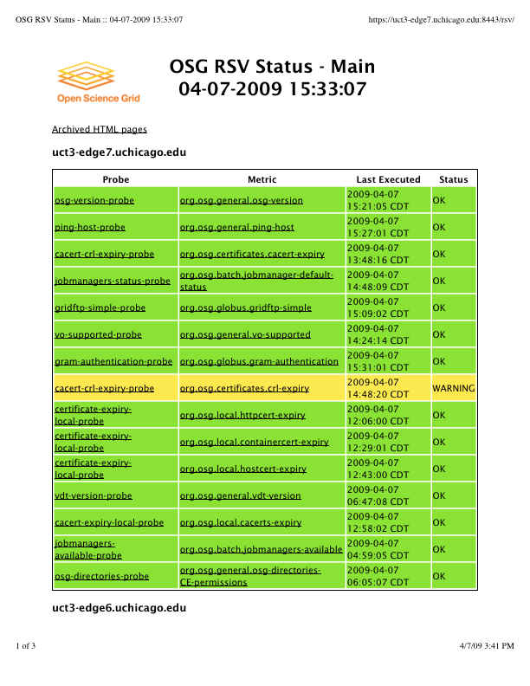
RSV output for UC_ITB resource
Web page generated by RSV showing the output of various probes. Clicking on the probe output will give history for last few invocations and error output

Slide 39
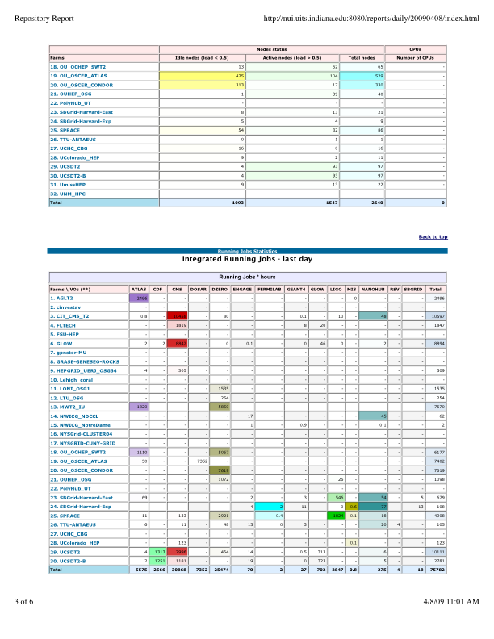
Daily Email report on Production Sites
Example of the daily email sent out to administrators with information on jobs and sites over the last day

Slide 40
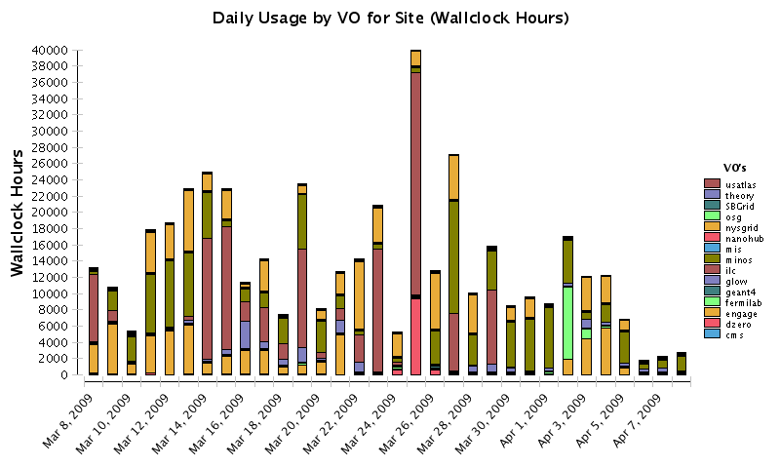
Gratia Report for the last Month at Fermigrid
This shows the daily usage by VOs of the Fermigrid resource over the last month as VO validations were run

Slide 41
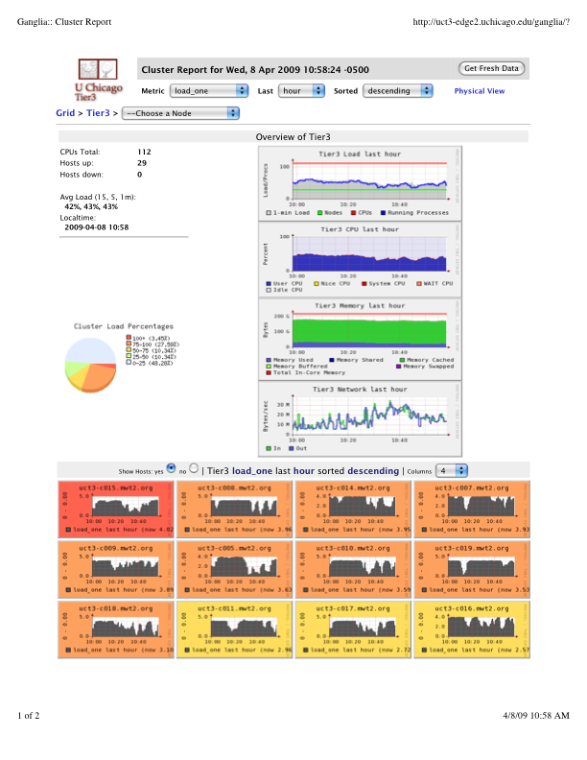
Ganglia Output for Cluster at UC
Top level information on the servers and compute nodes at a small cluster at the University of Chicago, clicking on hosts will allow more detailed information on each host to be obtained

Slide 42
Incremental Updates
Frequent (Every 1-4 weeks)
Can be done within a single installation
Either manually:
Turn off services
Backup installation directory
Perform update (move configuration files, pacman updates, etc.)
Re-enable services
Or use vdt-updater script

Slide 43
Major Updates
Irregular (Every 6-12 months)
Must be a new installation
Can copy configuration from old installation
Process:
Point to old install
Perform new install
Turn off old services
Turn on new services

Slide 44
Questions? Thoughts? Comments?
Introduction to OSG terms and operations
Installing an OSG site
Maintaining a site
Q&A time

Slide 45
Acknowledgements
Alain Roy
Terrence Martin

