Slide 1
Overview
Resource & Project Management
Current Initiatives
  Generate SOWs
    8 written and 6 remain;
    drafts will be complete next week
    Plan to complete OSG internal review and sign-off by end-Oct
  With Alain, Rob G, Abhishek & Britta, refine and document our end-to-end release planning process
  Get ready for next OSG Finance Board Meeting (in November)
  Get ready for next DOE Annual Report (in December)
  Get ready for next OSG/NSF Review of OSG (in January)
Accomplishments Since Last Report
  Clean drafts of OSG year3 WBS, staffing plan, and budget
Issues / Concerns
  Need to determine paths for greater engagement with LIGO and leverage of OSG for their production needs
  Transition to new org structure will require significant work and time; need to redesign the airplane while maintaining level flight

Slide 2
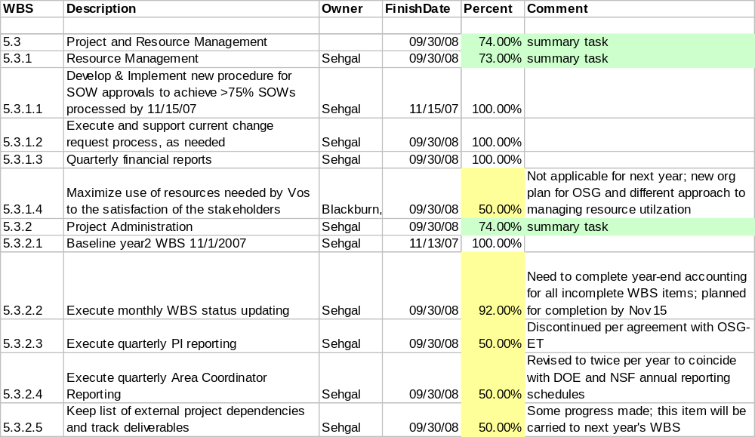
WBS Update & Status
Project and Resource Management

Slide 3
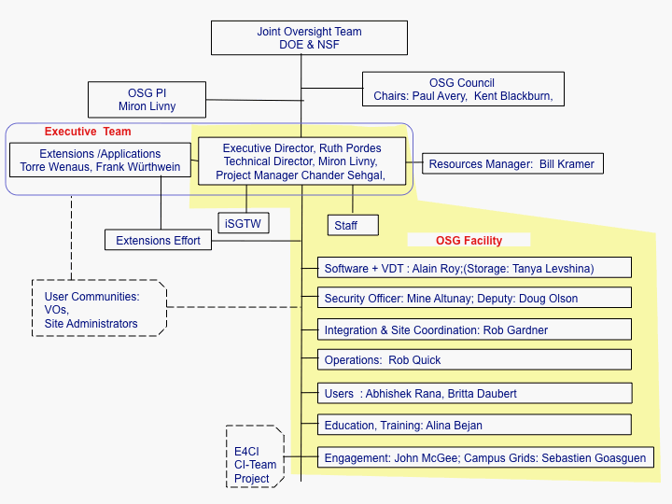
New Project Organization Chart

