Slide 1

VDS
The Virtual Data System
Summer Grid Workshop 2005
UT Brownsville South Padre Island Center
14 July 2005
Presented by: Mike Wilde
Argonne National Laboratory
Mathematics and Computer Science Division
Exercise & Example Preparation: Jed Dobson
Dartmouth College
Brain Imaging Center, Department of Psychology

Slide 2


Acknowledgements
…many thanks to the entire Trillium / OSG Collaboration, iVDGL and OSG Team, Virtual Data Toolkit Team, and all of our application science partners in ATLAS, CMS, LIGO, SDSS, Dartmouth DBIC and fMRIDC, SCEC, and Argonne’s Computational Biology and Climate Science Groups of the Mathematics and Computer Science Division.
The Virtual Data System group is:
  ISI/USC: Ewa Deelman, Carl Kesselman, Gaurang Mehta, Gurmeet Singh, Mei-Hui Su, Karan Vahi
  U of Chicago: Catalin Dumitrescu, Ian Foster, Luiz Meyer (UFRJ, Brazil), Doug Scheftner, Jens Voeckler, Mike Wilde, Yong Zhao
  www.griphyn.org/vds
GriPhyN and iVDGL are supported by the National Science Foundation
Many of the research efforts involved in this work are supported by the US Department of Energy, office of Science.

Slide 3
The GriPhyN Project
Enhance scientific productivity through…
Discovery, application and management of data and processes at petabyte scale
Using a worldwide data grid as a scientific workstation
The key to this approach is Virtual Data – creating and managing datasets through workflow “recipes” and provenance recording.

Slide 4

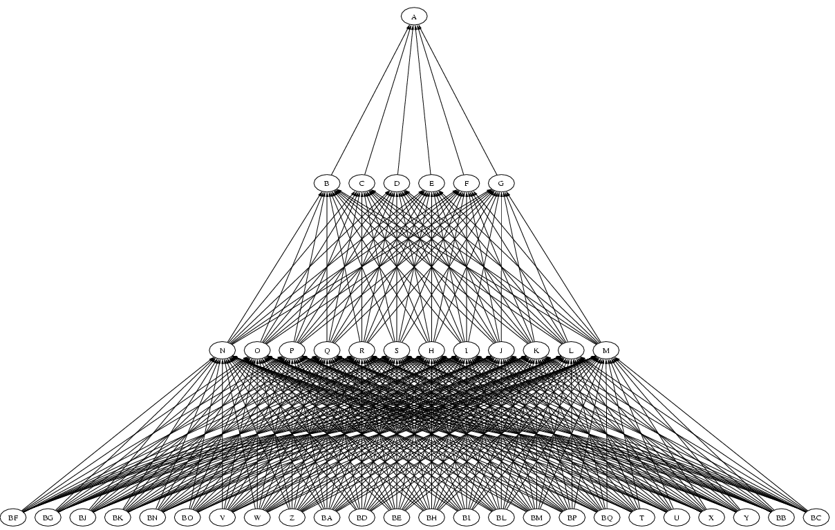
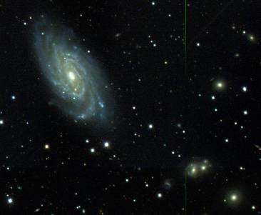
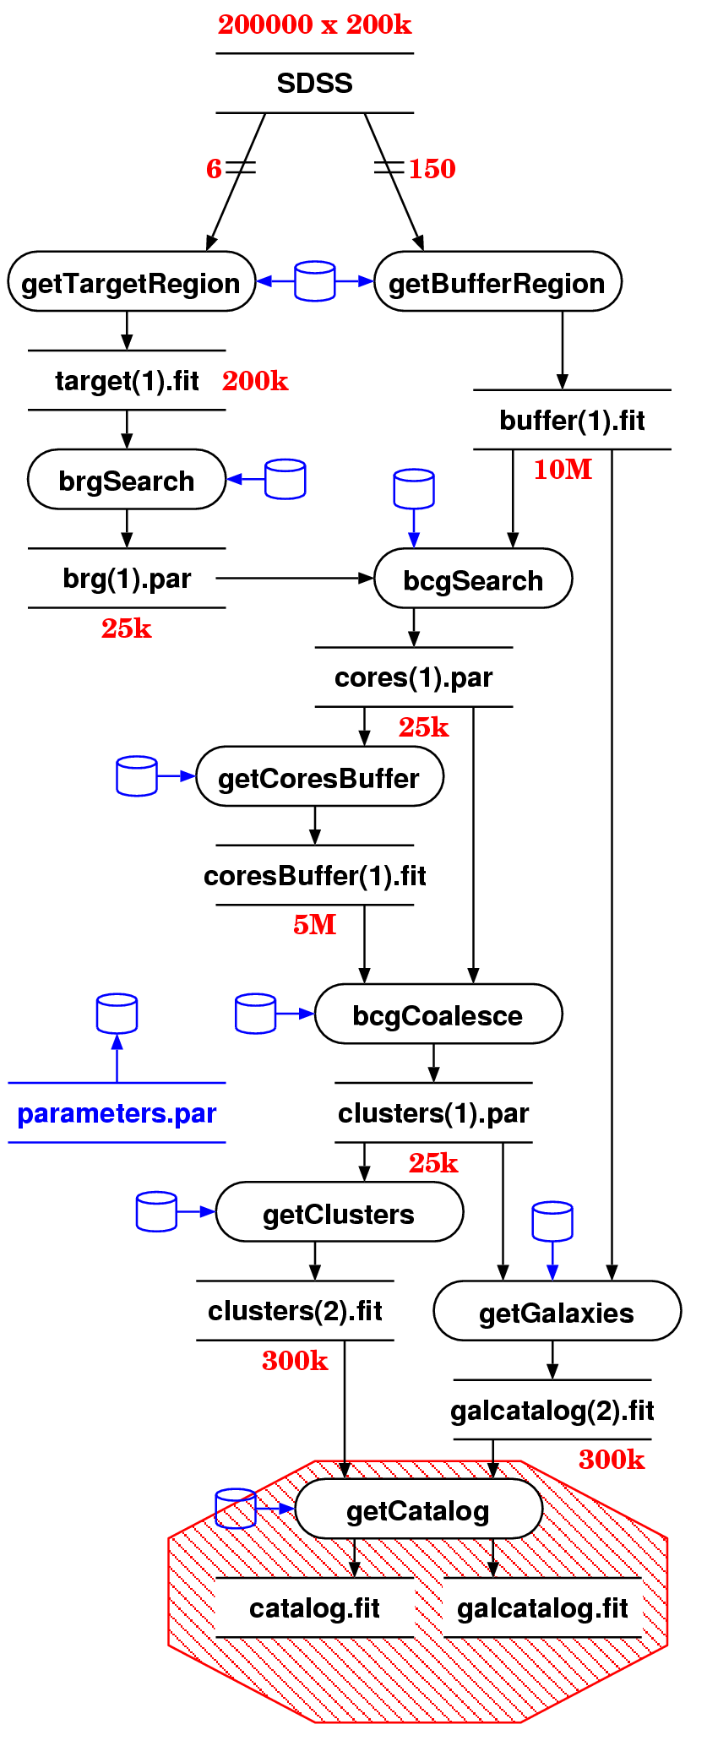
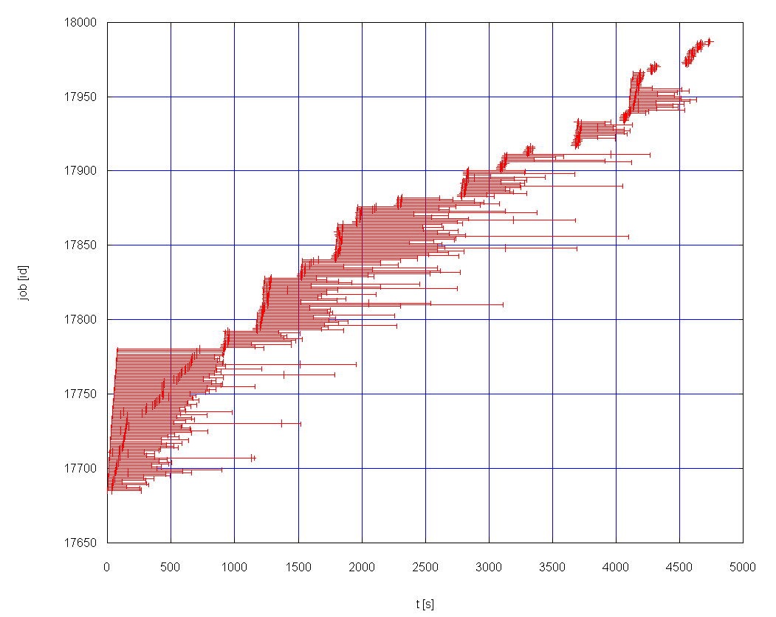
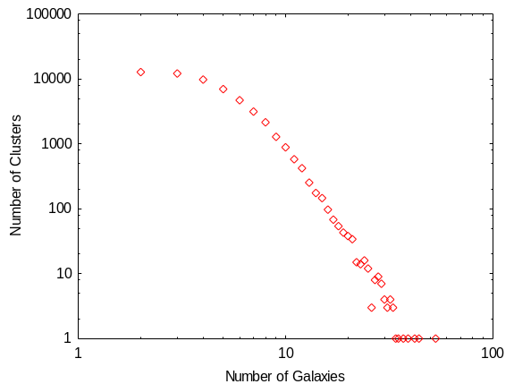
Virtual Data Example:
Galaxy Cluster Search
DAG
Sloan Data
Galaxy cluster
size distribution
Jim Annis, Steve Kent, Vijay Sehkri, Fermilab, Michael Milligan, Yong Zhao, University of Chicago

Slide 5
Virtual Data Concept
Motivated by next generation data-intensive applications
  Enormous quantities of data, petabyte-scale
  The need to discover, access, explore, and analyze diverse distributed data sources
  The need to organize, archive, schedule, and explain scientific workflows
  The need to share data products and the resources needed to produce and store them

Slide 6
Virtual Data System Capabilities
Producing data from transformations with uniform, precise data interface descriptions enables…
Discovery: finding and understanding datasets and transformations
Workflow: structured paradigm for organizing, locating, specifying, & producing scientific datasets
  Forming new workflow
  Building new workflow from existing patterns
  Managing change
Planning: automated to make the Grid transparent
Audit: explanation and validation via provenance

Slide 7
Virtual Data Application:
High Energy Physics
Data Analysis
mass = 200
decay = bb
mass = 200
mass = 200
decay = ZZ
mass = 200
decay = WW
stability = 3
mass = 200
decay = WW
stability = 1
LowPt = 20
HighPt = 10000
mass = 200
decay = WW
mass = 200
decay = WW
stability = 1
mass = 200
event = 8
mass = 200
decay = WW
stability = 1
event = 8
mass = 200
plot = 1
mass = 200
decay = WW
event = 8
Work and slide by
Rick Cavanaugh and
Dimitri Bourilkov,
University of Florida
mass = 200
decay = WW
plot = 1
mass = 200
decay = WW
stability = 1
plot = 1

Slide 8
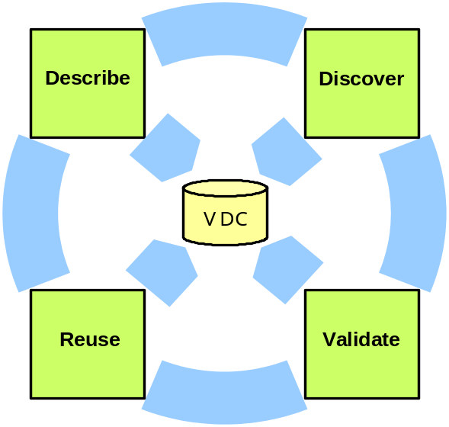
Lifecycle of Virtual Data
I need to document the devices and methods used to measure the data, and keep track of the analysis steps applied to the data.
I have some subject images, what analyses are available? which can be applied to this format?
I want to apply an image registration program to thousands of objects. If the results already exist, I’ll save weeks of computation.
I’ve come across some interesting data, but I need to understand the nature of the analyses applied when it was constructed before I can trust it for my purposes.

Slide 9
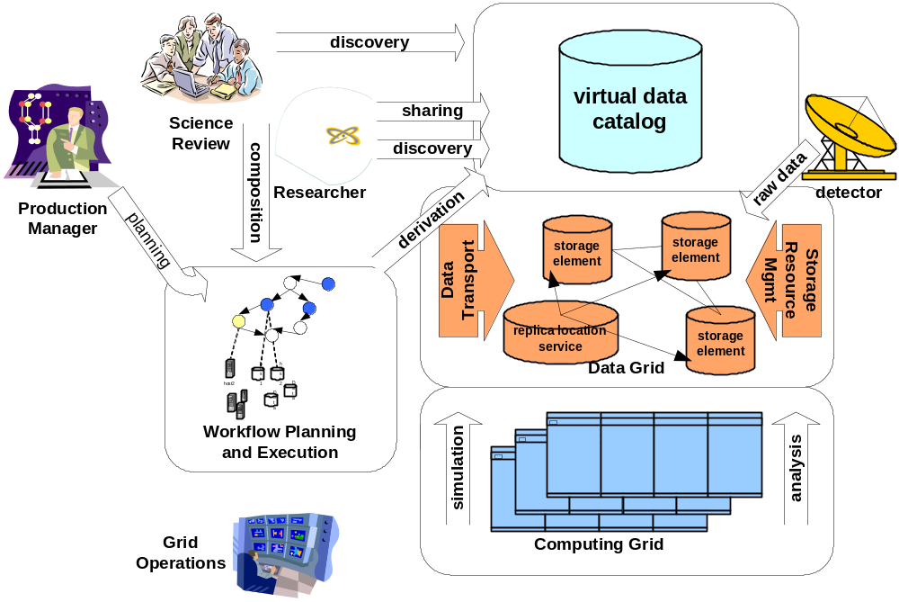
A Virtual Data Grid
Notes:
Stress that this is vision. Not yet fully implem:
Vdc’s not web-interconnected yet
Predictor not yet based on TR parameters
Discovery and composition are rudimentary (as described in our mgc paper)

Slide 10
Virtual Data Scenario
file1
psearch –t 10 …
file8
simulate –t 10 …
file1
file2
reformat –f fz …
file1
File3,4,5
file7
conv –I esd –o aod
summarize –t 10 …
file6
Update workflow following changes
Manage workflow;
On-demand data generation
Explain provenance, e.g. for file8:
  psearch –t 10 –i file3 file4 file5 –o file8
  summarize –t 10 –i file6 –o file7
  reformat –f fz –i file2 –o file3 file4 file5
  conv –l esd –o aod –i file 2 –o file6
  simulate –t 10 –o file1 file2

Slide 11
What must we “virtualize” to compute on the Grid?
Location-independent computing: represent all workflow in abstract terms
Declarations not tied to specific entities:
  sites
  file systems
  schedulers
Failures – automated retry for data server and execution site un-availability

Slide 12
A virtual data glossary
virtual data
  defining data by the logical workflow needed to create it virtualizes it with respect to location, existence, failure, and representation
VDS – Virtual Data System
  The tools to define, store, manipulate and execute virtual data workflows
VDT – Virtual Data Toolkit
  A larger set of tools, based on NMI, VDT provides the Grid environment in which VDL workflows run
VDL – Virtual Data Language
  A language (text and XML) that defines the functions and function calls of a virtual data workflow
VDC – Virtual Data Catalog
  The database and schema that store VDL definitions

Slide 13
Expressing Workflow in VDL
file1
TR grep (in a1, out a2) {
argument stdin = ${a1};
argument stdout = ${a2}; }
TR sort (in a1, out a2) {
argument stdin = ${a1};
argument stdout = ${a2}; }
DV grep (a1=@{in:file1}, a2=@{out:file2});
DV sort (a1=@{in:file2}, a2=@{out:file3});
grep
file2
sort
file3
Notes:
Explicit dependencies.

Slide 14
Expressing Workflow in VDL
Define a “function” wrapper for an application
file1
TR grep (in a1, out a2) {
argument stdin = ${a1};
argument stdout = ${a2}; }
TR sort (in a1, out a2) {
argument stdin = ${a1};
argument stdout = ${a2}; }
DV grep (a1=@{in:file1}, a2=@{out:file2});
DV sort (a1=@{in:file2}, a2=@{out:file3});
grep
Define “formal arguments” for the application
Connect applications via output-to-input dependencies
file2
sort
file3
Define a “call” to invoke application
Provide “actual” argument values for the invocation
Notes:
Explicit dependencies.

Slide 15
Essence of VDL
Elevates specification of computation to a logical, location-independent level
Acts as an “interface definition language” at the shell/application level
Can express composition of functions
Codable in textual and XML form
Often machine-generated to provide ease of use and higher-level features
Preprocessor provides iteration and variables

Slide 16
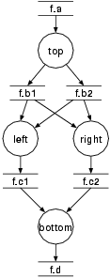
Compound Workflow
Complex structure
  Fan-in
  Fan-out
  "left" and "right" can run in parallel
Uses input file
  Register with RC
Supports complex file dependencies
  Glues workflow
preprocess
findrange
findrange
analyze
Notes:
We deal with "regular diamonds" (as in the big dag), and "black diamonds". Regular diamonds use a generating top node, and don't have cross-dependencies.
The processes are neither "findrange" nor "right". "findrange" is the TR name, "right" the DV name. The application (and thus process) is most likely "keg".

Slide 17
Compound Transformations for nesting Workflows
Compound TR encapsulates an entire sub-graph:
  TR rangeAnalysis (in fa, p1, p2,
  out fd, io fc1,
  io fc2, io fb1, io fb2, )
  {
  call preprocess( a=${fa}, b=[ ${out:fb1}, ${out:fb2} ] );
  call findrange( a1=${in:fb1}, a2=${in:fb2}, name="LEFT", p=${p1}, b=${out:fc1} );
  call findrange( a1=${in:fb1}, a2=${in:fb2}, name="RIGHT", p=${p2}, b=${out:fc2} );
  call analyze( a=[ ${in:fc1}, ${in:fc2} ], b=${fd} );
  }
Notes:
The declaration uses abbreviations, nothing for "none", "in" for "input" etc.
Until transient filenames are implemented, it is required to declare the glue filenames as IO formal argument.
IO arguments must declare their direction either as in or out when being used (referenced).

Slide 18
Compound Transformations (cont)
Multiple DVs allow easy generator scripts:
  DV d1-> rangeAnalysis ( fd=@{out:"f.00005"}, fc1=@{io:"f.00004"}, fc2=@{io:"f.00003"},
  fb1=@{io:"f.00002"}, fb2=@{io:"f.00001"},
  fa=@{io:"f.00000"}, p2="100", p1="0" );
  DV d2-> rangeAnalysis ( fd=@{out:"f.0000B"}, fc1=@{io:"f.0000A"}, fc2=@{io:"f.00009"},
  fb1=@{io:"f.00008"}, fb2=@{io:"f.00007"},
  fa=@{io:"f.00006"}, p2="141.42135623731", p1="0" );
  ...
  DV d70-> rangeAnalysis ( fd=@{out:"f.001A3"}, fc1=@{io:"f.001A2"}, fc2=@{io:"f.001A1"},
  fb1=@{io:"f.001A0"}, fb2=@{io:"f.0019F"},
  fa=@{io:"f.0019E"}, p2="800", p1="18" );

Slide 19
VDL: Virtual Data Language
Describes Data Transformations
Transformation - “TR”
  Abstract template of program invocation
  Similar to "function definition"
Derivation – “DV”
  “Function call” to a Transformation
  Store past and future:
    A record of how data products were generated
    A recipe of how data products can be generated
Invocation
  Record of a Derivation execution

Slide 20
Example Transformation
TR t1( out a2, in a1, none pa = "500", none env = "100000" ) {
argument = "-p "${pa};
argument = "-f "${a1};
argument = "-x –y";
argument stdout = ${a2};
profile env.MAXMEM = ${env};
}
$a1
t1
$a2

Slide 21
Example Derivations
DV d1->t1 (
env="20000", pa="600",
a2=@{out:run1.exp15.T1932.summary},
a1=@{in:run1.exp15.T1932.raw},
);
DV d2->t1 (
a1=@{in:run1.exp16.T1918.raw},
a2=@{out.run1.exp16.T1918.summary}
);

Slide 22
Workflow from File Dependencies
file1
TR tr1(in a1, out a2) {
argument stdin = ${a1};
argument stdout = ${a2}; }
TR tr2(in a1, out a2) {
argument stdin = ${a1};
argument stdout = ${a2}; }
DV x1->tr1(a1=@{in:file1}, a2=@{out:file2});
DV x2->tr2(a1=@{in:file2}, a2=@{out:file3});
x1
file2
x2
file3
Notes:
Explicit dependencies.

Slide 23
Example Workflow
Complex structure
  Fan-in
  Fan-out
  "left" and "right" can run in parallel
Uses input file
  Register with RLS
Complex file dependencies
  Glues workflow
preprocess
findrange
findrange
analyze
Notes:
We deal with "regular diamonds" (as in the big dag), and "black diamonds". Regular diamonds use a generating top node, and don't have cross-dependencies.
The processes are neither "findrange" nor "right". "findrange" is the TR name, "right" the DV name. The application (and thus process) is most likely "keg".

Slide 24
Workflow step "preprocess"
TR preprocess turns f.a into f.b1 and f.b2
  TR preprocess( output b[], input a ) {
  argument = "-a top";
  argument = " –i "${input:a};
  argument = " –o " ${output:b};
  }
Makes use of the "list" feature of VDL
  Generates 0..N output files.
  Number file files depend on the caller.

Slide 25
Workflow step "findrange"
Turns two inputs into one output
  TR findrange( output b, input a1, input a2,
  none name="findrange", none p="0.0" ) {
  argument = "-a "${name};
  argument = " –i " ${a1} " " ${a2};
  argument = " –o " ${b};
  argument = " –p " ${p};
  }
Uses the default argument feature

Slide 26
Can also use list[] parameters
  TR findrange( output b, input a[],
  none name="findrange", none p="0.0" ) {
  argument = "-a "${name};
  argument = " –i " ${" "|a};
  argument = " –o " ${b};
  argument = " –p " ${p};
  }

Slide 27
Workflow step "analyze"
Combines intermediary results
  TR analyze( output b, input a[] ) {
  argument = "-a bottom";
  argument = " –i " ${a};
  argument = " –o " ${b};
  }

Slide 28
Complete VDL workflow
Generate appropriate derivations
  DV top->preprocess( b=[ @{out:"f.b1"}, @{ out:"f.b2"} ], a=@{in:"f.a"} );
  DV left->findrange( b=@{out:"f.c1"}, a2=@{in:"f.b2"}, a1=@{in:"f.b1"}, name="left", p="0.5" );
  DV right->findrange( b=@{out:"f.c2"}, a2=@{in:"f.b2"}, a1=@{in:"f.b1"}, name="right" );
  DV bottom->analyze( b=@{out:"f.d"}, a=[ @{in:"f.c1"}, @{in:"f.c2"} );
Notes:
Filenames provide the glue.
findrange is called multiple times.

Slide 29
Compound Transformations
Using compound TR
  Permits composition of complex TRs from basic ones
  Calls are independent
    unless linked through LFN
  A Call is effectively an anonymous derivation
    Late instantiation at workflow generation time
  Permits bundling of repetitive workflows
  Model: Function calls nested within a function definition

Slide 30
Compound Transformations (cont)
TR diamond bundles black-diamonds
  TR diamond( out fd, io fc1, io fc2, io fb1, io fb2, in fa, p1, p2 ) {
  call preprocess( a=${fa}, b=[ ${out:fb1}, ${out:fb2} ] );
  call findrange( a1=${in:fb1}, a2=${in:fb2}, name="LEFT", p=${p1}, b=${out:fc1} );
  call findrange( a1=${in:fb1}, a2=${in:fb2}, name="RIGHT", p=${p2}, b=${out:fc2} );
  call analyze( a=[ ${in:fc1}, ${in:fc2} ], b=${fd} );
  }
Notes:
The declaration uses abbreviations, nothing for "none", "in" for "input" etc.
Until transient filenames are implemented, it is required to declare the glue filenames as IO formal argument.
IO arguments must declare their direction either as in or out when being used (referenced).

Slide 31
Compound Transformations (cont)
Multiple DVs allow easy generator scripts:
  DV d1->diamond( fd=@{out:"f.00005"}, fc1=@{io:"f.00004"}, fc2=@{io:"f.00003"},
  fb1=@{io:"f.00002"}, fb2=@{io:"f.00001"},
  fa=@{io:"f.00000"}, p2="100", p1="0" );
  DV d2->diamond( fd=@{out:"f.0000B"}, fc1=@{io:"f.0000A"}, fc2=@{io:"f.00009"},
  fb1=@{io:"f.00008"}, fb2=@{io:"f.00007"},
  fa=@{io:"f.00006"}, p2="141.42135623731", p1="0" );
  ...
  DV d70->diamond( fd=@{out:"f.001A3"}, fc1=@{io:"f.001A2"}, fc2=@{io:"f.001A1"},
  fb1=@{io:"f.001A0"}, fb2=@{io:"f.0019F"},
  fa=@{io:"f.0019E"}, p2="800", p1="18" );

Slide 32
A Case Study – Functional MRI
Problem: “spatial normalization” of a images to prepare data from fMRI studies for analysis
Target community is approximately 60 users at Dartmouth Brain Imaging Center
Wish to share data and methods across country with researchers at Berkeley
Process data from arbitrary user and archival directories in the center’s AFS space; bring data back to same directories
Grid needs to be transparent to the users: Literally, “Grid as a Workstation”

Slide 33
A Case Study – Functional MRI (2)
Based workflow on shell script that performs 12-stage process on a local workstation
Adopted replica naming convention for moving user’s data to Grid sites
Creates VDL pre-processor to iterate transformations over datasets
Utilizing resources across two distinct grids – Grid3 and Dartmouth Green Grid

Slide 34
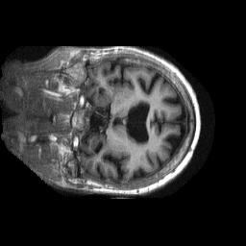
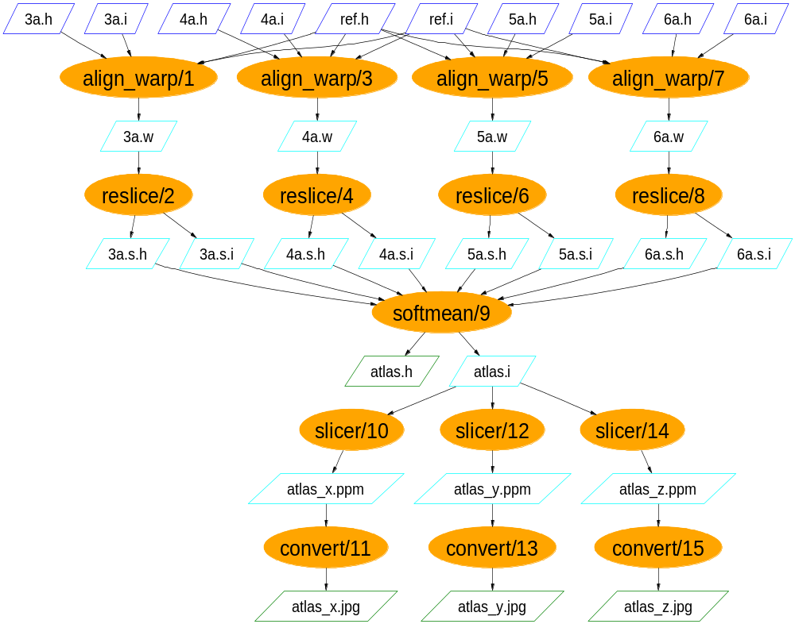
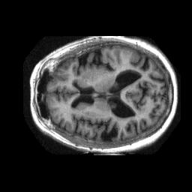
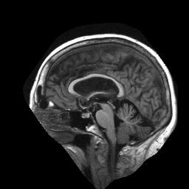
Functional MRI Analysis

Slide 35
fMRI Example: AIR Tools
TR air::align_warp( in reg_img, in reg_hdr, in sub_img,
in sub_hdr, m, out warp )
{
argument = ${reg_img};
argument = ${sub_img};
argument = ${warp};
argument = "-m " ${m};
argument = "-q";
}
TR air::reslice( in warp, sliced, out sliced_img, out sliced_hdr )
{
argument = ${warp};
argument = ${sliced};
}

Slide 36
fMRI Example: AIR Tools
TR air::warp_n_slice(
in reg_img, in reg_hdr, in sub_img, in sub_hdr, m = "12",
io warp, sliced, out sliced_img, out sliced_hdr )
{
call air::align_warp( reg_img=${reg_img}, reg_hdr=${reg_hdr},
sub_img=${sub_img}, sub_hdr=${sub_hdr},
m=${m},
warp = ${out:warp} );
call air::reslice( warp=${in:warp}, sliced=${sliced},
sliced_img=${sliced_img}, sliced_hdr=${sliced_hdr} );
}
TR air::softmean( in sliced_img[], in sliced_hdr[], arg1 = "y",
arg2 = "null", atlas, out atlas_img, out atlas_hdr )
{
argument = ${atlas};
argument = ${arg1} " " ${arg2};
argument = ${sliced_img};
}

Slide 37
fMRI Example: AIR Tools
DV air::i3472_3->air::warp_n_slice(
reg_hdr = @{in:"3472-3_anonymized.hdr"},
reg_img = @{in:"3472-3_anonymized.img"},
sub_hdr = @{in:"3472-3_anonymized.hdr"},
sub_img = @{in:"3472-3_anonymized.img"},
warp = @{io:"3472-3_anonymized.warp"},
sliced = "3472-3_anonymized.sliced",
sliced_hdr = @{out:"3472-3_anonymized.sliced.hdr"},
sliced_img = @{out:"3472-3_anonymized.sliced.img"} );
…
DV air::i3472_6->air::warp_n_slice(
reg_hdr = @{in:"3472-3_anonymized.hdr"},
reg_img = @{in:"3472-3_anonymized.img"},
sub_hdr = @{in:"3472-6_anonymized.hdr"},
sub_img = @{in:"3472-6_anonymized.img"},
warp = @{io:"3472-6_anonymized.warp"},
sliced = "3472-6_anonymized.sliced",
sliced_hdr = @{out:"3472-6_anonymized.sliced.hdr"},
sliced_img = @{out:"3472-6_anonymized.sliced.img"} );

Slide 38
fMRI Example: AIR Tools
DV air::a3472_3->air::softmean(
sliced_img = [
@{in:"3472-3_anonymized.sliced.img"},
@{in:"3472-4_anonymized.sliced.img"},
@{in:"3472-5_anonymized.sliced.img"},
@{in:"3472-6_anonymized.sliced.img"} ],
sliced_hdr = [
@{in:"3472-3_anonymized.sliced.hdr"},
@{in:"3472-4_anonymized.sliced.hdr"},
@{in:"3472-5_anonymized.sliced.hdr"},
@{in:"3472-6_anonymized.sliced.hdr"} ],
atlas = "atlas",
atlas_img = @{out:"atlas.img"},
atlas_hdr = @{out:"atlas.hdr"}
);

Slide 39
fMRI Dataset processing
FOREACH BOLDSEQ
DV reorient (# Process Blood O2 Level Dependent Sequence
input = [ @{in: "$BOLDSEQ.img"},
@{in: "$BOLDSEQ.hdr"} ],
output = [@{out: "$CWD/FUNCTIONAL/r$BOLDSEQ.img"}
@{out: "$CWD/FUNCTIONAL/r$BOLDSEQ.hdr"}],
direction = "y", );
END
DV softmean (
input = [ FOREACH BOLDSEQ
@{in:"$CWD/FUNCTIONAL/har$BOLDSEQ.img"}
END ],
mean = [ @{out:"$CWD/FUNCTIONAL/mean"} ]
);

Slide 40
Query Examples
Which TRs can process a "subject" image?
Q: xsearchvdc -q tr_meta dataType subject_image input
A: fMRIDC.AIR::align_warp
Which TRs can create an "ATLAS"?
Q: xsearchvdc -q tr_meta dataType atlas_image output
A: fMRIDC.AIR::softmean
Which TRs have output parameter "warp" and a parameter "options"
Q: xsearchvdc -q tr_para warp output options
A: fMRIDC.AIR::align_warp
Which DVs call TR "slicer"?
Q: xsearchvdc -q tr_dv slicer
A: fMRIDC.FSL::s3472_3_x->fMRIDC.FSL::slicer
fMRIDC.FSL::s3472_3_y->fMRIDC.FSL::slicer
fMRIDC.FSL::s3472_3_z->fMRIDC.FSL::slicer

Slide 41
fMRI Virtual Data Queries
Which transformations can process a “subject image”?
Q: xsearchvdc -q tr_meta dataType
subject_image input
A: fMRIDC.AIR::align_warp
List anonymized subject-images for young subjects:
Q: xsearchvdc -q lfn_meta dataType subject_image
privacy anonymized subjectType young
A: 3472-4_anonymized.img
Show files that were derived from patient image 3472-3:
Q: xsearchvdc -q lfn_tree 3472-3_anonymized.img
A: 3472-3_anonymized.img
3472-3_anonymized.sliced.hdr
atlas.hdr
atlas.img
…
atlas_z.jpg
3472-3_anonymized.sliced.img

Slide 42
Virtual Provenance: list of derivations and files
<job id="ID000001" namespace="Quarknet.HEPSRCH" name="ECalEnergySum" level="5"
dv-namespace="Quarknet.HEPSRCH" dv-name="run1aesum">
<argument><filename file="run1a.event"/> <filename file="run1a.esm"/></argument>
<uses file="run1a.esm" link="output" dontRegister="false" dontTransfer="false"/>
<uses file="run1a.event" link="input" dontRegister="false“ dontTransfer="false"/>
</job>
...
<job id="ID000014" namespace="Quarknet.HEPSRCH" name="ReconTotalEnergy" level="3"…
<argument><filename file="run1a.mis"/> <filename file="run1a.ecal"/> …
<uses file="run1a.muon" link="input" dontRegister="false" dontTransfer="false"/>
<uses file="run1a.total" link="output" dontRegister="false" dontTransfer="false"/>
<uses file="run1a.ecal" link="input" dontRegister="false" dontTransfer="false"/>
<uses file="run1a.hcal" link="input" dontRegister="false" dontTransfer="false"/>
<uses file="run1a.mis" link="input" dontRegister="false" dontTransfer="false"/>
</job>
<!--list of all files used -->
<filename file="ecal.pct" link="inout"/>
<filename file="electron10GeV.avg" link="inout"/>
<filename file="electron10GeV.sum" link="inout"/>
<filename file="hcal.pct" link="inout"/>
...
(excerpted for display)

Slide 43
Virtual Provenance in XML: control flow graph
<child ref="ID000003"> <parent ref="ID000002"/> </child>
<child ref="ID000004"> <parent ref="ID000003"/> </child>
<child ref="ID000005"> <parent ref="ID000004"/>
<parent ref="ID000001"/>...
<child ref="ID000009"> <parent ref="ID000008"/> </child>
<child ref="ID000010"> <parent ref="ID000009"/>
<parent ref="ID000006"/>...
<child ref="ID000012"> <parent ref="ID000011"/> </child>
<child ref="ID000013"> <parent ref="ID000011"/> </child>
<child ref="ID000014"> <parent ref="ID000010"/>
<parent ref="ID000012"/>...
<parent ref="ID000013"/>...</child>…
(excerpted for display…)

Slide 44
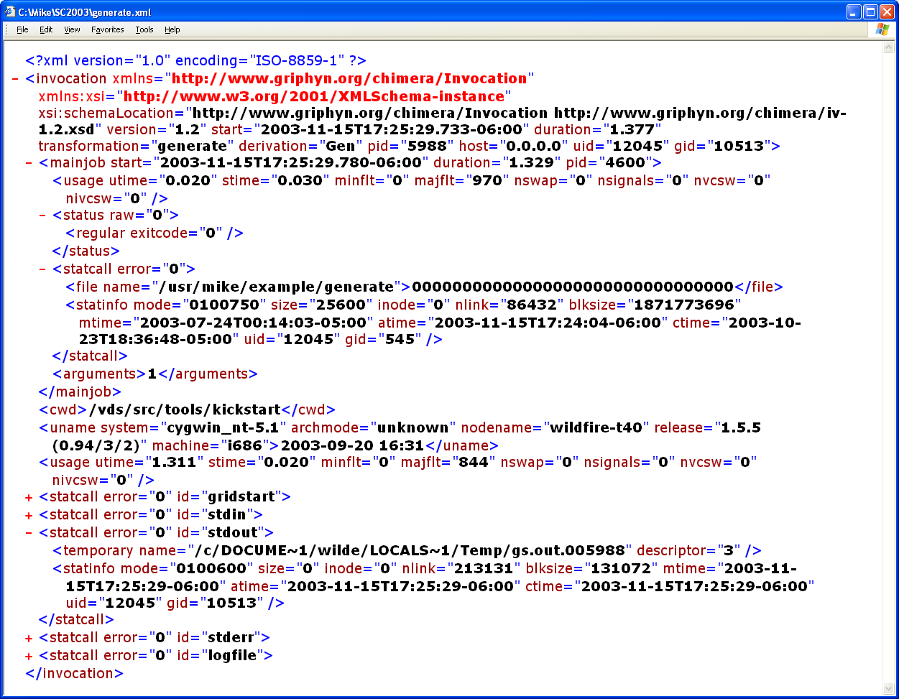
Invocation Provenance
Completion status and resource usage
Attributes of executable transformation
Attributes of input and output files

Slide 45
Using VDL
Generated directly for low-volume usage
Generated by scripts for production use
Generated by application tool builders as wrappers around scripts provided for community use
Generated transparently in an application-specific portal (e.g. quarknet.fnal.gov/grid)
Generated by drag-and-drop workflow design tools such as Triana

Slide 46
Basic VDL Toolkit
Convert between text and XML representation
Insert, update, remove definitions from a virtual data catalog
Attach metadata annotations to defintions
Search for definitions
Generate an abstract workflow for a data derivation request
Multiple interface levels provided:
  Java API, command line, web service

Slide 47
Representing Workflow
Specifies a set of activities and control flow
Sequences information transfer between activities
VDS uses XML-based notation called
“DAG in XML” (DAX) format
VDC Represents a wide range of workflow possibilities
DAX document represents steps to create a specific data product

Slide 48
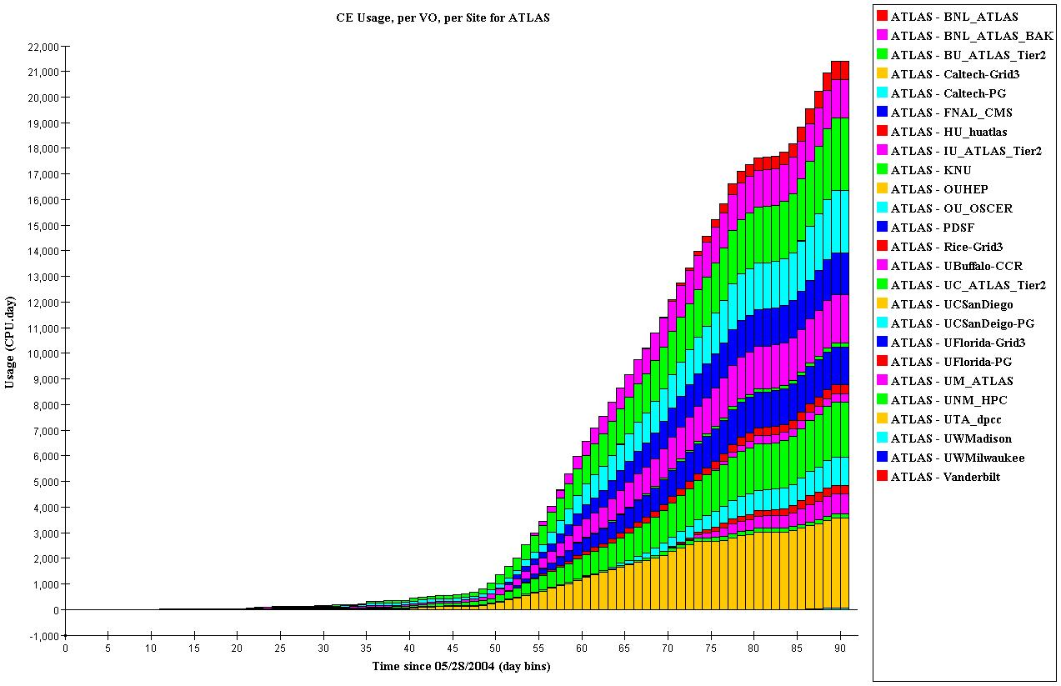
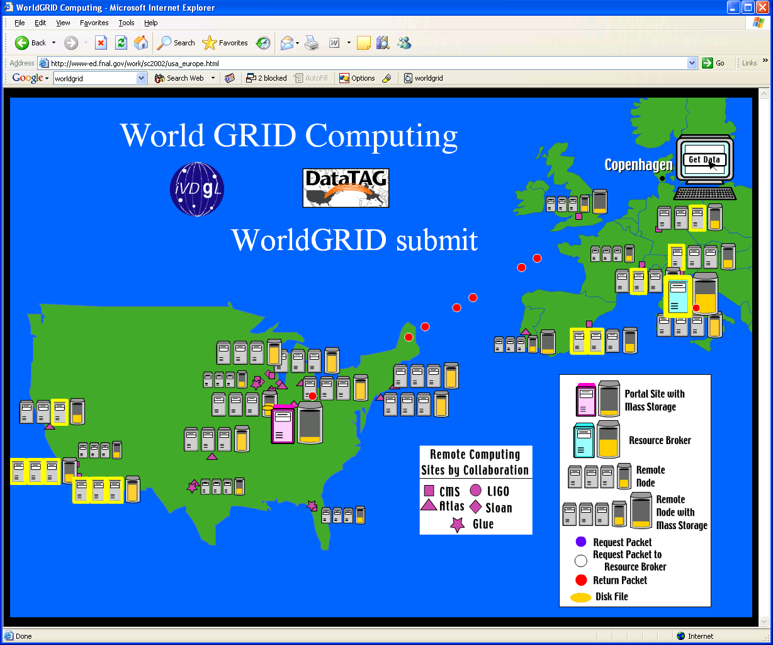
Executing VDL Workflows
Workflow spec
Create Execution Plan
Grid Workflow Execution
VDL
Program
Statically
Partitioned
DAG
DAGman
DAG
Virtual Data
catalog
DAGman &
Condor-G
Dynamically
Planned
DAG
Virtual Data
Workflow
Generator
Job
Planner
Job
Cleanup
Local planner
Abstract
workflow
Notes:
VDLt: textual version of the virtual data language
VDLx: XML version of the virtual data language
DAX: abstract directed acyclic graph description
VDLt is slightly less expressive than VDLx, thus the initial back-and-forth conversion between the formats might lose some non-essential information. Any further round will yield equivalent results.

Slide 49
VDS Applications
Application | Jobs / workflow | Levels | Status
ATLAS HEP Event Simulation | 500K | 1 | In Use
LIGO Inspiral/Pulsar | ~700 | 2-5 | Inspiral In Use
NVO/NASA Montage/Morphology | 1000s | 7 | Both In Use
GADU Genomics: BLAST,… | 40K | 1 | In Use
fMRI DBIC AIRSN Image Proc | 100s | 12 | In Devel
QuarkNet CosmicRay science | <10 | 3-6 | In Use
SDSS Coadd; Cluster Search | 40K 500K | 2 8 | In Devel / CS Research
FOAM Ocean/Atmos Model | 2000 (core app runs 250 8-CPU jobs) | 3 | In use
GTOMO Image proc | 1000s | 1 | In Devel
SCEC Earthquake sim | 1000s |  | In use

Slide 50
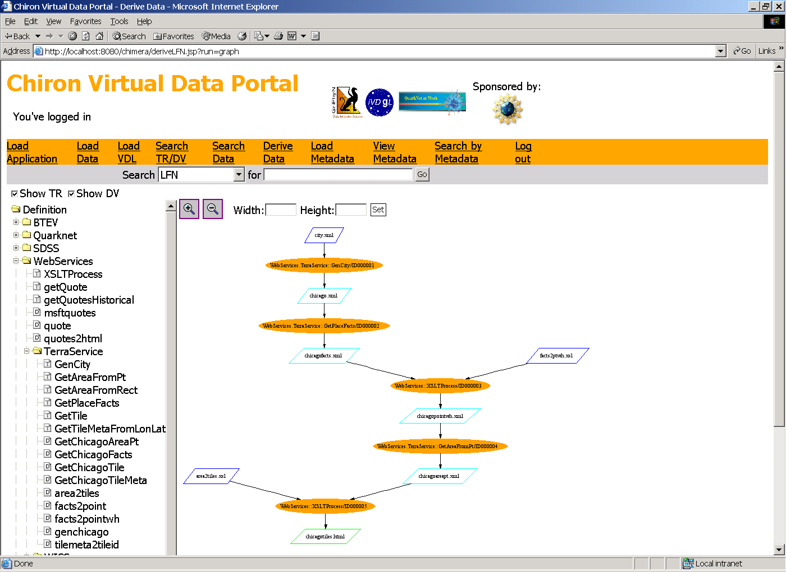
Using active data from Web Services

Slide 51
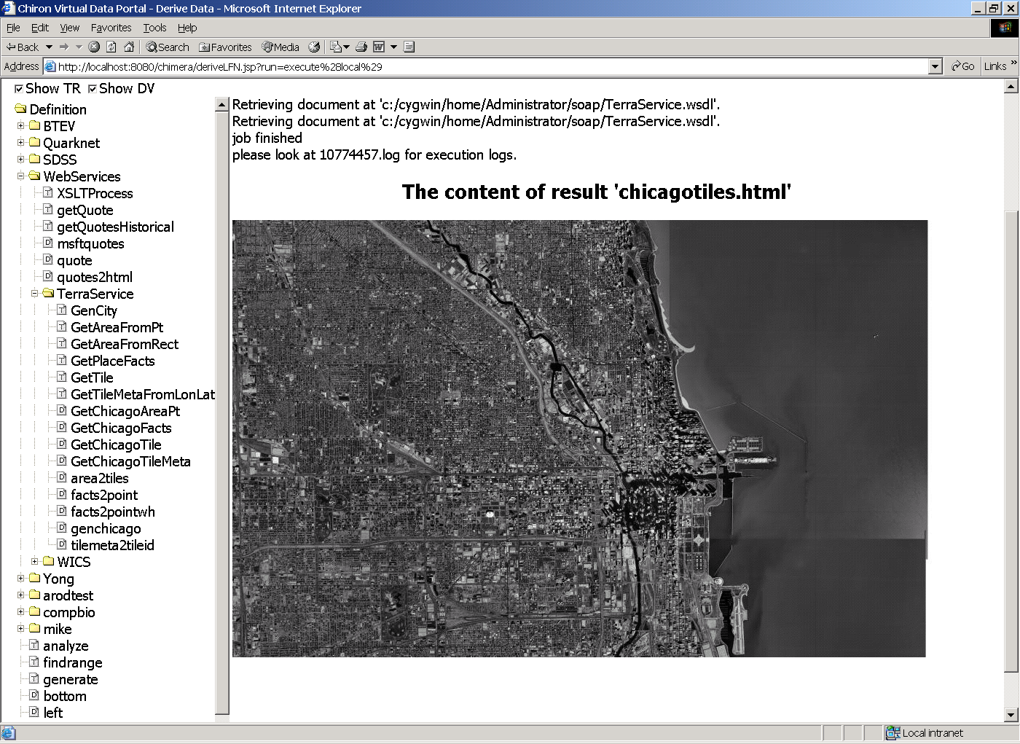

Slide 52

US-ATLAS
Data Challenge 2
CPU-day
Mid July
Event generation using Virtual Data
Sep 10

Slide 53
Provenance for DC2
How much compute time was delivered?
| years| mon | year |
+------+------+------+
| .45 | 6 | 2004 |
| 20 | 7 | 2004 |
| 34 | 8 | 2004 |
| 40 | 9 | 2004 |
| 15 | 10 | 2004 |
| 15 | 11 | 2004 |
| 8.9 | 12 | 2004 |
+------+------+------+
Selected statistics for one of these jobs:
start: 2004-09-30 18:33:56
duration: 76103.33
pid: 6123
exitcode: 0
args: 8.0.5 JobTransforms-08-00-05-09/share/dc2.g4sim.filter.trf CPE_6785_556
... -6 6 2000 4000 8923 dc2_B4_filter_frag.txt
utime: 75335.86
stime: 28.88
minflt: 862341
majflt: 96386
Which Linux kernel releases were used ?
How many jobs were run on a Linux 2.4.28 Kernel?

Slide 54
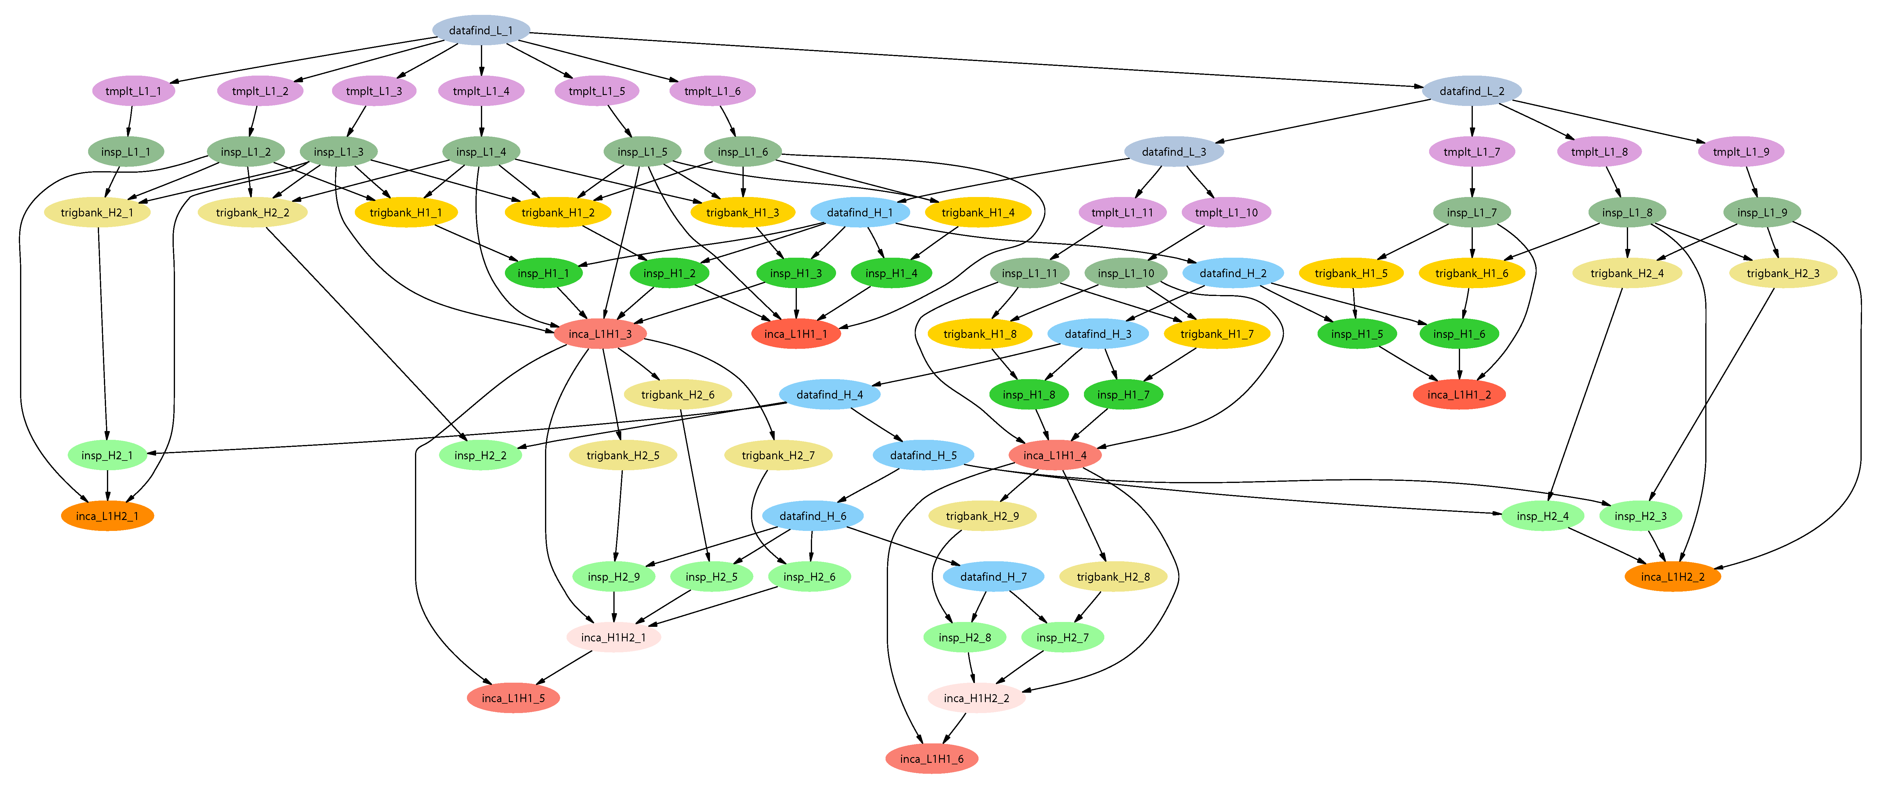
LIGO Inspiral Search Application
Describe…
Inspiral workflow application is the work of Duncan Brown, Caltech,
Scott Koranda, UW Milwaukee, and the LSC Inspiral group

Slide 55
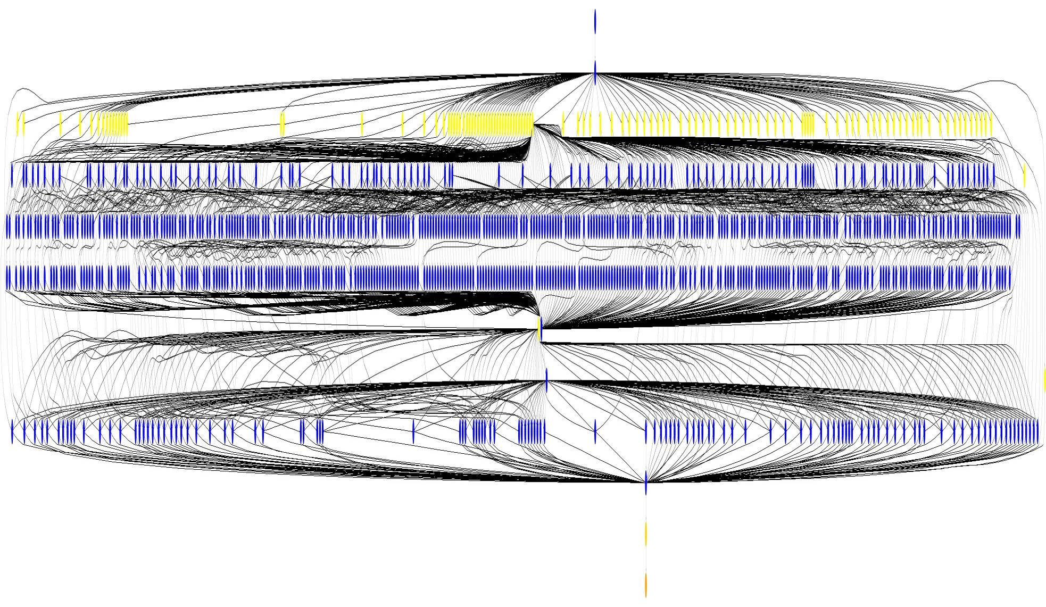
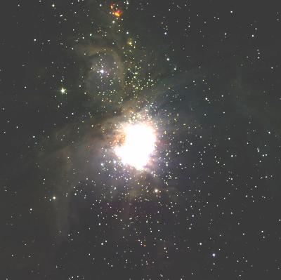
Small Montage Workflow
~1200 node workflow, 7 levels
Mosaic of M42 created on
the Teragrid using Pegasus

Slide 56
FOAM:
Fast Ocean/Atmosphere Model
250-Member Ensemble
Run on TeraGrid under VDS
Remote Directory Creation for Ensemble Member 1
Remote Directory Creation for Ensemble Member 2
Remote Directory Creation for Ensemble Member N
FOAM run for Ensemble Member 1
FOAM run for Ensemble Member 2
FOAM run for Ensemble Member N
Atmos Postprocessing
Atmos Postprocessing for Ensemble Member 2
Ocean Postprocessing for Ensemble Member 2
Coupl Postprocessing for Ensemble Member 2
Coupl Postprocessing for Ensemble Member 2
Results transferred to archival storage
Work of: Rob Jacob (FOAM), Veronica Nefedova (Workflow design and execution)

Slide 57
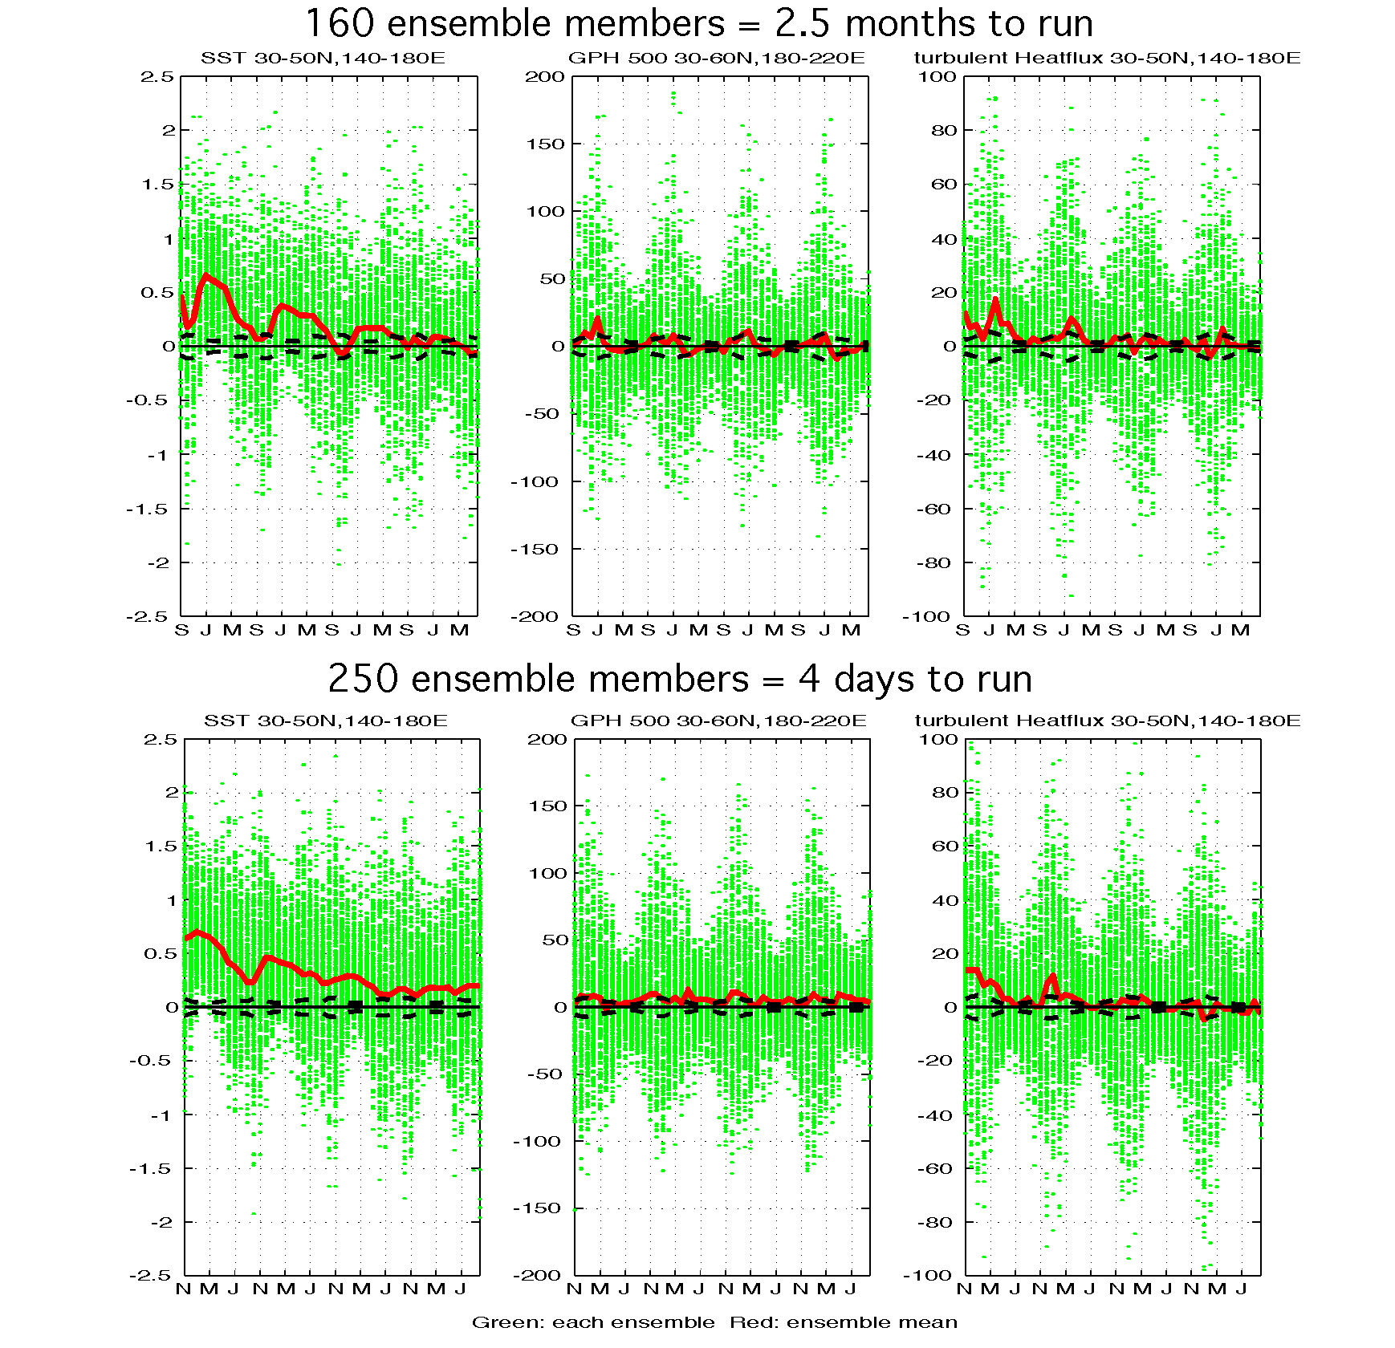
FOAM: TeraGrid/VDSBenefits
Climate Supercomputer
TeraGrid with NMI and VDS
Visualization courtesy Pat Behling and Yun Liu, UW Madison

Slide 58
Next Steps
Unified representation of data-sets, metadata, provenance and mappings to physical storage
Improved queries to discover existing products and to perform incremental work (versioning)
Improved error handling and diagnosis: VDS is like a compiler whose target chip architecture is the Grid – this is a tall order, and much work remains.
Leverage XQuery to formulate new workflows from those in a VO’s catalogs

Slide 59
Managing
Scientific Datasets
Physical Archive Format
DBIC.Dartmouth.EDU AFS
Study 2004.0521.hgd
Group 1
Subject 2004.e-024
volume_anat.img
volume_anat.hdr
bold1_001.img
bold1_001.hdr
...
bold1_275.img
bold1_275.hdr
bold2_001.img
...
snrbold*_*
...air*
...
Group 5
...
Study ...
Logical view
DBIC
Study_20040521_hgd
Group1
S2004e024
Anatomy
volume_anat
run
r1
001
...
275
...
r5
001
...
242
snrun…
Group5
...
Study ...

Slide 60
High-Level Dataset Types
type Volume { Image img; Header hdr; }
type Image String;
type Header String;
type Run { Volume v[ ]; }
type Anat Volume;
type Subject { Anatomy anat;
Run run [ ];
Run snrun [ ]; }
type Group { Subject s[ ]; }
type Study { Group g[ ]; }
type Air String;
type AirVector { Air a[ ]; }
type Warp String;
type NormAnat { Anat aVol;
Warp aWarp;
Volume nHires; }

Slide 61
Dataset Workflow Procedures
(Run snr) functional( Run r, NormAnat a, Air shrink ) {
Run yroRun = reorientRun( r , y );
Run roRun = reorientRun( r , x );
Volume std = roRun[0];
Run rndr = rand_select(roRun,.1); // 10% sample
AirVector rndAirVec
align_linear_run(rndr, std, 12, 1000, 1000, [81,3,3]);
Run reslicedRndr = reslice_run( rndr,rndAirVec,"o","k");
Volume meanRand = softmean(reslicedRndr, y, null );
Air mnQAAir =
alignlinear(a.nHires, meanRand, 6, 1000, 4, [ ] );
Volume mnQA = reslice(meanRand, mnQAAir, "o","k");
Warp boldNormWarp =
combinewarp(shrink, a.aWarp, mnQAAir );
Run nr = reslice_warp_run( boldNormWarp, roRun );
Volume meanAll = strictmean ( nr, y, null )
Volume boldMask = binarize( meanAll, y );
snr = gsmooth_run( nr, boldMask, 6, 6, 6);
}

Slide 62
High-Level Dataset
Workflow Procedures
airsn_subject(Subject s, Volume atlas, Air ashrink, Air fshrink ) {
NormAnat a = anatomical(s.anat, atlas, ashrink);
Run r, snr;
foreach r in s.run {
snr = functional ( r, a, fshrink );
s.snrun[ name(r) ] = snr;
}
}
airsn_group(Group g,Volume atlas, Air ashrk, Air fshrk){
Subject s;
foreach s in g {
airsn_subject( s, atlas, ashrk, fshrk );
}
}

Slide 63
High-Level Dataset
Workflow Procedures
(Air out) alignlinear(Volume std, Volume v, Int m, Int t1,
Int t2, Int s[ ] )
{
argument = out;
argument = std".hdr";
argument = v".hdr";
argument = "-m " m;
argument = "-t1" t1;
argument = "-t2" t2;
argument = "-s " s[0] s[1] s[2];
}

Slide 64
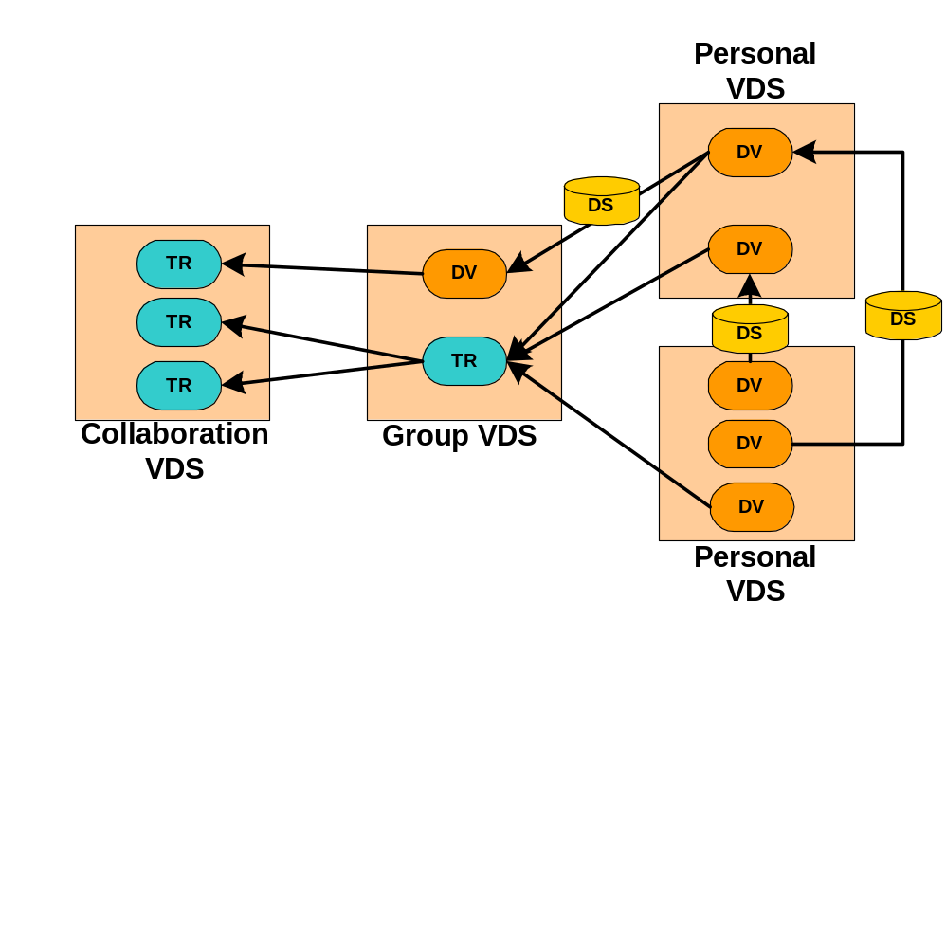
Goal:
Ubiquitous Virtual Data Web

Slide 65
Goals for a Dataset Model
<FORM
<Title…>
/FORM>
File
Set of files
Object closure
XML Element
Relational query or spreadsheet range
New user-defined dataset type:
Set of files with relational index
Speculative model described in CIDR 2003 paper by Foster, Voeckler, Wilde and Zhao

Slide 66
Conclusion
Using VDL to express location-independent computing is proving effective: science users save time by using it over ad-hoc methods
  VDL automates many complex and tedious aspects of distributed computing
Proving capable of expressing workflows across numerous sciences and diverse data models: HEP, Genomics, Astronomy, Biomedical
Makes possible new capabilities and methods for data-intensive science based on its uniform provenance model
Provides an abstract front-end for Condor workflow, automating DAG creation

Slide 67
Acknowledgements:
Virtual Data is a Large Team Effort
The Virtual Data System
is the work of Ewa Deelman, Ian Foster, Carl Kesselman, Gaurang Mehta, Doug Scheftner, Jens Voeckler, Karan Vahi, Mike Wilde and Yong Zhao
The Pegasus Planner is the work of Ewa Deelman, Gaurang Mehta, and Karan Vahi
Applications described are the work of many people, including: James Annis, Duncan Brown, Rick Cavanaugh, Jed Dobson, Dan Engh, Rob Gardner, Eric Gilbert, Rob Jacob, Albert Lazzarini, Natalia Maltsev, Marge Bardeen, and their teams

Slide 68
Acknowledgements
GriPhyN, iVDGL, and QuarkNet
(in part) are supported by the National Science Foundation
The Globus Alliance, PPDG, and QuarkNet are supported in part by the US Department of Energy, Office of Science; by the NASA Information Power Grid program; and by IBM

