Slide 1
_x000e_
Introduction to Swift
Parallel scripting for distributed systems
Mike Wilde
wilde@mcs.anl.gov
Ben Clifford
benc@ci.uchicago.edu
Computation Institute, University of Chicago
and Argonne National Laboratory
www.ci.uchicago.edu/swift

Slide 2
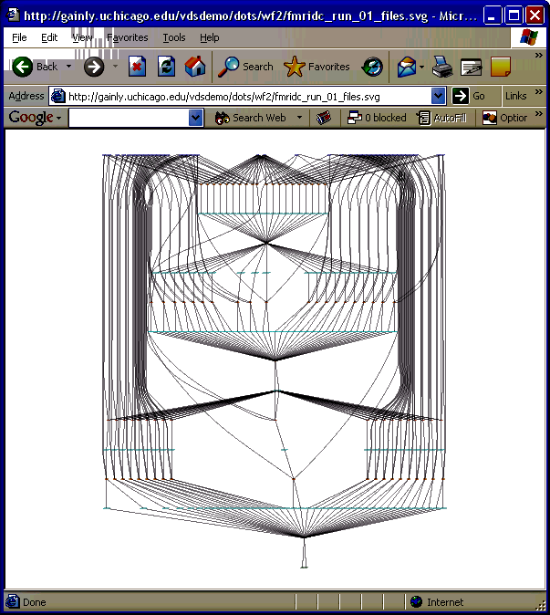
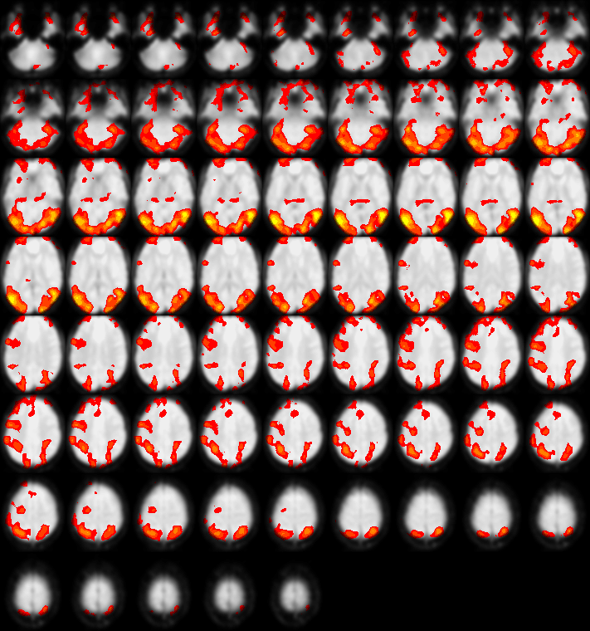

Workflow Motivation: example from Neuroscience
Large fMRI datasets
  90,000 volumes / study
  100s of studies
Wide range of analyses
  Testing, production runs
  Data mining
  Ensemble, Parameter studies
Notes:
Data sharing, publishing, reproducing results, making new discovery

Slide 3
Target environment: Cluster and Grids
(distributed sets of clusters)
Grid Client
Grid Resources at UW
Computing
Cluster
Application
User
Interface
Grid
Storage
Grid
Middleware
Grid
Middleware
Grid Resources at UCSD
Computing
Cluster
Grid Protocols
Grid
Middleware
Grid
Storage
Resource,
Workflow
And Data
Catalogs
Grid Resources at ANL
Computing
Cluster
Grid
Storage
Grid
Middleware
Running a uniform middleware stack:
Security to control access and protect communication (GSI)‏
Directory to locate grid sites and services: (VORS, MDS)‏
Uniform interface to computing sites (GRAM)‏
Facility to maintain and schedule queues of work (Condor-G)‏
Fast and secure data set mover (GridFTP, RFT)‏
Directory to track where datasets live (RLS)‏

Slide 4
Why script in Swift?
Orchestration of many resources over long time periods
  Very complex to do manually - workflow automates this effort
Enables restart of long running scripts
Write scripts in a manner that’s location-independent: run anywhere
  Higher level of abstraction gives increased portability of the workflow script (over ad-hoc scripting)

Slide 5
Swift is…
A language for writing scripts that:
  process and produce large collections of persistent data
  with large and/or complex sequences of application programs
  on diverse distributed systems
  with a high degree of parallelism
  persisting over long periods of time
  surviving infrastructure failures
  and tracking the provenance of execution

Slide 6
Swift programs
A Swift script is a set of functions
  Atomic functions wrap & invoke application programs
  Composite functions invoke other functions
Data is typed as composable arrays and structures of files and simple scalar types (int, float, string)
Collections of persistent file structures (datasets) are mapped into this data model
Members of datasets can be processed in parallel
Statements in a procedure are executed in data-flow dependency order and concurrency
Variables are single assignment
Provenance is gathered as scripts execute

Slide 7
A simple Swift script
type imagefile;
(imagefile output) flip(imagefile input) {
app {
convert "-rotate" "180" @input @output;
}
}
imagefile stars <"orion.2008.0117.jpg">;
imagefile flipped <"output.jpg">;
flipped = flip(stars);

Slide 8
Parallelism via foreach { }
type imagefile;
(imagefile output) flip(imagefile input) {
app {
convert "-rotate" "180" @input @output;
}
}
imagefile observations[ ] <simple_mapper; prefix=“orion”>;
imagefile flipped[ ] <simple_mapper; prefix=“orion-flipped”>;
foreach obs,i in observations {
flipped[i] = flip(obs);
}
Name
outputs
based on inputs
Process all
dataset members
in parallel

Slide 9
A Swift data mining example
type pcapfile; // packet data capture - input file type
type angleout; // “angle” data mining output
type anglecenter; // geospatial centroid output
(angleout ofile, anglecenter cfile) angle4 (pcapfile ifile)
{
app { angle4.sh --input @ifile --output @ofile --coords @cfile; }
// interface to shell script
}
pcapfile infile <"anl2-1182-dump.1.980.pcap">; // maps real file
angleout outdata <"data.out">;
anglecenter outcenter <"data.center">;
(outdata, outcenter) = angle4(infile);

Slide 10
Parallelism and name mapping
type pcapfile;
type angleout;
type anglecenter;
(angleout ofile, anglecenter cfile) angle4 (pcapfile ifile)
{
app { angle4.sh --input @ifile --output @ofile --coords @cfile; }
}
pcapfile pcapfiles[]<filesys_mapper; prefix="pc", suffix=".pcap">;
angleout of[] <structured_regexp_mapper;
source=pcapfiles,match="pc(.*)\.pcap",
transform="_output/of/of\1.angle">;
anglecenter cf[] <structured_regexp_mapper;
source=pcapfiles,match="pc(.*)\.pcap",
transform="_output/cf/cf\1.center">;
foreach pf,i in pcapfiles {
(of[i],cf[i]) = angle4(pf);
}
Name outputs based on inputs
Iterate over dataset members in parallel

Slide 11

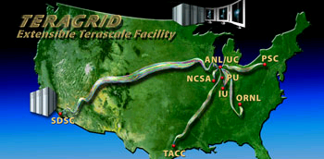

Swift Architecture
Specification
Scheduling
Execution
Provisioning
Abstract
computation
Execution Engine
(Karajan w/
Swift Runtime)‏
Virtual Node(s)‏
Falkon
Resource
Provisioner
Worker Nodes
file1
SwiftScript
Compiler
Swift runtime
callouts
launcher
C
C
C
App
F1
C
Provenance
data
file2
Virtual Data
Catalog
Status reporting
launcher
App
F2
Amazon
EC2
Provenance
data
file3
SwiftScript
Provenance
collector
Notes:
Note that current version has not yet integrated the VDC from the VDS VDL implementation.
One advantage of this is simplicity for the user. When we integrate it back in, its likely that we’ll make it optional to retain this simplicity, especially for users less interested in provenance storage.
Explain: what is the format of the abstract workflow.

Slide 12
The Swift Scripting Model
Program in high-level, functional model
Swift hides issues of location, mechanism and data representation
Basic active elements are functions that encapsulate application tools and run jobs
Typed data model: structures and arrays of files and scalar types
Variables are single assignment
Control structures perform conditional, iterative and parallel operations

Slide 13
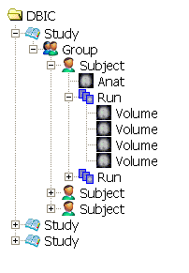







The Messy Data Problem (1)‏
Scientific data is often
logically structured
  E.g., hierarchical structure
  Common to map functions
  over dataset members
  Nested map operations can scale to millions of objects

Slide 14
The Messy Data Problem (2)‏
./group23
drwxr-xr-x 4 yongzh users 2048 Nov 12 14:15 AA
drwxr-xr-x 4 yongzh users 2048 Nov 11 21:13 CH
drwxr-xr-x 4 yongzh users 2048 Nov 11 16:32 EC
./group23/AA:
drwxr-xr-x 5 yongzh users 2048 Nov 5 12:41 04nov06aa
drwxr-xr-x 4 yongzh users 2048 Dec 6 12:24 11nov06aa
. /group23/AA/04nov06aa:
drwxr-xr-x 2 yongzh users 2048 Nov 5 12:52 ANATOMY
drwxr-xr-x 2 yongzh users 49152 Dec 5 11:40 FUNCTIONAL
. /group23/AA/04nov06aa/ANATOMY:
-rw-r--r-- 1 yongzh users 348 Nov 5 12:29 coplanar.hdr
-rw-r--r-- 1 yongzh users 16777216 Nov 5 12:29 coplanar.img
. /group23/AA/04nov06aa/FUNCTIONAL:
-rw-r--r-- 1 yongzh users 348 Nov 5 12:32 bold1_0001.hdr
-rw-r--r-- 1 yongzh users 409600 Nov 5 12:32 bold1_0001.img
-rw-r--r-- 1 yongzh users 348 Nov 5 12:32 bold1_0002.hdr
-rw-r--r-- 1 yongzh users 409600 Nov 5 12:32 bold1_0002.img
-rw-r--r-- 1 yongzh users 496 Nov 15 20:44 bold1_0002.mat
-rw-r--r-- 1 yongzh users 348 Nov 5 12:32 bold1_0003.hdr
-rw-r--r-- 1 yongzh users 409600 Nov 5 12:32 bold1_0003.img
Heterogeneous storage format & access protocols
  Same dataset can be stored in text file, spreadsheet, database, …
  Access via filesystem, DBMS, HTTP, WebDAV, …
Metadata encoded in directory and file names
Hinders program development, composition, execution

Slide 15
Automated image registration for spatial normalization
AIRSN workflow:
AIRSN workflow expanded:
Collaboration with James Dobson, Dartmouth [SIGMOD Record Sep05]

Slide 16
Example: fMRI Type Definitions
type Study {
Group g[ ];
}
type Group {
Subject s[ ];
}
type Subject {
Volume anat;
Run run[ ];
}
type Run {
Volume v[ ];
}
type Volume {
Image img;
Header hdr;
}
type Image {};
type Header {};
type Warp {};
type Air {};
type AirVec {
Air a[ ];
}
type NormAnat {
Volume anat;
Warp aWarp;
Volume nHires;
}
Simplified version of
fMRI AIRSN Program (Spatial Normalization)‏

Slide 17
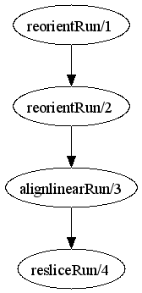
fMRI Example Workflow
(Run resliced) reslice_wf ( Run r)
{
Run yR = reorientRun( r , "y", "n" );
Run roR = reorientRun( yR , "x", "n" );
Volume std = roR.v[1];
AirVector roAirVec =
alignlinearRun(std, roR, 12, 1000, 1000, "81 3 3");
resliced = resliceRun( roR, roAirVec, "-o", "-k");
}
(Run or) reorientRun (Run ir, string direction, string overwrite)
{
foreach Volume iv, i in ir.v {
or.v[i] = reorient (iv, direction, overwrite);
}
}
Collaboration with James Dobson, Dartmouth

Slide 18
AIRSN Program Definition
(Run or) reorientRun (Run ir,
string direction) {
foreach Volume iv, i in ir.v {
or.v[i] = reorient(iv, direction);
}
}
(Run snr) functional ( Run r, NormAnat a,
Air shrink ) {
  Run yroRun = reorientRun( r , "y" );
  Run roRun = reorientRun( yroRun , "x" );
  Volume std = roRun[0];
  Run rndr = random_select( roRun, 0.1 );
  AirVector rndAirVec = align_linearRun( rndr, std, 12, 1000, 1000, "81 3 3" );
  Run reslicedRndr = resliceRun( rndr, rndAirVec, "o", "k" );
  Volume meanRand = softmean( reslicedRndr, "y", "null" );
  Air mnQAAir = alignlinear( a.nHires, meanRand, 6, 1000, 4, "81 3 3" );
  Warp boldNormWarp = combinewarp( shrink, a.aWarp, mnQAAir );
  Run nr = reslice_warp_run( boldNormWarp, roRun );
  Volume meanAll = strictmean( nr, "y", "null" )
  Volume boldMask = binarize( meanAll, "y" );
  snr = gsmoothRun( nr, boldMask, "6 6 6" );
}

Slide 19
SwiftScript Expressiveness
Lines of code with different workflow encodings
AIRSN workflow:
AIRSN workflow expanded:
fMRI
Workflow
Shell
Script
VDL
Swift
ATLAS1
49
72
6
ATLAS2
97
135
10
FILM1
63
134
17
FEAT
84
191
13
AIRSN
215
~400
34
Collaboration with James Dobson, Dartmouth [SIGMOD Record Sep05]

Slide 20
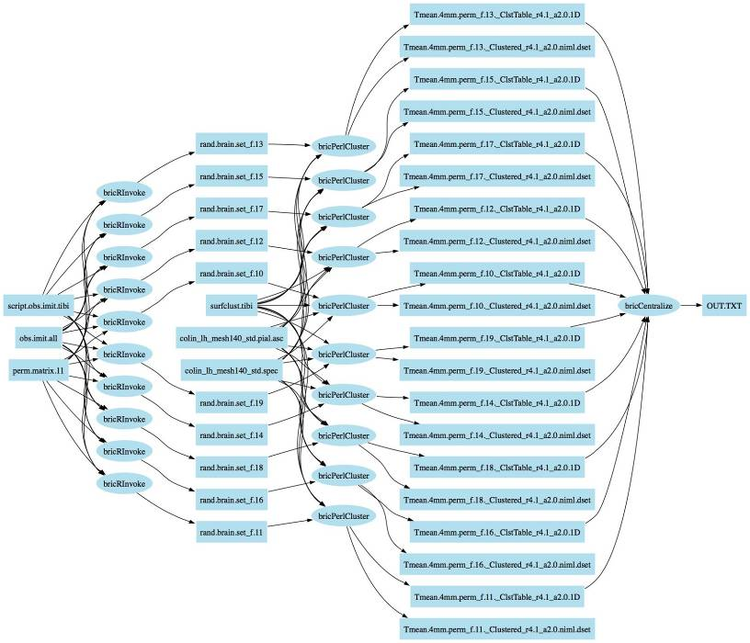
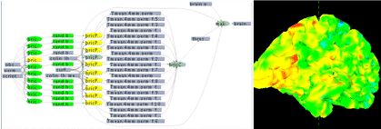
Application example:
ACTIVAL: Neural activation validation
The ACTIVAL Swift script identifies clusters of neural activity not likely to be active by random chance: switch labels of the conditions for one or more participants; calculate the delta values in each voxel, re-calculate the reliability of delta in each voxel, and evaluate clusters found. If the clusters in data are greater than the majority of the clusters found in the permutations, then the null hypothesis is refuted indicating that clusters of activity found in our experiment are not likely to be found by chance.
Work by S. Small and U. Hasson, UChicago.
Notes:
10-second slide:
DON’T read this – just say it in a few words: “To illustrate Swift I’ll present as an example a workflow which we call “ACTIVAL” that uses statistical analysis (with R) to validate observed activations in a functional MRI study”.
ACTIFIND is our name for this algorithm (its not a formal neuroscience name)

Slide 21
SwiftScript Workflow ACTIVAL – Data types and utilities
type script {} type fullBrainData {}
type brainMeasurements{} type fullBrainSpecs {}
type precomputedPermutations{} type brainDataset {}
type brainClusterTable {}
type brainDatasets{ brainDataset b[]; }
type brainClusters{ brainClusterTable c[]; }
// Procedure to run "R" statistical package
(brainDataset t) bricRInvoke (script permutationScript, int iterationNo,
brainMeasurements dataAll, precomputedPermutations dataPerm) {
app { bricRInvoke @filename(permutationScript) iterationNo
@filename(dataAll) @filename(dataPerm); }
}
// Procedure to run AFNI Clustering tool
(brainClusterTable v, brainDataset t) bricCluster (script clusterScript,
int iterationNo, brainDataset randBrain, fullBrainData brainFile,
fullBrainSpecs specFile) {
app { bricPerlCluster @filename(clusterScript) iterationNo
@filename(randBrain) @filename(brainFile)
@filename(specFile); }
}
// Procedure to merge results based on statistical likelhoods
(brainClusterTable t) bricCentralize ( brainClusterTable bc[]) {
app { bricCentralize @filenames(bc); }
}
Notes:
Replace this sequence with one that uses better typenames

Slide 22
ACTIVAL Workflow – Dataset iteration procedures
// Procedure to iterate over the data collection
(brainClusters randCluster, brainDatasets dsetReturn) brain_cluster
(fullBrainData brainFile, fullBrainSpecs specFile)
{
int sequence[]=[1:2000];
brainMeasurements dataAll<fixed_mapper; file="obs.imit.all">;
precomputedPermutations dataPerm<fixed_mapper; file="perm.matrix.11">;
script randScript<fixed_mapper; file="script.obs.imit.tibi">;
script clusterScript<fixed_mapper; file="surfclust.tibi">;
brainDatasets randBrains<simple_mapper; prefix="rand.brain.set">;
foreach int i in sequence {
randBrains.b[i] = bricRInvoke(randScript,i,dataAll,dataPerm);
brainDataset rBrain = randBrains.b[i] ;
(randCluster.c[i],dsetReturn.b[i]) =
bricCluster(clusterScript,i,rBrain, brainFile,specFile);
}
}
Notes:
Point out that this is the heart of the algorithm – and that the parallelism comes from the foreach.
Show how the datasets flow in the body of the foreach
QUESTION: why do we create the variable “rBrain”? Whats the data structuring concept being used here? (in green, above)

Slide 23
ACTIVAL Workflow – Main Workflow Program
// Declare datasets
fullBrainData brainFile<fixed_mapper; file="colin_lh_mesh140_std.pial.asc">;
fullBrainSpecs specFile<fixed_mapper; file="colin_lh_mesh140_std.spec">;
brainDatasets randBrain<simple_mapper; prefix="rand.brain.set">;
brainClusters randCluster<simple_mapper; prefix="Tmean.4mm.perm",
suffix="_ClstTable_r4.1_a2.0.1D">;
brainDatasets dsetReturn<simple_mapper; prefix="Tmean.4mm.perm",
suffix="_Clustered_r4.1_a2.0.niml.dset">;
brainClusterTable clusterThresholdsTable<fixed_mapper; file="thresholds.table">;
brainDataset brainResult<fixed_mapper; file="brain.final.dset">;
brainDataset origBrain<fixed_mapper; file="brain.permutation.1">;
// Main program – executes the entire workflow
(randCluster, dsetReturn) = brain_cluster(brainFile, specFile);
clusterThresholdsTable = bricCentralize (randCluster.c);
brainResult = makebrain(origBrain,clusterThresholdsTable,brainFile,specFile);
Notes:
Explain the dataset declarations and the two mappers used here.
Simple_mapper
Fixed_mapper
Point out that entire datasets are being passed as arguments.

Slide 24
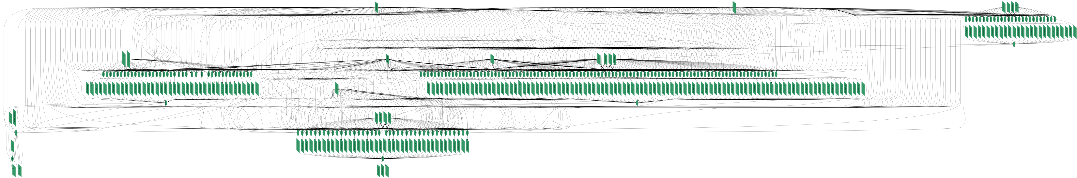
Swift Application:
Economics “moral hazard” problem
~200 job workflow using Octave/Matlab and the CLP LP-SOLVE application.
Work by Tibi Stef-Praun, CI, with Robert Townsend & Gabriel Madiera, UChicago Economics

Slide 25
Running swift
Fully contained Java grid client
Can test on a local machine
Can run on a PBS cluster
Runs on multiple clusters over Grid interfaces

Slide 26
Using Swift
site
list
Worker Nodes
Data
app
list
f1
f1
f2
f3
launcher
SwiftScript
App
a1
swift
command
App
a1
App
a2
f2
launcher
Workflow
Status
and logs
App
a2
Provenance
data
f3
Notes:
Note that current version has not yet integrated the VDC from the VDS VDL implementation.
One advantage of this is “separation of layers” is simplicity for the user. When we integrate it back in, its likely that we’ll make it optional to retain this simplicity, especially for users less interested in provenance storage, and for new users that may not have ready access to a DBMS to hold the VDC.
To do: Animate and color this slide

Slide 27
The Variable model
Single assignment:
  Can only assign a value to a var once
  This makes data flow semantics much cleaner to specify, understand and implement
Variables are scalars or references to composite objects
Variables are typed
File typed variables are “mapped” to files

Slide 28
Data Flow Model
This is what makes it possible to be location independent
Computations proceed when data is ready (often not in source-code order)
User specifies DATA dependencies, doesn’t worry about sequencing of operations
Exposes maximal parallelism

Slide 29
Swift statements
Var declarations
  Can be mapped
Type declarations
Assignment statements
  Assignments are type-checked
Control-flow statements
  if, foreach, iterate
Function declarations

Slide 30
Passing scripts as data
When running scripting languages, target language interpreter can be the executable (eg shell, perl, python, R)‏

Slide 31
Assessing your analysis tool performance
Job usage records tell where when and how things ran: v runtime cputime
angle4-szlfhtji-kickstart.xml 2007-11-08T23:03:53.733-06:00 0 0 1177.024 1732.503 4.528 ia64 tg-c007.uc.teragrid.org
angle4-hvlfhtji-kickstart.xml 2007-11-08T23:00:53.395-06:00 0 0 1017.651 1536.020 4.283 ia64 tg-c034.uc.teragrid.org
angle4-oimfhtji-kickstart.xml 2007-11-08T23:30:06.839-06:00 0 0 868.372 1250.523 3.049 ia64 tg-c015.uc.teragrid.org
angle4-u9mfhtji-kickstart.xml 2007-11-08T23:15:55.949-06:00 0 0 817.826 898.716 5.474 ia64 tg-c035.uc.teragrid.org
Analysis tools display this visually

Slide 32
Performance recording
site
list
Worker Nodes
Data
app
list
f1
f1
f2
f3
launcher
SwiftScript
App
a1
swift
command
App
a1
App
a2
f2
launcher
Workflow
Status
and logs
App
a2
Provenance
data
f3
Notes:
Note that current version has not yet integrated the VDC from the VDS VDL implementation.
One advantage of this is “separation of layers” is simplicity for the user. When we integrate it back in, its likely that we’ll make it optional to retain this simplicity, especially for users less interested in provenance storage, and for new users that may not have ready access to a DBMS to hold the VDC.
To do: Animate and color this slide

Slide 33
Data Management
Directories and management model
  local dir, storage dir, work dir
  caching within workflow
  reuse of files on restart
Makes unique names for: jobs, files, wf
Can leave data on a site
  For now, in Swift you need to track it
  In Pegasus (and VDS) this is done automatically

Slide 34
Mappers and Vars
Vars can be “file valued”
Many useful mappers built-in, written in Java to the Mapper interface
“Ext”ernal mapper can be easily written as an external script in any language

Slide 35
Mapping outputs based on input names
type pcapfile;
type angleout;
type anglecenter;
(angleout ofile, anglecenter cfile) angle4 (pcapfile ifile)
{
app { angle4 @ifile @ofile @cfile; }
}
pcapfile pcapfiles[]<filesys_mapper; prefix="pc", suffix=".pcap">;
angleout of[] <structured_regexp_mapper;
source=pcapfiles,match="pc(.*)\.pcap",
transform="_output/of/of\1.angle">;
anglecenter cf[] <structured_regexp_mapper;
source=pcapfiles,match="pc(.*)\.pcap",
transform="_output/cf/cf\1.center">;
foreach pf,i in pcapfiles {
(of[i],cf[i]) = angle4(pf);
}
Name outputs based on inputs

Slide 36
Parallelism for processing datasets
type pcapfile;
type angleout;
type anglecenter;
(angleout ofile, anglecenter cfile) angle4 (pcapfile ifile)
{
app { angle4.sh --input @ifile --output @ofile --coords @cfile; }
}
pcapfile pcapfiles[]<filesys_mapper; prefix="pc", suffix=".pcap">;
angleout of[] <structured_regexp_mapper;
source=pcapfiles,match="pc(.*)\.pcap",
transform="_output/of/of\1.angle">;
anglecenter cf[] <structured_regexp_mapper;
source=pcapfiles,match="pc(.*)\.pcap",
transform="_output/cf/cf\1.center">;
foreach pf,i in pcapfiles {
(of[i],cf[i]) = angle4(pf);
}
Name outputs based on inputs
Iterate over dataset members in parallel

Slide 37
Coding your own “external” mapper
awk <angle-spool-1-2 '
BEGIN {
server="gsiftp://tp-osg.ci.uchicago.edu//disks/ci-gpfs/angle";
}
{ printf "[%d] %s/%s\n", i++, server, $0 }’
$ cat angle-spool-1-2
spool_1/anl2-1182294000-dump.1.167.pcap.gz
spool_1/anl2-1182295800-dump.1.170.pcap.gz
spool_1/anl2-1182296400-dump.1.171.pcap.gz
spool_1/anl2-1182297600-dump.1.173.pcap.gz
…
$ ./map1 | head
[0] gsiftp://tp-osg.ci.uchicago.edu//disks/ci-gpfs/angle/spool_1/anl2-1182294000-dump.1.167.pcap.gz
[1] gsiftp://tp-osg.ci.uchicago.edu//disks/ci-gpfs/angle/spool_1/anl2-1182295800-dump.1.170.pcap.gz
[2] gsiftp://tp-osg.ci.uchicago.edu//disks/ci-gpfs/angle/spool_1/anl2-1182296400-dump.1.171.pcap.gz
…

Slide 38
Site selection and throttling
Avoid overloading target infrastructure
Base resource choice on current conditions and real response for you
Balance this with space availability
Things are getting more automated.

Slide 39
Clustering and Provisioning
Can cluster jobs together to reduce grid overhead for small jobs
Can use a provisioner
Can use a provider to go straight to a cluster

Slide 40
Testing and debugging techniques
Debugging
  Trace and print statements
  Put logging into your wrapper
  Capture stdout/error in returned files
  Capture glimpses of runtime environment
  Kickstart data helps understand what happened at runtime
  Reading/filtering swift client log files
  Check what sites are doing with local tools - condor_q, qstat
Log reduction tools tell you how your workflow behaved

Slide 41
Other Workflow Style Issues
Expose or hide parameters
One atomic, many variants
Expose or hide program structure
Driving a parameter sweep with readdata() - reads a csv file into struct[].
Swift is not a data manipulation language - use scripting tools for that

Slide 42
Swift: Getting Started
www.ci.uchicago.edu/swift
  Documentation -> tutorials
Get CI accounts
  https://www.ci.uchicago.edu/accounts/
    Request: workstation, gridlab, teraport
Get a DOEGrids Grid Certificate
  http://www.doegrids.org/pages/cert-request.html
    Virtual organization: OSG / OSGEDU
    Sponsor: Mike Wilde, wilde@mcs.anl.gov, 630-252-7497
Develop your Swift code and test locally, then:
  On PBS / TeraPort
  On OSG: OSGEDU
Use simple scripts (Perl, Python) as your test apps
http://www.ci.uchicago.edu/swift

Slide 43
Planned Enhancements
Additional data management models
Integration of provenance tracking
Improved logging for troubleshooting
Improved compilation and tool integration (especially with scripting tools and SDEs)‏
Improved abstraction and descriptive capability in mappers
Continual performance measurement and speed improvement

Slide 44
Swift: Summary
Clean separation of logical/physical concerns
  XDTM specification of logical data structures
+ Concise specification of parallel programs
  SwiftScript, with iteration, etc.
+ Efficient execution (on distributed resources)‏
  Karajan+Falkon: Grid interface, lightweight dispatch, pipelining, clustering, provisioning
+ Rigorous provenance tracking and query
  Records provenance data of each job executed
→ Improved usability and productivity
  Demonstrated in numerous applications
http://www.ci.uchicago.edu/swift

Slide 45
Acknowledgments
Swift effort is supported in part by NSF grants OCI-721939 and PHY-636265, NIH DC08638, and the UChicago/Argonne Computation Institute
The Swift team:
  Ben Clifford, Ian Foster, Mihael Hategan, Veronika Nefedova, Ioan Raicu, Tibi Stef-Praun, Mike Wilde,
  Zhao Zhang, Yong Zhao
Java CoG Kit used by Swift developed by:
  Mihael Hategan, Gregor Von Laszewski, and many collaborators
User contributed workflows and application use
  I2U2, U.Chicago Molecular Dynamics,
  U.Chicago Radiology and Human Neuroscience Lab, Dartmouth Brain Imaging Center

Slide 46
References - Workflow
Taylor, I.J., Deelman, E., Gannon, D.B. and Shields, M. eds. Workflows for e-Science, Springer, 2007
SIGMOD Record Sep. 2005 Special Section on Scientific Workflows, http://www.sigmod.org/sigmod/record/issues/0509/index.html
Zhao Y., Hategan, M., Clifford, B., Foster, I., vonLaszewski, G., Raicu, I., Stef-Praun, T. and Wilde, M Swift: Fast, Reliable, Loosely Coupled Parallel Computation IEEE International Workshop on Scientific Workflows 2007
Stef-Praun, T., Clifford, B., Foster, I., Hasson, U., Hategan, M., Small, S., Wilde, M and Zhao,Y. Accelerating Medical Research using the Swift Workflow System Health Grid 2007
Stef-Praun, T., Madeira, G., Foster, I., and Townsend, R. Accelerating solution of a moral hazard problem with Swift e-Social Science 2007
Zhao, Y., Wilde, M. and Foster, I. Virtual Data Language: A Typed Workflow Notation for Diversely Structured Scientific Data. Taylor, I.J., Deelman, E., Gannon, D.B. and Shields, M. eds. Workflows for eScience, Springer, 2007, 258-278.
Zhao, Y., Dobson, J., Foster, I., Moreau, L. and Wilde, M. A Notation and System for Expressing and Executing Cleanly Typed Workflows on Messy Scientific Data. SIGMOD Record 34 (3), 37-43
Vöckler, J.-S., Mehta, G., Zhao, Y., Deelman, E. and Wilde, M., Kickstarting Remote Applications. 2nd International Workshop on Grid Computing Environments, 2006.
Raicu, I., Zhao Y., Dumitrescu, C., Foster, I. and Wilde, M Falkon: a Fast and Light-weight tasK executiON framework Supercomputing Conference 2007

Slide 47
Additional Information
www.ci.uchicago.edu/swift
  Quick Start Guide:
    http://www.ci.uchicago.edu/swift/guides/quickstartguide.php
  User Guide:
    http://www.ci.uchicago.edu/swift/guides/userguide.php
  Introductory Swift Tutorials:
    http://www.ci.uchicago.edu/swift/docs/index.php

