Slide 1
The VO Services Project
Collaboration with the Globus Team
Feb 14, 2007
Gabriele Garzoglio
Computing Division, Fermilab

Slide 2
Overview
The VO Service Project
Wish List for our Collaboration
GT4 XACML call-out
Investigating CAS

Slide 3
Overview
The VO Service Project
Wish List for our Collaboration
GT4 XACML call-out
Investigating CAS

Slide 4
Project Charter
The project provides an infrastructure to manage user registration and implement fine-grained authorization to access rights on computing and storage resources.
Authorization is linked to identities and extended attributes. Mapping is dynamic and supports pool accounts. Enforcement of access rights is implemented using UID/GID pairs.
The infrastructure aims at reducing administrative overhead. Authorization service is central at the site.
The project is responsible for the development and maintenance of the infrastructure and for assisting with the deployment and support on the OSG.

Slide 5
Overview
The VO Service Project
Wish List for our Collaboration
GT4 XACML call-out
Investigating CAS

Slide 6
Wish list for our Collaboration (I)
GOAL 1
CE/SE Gateways call-out uses proprietary modules (PRIMA / gPlazma):
  Standardization process resulted to be hard
  Software requires maintenance
Our goal is using a standard GT4 call-out module
  We would like to collaborate on the implementation of the GT4 XACML call-out module

Slide 7
Wish list for our Collaboration (II)
GOAL 2
The VO Services project provides the authorization infrastructure for OSG.
Our goal is staying abreast of new security technologies and models
  We want to understand how the GT4 infrastructure (PEP / PIP / PDP interfaces, CAS, …) addresses our current and future use cases

Slide 8
Collaboration
How close should we work ?
  VO services providing use cases / requirements
  Testing libraries
  …
GT4 Deliverables ?
  GT4 XACML module immediately usable in GT4 and adaptable to our SE software
  Set of libraries to implement a PDP
  Proof-of-concept prototype
Timeline for implementation

Slide 9
Overview
The VO Service Project
Wish List for our Collaboration
GT4 XACML call-out
Investigating CAS

Slide 10
Discussion
Use cases from OSG CE and SE experience (FNAL)
Current implementation using SAML (FNAL)
Discussion on the XACML model to address the OSG use cases (Globus)
Discussion on requirement gathering process (Both)

Slide 11
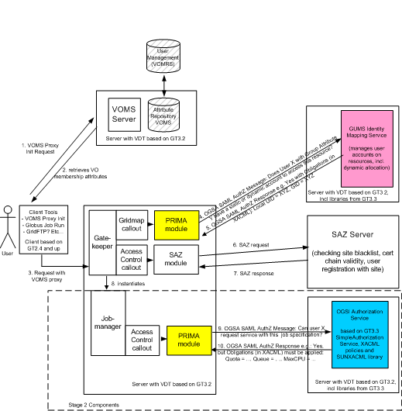
VO Services Architecture
User identity and attributes are maintained in VOMS through VOMRS
Users interact with VOMS to get attribute-enhanced credentials
Gateway software (CE and SE) performs
  identity mapping call-out through the PRIMA module
  access control call-out through the SAZ module
GUMS server maintains identity / attribute mapping for all the gateways at a site
gPlazma server (not shown) enhances UID/GID mapping with service-specific parameters (e.g. root path for SE).
SAZ checks black/white lists
Periodically, GUMS synchronizes with VOMS users/groups
synchronizes

Slide 12
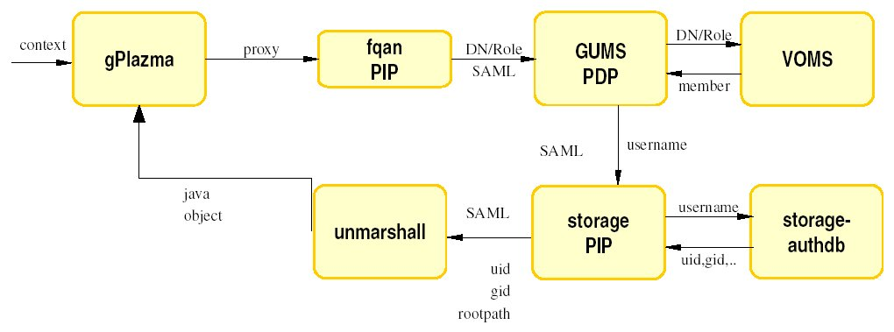
gPlazma AuthZ Infrastructure

Slide 13
Overview
The VO Service Project
Wish List for our Collaboration
GT4 XACML call-out
Investigating CAS

Slide 14
Discussion
Use of CAS as an Identity Mapping Service
  Use cases addressed in GUMS (BNL / FNAL)
Use of CAS as a white / black list service
  Use cases address in SAZ
Details of the CAS Model (Globus)
Discussion of applicability of CAS to address the OSG needs (Both)

