Slide 2
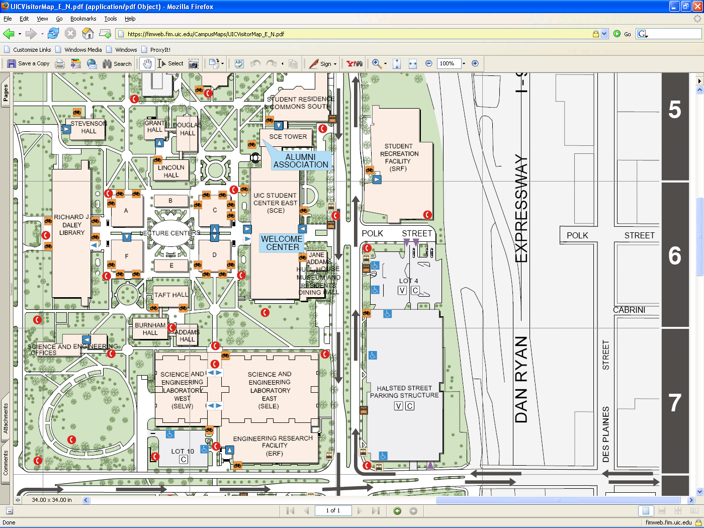
Workshop Here
Park Here

