Slide 1


Report from RAL Tier-1 and associated Tier-2s
WLCG workshop
Jeremy Coles
J.Coles@rl.ac.uk
24th January 2007

Slide 2

1 How the UK is contributing and Tier-1 status
2 What resources are being delivered
3 Resource usage
4 Testing & Development
5 Interaction with experiments and lessons from data challenges
6 Availability and monitoring

Slide 3
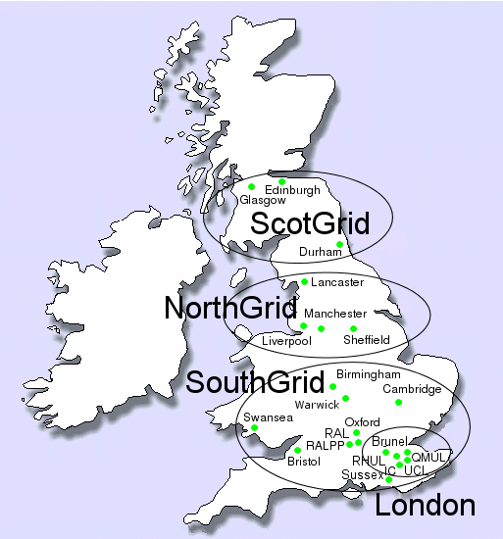
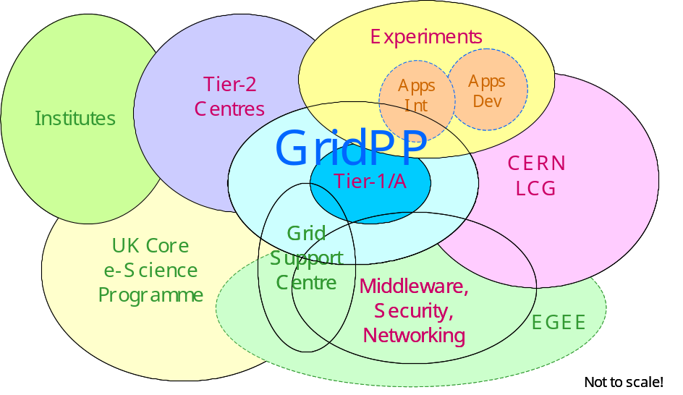
You’ve probably seen it before - this is GridPP
GridPP is a collaboration of 19 UK Universities (RAL & Daresbury) and CERN.

Slide 4
There is a formal operations structure that looks like this!
Oversight Committee
Collaboration Board
Project Management Board
Deployment Board
Tier-2 Board
User Board
Tier-1 Board
Helpdesk support
Production Manager
Tier-1 Manager
Catalogue support
NorthGrid Coordinator
SouthGrid Coordinator
ScotGrid Coordinator
London Tier-2 Coordinator
Tier-1 Technical Coordinator
Storage Group
Tier-2 support
Tier-2 support
Tier-2 support
Tier-2 support
Tier-1 support & administrators
Networking Group
Site Administrator
Site Administrator
Site Administrator
Site Administrator
VOMS support
Example activities from across these areas
Supporting dCache
Supporting DPM
Developing plug-ins
Constructing data views
Supporting network testing
Running core services
Ticket process management
Pre-production service
UK testzone
Pre-release testing
Deployment of new hardware
Information exchange
Maintaining site services
Maintaining production services
LCG service challenges
GridPP challenges
Monitoring use of resources
Reporting
Running helpdesks
Interoperation – parallel deployment
Updating project plans
Agreeing resource allocations
Checking project direction
Tracking documentation
VO interaction/support
Portal development

Slide 5
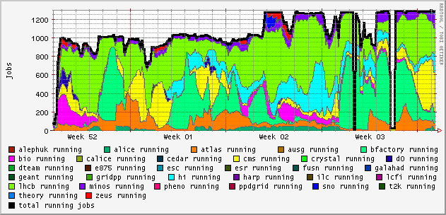
RAL Tier-1 status
500 KSI2K added
Farm remains pretty full.
Resources have continued to be allocated as required by the GridPP User Board
Approval for new (shared) machine room – ETA Summer 2008. Space for 300 racks.
Procurement
  March 06: 52x1U twin dual-core AMD 270 units, 21x5U 24-bay disk servers (168TB data caoacity)
  FY 06/07: 47x3U 16-bay disk servers (282TB disk capacity), 64x1U twin dual-core Intel Woodcrest 5130 units (550kSI2K)
  FY 06/07 upcoming: Further 210 TB disk capacity (as above) plus high-availability systems (redundant PSUs, hot-swappable paired HDDs)
Move to CASTOR
  Very support heavy but made available for CSA06 and performing well
  Will phase out dCache during summer 2007

Slide 6
RAL Tier-1 status continued
Storage commissioning saga is well known
  Problems first seen with March kit. Disks on Areca 1170 in raid 6 experienced multiple dropouts during Tier-1 load testing. The rate was unacceptable.
  Several candidate solutions were tried before the true cause was identified. If the drive head stays in one place too long it repositions to allow lubricant to flow back. No return statement from reposition, drive locks and 8 seconds later is ejected from RAID set. This required a firmware fix.
  The problem was difficult to diagnose as:
    It depended on reproducing the problem I/O pattern
    Rate was low and needed many servers under load.
    Nevertheless CMS triggered it in CSA06
General
  Air-con problems with high-temperatures triggering high pressure cut-outs in refrigerator gas circuits during summer
  July security incident
  10Gb CERN line in place. UK academic network provider now intends to connect RAL directly to the SuperJanet5 core so an upgrade is now planned for the end of March.
Staff
  2 new sysadmins and 1 hardware support post recruited. 1 new EGEE member with pre-production site responsibilities also joined the team.

Slide 7
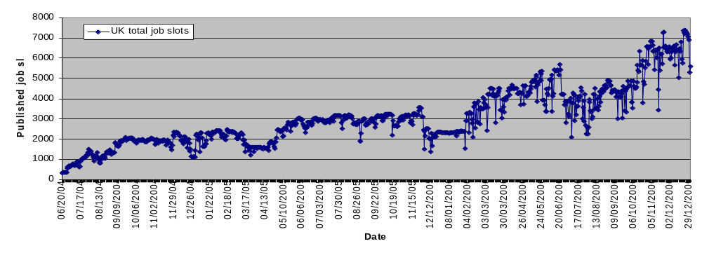
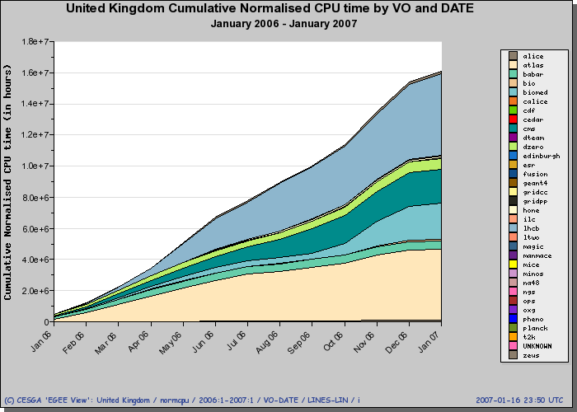
The ramp up of GridPP (T1+T2) job slots looks reasonable…
http://goc.grid.sinica.edu.tw/gstat/UKI.html
The job slots made available have been used by a number of VOs but mainly by ATLAS, CMS, LHCb and Biomed
http://www3.egee.cesga.es/gridsite/accounting/CESGA/egee_view.php

Slide 8
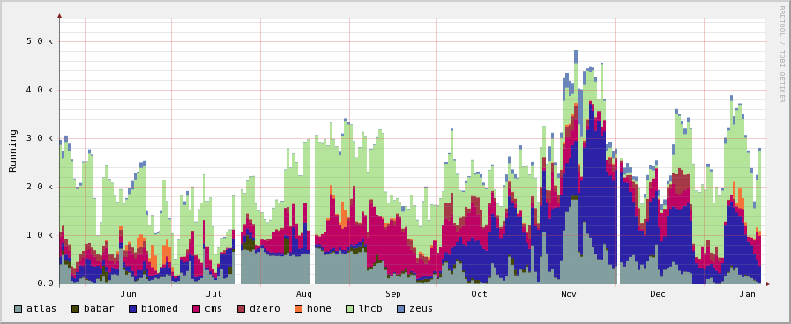
Usage of CPU resources by 8 dominant VOs
Data taken from Imperial College RB L&B harvested
records and does not include ATLAS Condor-G submissions

Slide 9
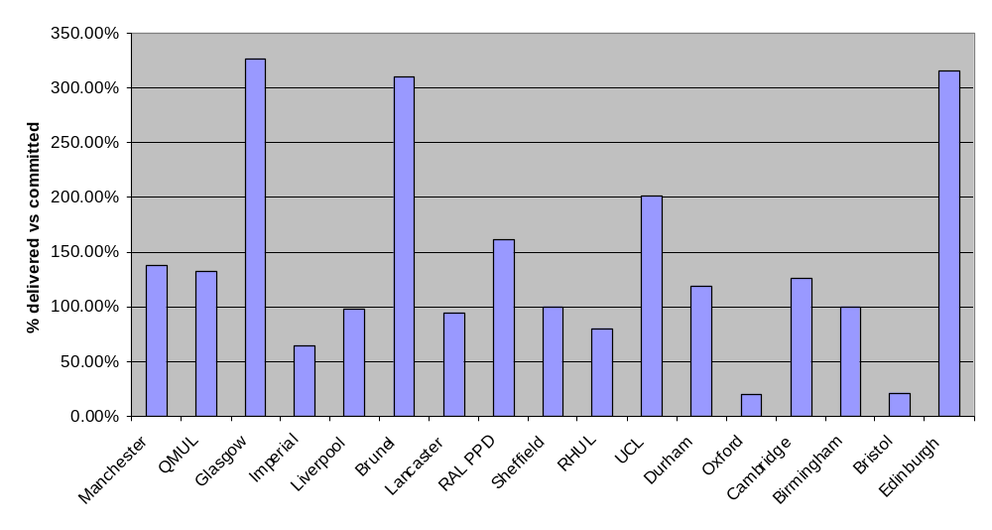
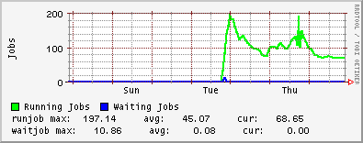
Individually Tier-2 sites are generally delivering more KSI2K than MoU committed levels (Q406)
HEP fraction of cluster will reduce
New computer room being built
New nodes now being ordered
New shared cluster just being commissioned
New cluster filled quickly

Slide 10
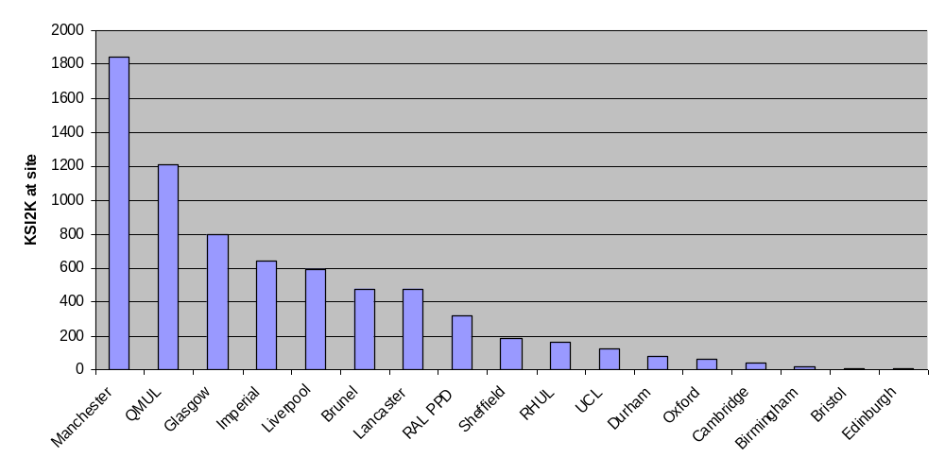
Note that there is a large difference in the scale of GridPP Tier-2 sites – this is what is currently delivered
HEP site plus an eScience shared cluster
Several sites make use of shared university resources

Slide 11
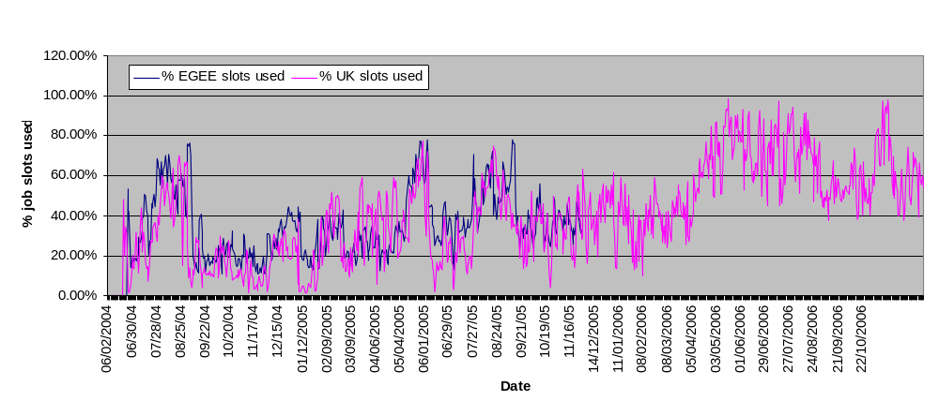
A very rough idea of GridPP resource average utilisation based on gstat job slots/usage
Peaks are not just caused by more submitted jobs but also reflect periods when larger sites are not available

Slide 12
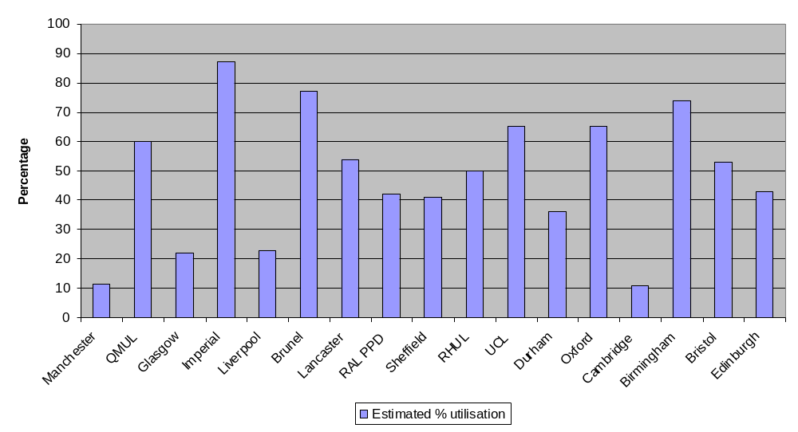
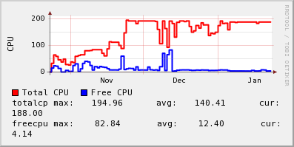
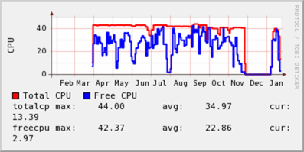
A more accurate picture for Q406 based on KSI2K hrs (wall time) and the possible site maximum (no errors/problems)
Good interaction with CMS
and other VOs
New CE start Dec and data not in APEL
Site down for 1 month due to server room changes
Accounting?
Checking utilisation is a good check on the accounting!

Slide 13
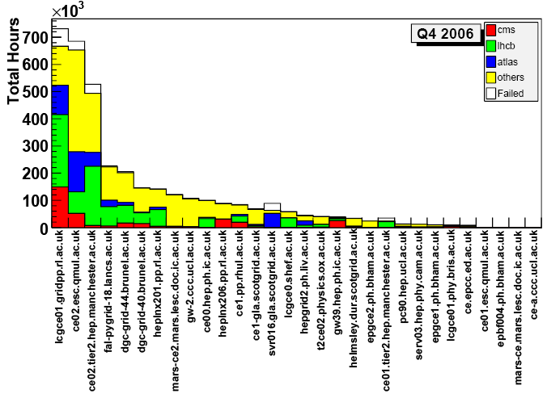
CE usage for Tier-1 and Tier-2 sites during Q4 2006
Note these for next slide
RAL Tier-1
Based on data collected by Imperial College RTM. Thanks to Olivier van der Aa and Gidon Moont for this summary of RB logging information. http://gridportal.hep.ph.ic.ac.uk/rtm/reports.html

Slide 14
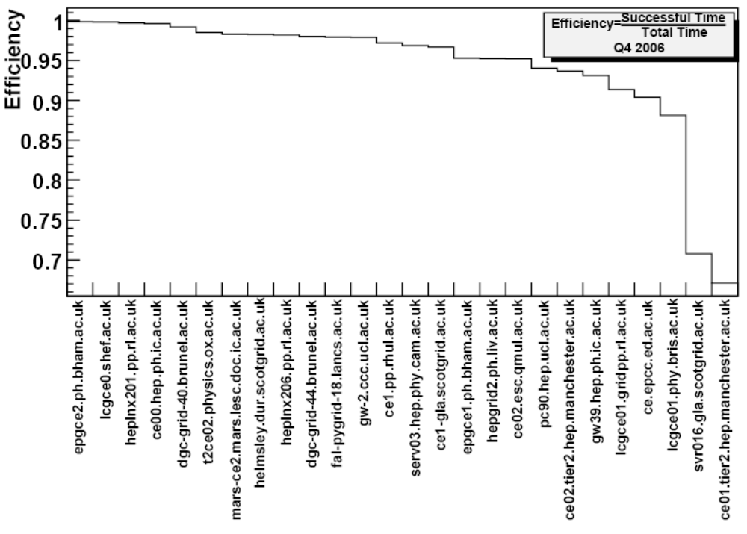
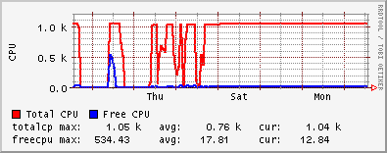
Efficiency per CE for Q4 2006
Glasgow:
Site suffered during switchover to new cluster
Manchester:
CE hardware became slow causing jobs to get terminated as proxies expired. CE was replaced and December’s performance pulled up the overall efficiency
Note impact last year after improving the Tier-1 CE hardware!
Impact of improving the Tier-1 CE hardware

Slide 15
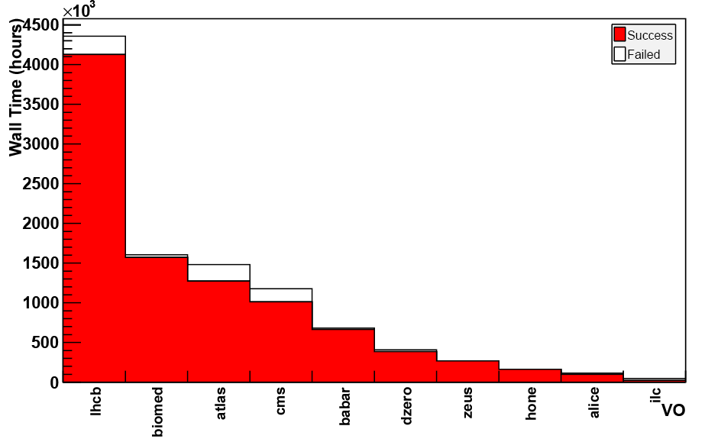
RB data, again for Q4 2006 showing that Biomed had a successful time. Typically their jobs are shorter.

Slide 16
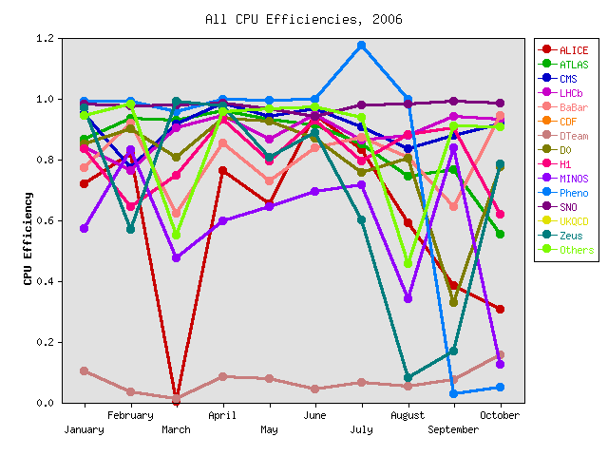
Tier-1 observed efficiencies over 2006: Average ~ 85%
Even if availability is good how optimised is the code running on it and what i/o bottlenecks exist?
The RAL Tier-1 monitors the VO efficiencies (CPU time/wall time). Similar data is being reviewed for Tier-2s.
Phenomenology group finds a way to spontaneously create CPU time!
Low number of jobs submitted
For more see: http://www.gridpp.rl.ac.uk/stats-old/

Slide 17
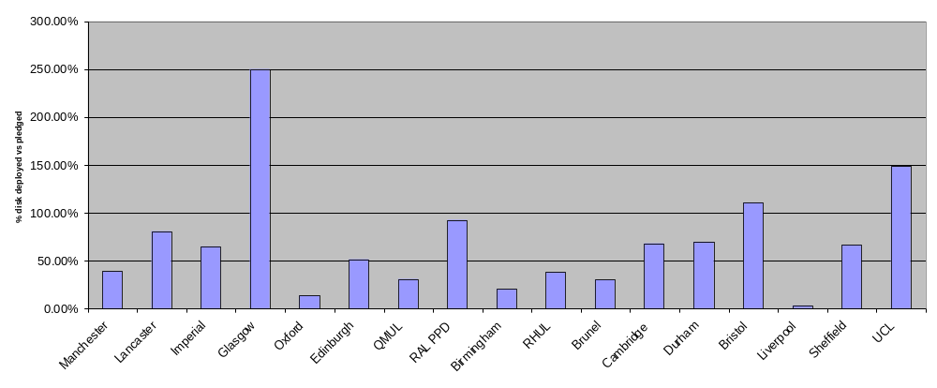
Storage is a less happy story. Most Tier-2 sites are below MoU pledges (end Q406)
New hardware being purchased
Using dCache across WNs
Hardware at site but not commissioned

Slide 18
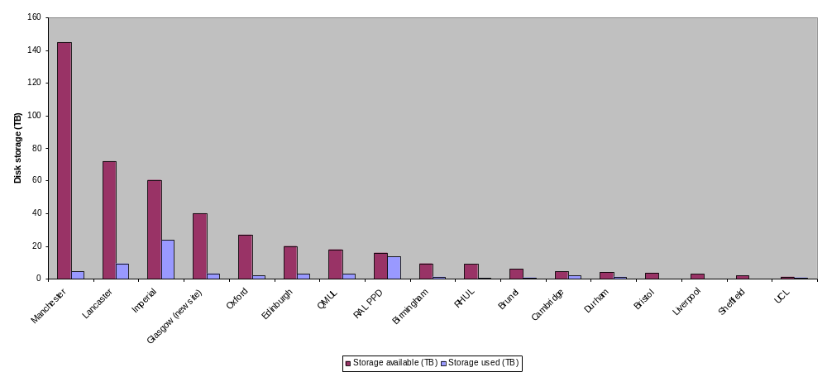
However with the Tier-2 disk currently deployed there is no immediate shortage (end Q406)
… but we have recently seen the rate of disk usage increasing (especially by ATLAS and CMS). Many sites are intending to expand (~100TB) in the near future.

Slide 19
Some things to note and observe on storage
Most UK sites are running the latest GIP plugins which are needed for the new storage accounting system and understand that it is preferable to dedicate storage pools/filesystems to individual VOs.
In purchasing new disk, sites are being reminded about the experiment requirements on KSI2K to TB ratios
We need to review the type of storage hardware sites are intending to buy and how the experiments would use it? For example WN disk or dedicated servers. Storage must be robust.
Most sites at dCache v1.7.0 or DPM v1.5.10
GridPP tests have concentrated on WAN access to SRMs (next slides). We also need to look at performance across the LAN and experimental analysis usage.
SRM v2.2 is being implemented and there is a need to test interoperability.
For GridPP3: the storage group may have to support a greater number of SRM implementations + distributed filesystems.
Also see Greig and Graeme’s talk from the DPM BOF: http://indico.cern.ch/getFile.py/access?contribId=68&amp;sessionId=13&amp;resId=0&amp;materialId=slides&amp;confId=3738

Slide 20
Now
GridPP transfer tests
Basic site tests:
  Beforehand copy 100 1GB “canned” to the source SRM
  Repeatedly transfer these files to the sink for 24hrs
  Reverse the flow and copy data from the reference for 24hrs
  Rate is simply (No Files successfully transferred * Size) / Time
Problems:
Loss of reference site early on! Email communications slow.
Lack of pre-tests and putting files in place ahead of tests
Tight 24hr timescales for each set of tests
Network variability (not seen on LAN tests)
BUT >60TB transferred.
Slide based on Chris Brew’s HEPIX talk
Dept
Site/Uni
MAN
UK Backbone

Slide 21
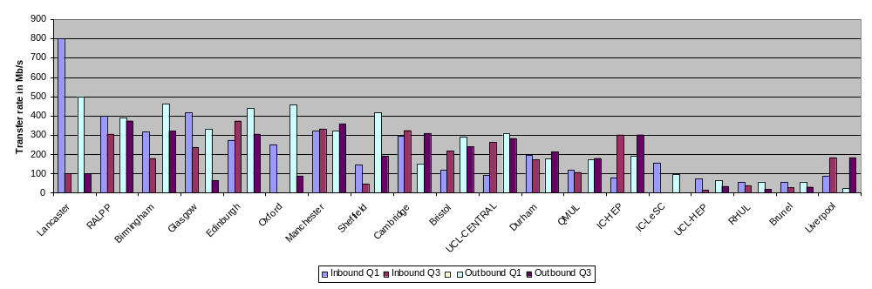
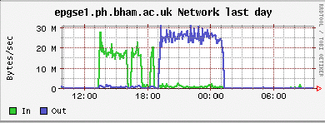
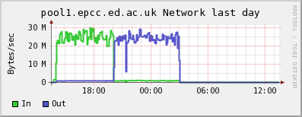
Transfer tests – 3 (individual rates)
http://www.gridpp.ac.uk/wiki/Service_Challenge_Transfer_Test_Summary
Since testing these sites have improved their connectivity or have plans to do it.
We are still working on how to maintain data transfers at a level where sites can monitor their improvements/status

Slide 22
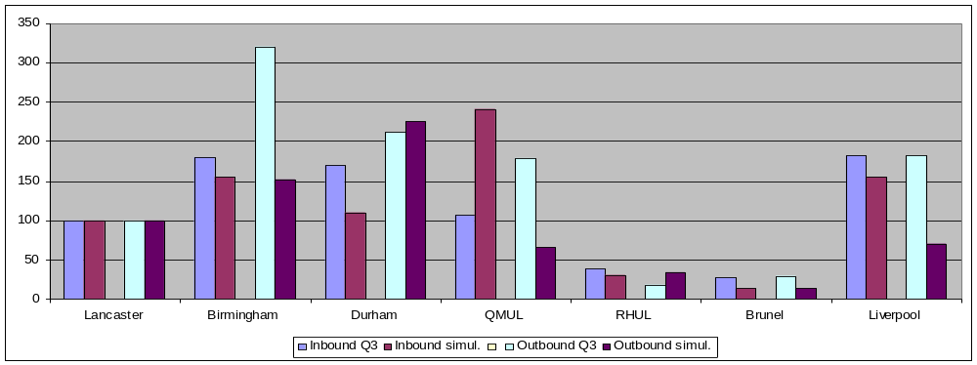
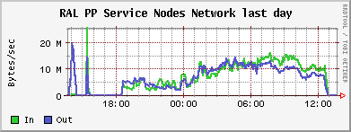
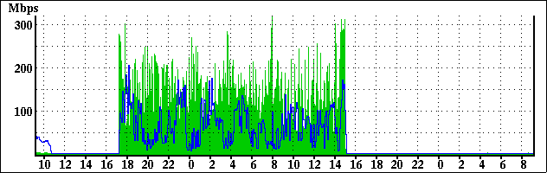
Transfer tests – 3 (comparison with rates from simultaneous read/write tests)
Unexpected behaviour probably due to environment at time of first test
Site was capped
Liverpool

Slide 23
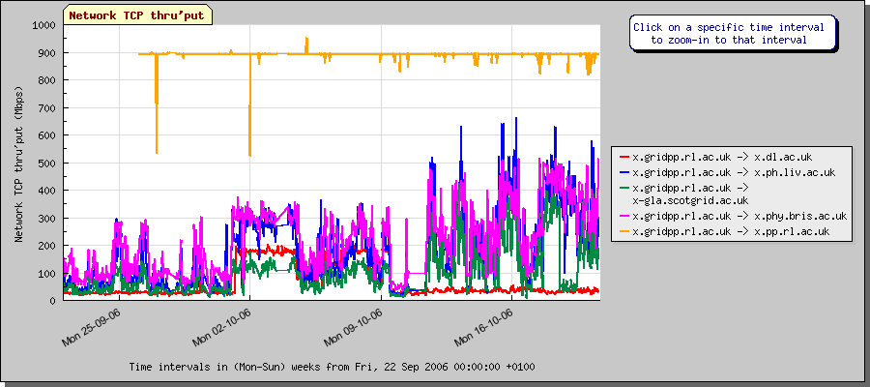
A useful tool for problem diagnosis - Gridmon
Standard nodes installed at sites and small transfers are run regularly with the data captured in a database.
Highlights of GUI:
  Plot multiple test paths on the same graph
  Zoom-in to particular time periods in raw data plots
  Plots of frequency distribution
New Web interface (v0.2): http://gridmon3.dl.ac.uk/gridmon/
The tool allowed a correlation to be seen between a 50% decrease in Oxford’s bandwidth and a change in the university firewall

Slide 24
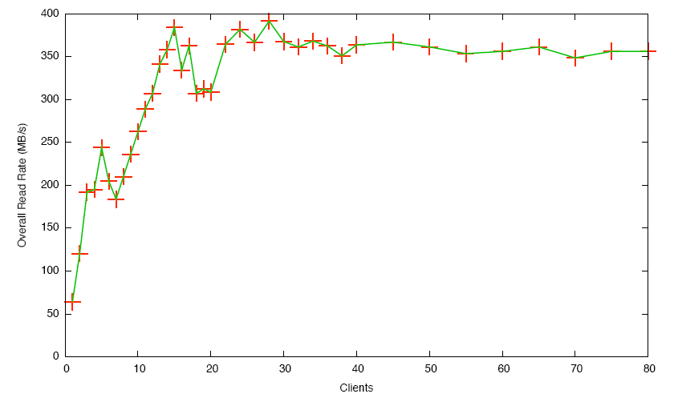
Future WAN tests and LAN testing
Previous testing has been very useful but we would like to explore other areas.
We are now getting more detailed expectations on Tier-2 connectivity from the experiments and plan to test with them and involve CASTOR at the Tier-1 (previous Tier-1 to Tier-2 testing used RAL dCache) and external Tiers.
Sites are developing networking forward-looks
Simultaneously there is a need to understand the connectivity between WNs and SEs. Tests have started in Glasgow using DPM rfio servers
One result from Glasgow rfio tests of DPM where rfio clients set up on WNs try to read different files.
See the talk from yesterday: http://indico.cern.ch/getFile.py/access?contribId=101&amp;sessionId=13&amp;resId=0&amp;materialId=slides&amp;confId=3738

Slide 25
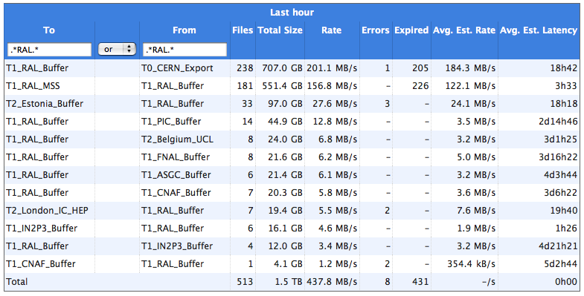
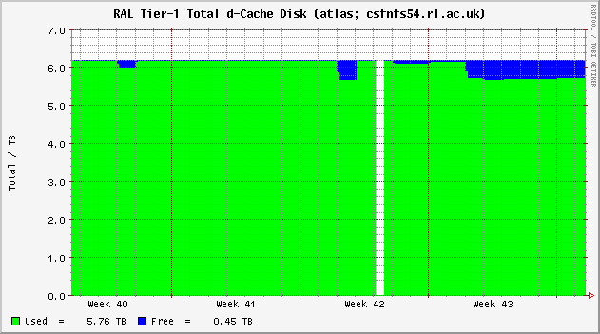
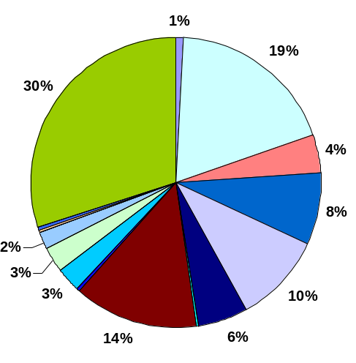
The UK Tier-1 and many Tier-2s took part in the experiment data challenges during 2006
CSA06
  RAL Tier-1 and two UK Tier-2 centres (Imperial, PPD) involved
  Disk hardware problems at Tier-1; overcome with loan of PPD disk
  CASTOR deployment required a lot of hardwork and close monitoring
ATLAS
  RAL Tier-1 and 7 Tier-2 sites involved
  6/7 sites received data; 3/7 shipped it back
  Main problem was availability of Tier-1 disk and this led to the need for frequent clean ups
  Clear need identified to separate production and user disk space/allocations
  Site SRM stability is a problem
  20 MSI days of UK running - ~76% efficiency
LHCb
  DC06 ran from May and many UK sites involved
  RAL gridFTP doors crashed a few times in August / September (unexplained)
  Occasional site outages noted (not very serious. E.g. QMUL over Christmas)
  Compiler optimizations used recently
    Software crashes on PIII machines (RAL, Imperial,…)
UK
Switzerland
Spain
France
Italy

Slide 26
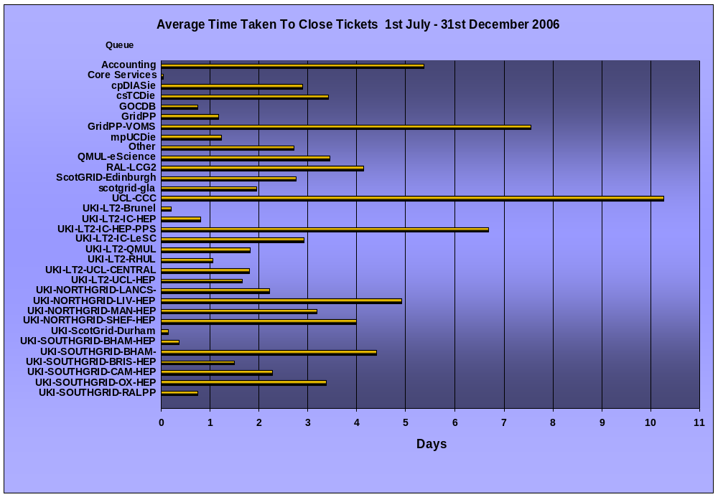
Site responsiveness is generally good – sometimes tickets do take time to resolve and these distort things…
Better to have a metric weighted by the number of tickets

Slide 27
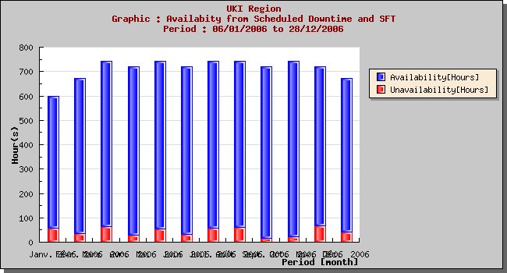
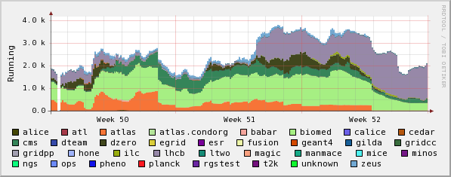
So what can we say about UKI site availability?
Results taken from the CIC portal – Operation metrics: https://cic.gridops.org/index.php?section=roc&page=operationmetrics
Some sites still in SD too long. Generally things are consistent and improving.
No major issues from the Christmas and New Year period when most sites ran at risk. There is still a need to develop improved cross-site support structures – actively encouraged in GridPP

Slide 28
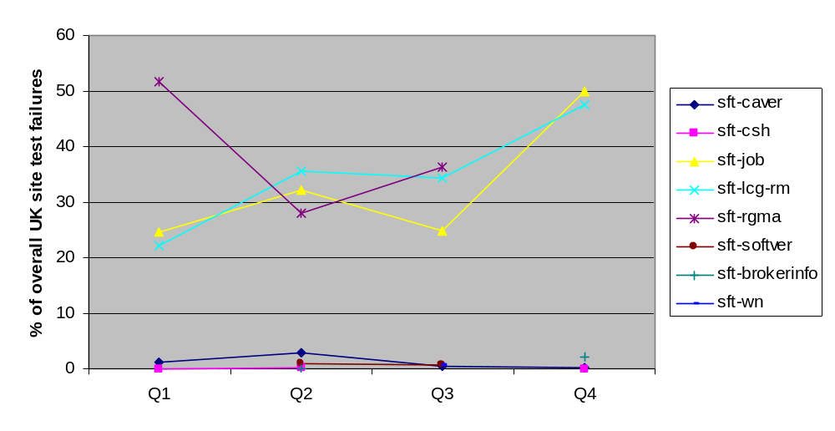
The breakdown of problems identified by SAM over time shows that 2 tests dominated 2006
Sites will welcome the time when common problems are removed from the report
Still many failures that are transient or not clearly due to the site concerned – sft-rm in particular has external dependencies (BDII, LFC...) which mean SAM tests do not correctly measure SE availability.
Would it be possible for the SAM test results to be integrated with an RSS feed which is updated when a site starts failing tests? It would save a lot of sysadmin time.
There is a real need for more experiment/VO testing with transparent results….

Slide 29
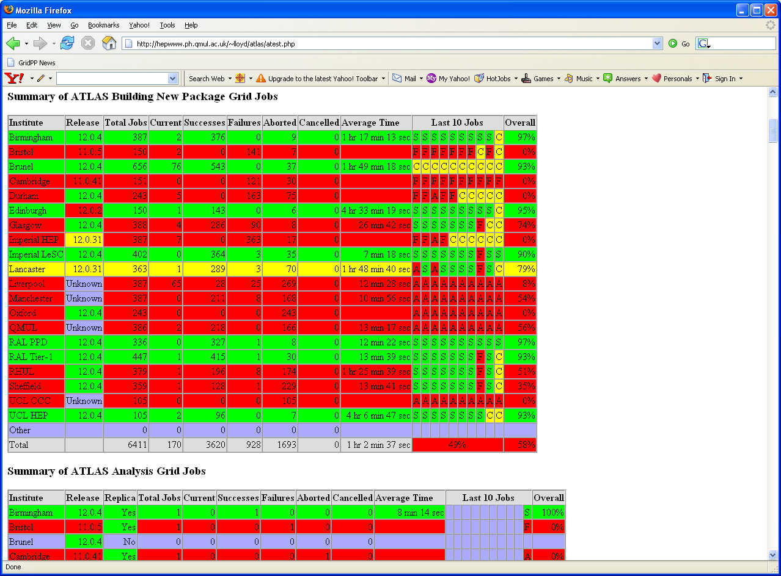
Improving ATLAS success rates
Based on evidence such as metrics given earlier in this talk there was a clear need to find out why some sites were being used and others not.
A member of ATLAS and the GridPP management board wrote some simple scripts to test our sites
We find that many sites have an issue with the software version installed and getting it updated is not quick. Also discover needed compilers are missing.
Creating these tests raises other questions like whether it is possible for a script to easily check site SD information. Can users write add-ons for the standard VO SAM tests?
Other recent UK issues:
General problem noted with users not specifying CPU time requirements leading to jobs getting terminated
User guide updated: https://www.gridpp.ac.uk/deployment/users/glite3userguide.pdf
Find that biomed jobs queuing at some sites discourage ATLAS Condor-G submissions even though fairshares favour ATLAS

Slide 30
Talk summary
1 GridPP operations = Tier-1 + 4xTier-2s
2 RAL Tier-1 is well used - more resources coming online shortly
3 Tier-2 CPU situation better than disk (which is not well used)
4 There is a lot of existing data which helps uncover site problems
5 GridPP site testing is evolving – LAN and more WAN tests soon
6 Availability is improving. More experiment tests/feedback needed

Slide 31
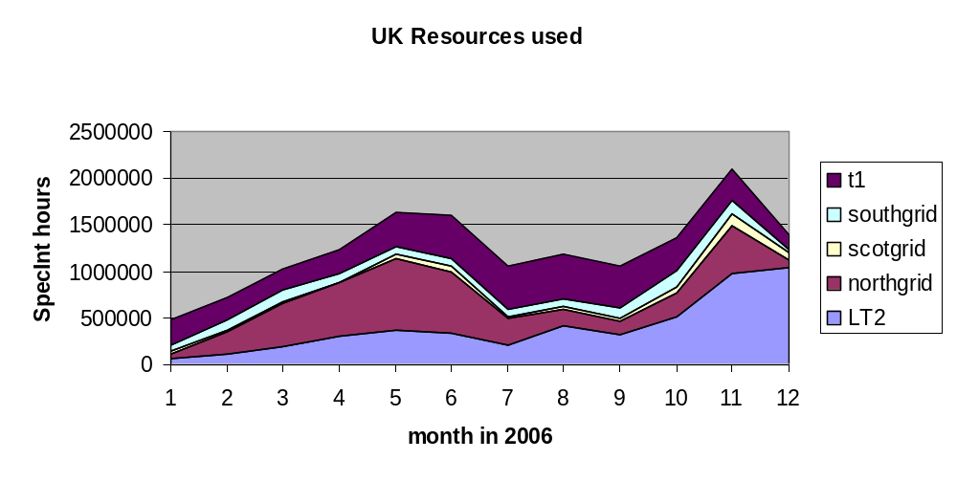
The London Tier-2 approach works…
… plot prepared by the London Tier-2 manager!

Slide 32
Additional GridPP data views
The plots that follow were made by Olivier van der Aa (Imperial College) using root. Data gathered by Gidon Moont (Imperial College) from 1st Jan 2006 to 31st Dec 2006 was used.

Slide 33
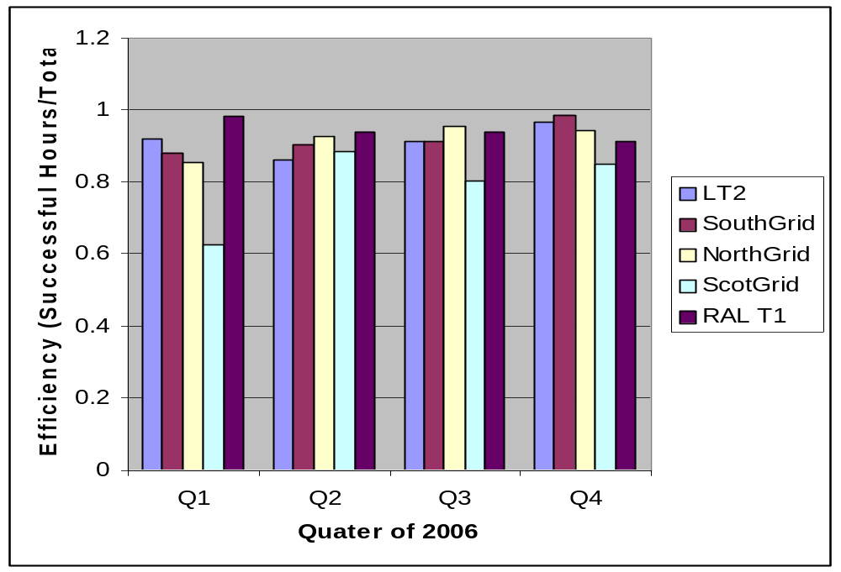
Efficiency per Tier per quarter

Slide 34
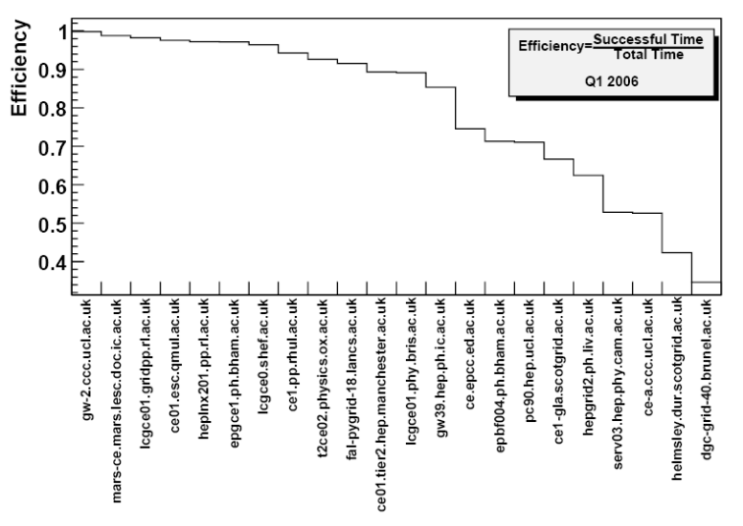
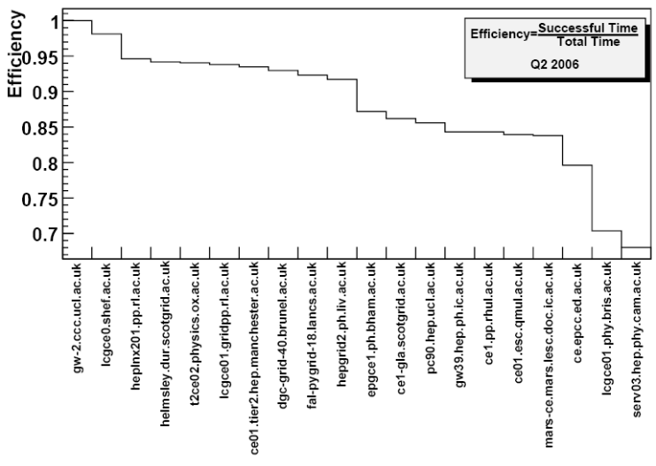
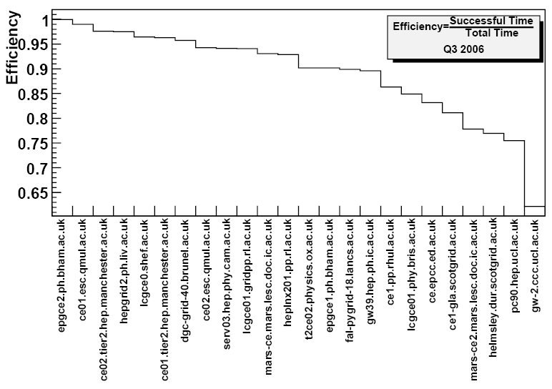
Efficiency per ce per quarter

Slide 35
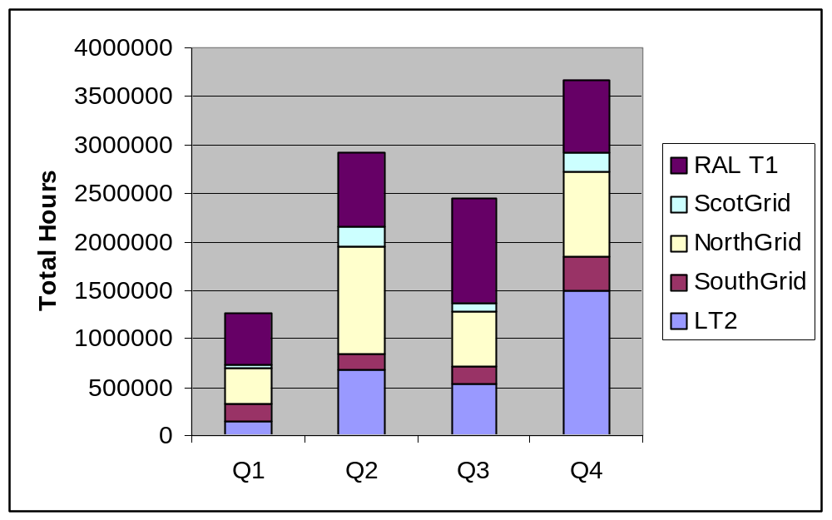
Total Hours per Tier

Slide 36
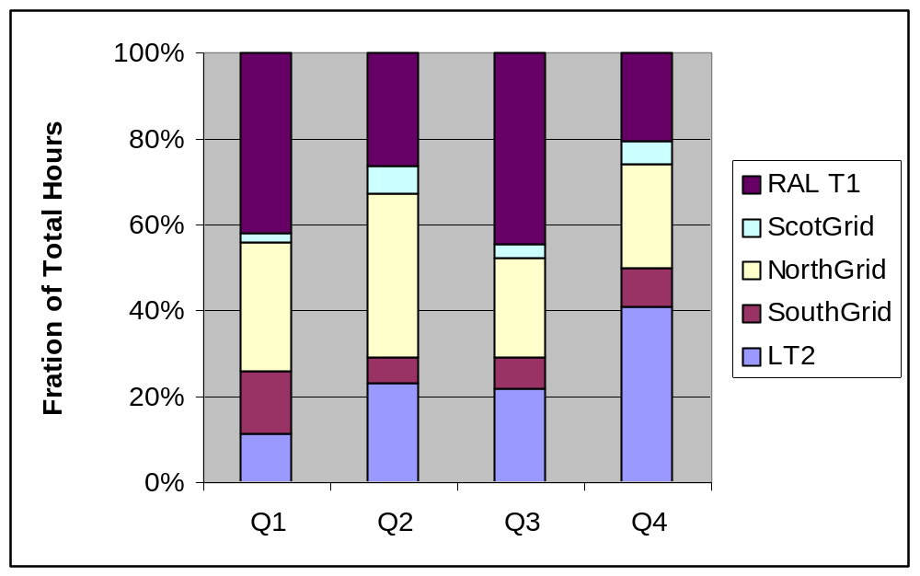
Total Hours Fractions per Tier

Slide 37
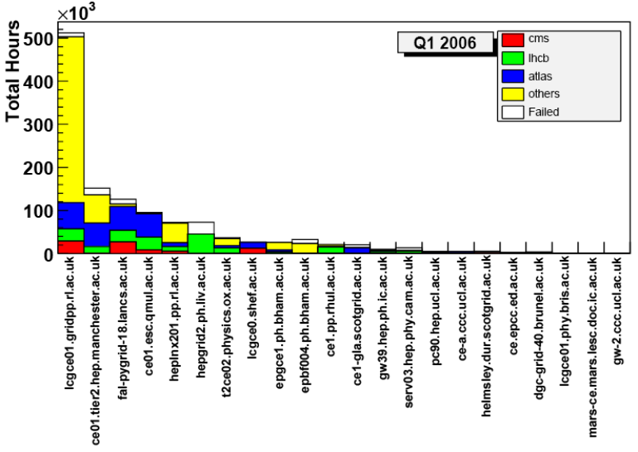
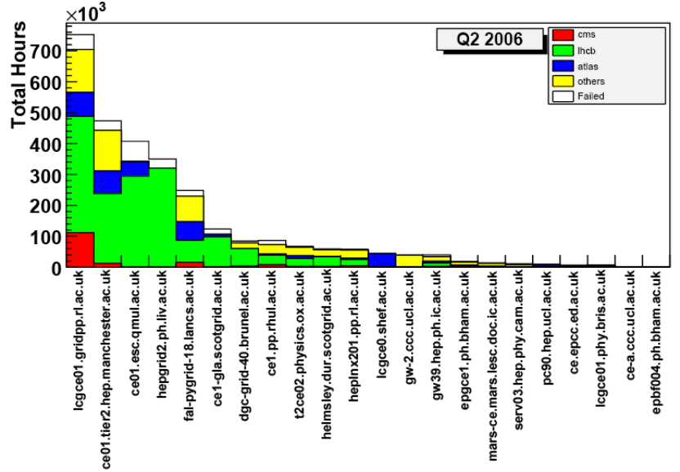
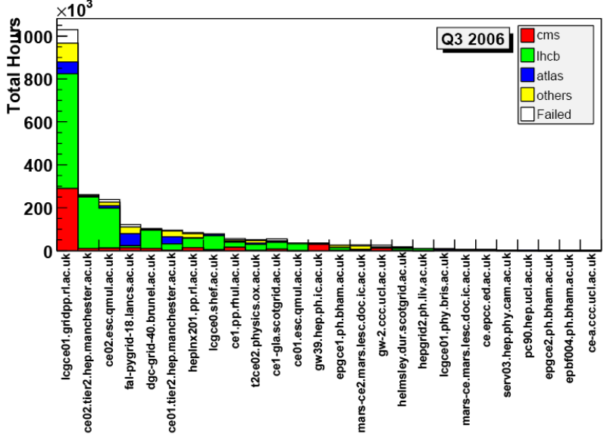
Succes/Failed Hours per CE

