Slide 1
Distributed resource management and glide-ins
Wed July 21st, 1:15pm
Igor Sfiligoi, isfiligoi@ucsd.edu
OSG Scalability Area coordinator and
OSG glideinWMS factory manager
University of California San Diego

Slide 2
What your learned until now
Scientific problems need a lot of CPU time
  Using a batch system like Condor is a must
Local compute resources are often not enough
  Get some/most of the needed CPU cycles from the Grid

Slide 3
Moving to the Grid
What resources are out there?
How do I know if they have the needed software installed?
How do I know where will my jobs finish the soonest?
Use the
OSG Matchmaker

Slide 4
Using OSG MM/Condor-G
Limited functionality
  Need to specify output file names
  Limited monitoring
  No checkpointing
Very heterogeneous environment
  Discover which apps are installed
  Discover which libs are installed

Slide 5
Can we make life easier?
More Condor (without G) like?
Yes
Pilot systems

Slide 6
What is a pilot system?
An infrastructure that creates
a virtual-private batch system
  It hides “the Grid” from the users
For users like a local system
All Grid interaction taken care of in a separate layer (hidden from users)

Slide 7
Pilot principles
Never send user jobs directly to the Grid
  Send pilots instead
After a pilot lands on a Grid resource
  Detect local resources
  Stop execution if resource is bad
Pilot fetches a user job
  Fetch currently the most important job
  (late binding)
  Start and monitor the job

Slide 8





Glide-ins
Glidein-ins are Condor-based pilots
A glide-in is a Condor startd sent as a Grid job
  When it starts, it joins the Condor pool
  User jobs now can start in the Grid
Collector
Negotiator
Glide-in
Grid
Schedd
Startd

Slide 9
Glide-ins (2)
From the user point of view, just a regular Condor pool
  Like the one you learned about
  Mon morning
All Condor functionality available
  Detailed matchmaking
  Detailed monitoring
  Can use checkpointing

Slide 10
glideinWMS
Someone has to submit the glideins to the Grid resources
  User could do it him/herself, but that can be tedious
In OSG users can use the glideinWMS
  Provides for an automated glidein submission system

Slide 11



glideinWMS (2)
Split in two pieces
  A glidein factory (submits glideins)
  A VO frontend (regulates how many)
Glideins are submitted when idle user jobs in a schedd found
Factory
Glide-ins
Frontend
Grid
Schedd

Slide 12
GlideinWMS (3)
Every community/VO supposed to host its own Condor system and frontend
  Knows best its own user needs
  Provides the Grid credentials needed to submit the pilots
Factory can be shared
  OSG hosts a glidein factory at UCSD
  Able to submit glideins both to OSG
  as well as European grids

Slide 13
Other pilot systems
Two other major pilot systems
used in the US
  Corral
  PANDA

Slide 14
Corral
Based on glide-ins
  Similar to glideinWMS
Uses explicit glidein provisioning
  i.e. users must explicitly ask for a certain number of glideins
  Unlike glideinWMS automated requests
Mostly used on Teragrid resources
  Fits that operation mode better

Slide 15


PANDA
A Web Services based pilot system
  Database driven
Same concept, different implementation
WebService
Database
Grid
Pilot

Slide 16
Pilot system drawbacks
Requires networking from the
worker nodes
  Pilots need to “call home”
  Regular Grid jobs can live without
Potentially wasting resources
  When a pilot starts, there may not be any more user jobs waiting to be run

Slide 17
Part 1 Summary
Pilot systems can hide most of the Grid complexity from the users
Glide-ins are a Condor implementation of a pilot system
  With glideinWMS providing automation
Other pilot systems available

Slide 18
Part 2
A closer look at glideinWMS

Slide 19
glideinWMS
At a glance
Collector
Negotiator
Grid
Schedd
Startd
Frontend
Glide-in
Factory

Slide 20
glideinWMS – for the user
The user really only sees the regular Condor pool
Collector
Negotiator
Grid
Schedd
Startd
Frontend
Glide-in
Factory

Slide 21
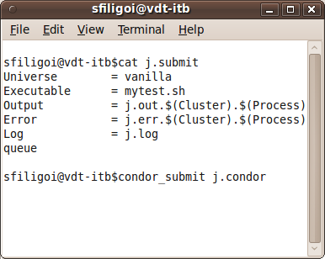
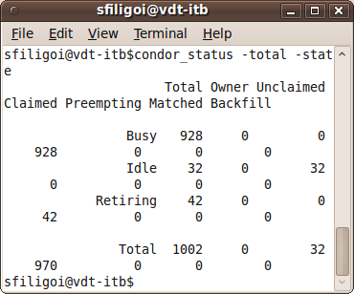
Just a regular-looking pool
Submit vanilla jobs
Monitor resources

Slide 22
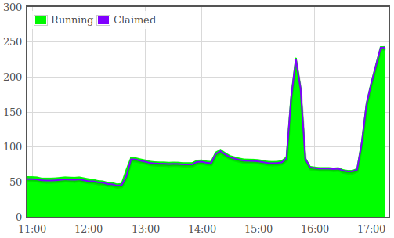
Just a dynamic one
Resources come and go
Courtesy of the UCSD CMS frontend

Slide 23
glideinWMS backend
glideinWMS processes make sure users have resources when needed
Collector
Negotiator
Grid
Schedd
Startd
Frontend
Glide-in
Factory

Slide 24

Glidein Factory
The glidein factory actually submits the Grid jobs – the glideins
Uses Condor-G for the task
Schedd
Glide-ins
Factory
Grid

Slide 25
Frontend
The frontend decides how many glideins to submit
The decision based on how many jobs need more resources and where
Schedd
Factory
condor_q
50 running
75 idle
Please submit 25 more
Frontend

Slide 26
The glideins
Glideins are regular Grid jobs
  Nothing special about this
Will configure a Condor instance
  Get the binaries
  Discover/validate WN environment
  Create condor config
Finally start a Condor startd
  Condor takes care of itself after that

Slide 27
The glideins (2)
Glideins are not specific to a user
  The startd will pick the highest priority job that matches
  Just like in a regular pool
A glidein can run many jobs
  Possibly from many users
  Just like in a regular pool
Uses its own credential for Grid submission
  Usually a service proxy

Slide 28
Security considerations
Traffic to and from a Grid site flows over untrusted Internet
All WAN connections must have security measures in place
Factory
Collector
Negotiator
Grid
Schedd
Startd

Slide 29
Security considerations (2)
The glidein will have its own proxy
when landing
  Will use it to authenticate
  to the rest of the system
The other processes have a certificate
as well
  Mutual authentication
Using whitelist authorization
Also enabling integrity checks in Condor

Slide 30
Part 3
Resource selection

Slide 31
Anything glideinWMS specific?
From the user's point of view,
isn't this just a regular Condor pool?
Can't I just set the
“requirements”
and be done?
(i.e. the negotiator will take care of it)
Only partially

Slide 32
The “requirements”
only used by the negotiator
The negotiator only matches
jobs to running startds
Grid
Collector
Negotiator
Startd
Schedd
Startd

Slide 33
Where will the glideins run?
There may be many Grid sites
  OSG g.factory @UCSD serves ~160
Frontend will match
user job attributes
against
site attributes
(provided by the factory)
Site 2
Site 3
Site 1
Schedd
Factory
Frontend

Slide 34
Frontend matchmaking
The standard “requirements” attribute
cannot be used by the frontend
  The glidein factory attributes are likely different than the glidein-startd attributes
The factory has only generic information about the site
  Glideins can augment it with information discovered on the worker nodes

Slide 35
Two level matchmaking
Based on different information
Can potentially be a problem
  Glideins that start and
  don't get matched
Site 2
Site 3
Collector
Negotiator
Site 1
Startd
Startd
Schedd
Factory
Frontend

Slide 36
An example
Site selection criteria:
  Site=!=”Nebraska” && HasBLAST
Startd requirements:
  BLAST_version>2 && Disk>100000

Slide 37
Parts 2 & 3 summary
glideinWMS looks almost like a regular Condor pool to the users
  Most of the Grid details taken care of by the glideinWMS admins
Users may need to add additional attributes for Grid site selection

Slide 38
Questions?
Questions? Comments?
Feel free to ask me questions later:
Igor Sfiligoi, isfiligoi@ucsd.edu
Upcoming sessions
  2:00pm-3:00pm
    Hands-on exercises with glide-ins
  3:00pm – 3:15pm
    Break
  3:15pm - 5:00pm
    Dealing with real resources

Slide 39
Get ready for practice
Glide-in hands-on session next

