Slide 1
10,000 Ft. Day One Overview
Introduction to Grid Computing and the Open Science Grid
(And a brief introduction to BLAST)
Rob Quick <rquick@iu.edu>
OSG Operations Coordinator
Manager High Throughput Computing Group
Indiana University
Slides By Rob Quick, Brian Bockleman, and Scot Kronenfeld

Slide 2
Day One
You now have credentials
You learned to Submit Jobs
  One your local machine
    $ ./simple 4 10
  On your local cluster
    $ condor_submit submit
    Single (Queue) and Multiple (Queue 50)
  In a larger workflow
    $ condor_submit_dag submit.dag

Slide 3
What's Next???
Distributed High Throughput Computing
Not just distributed in a room
Or a building
Or a campus
Or a country
But a WORLD!!!

Slide 4
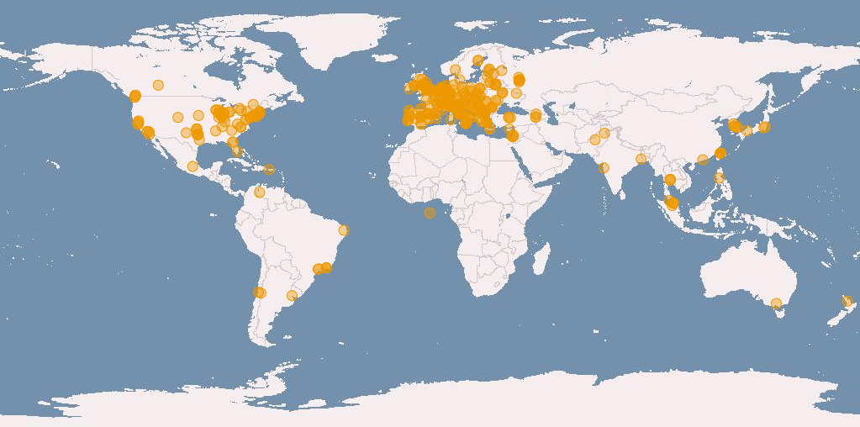

Slide 5
What is Grid Computing?
Wikipedia definition
  Grid computing is the combination of computer resources from multiple administrative domains for a common goal.
    Implies each resource can function separately.
    Overall, extra layer of difficulty to handle compared to using a single resource (even if this is hidden from the end user!).
    There must be some level of trust between the user and sites. These trust relationships can be very complex!

Slide 6
Grid Computing
Grid computing is used to perform computations which may not be feasible otherwise.
The original idea behind grid computing was to make computing power as easy to access as the electrical grid.

Slide 7
Some things to think about...
How is grid computing similar/different from cloud computing?
How does the capabilities you've learned about condor assist Grid Computing?

Slide 8
The Open Science Grid
Some Statistics:
  111 Resource Groups on 5 continents
  40 Virtual Organizations
    ATLAS, CMS, Alice, CDF and other Physics
    But also Structural Biology, Engineering, Astronomy, Mathematics, Statistics, Geology, and many others
Site policy overrides VO policy
No ssh needed
Many other infrastructure services

Slide 9
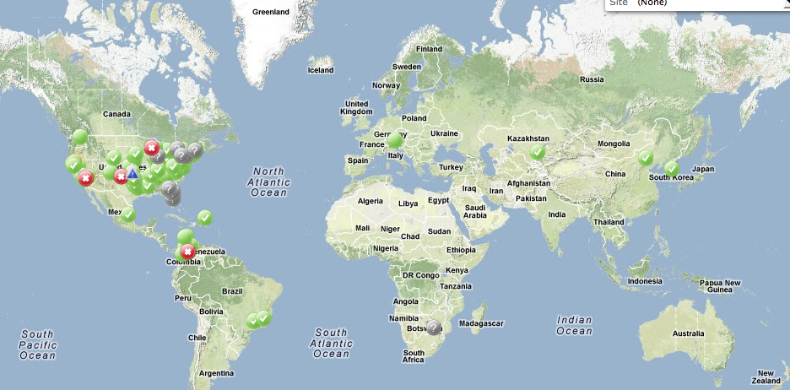

Slide 10
Economies of Scale
There are factors that cause a producer’s average cost per unit to fall as the scale of output is increased. "Economies of scale" is a long run concept and refers to reductions in unit cost as the size of a facility and the usage levels of other inputs increase.
-Wikipedia

Slide 11
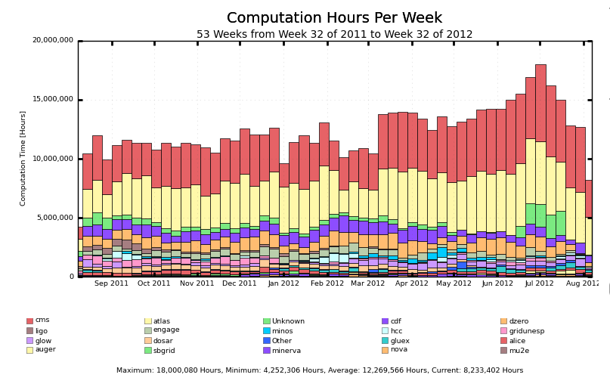
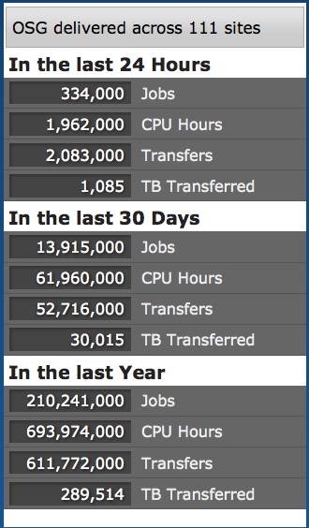
More Numbers

Slide 12
Are you starting to understand the scale and power of Open Science Grid and High Throughput Computing?
Can you see how it can enable big-data science such as the LHC?

Slide 13

BLAST Detour

Slide 14
And now BLAST
To this point our jobs have been trivial and useful as examples, but not “real science”
BLAST = Basic Local Alignment Search Tool

Slide 15
BLAST
...finds regions of local similarity between sequences. The program compares nucleotide or protein sequences to sequence databases and calculates the statistical significance of matches. BLAST can be used to infer functional and evolutionary relationships between sequences as well as help identify members of gene families.
-BLAST Web Page

Slide 16
Biologists have sequences:
  Nucleotides in DNA: ACGTTGCA...
  Amino acids in proteins: GECVASR...
They also have databases of lots of sequences
  From lots of organisms, from tiny bacteria to humans
BLAST helps them answer questions:
  Which bacterial species have a protein that is related in lineage to another protein?
  What other genes encode proteins that exhibit structures or motifs such as ones that have just been determined
BLAST is widely used and considered important

Slide 17
Questions?
Questions? Comments?
  Feel free to ask me questions later:
  Rob Quick <rquick@iu.edu>

