Slide 1

OWAMP
August 10th 2010, OSG Site Admin Workshop - Network Performance
Jason Zurawski, Internet2

Slide 2


Agenda
Tutorial Agenda:
  Network Performance Primer - Why Should We Care? (15 Mins)
  Getting the Tools (10 Mins)
  Use of the BWCTL Server and Client (30 Mins)
  Use of the OWAMP Server and Client (30 Mins)
  Use of the NDT Server and Client (30 Mins)
  BREAK (15 mins)
  Diagnostics vs Regular Monitoring (30 Mins)
  Network Performance Exercises (1 hr 30 Mins)
<number> – 11/08/26, © 2010 Internet2

Slide 3
OWAMP: What is it
OWAMP is:
  Command line client application
  Policy and scheduling daemon
  Used to determine one way latencies between hosts.
Implementation of the OWAMP protocol as defined by http://www.rfc-editor.org/rfc/rfc4656.txt
  Command Protocol to speak between client and server, server and server
  Test protocol
Different attempts to do this in the past:
  Surveyor
  RIPE
<number> – 11/08/26, © 2010 Internet2

Slide 4
Why One Way Latency?
Passive Measurements (e.g. SNMP)
  Higher polling interval may mask queue depths
  Active probing gives a better picture of real traffic
Round Trip Measurements:
  Hard to isolate the direction of a problem
  Congestion and queuing can be masked in the final measurement
  Can be done with a single ‘beacon’ (e.g. using ICMP responses)
One Way Measurements:
  Direction of a problem is implicit
  Detects asymmetric behavior
  See congestion or queuing in one direction first (normal behavior)
  Requires ‘2 Ends’ to measure properly
<number> – 11/08/26, © 2010 Internet2

Slide 5
OWAMP Control Protocol
Supports authentication and authorization of the users that will test
Used to configure the parameters of a test
  Endpoint controlled port numbers
  Extremely configurable send schedule
  Configurable packet sizes
Used to start/stop tests
Used to retrieve results
  Provisions for dealing with partial session results in the event of a failure
<number> – 11/08/26, © 2010 Internet2

Slide 6
OWAMP Test Protocol
“Lightweight” compared to the control protocol
Uses UDP as the transport protocol, since the protocol needs to be able to measure individual packet delivery times
Supports varying packet sizes
Data needed to calculate experimental errors on the final result is in every packet
Packets can be “open”, “authenticated”, or “encrypted”
<number> – 11/08/26, © 2010 Internet2

Slide 7
Sample Implementation
Applications
  owampd daemon
  owping client
Open source license and development
Built upon protocol abstraction library
  Supports one-off applications
    E.g. “powstream” is a client that sends a constant stream of measurement packets.
  Allows authentication/policy hooks to be incorporated
<number> – 11/08/26, © 2010 Internet2

Slide 8
Functionality (owping client)
Owping
  client requests tests from an OWAMP server
  Client can be sender or receiver
  Communication can be “open”, “authenticated”, or “encrypted”
  Supports the setup (scheduling) of many tests concurrently
  Supports the buffering of results on the server for later retrieval
<number> – 11/08/26, © 2010 Internet2

Slide 9
Functionality (owampd server)
owampd
  Accepts requests for tests
  Responds with a message: accepted/denied
  Tests are formally started with a StartSessions message from the client.
  Runs tests
  Sessions with packets received at the server are buffered for later retrieval
<number> – 11/08/26, © 2010 Internet2

Slide 10
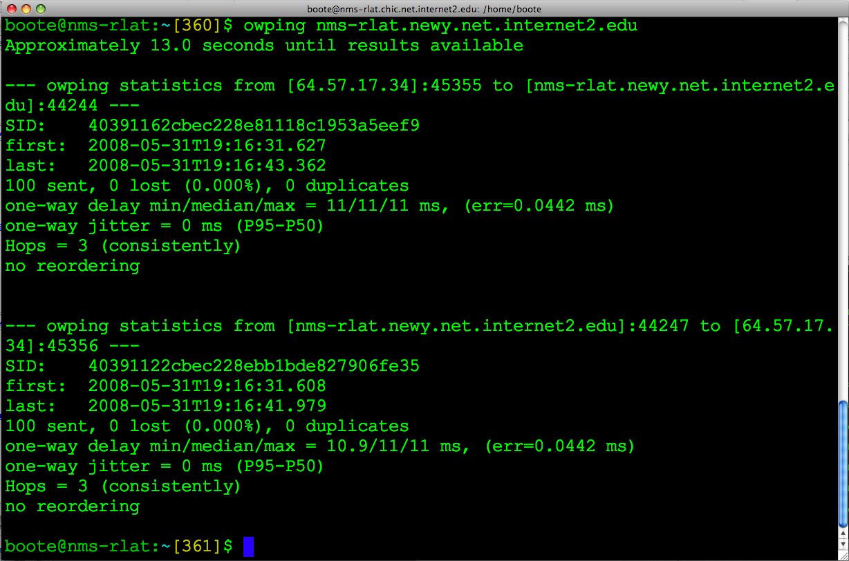
OWPING Example
<number> – 11/08/26, © 2010 Internet2

Slide 11
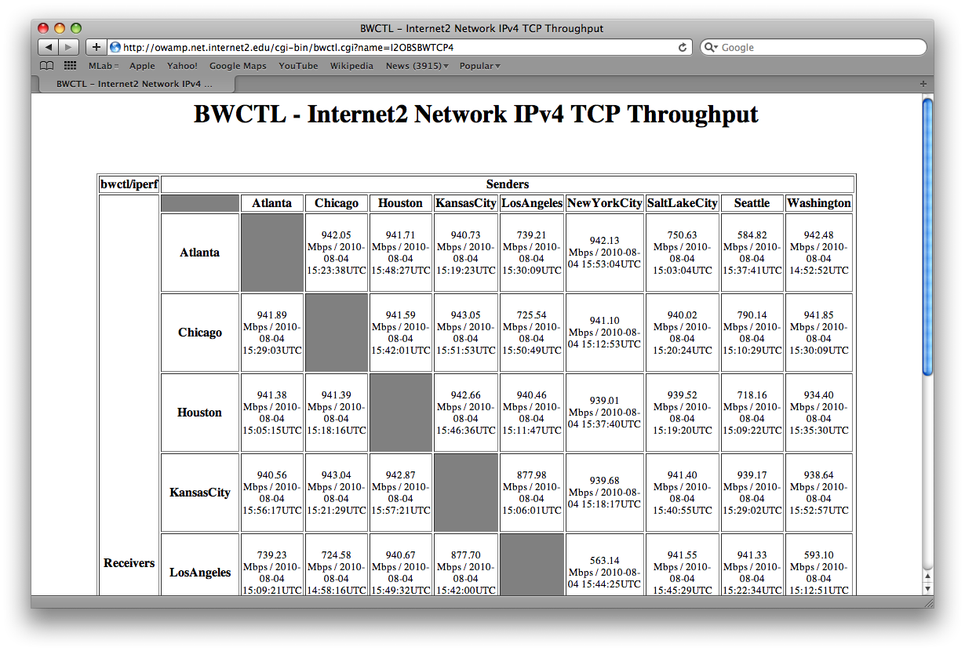
OWAMP GUIs - Mesh
<number> – 11/08/26, © 2010 Internet2

Slide 12
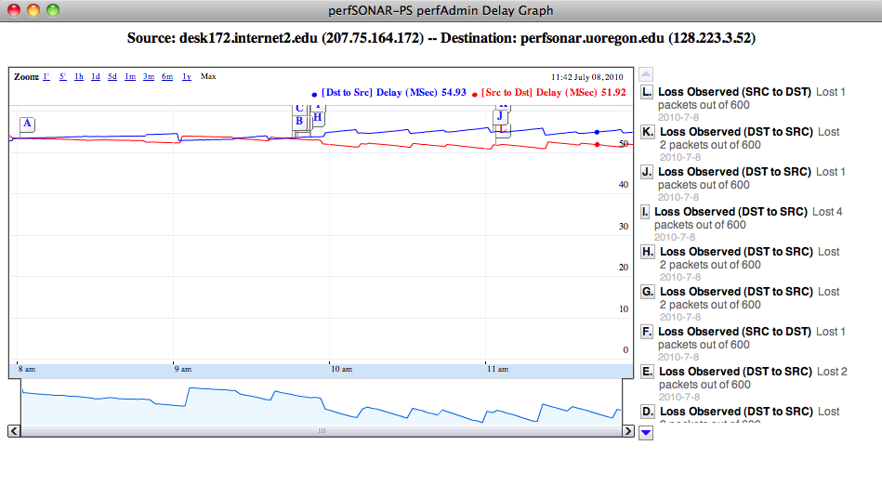
OWAMP GUIs – Delay/Loss Plot
<number> – 11/08/26, © 2010 Internet2

Slide 13
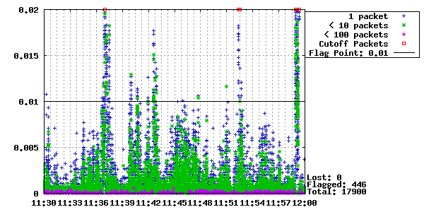
OWAMP GUIs - Jitter
<number> – 11/08/26, © 2010 Internet2

Slide 14
Resource Allocation
Each connection is “classified” (authentication)
Each classification is associated with a set of hierarchical limits
  Bandwidth (bandwidth)
  Session buffer (disk)
  Data retention (delete_on_fetch)
  Connection policy (allow_open_mode)
(no time dependent dimension to resource allocation in owampd)
<number> – 11/08/26, © 2010 Internet2

Slide 15
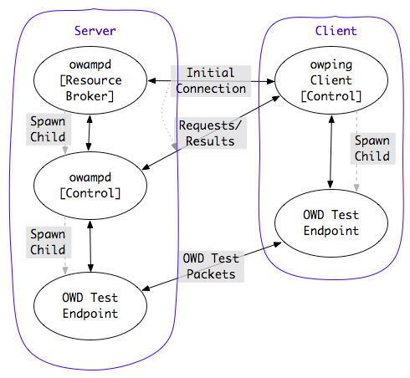
Architecture
<number> – 11/08/26, © 2010 Internet2

Slide 16
General Requirements – Time Source
NTP (ntpd) synchronized clock on the local system
  Configure NTP properly (don’t rely on system defaults!)
  Strictly speaking, owamp will work without NTP. However, your results will be meaningless in many cases
  More info here: http://www.internet2.edu/performance/owamp/details.html#NTP
<number> – 11/08/26, © 2010 Internet2

Slide 17
General Requirements – Support
Source should compile for all modern *NIX
  *BSD, Linux, OS X
  configure/make/make install
RPMs compiled specifically for CentOS 5.x
  May work with other RPM based systems (Fedora, RHEL)
<number> – 11/08/26, © 2010 Internet2

Slide 18
Hardware
Stable System Clock
  Temperature controlled environment
  No power management of CPU
  “Smart” or “Green” CPUs/Cores may degrade performance to save energy – this may cause jitter in the measurements
No strict requirements for CPU, Memory, Bus speed
  More tasking schedules will require more capable hardware
<number> – 11/08/26, © 2010 Internet2

Slide 19
Operational Concerns
Time:
  NTP issues predominate the problems
  Determining an accurate timestamp “error” is in many ways more difficult than getting a “very good” timestamp
  Working as an “open” server requires UTC time source (For predefined test peers, other options available)
Firewalls:
  Port filter trade-off
    Administrators like pre-defined port numbers
    Vendor manufactures would probably like to “prioritize” test traffic
  Owampd allows a range of ports to be specified for the receiver
  Read documentation for more details
<number> – 11/08/26, © 2010 Internet2

Slide 20
Policy/Security Considerations
Third-Party DoS source
  Compromised server may send packets to other locations.
DoS target
  Excessive traffic will harm measurement results
Resource consumption
  Memory (primary and secondary)
  Network bandwidth
<number> – 11/08/26, © 2010 Internet2

Slide 21
Policy Recommendations
Restrict overall bandwidth to something relatively small
  Most OWAMP sessions do not require much
Limit “open” tests to ensure they do not interfere with precision of other tests
<number> – 11/08/26, © 2010 Internet2

Slide 22
Availability
Main Page:
  http://www.internet2.edu/performance/owamp
Mailing lists:
  owamp-users@internet2.edu
  owamp-announce@internet2.edu
<number> – 11/08/26, © 2010 Internet2

Slide 23
Hands On
Testing OWAMP:
  Log on to testbed
  Test from one host to another:
    owping HOSTNAME
  Try different hosts. Try longer tests. What happens when we use:
    -c (number of packets to send, try 1000)
    -t (test to HOSTNAME only)
    -f (test from HOSTNAME only)
<number> – 11/08/26, © 2010 Internet2

Slide 24
OWAMP
August 10th 2010, OSG Site Admin Workshop – Network Performance
Jason Zurawski – Internet2
For more information, visit http://www.internet2.edu/workshops/npw
<number> – 11/08/26, © 2010 Internet2

