Slide 1
OSG
Area Coordinators
Meeting
Proposal
Chander Sehgal
Fermilab
630-840-5618
cssehgal@fnal.gov

Slide 2
Area Coordinators
Meeting Purpose
Track Progress on Key Initiatives and currently defined Work Program
  WBS is the plan-of-record; but a living document
  We can update the WBS as technology and stakeholders needs evolve
  We can update the WBS as our priorities evolve
Share information across OSG areas and leverage synergies
Identify issues in a timely manner and kick-off steps to develop mitigation plans

Slide 3
Area Coordinators
A Pivotal Role in OSG
Plan the work program (➔ WBS)
  Major initiatives that align with the OSG Vision
  Based on understanding the needs of stakeholders
  Handle interface to external partners (LHC, LIGO,…..)
Coordinate effort across multiple institutions (lead the “matrixed” team) for that area
Escalate issues to the Exec. Team when needed
Serve as the point of accountability for leading and managing the work in an area

Slide 4
Process
60 minute telephone meetings every other Thursday at 11:30am central (90 minutes would be better…)
Full cycle to cover all areas will require two meetings (see groupings on next chart)
  <10 minutes per area/sub-area
  2 “prescribed” slides as “standard” presentation (example later)
  Brief additional material, as needed
Talk to higher level status and issues
  Key Accomplishments
  Key Issues and Obstacles
  Exception reporting on WBS; items falling behind or where you have concern about achieving desired results
Evolve this reporting “tool” based on learning and feedback

Slide 5
Near-term Schedule
Facility
  Middleware – Alain Roy (input from Ted Hesselroth)
  Operations – Rob Quick
  Integration and Site Coordination – Rob Gardner
  Troubleshooting – Shaowen Wang
  Engagement – John McGee (input from Sebastien Goasguen)
Security – Mine Altunay
Education & Training – Alina Bejan
Applications, Extensions, and User Support
  Usability and Scalability – Frank Wuerthwein
  Work Load Management – Torre Wenaus
  Users Support – Abhishek Rana & Chris Green
  Storage Management – Ted Hesselroth
Administration & Metrics
  External Communication & Coordination – Ruth Pordes
  Metrics – Brian Bockelman & Ruth
  Resource & Project Management – Chander Sehgal & Kent & Paul
  Users & OSG Community Communication – Anne Heavey
Green
  Feb 14
  Mar 6
  Apr 3
  …
Blue
  Feb 28
  Mar 20
  Apr 17
  …

Slide 6
Presentation Template/Example
(next 3 slides)

Slide 7
Overview
Resource & Project Management
Current Initiatives
  Establish stronger linkage (traceability) for OSG Work program to WLCG and other experiments
  Financial Report for period ending Dec 31, 2007
  Launch Area Coordinators Meeting
  Process FWPs for DOE funding for year3
Accomplishments Since Last Report
  Coordinated the production of 1st Area Coordinators Report for 4Q2007
  Baselined year2 WBS and started monthly status updates
  Achieved >75% SOWs approved within OSG
  Coordinated logistics for NSF/DOE Joint OSG Review
Issues / Concerns
  Need quality review of opportunistic resources management process (authored by Kent Blackburn)
  Internal obstacles to setting up sub-contract to Clemson and Nebraska (need to check with Wisconson – may have recently been resolved?)
  We are staff limited on WBS 5.5.5 (external projects) due to other priority tasks within OSG; falling farther behind on this work
  Establishing a strong WBS connection to WLCG and other experiments will require significant getting started effort in OSG and depends on pro-active help from the science communities

Slide 8
WBS
Resource & Project Management
WBS | Agency | TaskName | Start | Finish | %Complete
5.4 | No | Resource Management | 10/01/07 | 09/30/08 | 28%
5.4.1 | No | Develop & Implement new procedure for SOW approvals to achieve >75% SOWs processed by 11/15/07 | 10/01/07 | 11/15/07 | 100%
5.4.2 | No | Execute and support current change request process, as needed | 10/01/07 | 09/30/08 | 25%
5.4.3 | No | Quarterly financial reports | 10/01/07 | 09/30/08 | 25%
5.4.4 | No | Maximize use of resources needed by VOs to the satisfaction of the stakeholders | 10/01/07 | 09/30/08 | 25%
5.5 | No | Project Administration | 10/01/07 | 09/30/08 | 18%
5.5.1 | No | Baseline year2 WBS 11/1/2007 | 10/01/07 | 11/13/07 | 100%
5.5.2 | No | Execute monthly WBS status updating | 10/01/07 | 09/30/08 | 25%
5.5.3 | No | Execute quarterly PI reporting | 10/01/07 | 09/30/08 | 25%
5.5.4 | No | Execute quarterly Area Coordinator Reporting | 10/01/07 | 09/30/08 | 0%
5.5.5 | No | Keep list of external project dependencies and track deliverables | 10/01/07 | 09/30/08 | 10%

Slide 9
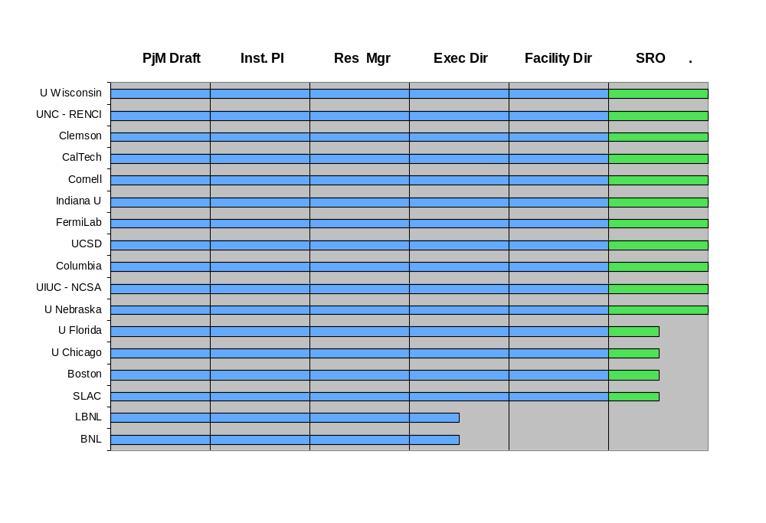
Additional Perspectives
Resource & Project Management

