Slide 1





NEES Performance Management System
Thomas Hacker
Barb Fossum
Matthew Lawrence
Open Science Grid May 19, 2011

Slide 2
What is a Performance Management System?
The Performance Management System is a governance model that utilizes a closed-loop process and defined organizational structures to define and achieve desired strategic and operational performance.
Key Deliverables of the Performance Management System include:
Strategic Plan
Annual Work Plan
Portfolio Implementation Plan
Balanced Scorecard
Operational Reporting
Program Assessments

Slide 3
Why is a Performance Management System important?
Identify the desired future state for the organization satisfying or exceeding stakeholders’ expectations
Understand the challenge – what and how to drive change, identify risks and resistance, define scenarios and opportunities
Define the overall mission of the organization and define what “success” looks like
Establish direction and create focus on what is important
Create understanding and alignment throughout the organization
Define resource requirements and align to prioritized plan
Drive accountability structure for achieving “success”
Respond to changes in the environment, adjust priorities, capability changes, and newly created opportunities

Slide 4

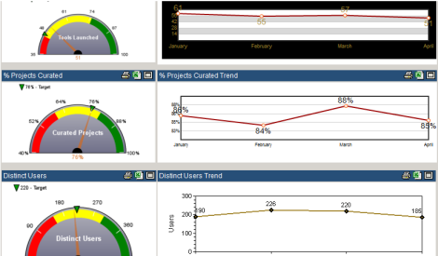
PLAN
ACT
Strategic Plan and Annual Work Plan create FOCUS
DO
PERFORMANCE MANAGEMENT SYSTEM
Assessments identify NEEDS and OPPORTUNITIES
CHECK
Portfolio Management creates ALIGNMENT
Reporting checks performance and drives ACCOUNTABILITY

Slide 5
Planning for Success – Strategic Planning
Strategic Plan Review
Stakeholder Analysis
Mission and Vision
Capability Assessment
Define the Challenge (SWOT – Strengths, Weakness, Opportunities, Threats)
Establish Strategic Goals
Plan Specific Objectives (SMART Objectives)
Identify Critical Success Factors
Plan your Actions
Metrics Identification – How to measure success/progress
Strategy Execution – Define priorities

Slide 6
Strategic Planning at NEES
Interviewed 30+ members of NEES community
Hosted a facilitated NEES Strategic Planning Retreat
Revised plan based upon NEES community drivers
Completed Strategic Plan with reviews from Community Stakeholders, Governance Board, Equipment Sites Forum, and Users Forum
CREATE FOCUS

Slide 7
NEES Facilitated Strategic Planning Meeting Agenda
Day 1
Strategic Plan Review
Stakeholder Analysis
Mission and Vision Review
Strategic Goals Review
Focused-Topic Presentations
Objective Planning (SMART Objectives)
Critical Success Factors
Day 2
Action Planning
Metrics Identification
Strategy Execution – Define priorities

Slide 8
NEES VISION
Through NEES and its partnerships, researchers will have access to the world's best integrated state-of-the-art physical simulation facilities.
NEES will be a cyber-enabled community that shares ideas, data, and computational tools and models.
NEES will provide the education and training for the next generation of earthquake engineering researchers and practitioners.
NEES will have partnerships with organizations to support the dissemination of research results and reducing risks of seismic disasters by transferring these results into practice.
NEES will be a global community achieving excellence in research and education efforts to mitigate earthquake and tsunami risk to life and will serve as a model to other engineering and science communities facing similar challenges.
DEFINE SUCCESS

Slide 9
Strategic Goals for NEES
COMMUNITY
Build a broad and engaged NEES community based upon a culture of collaborating in research and education through sharing facilities, ideas, data, and computational tools and models.
RESEARCH
Enable unique and innovative experimental and computational research that addresses the engineering challenges and responds to the social and institutional factors influencing implementation.
KNOWLEDGE TRANSFER
Support the development of Performance-Based Seismic Design and existing-infrastructure assessment procedures by linking the researcher and practitioner communities.
WORKFORCE DEVELOPMENT
Support the development of the researcher and practitioner talent pipeline through effective education and outreach programs.
PUBLIC AWARENESS
Increase the visibility of the NEES community, capabilities, and contributions focused on reducing earthquake and tsunami risks to life through research, engineering, and education.
FOCUS AREAS to ACHIEVE SUCCESS

Slide 10
Example: Define actions for success
Strategic Goal: Deliver a production-quality cyberinfrastructure
Objective: Develop fully utilized, functional project warehouse by Q4 2010
Critical Success Factors:
Develop NEEShub portal
Curate project data
Develop project viewer
Specific activities are defined and prioritized within Portfolio Mgmt. process
Balanced Scorecard
Lagging Metric:
% of completed projects available in transitioned repository on NEEShub
Leading Metrics:
% of completed projects data curated into project warehouse
% of curated completed projects viewable with new Project Display
Operational Reporting:
% uptime of NEEShub
# of security breaches in cyberinfrastructure
Link actions to objectives and monitor progress
Notes:
Critical success factors are activities/projects planned and prioritized within the portfolio.
Balanced scorecard is used to monitor implementation of strategic plan.
Lagging metrics become operational metrics once objective is initially realized. If metric is not sustained, then corrective actions are identified and prioritized again within the Portfolio. Leading metrics may be also established to monitor the implementation of these corrective actions.

Slide 11
PLAN
ACT
Strategic Plan and Annual Work Plan create FOCUS
DO
PERFORMANCE MANAGEMENT SYSTEM
Assessments identify NEEDS and OPPORTUNITIES
CHECK
Portfolio Management creates ALIGNMENT
Reporting checks performance and drives ACCOUNTABILITY

Slide 12
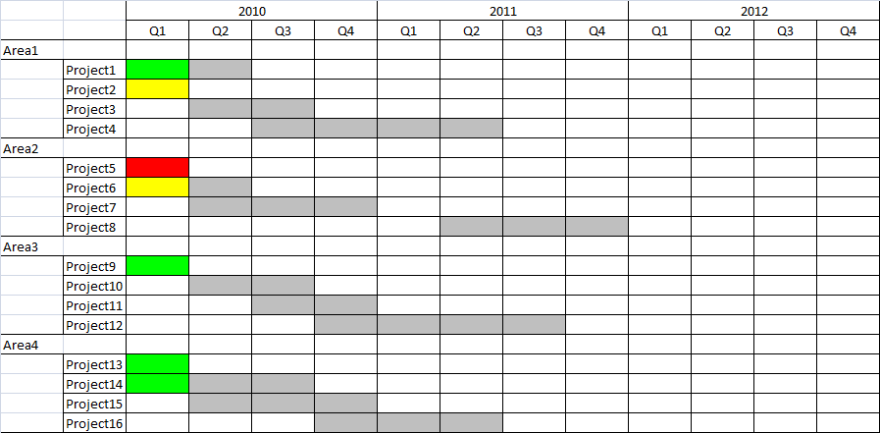
Monitor your execution with Portfolio Management
Puts strategy into action
Aligns organization’s resources to priorities
Time-phased project portfolio
Provides oversight to progress
Create alignment of operations to strategic goals
Notes:
Time-phased means
Monitor what we are doing today (Operational oriented)
Identify what we plan to do in the future (Strategic Council oriented)
Areas are defined by purpose
Strategic review: Area = Strategic Goals (show how projects/critical success factors are aligned to goals)
Operational review: Area = Functional teams (responsibility and resource planning)

Slide 13
Monitor Portfolio Implementation at NEES
New projects linked to Strategic Goals
Prioritization process ensuring focus and alignment for strategy execution
Strategic Council reviews status bi-weekly – issues and opportunities will be discussed and acted upon as needed
Quarterly portfolio be reviewed and updated according to latest priorities and resources
CREATE ALIGNMENT

Slide 14
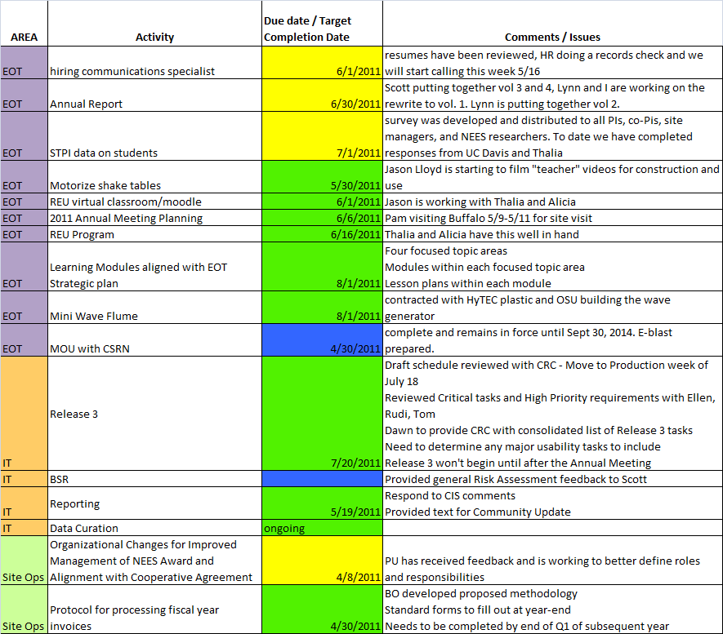
NEES Portfolio Dashboard (example)

Slide 15
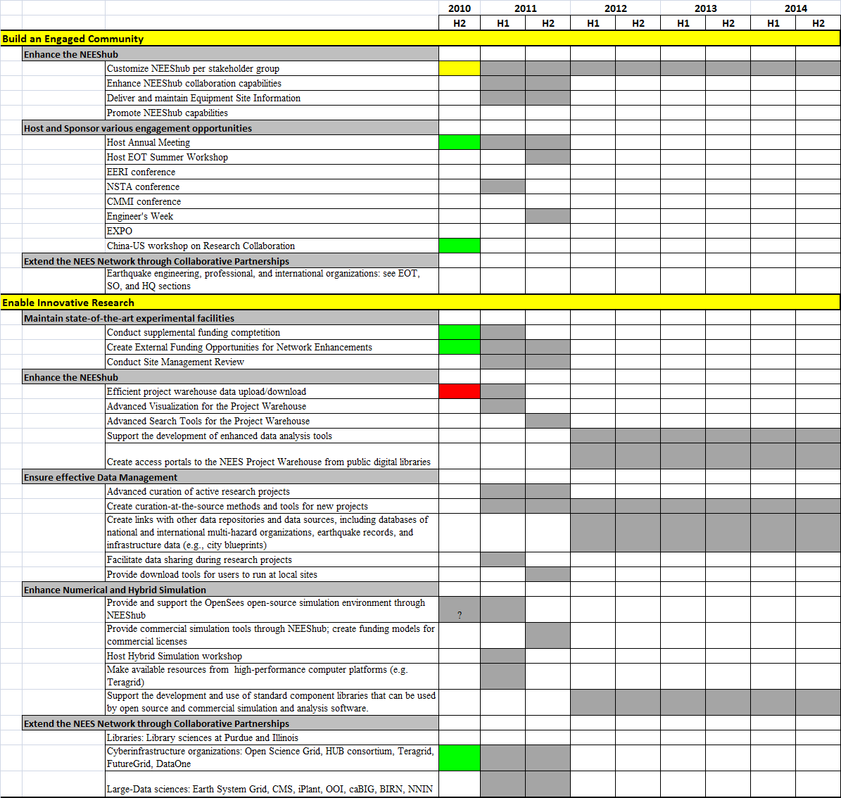
NEES Portfolio Dashboard (another example)

Slide 16
PLAN
ACT
Strategic Plan and Annual Work Plan create FOCUS
DO
PERFORMANCE MANAGEMENT SYSTEM
Assessments identify NEEDS and OPPORTUNITIES
CHECK
Portfolio Management creates ALIGNMENT
Reporting checks performance and drives ACCOUNTABILITY

Slide 17
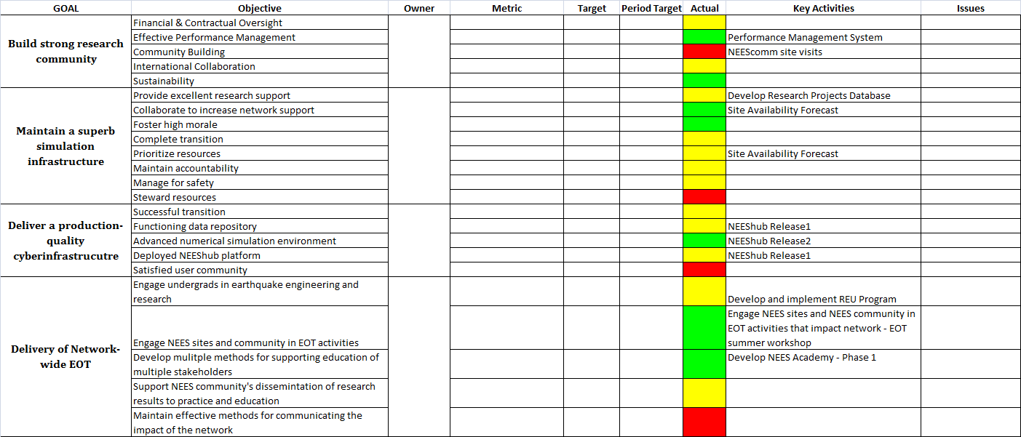
Monitor your Performance
Balanced Scorecard
Tracks delivery of critical success factors
Are we getting there?
Are we there yet?
Operational Reporting
Measures operational performance
Is everything working?
Balanced Scorecard
Dashboard
Think Navigation System versus Dashboard
Notes:
Balanced Scored = Navigation System (input destination, set route, and follow)
Operational Reporting = Dashboard (fuel gauge, speedometer, etc.)
Are we getting there?
Use leading metrics
Leading metrics monitor delivery of critical success factors and indicate whether objective will be objective will be met
Are we there yet?
Use lagging metrics
Lagging metrics are used to measure whether the objective has been met or not

Slide 18
Performance Reporting
NEES uses a Balanced Scorecard reporting method to monitor the implementation of the Strategic Plan
Metrics are linked to Strategic Aims and Objectives
Measures performance against targets defined for period
Quarterly reviews
Corrective action planning feeds portfolio
DRIVE ACCOUNTABILITY

Slide 19
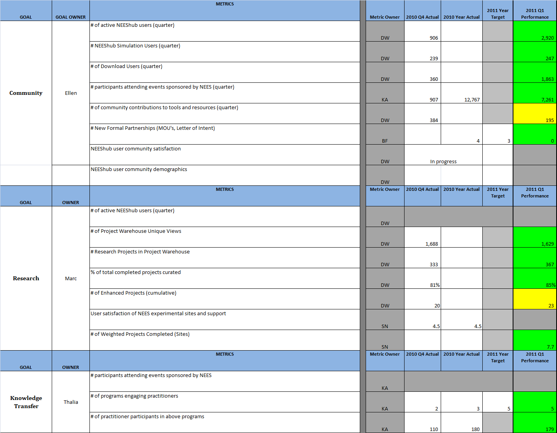
Balanced Scorecard (example)

Slide 20
PLAN
ACT
Strategic Plan and Annual Work Plan create FOCUS
DO
PERFORMANCE MANAGEMENT SYSTEM
Assessments identify NEEDS and OPPORTUNITIES
CHECK
Portfolio Management creates ALIGNMENT
Reporting checks performance and drives ACCOUNTABILITY

Slide 21
Assessments
Assessments are performed throughout the year to identify risks and opportunities for a more impactful implementation of the NEES Strategic Plan:
User Satisfaction
Cyberinfrastructure
Equipment Site
EOT
Budget & Spend
Governance model
User base & demographics assessment
Impact assessment
Self assessments
Balanced Scorecard Reviews
Portfolio Reviews
RESPOND to RISKS and OPPORTUNITIES

Slide 22
PLAN
ACT
Strategic Plan and Annual Work Plan create FOCUS
DO
PERFORMANCE MANAGEMENT SYSTEM
Assessments identify NEEDS and OPPORTUNITIES
CHECK
Portfolio Management creates ALIGNMENT
Reporting checks performance and drives ACCOUNTABILITY

Slide 23
Performance Management Implementation
Start somewhere – don’t always need to start with strategic plan (maybe start with reporting)
Be practical – use it then adjust
Keep it Simple
Commit to it – the payoff is there
Performance
Efficiency
Creditability

Slide 24
Acklowedgements
Thanks to Matt Lawrence and Barb Fossum for the slides
Barb Fossum, Deputy Director NEES
(765) 494-6403 bfossum@purdue.edu
Matt Lawrence, Management Consultant
(765) 532-9004

