Slide 1
Campus Grids & Campus Infrastructures Community
Rob Gardner
Computation Institute / University of Chicago
June 4, 2013

Slide 2
Recasting Campus Grids as Platform of Services
OSGConnect.org
Define a suite of service offerings for campuses
Connect to resources with increasing capabilities
Task Launch
Cycle Share
Software Share
Data Share
Data
Local access
Anywhere access
Transfer services
Advanced analytics
Software
Campus access
Anywhere access
Tasks
Resource access
Campus
Grid
Cloud
HPC
Connected Science Shared Capabilities

Slide 3
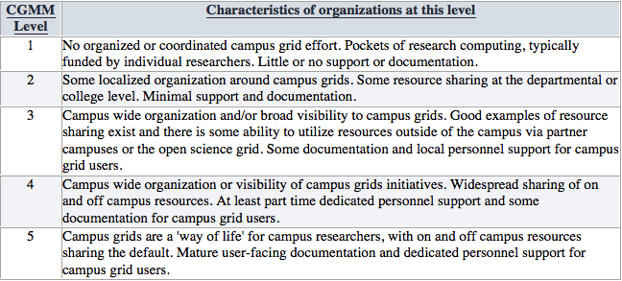
Campus Infrastructures Maturity Model
INCREASING CAPABILITIES
None
BOSCO campus usage
+ OSG Connect : Jobs
+ OSG Connect : Software & Data access
+ OSG Connect : Integrated Accounting & Informatics
https://twiki.grid.iu.edu/bin/view/CampusGrids/DeployedCampusInfrastructures

Slide 4
What are the elements?
Graduated Platform of Services
Campus Engagement & Identity Integration tools
Job management: BOSCO and its extensions + pure HTCondor
Distributed software access (OASIS, PALMS, PARROT)
Distributed data access (SRM, XRD, HTTP, SKELETONKEY)
Accounting and Informatics services for cycle sharing (GRATIA, CIVAIS)
Campus Infrastructures Community
Forum, meetings, context to drive adoption, gather feedback, register impact
Tutorials, demonstrators, campus blueprints, engagements

Slide 5
Campus Infrastructure in the OSG context
A Campus Infrastructure is a resource sharing capability that enables users to submit jobs and access data from diverse compute resources using only their campus identity management credentials.
A campus infrastructure is not limited to resources on a campus but incorporates the ability to access resources directly from other campuses and can also fuse resources from national cyberinfrastructures such as the Open Science Grid (OSG) or XSEDE.

Slide 6
Capabilities
Foundational
Campus identity ( → federated, grid)
Job management over diverse resources
Ubiquitous software and data access
Monitoring and accounting services
Practical
Application best practices on d-HTC
Advanced workflow services
Advanced user interfaces

Slide 7
SkeletonKey
Motivated by UC3 users needing to have an easy way to remotely access their software and data on clusters around campus
Designed as an easy alternative for users to manually using Parrot/Chirp
Utilizes Parrot/Chirp but provides an easy to use configuration file

Slide 8
Design Goals
Provide an easily understood way for users to incorporate remote software/data access into their current workflows
Allow users to expand their computations to incorporate opportunistic usage of other campus clusters
Eventually, allow users to expand from campus grids to using OSG opportunistically

Slide 9
Current Work
Have initial ‘version one’ implementation
Working with three groups to incorporate SkeletonKey in their workflows and actively utilize campus grid environment at U of C
Incorporating user feedback into current code and updating features based on user needs

Slide 10


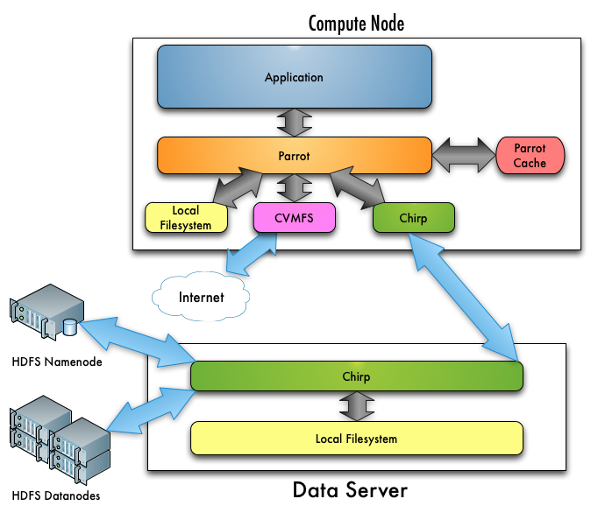
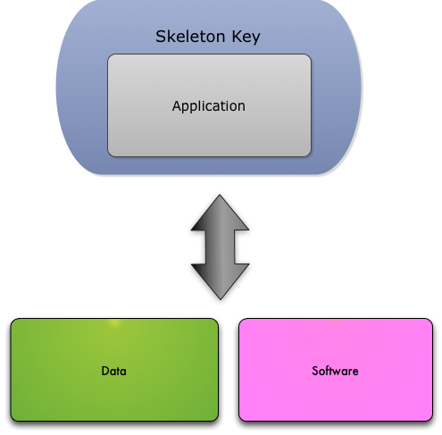
SkeletonKey
Directly
With SkeletonKey
Notes:
Use diagrams for software / data slides

Slide 11
PALMS project
OASIS:
provides the infrastructure to host the software in CVMFS but users need more guidance to install the software (1) and to access it from OSG resources (2)
Programs, Applications and Libraries Management and Setup (PALMS)
A system to install and manage software in OASIS
Simplifies the packaging and installation of different versions for different platforms
Helps users to setup the correct and desired environment (applications and libraries)

Slide 12
PALMS software manager features
Help packaging application and deploying it on OASIS (or into any CVMFS stratum)
Allow installs, updates and removals of applications and libraries
Allow multiple versions for distinct platforms
Allow multiple versions for the same platform
Does not require root on the OASIS server
Can manage and solve dependencies and conflicts
Help adapting and installing native packages

Slide 13
PALMS user features
Help select the correct version for the platform
Provide a default version but allow to choice
Setup the correct environment for the user shell
Work automatically with different shells
Add no performance penalty compared to default OASIS

Slide 14
PALMS activities
Project planning
Presentations and white paper
Software development, packaging and documentation
Deployment on OSG OASIS and on UC3
Librarian (software manager) activities for the OSG VO

Slide 15
CIVAIS project
There is a lot of information about the operation of a Campus Infrastructure or OSG
Processed information is more valuable than raw data
Data and info differ by role (researcher, PI, computer center director, funding program manager, network administrator, …)
CIVAIS: Campus Infrastructures Visual Analytics and Informatics Services
A analytics service collecting information form a Campus Infrastructure
Provides clear, concise and flexible views for users
And an open data platform (policy based) to stimulate derived metrics and 3rd party apps for advanced analytics

Slide 16
Use Case Example (1)
What do computing center executive/steering committees most want to know?
How are resources being used
Are they serving investing stakeholders fairly, as well as the broader university community
Is capacity meeting demand
Which technologies (processing, storage, network, visualization) are most likely to yield the most benefit to the most users
How do we judge the effectiveness of resource usage for advancing the scientific goals of our stake-holding partners

Slide 17
Use Case Example (2)
What does the OSG Executive Team most want to know?
How effective is the campus program in engaging new users and research communities on campuses
Which disciplines, outside of high energy physics, have received benefit from OSG
What are the impacts of OSG services and technologies on accelerating the scientific mission of our stake-holding organizations as well as the national

Slide 18
CIVAIS key features
Design starting from the user experience
Multiple roles determining access policies and interests
Interactive extensible web displays tailored to the role of the user
Designed for a Campus Infrastructure
Easy to install and deploy on a Campus
Hierarchical reporting for a wider community (e.g. OSG CIC)
Highly scalable
a single Campus reporting running on a single machine, bigger and more complex structures scaling on a distributed architecture
Pluggable and open interface
Accepting multiple inputs (Gratia, message queues, etc…)
Ability to add custom views to the display
Open Data available via RESTful API

Slide 19
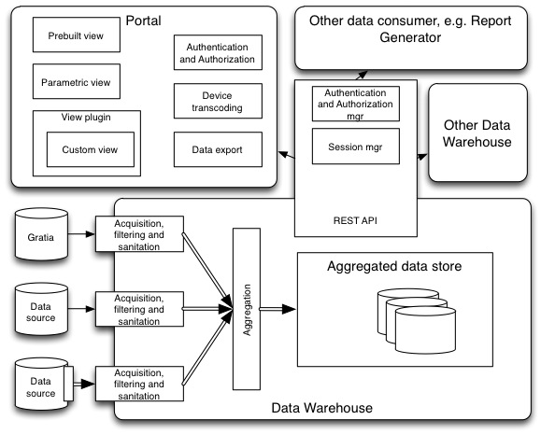
CIVAIS architecture diagram

Slide 20
CIVAIS architecture highlights
Highly scalable and reliable data warehouse
Multiple data inputs including Gratia server and probes and Google documents and Web forms
Message bus for flexible and reliable communication (double arrows in the diagram)
RESTful API for controlled data access
Multiplatform portal using HTML5 and vector graphics for viewing, browsing and exporting data
Standard plug-in definition for both data input and viewer extension

Slide 21
CIVAIS activities
Project planning
Presentations and white paper
Project mock-ups and evaluation
Software development, packaging and documentation
Deployment and testing on UC3

