Slide 1




Building, Monitoring and Maintaining a Grid

Slide 2
Introduction
What we’ve already learned
  What are grids, why we want them and who is using them: Intro
  Grid Authentication and Authorization
  Harnessing CPU cycles with condor
  Data Management and the Grid
In this lecture
  Fabric level infrastructure: Grid building blocks
  National Grid efforts in the US
    The Open Science Grid
    TeraGrid

Slide 3
Grid Building Blocks
Computational Clusters
Storage Devices
Networks
Grid Resources and Layout:
  User Interfaces
  Computing Elements
  Storage Elements
  Monitoring Infrastructure…

Slide 4
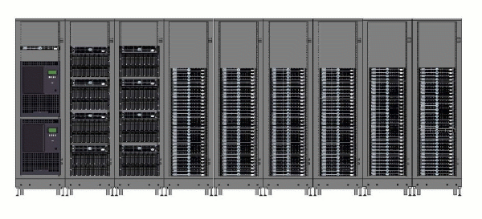
Computer Clusters
Cluster Management
“frontend”
I/O Servers typically RAID fileserver
A few Headnodes, gatekeepers and other service nodes
Disk Arrays
The bulk are Worker Nodes
Dell Cluster at the University of Florida High Performance Computing Center (Phase I)
Tape Backup robots

Slide 5
A Typical Cluster Installation
WAN
Computing Cycles
Data Storage
Connectivity
Head Node/Frontend Server
Pentium III
I/O Node + Storage
Cluster Management
  OS Deployment
  Configuration
  Many options
    ROCKS (kickstart)
    OSCAR (sys imager)
    Sysconfig
Worker Nodes
Pentium III
Pentium III
Network Switch
Pentium III

Slide 6
Networking
“one planet one network”
Global Crossing
WAN
Internal Networks (LAN)
  Private, accessible only to servers inside a facility
  Some sites allow outbound connectivity via Network Address Translation
  Typical technologies used
    Ethernet (0.1, 1 & 10 Gbps)
    HP, Low Latency interconnects
      Myrinet: 2, 10 Gbps
      Infiniband: max at 120Gbps
External connectivity
  Connection to Wide Area Network
  Typically achieved via same switching fabric as internal interconnects
Head Node/Frontend Server
Pentium III
I/O Node + Storage
Worker Nodes
Pentium III
Pentium III
Network Switch
Pentium III

Slide 7
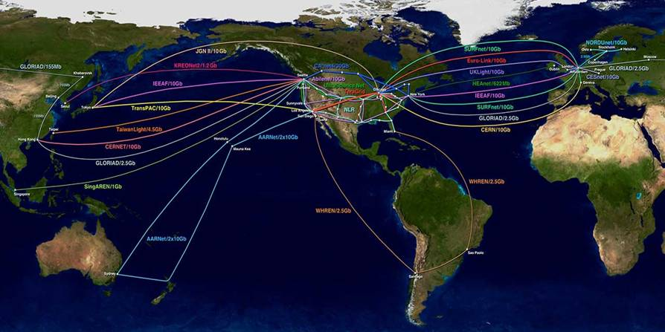
The Wide Area Network
Ever increasing network capacities are what make grid computing possible, if not inevitable
The Global Lambda Integrated Facility for Research and Education (GLIF)

Slide 8
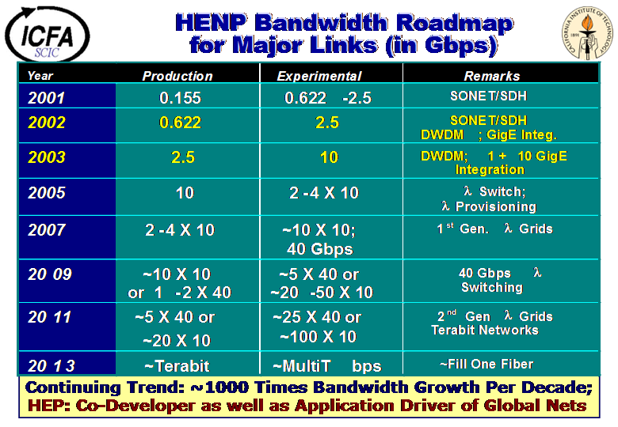


Slide 9
Computation on a Clusters
WAN
Batch scheduling systems
  Submit many jobs through a head node
    #!/bin/sh
    for each i in $list_o_jobscripts
    do
    /usr/local/bin/condor_submit $i
    done
  Execution done on worker nodes
Many different batch systems are deployed on the grid
  condor (highlighted in lecture 5)
  pbs, lsf, sge…
Head Node/Frontend Server
Pentium III
I/O Node + Storage
Worker Nodes
Pentium III
Pentium III
Network Switch
  Primary means of controlling CPU usage, enforcing allocation policies and scheduling of jobs on the local computing infrastructure
Pentium III

Slide 10
Computation on Super Computers
What is a super computer?
  Machines with lots of share memory and large number of symmetric multiprocessors
  Also large farms with low latency interconnects…
Applications tailored to a specific to Super computer, class or hardware
  Hardware optimized applications
  Massively parallel jobs on large SMP machines
  Also Message Passing Interface
    treat cluster with fast interconnects as SMP machine

Slide 11
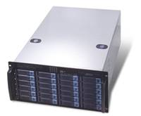
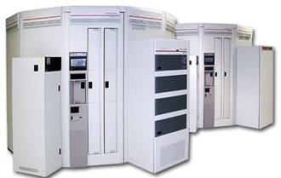
Storage Devices
Many hardware technologies deployed from:
  Single fileserver
    Linux box with lots of disk: RAID 5…
    Typically used for work space and temporary space a.k.a. local or “tactical” storage
  to
  Large Scale Mass Storage Systems
    Large peta-scale disk + tape robots systems
    Ex: FNAL’s Enstore MSS
      dCache disk frontend
      Powderhorn tape backend
    Typically used as permanent stores
    “strategic” storage
StorageTek Powderhorn Tape Silo

Slide 12
Tactical Storage
WAN
Typical Hardware Components
  Servers: Linux, RAID controllers…
  Disk Array
    IDE, SCSI, Fiber Channel attached
    RAID levels 5, 0, 50, 1…
Local Access
  Volumes mounted across compute cluster
    nfs, gpfs, afs…
  Volume Virtualization
    dCache
    pnfs
Remote Access
  gridftp: globus-url-copy
  SRM interface
    space reservation
    request scheduling
Head Node/Frontend Server
Pentium III
/share/DATA = nfs:/tmp1
/share/TMP = nfs:/tmp2
/tmp1
/tmp2
Worker Nodes
Pentium III
Pentium III
Network Switch
/share/DATA = nfs:/tmp1
/share/TMP = nfs:/tmp2
Pentium III

Slide 13
Layout of Typical Grid Site
The
Gr i
d
A Grid Site
Computing Fabric
User Interface
Compute
Element
Authz server
=>
Monitoring Element
+
Storage
Element
+
=>
Grid Middleware
Grid Level Services
globus
globus
globus
Data Management Services
Grid Operations
globus
globus
Monitoring Clients Services

Slide 14
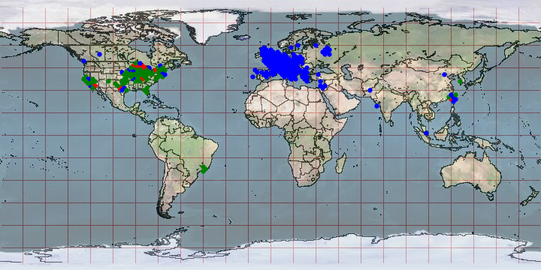
World Grid Resources
TeraGrid + OSG + EGEE sites

Slide 15
National Grid Infrastructure
The Open Science Grid
&
The TeraGrid

Slide 16


Grid Resources in the US
The TeraGrid
The OSG
Origins:
  National Super Computing Centers, funded by the National Science Foundation
Current Compute Resources:
  9 TeraGrid sites
  Connected via dedicated multi-Gbps links
  Mix of Architectures
    ia64, ia32: LINUX
    Cray XT3
    Alpha: True 64
    SGI SMPs
  Resources are dedicated but
    Grid users share with local and grid users
    1000s of CPUs, > 40 TeraFlops
  100s of TeraBytes
Origins:
  National Grid (iVDGL, GriPhyN, PPDG) and LHC Software & Computing Projects
Current Compute Resources:
  61 Open Science Grid sites
  Connected via Inet2, NLR.... from 10 Gbps – 622 Mbps
  Compute & Storage Elemets
  All are Linux clusters
  Most are shared
    Campus grids
    Local non-grid users
  More than 10,000 CPUs
    A lot of opportunistic usage
    Total computing capacity difficult to estimate
    Same with Storage

Slide 17







The Open Science Grid
A consortium of universities and National Laboratories to build a sustainable grid infrastructure for science in the U.S.
…

Slide 18
The Open Science Grid
OSG Resource Providers
User Communities
OSG Operations
UW Campus Grid
Nanotech
nanoHub
UW Campus Grid
Biology
nanoHub
VO support center
VO support center
VO support center A
AstroPhysics
LIGO VO
Dep.
cluster
AstroPhysics
LIGO VO
Dep.
cluster
FNAL
cluster
Astrophysics
LIGO VO
Dep.
cluster
BNL cluster
Dep.
cluster
BNL cluster
RP support center
RP support center
RP support center
RP support center A
AstromomySDSS VO
AstromomySDSS VO
Astronomy SDSS VO
HEP Physics
CMS VO
Tier2 site A
HEP Physics
CMS VO
Tier2 site A
HEP Physics
CMS VO
Tier2 site A
HEP Physics
CMS VO
Tier2 site A
Virtual Organization (VO): Organization composed of institutions, collaborations and individuals, that share a common interest, applications or resources. VOs can be both consumers and providers of grid resources.

Slide 19
The OSG: A High Level View
Grid Operations User & Facilities Support
OSG Operations
Grid Software and ENV Deployment
OSG Provisioning
Authorization, Accounting and Authentication
OSG Privilege
Grid Monitoring and Information Systems
OSG Monitoring and Information

Slide 20
OSG
Authentication, Authorization
&
Accounting
“Authz”

Slide 21
Authentication & Authorization
Authentication:
  Verify that you are who you say you are
  OSG users typically use the DOEGrids CA
  OSG sites also accept CAs from LCG and other organizations including TeraGrid
Authorization:
  Allow a particular user to use a particular resource
  Method based on flat files (the gridmap-file)
  Privilege method, used primarily at US-LHC sites

Slide 22
OSG Authentication (1)
The gridmap-file
  Physical mapping of users Distinguished Name (DN) to local Unix account
"/C=CH/O=CERN/OU=GRID/CN=Laurence Field 3171" ivdgl
"/C=CH/O=CERN/OU=GRID/CN=Michela Biglietti 4798" usatlas1
"/C=CH/O=CERN/OU=GRID/CN=Shulamit Moed 9840" usatlas1
"/C=ES/O=DATAGRID-ES/O=PIC/CN=Andreu Pacheco Pages" cdf
"/C=FR/O=CNRS/OU=LPNHE/CN=Antonio Sidoti/Email=sidoti@lpnhep.in2p3.fr" cdf
"/C=IT/O=INFN/OU=Personal Certificate/L=CNAF/CN=Daniele Cesini/Email=daniele.cesini@cnaf.infn.it" cdf
"/C=IT/O=INFN/OU=Personal Certificate/L=CNAF/CN=Subir Sarkar" cdf
"/C=IT/O=INFN/OU=Personal Certificate/L=Padova/CN=Ignazio Lazzizzera" cdf
"/C=IT/O=INFN/OU=Personal Certificate/L=Pisa/CN=Armando Fella" cdf
"/C=IT/O=INFN/OU=Personal Certificate/L=Roma 1/CN=Daniel Jeans" cdf
"/C=IT/O=INFN/OU=Personal Certificate/L=Trieste/CN=stefano belforte/Email=stefano.belforte@ts.infn.it" cdf
"/C=UK/O=eScience/OU=Birmingham/L=ParticlePhysics/CN=carlo nicola colacino" ligo
rmingham/L=ParticlePhysics/CN=chris messenger" ligo
rmingham/L=ParticlePhysics/CN=virginia re" ligo
rmingham/L=ParticlePhysics/CN=virginia re 0C74" ligo

Slide 23
OSG Authentication (2)
edg-mkgridmap.sh
gridmap-file
user DNs
Grid site A
vomss://grid03.uits.indiana.edu.…/ivdglpl
OSG VOMS
Grid site B
CMS DNs
vomss://lcg-voms.cern.ch:8443/voms/cms
CMS VOMS
user DNs
vomss://voms.fnal.gov:8443/voms/nanohub
nanHub VOMS
VOMS= Virtual Organization Management System
DN=Distinguished Name
edg= European Data Grid (EU grid project)
Grid site N

Slide 24
The Privilege Project
Application of a
Role Based Access Control model for OSG
  An advanced authorization mechanism

Slide 25
The Privilege Project Provides
A more flexible way to assign DNs to local UNIX qualifiers, (uid, gid…)
  VOMSes are still used to store grid identities
  But gone are the static gridmap-files
  voms-proxy-init replaces grid-proxy-init
    Allows a user to specify a role along with unique ID
  Access rights granted based on user’s
    VO membership
    User selected role(s)
Grid Identity Unix ID Certificate DN <−−−−−−−−−−
Role(s) <−−−−−−−−−−−−−−−
|→ UID

Slide 26
Privilege Project Components
User Management
(VOMSRS)
Server with VDT>1.3 based on gt3.2
Client server (UI)
1. VOMS-proxy-init request
with specified role
A VO service
Client tool for
role selection:
VOMS-proxy-init
VOMS
Server
VOMS
Attribute
Repository
2. Retrieves VO membership and role attribute
3. Standard globus-job-runrequest with VOMS-extended proxy
VO membership synchronization
Servers with VDT > 1.3 based on gt3.2
4. HTTPS/SOAP Request: SAML Query:
Web-Service Container
Server with VDT 1.3 based on GT3.2
Server with VDT 1.3 based on GT3.2
GUMS Identity Mapping Service
(manages user accounts on resources, incl. dynamic allocation)
gridFTP &
Gate-keeper
Gridmap
callout
PRIMA
module
May user “Markus Lorch” of “VO=USCMS / Role=prod” access this resource?
5. HTTPS/SOAP Response:
6. instantiates
SAML Statement: Decision=Permit, with obligation local UID=xyz, GID=xyz
job-manager
An OSG site

Slide 27
OSG Grid Monitoring

Slide 28
OSG Grid Monitoring
Site Level Infrastructure
Grid Level Clients
MonALISA server
MIS-Core Infrastructure
MDS
GridCat
stor_stat
https: Web Services
ACDC
Monitoring
Information
Consumer API
Ganglia
GRAM: jobman-mis
GINI, SOAP, WDSL…
MonALISA
GIP
Collector
job_state
Monitoring
information
DataBase
Discovery
Service
Historical
information
DataBase
…
others…

Slide 29
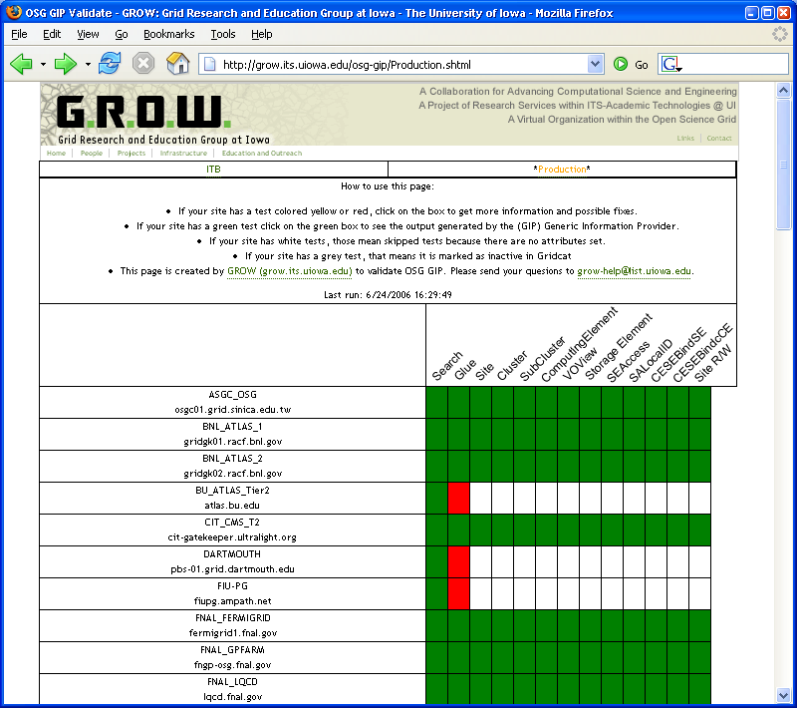
OSG MDS: GIP and BDII
The Generic Information Provider (GIP)
  Collects & formats information for a site’s GRIS
  Integrated with other OSG MIS systems
The Berkley Database Information System (BDII)
  LDAP information repository of GLUE information collected from a site’s GRIS
  GRIS is part of the globus’ MDS information system
  EGEE Interoperability between OSG & EGEE grids
http://scan.grid.iu.edu/ldap/index.html

Slide 30
OSG Grid Level Clients
Tools provide basic information about OSG resources
  Resource catalog: official tally of OSG sites
  Resource discovery: what services are available, where are they and how do I access it
  Metrics Information: Usage of resources over time
Used to asses scheduling priorities
  Where and when should I send my jobs?
  Where can I put my output?
Used to monitor health and status of the Grid

Slide 31
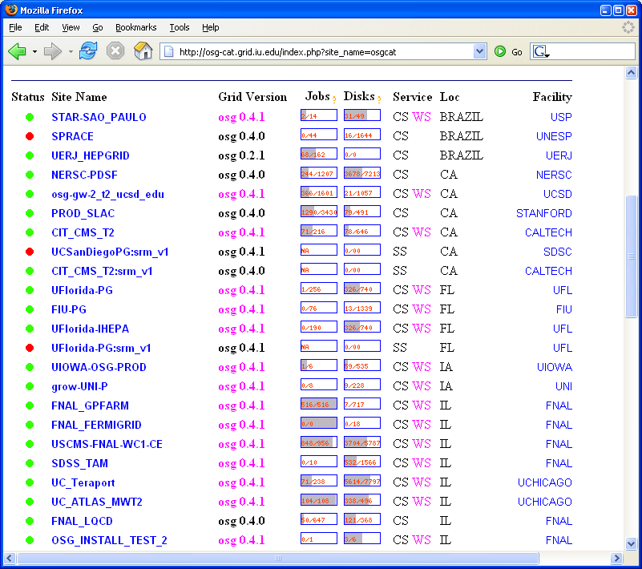
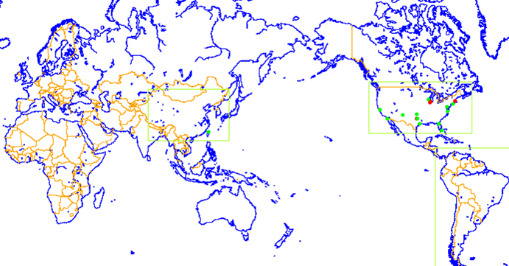
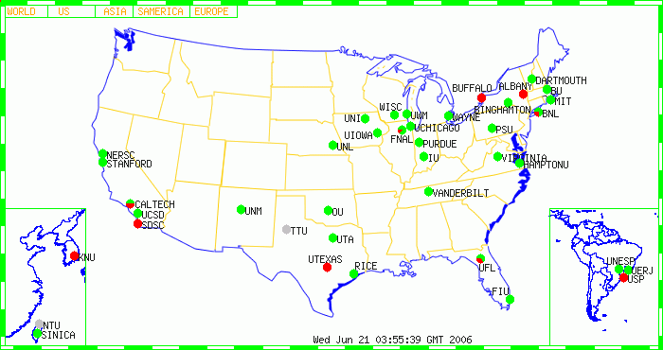
GridCat
Functions as:
OSG Site Catalog
Site Basic Functionality Tests
http://osg-cat.grid.iu.edu

Slide 32
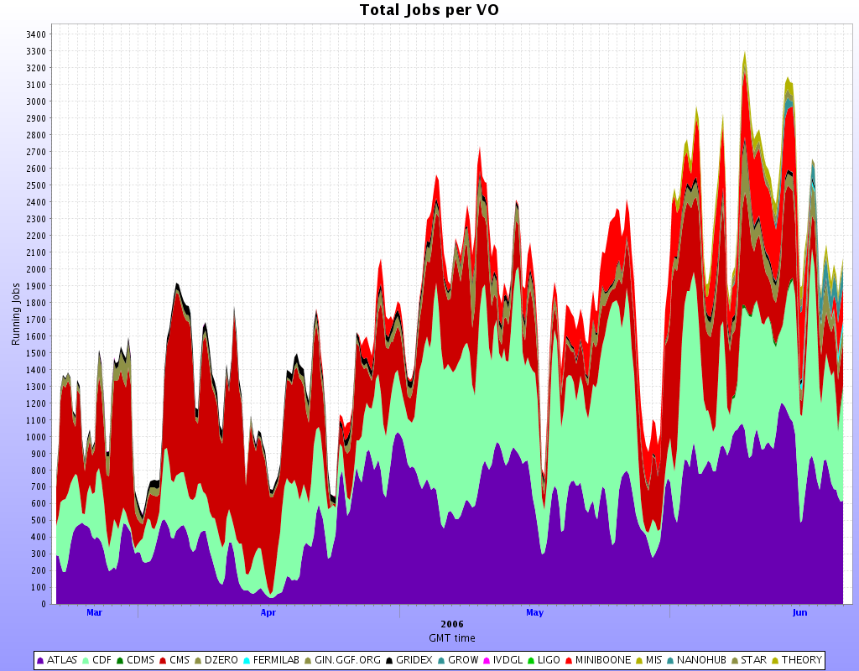
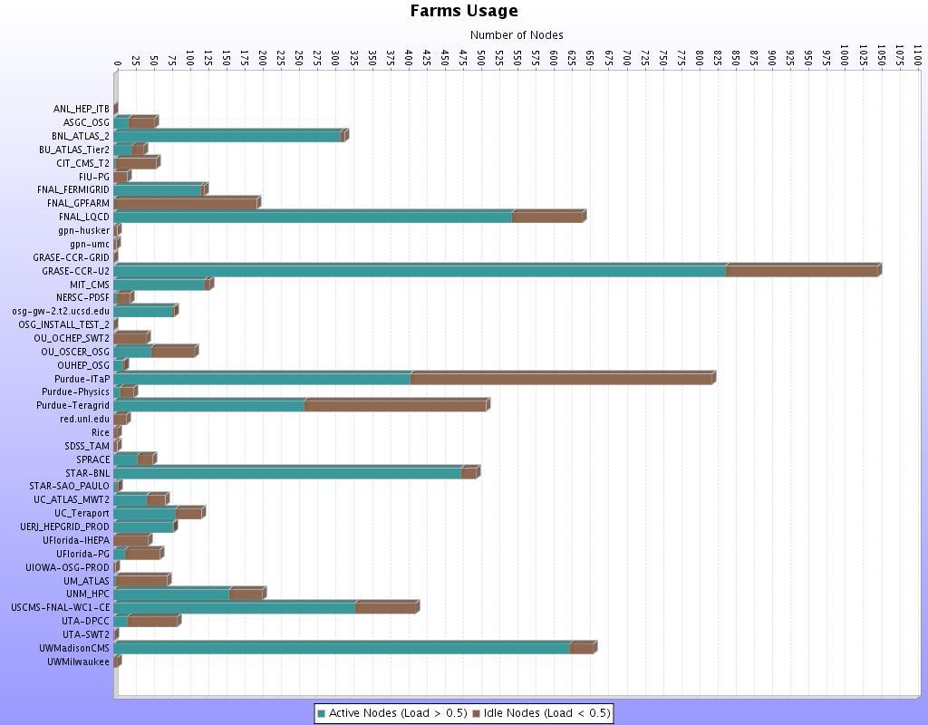
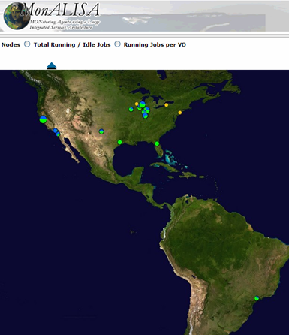
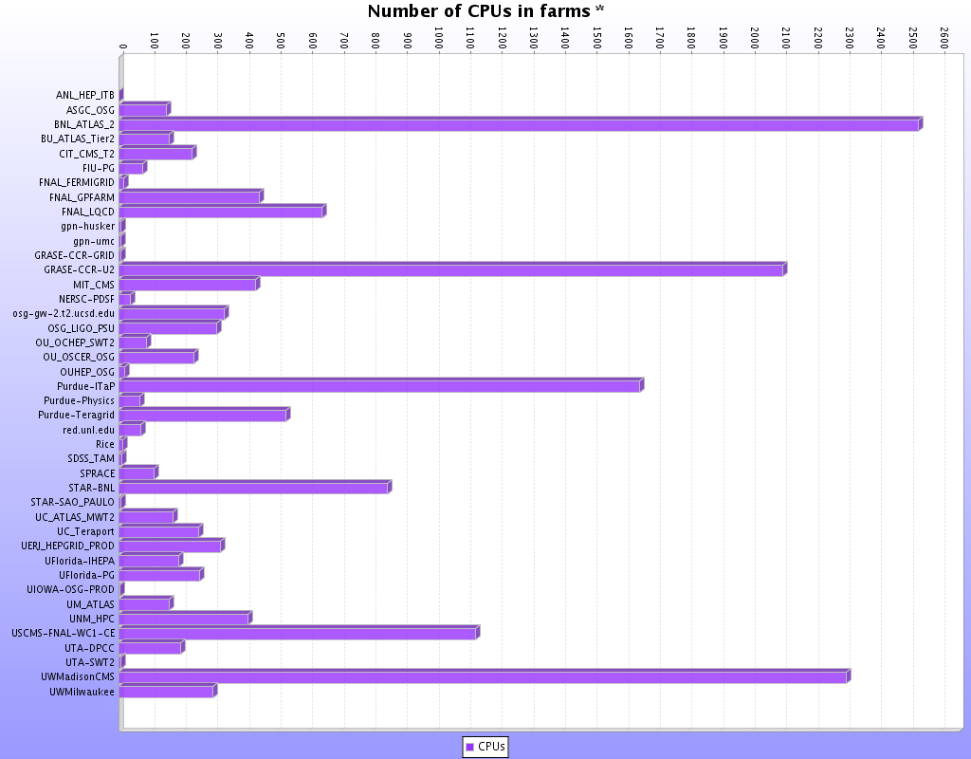
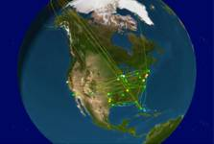
MonALISA

Slide 33
OSG Provisioning:
Grid Middleware & ENV Deployment
OSG Software Cache
OSG Meta Packager

Slide 34
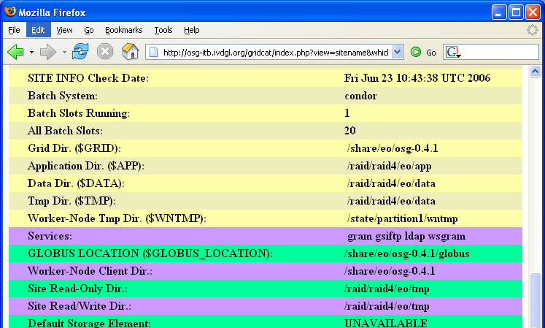
The OSG ENV
Provide access to grid middleware ($GRID)
  On the gatekeeper node via shared space
  Local disk on the worker node via wn-client.pacman
OSG “tactical” or local storage directories
  $APP: global, where you install applications
  $DATA: global, write job output staging area
  SITE_READ/SITE_WRITE: global, but on a Storage Element on site
  $WN_TMP: local to Worker Node, available to job

Slide 35
The OSG Software Cache
Most software comes from the Virtual Data Toolkit (VDT)
OSG components include
  VDT configuration scripts
  Some OSG specific packages too
Pacman is the OSG Meta-packager
  This is how we deliver the entire cache to Resource Providers

Slide 36
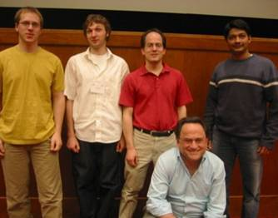
What is The VDT ?
A collection of software
  Grid software
  Virtual data software
  Utilities
An easy installation mechanism
  Goal: Push a button, everything just works
  Two methods:
    Pacman: installs and configures it all
    RPM: installs some of the software, but no configuration
A support infrastructure
  Coordinate bug fixing
  Help desk

Slide 37
What is in the VDT? (A lot!)
Condor Group
  Condor/Condor-G
  DAGMan
  Fault Tolerant Shell
  ClassAds
  NeST
Globus (pre WS & GT4 WS)
  Job submission (GRAM)
  Information service (MDS)
  Data transfer (GridFTP)
  Replica Location (RLS)
EDG & LCG
  Make Gridmap
  Cert. Revocation list updater
  Glue & Gen. Info. provider
  VOMS
Core software
User Interface
Computing Element
Storage Element
Authz System
Monitoring System
Condor Group
  Condor/Condor-G
  DAGMan
  Fault Tolerant Shell
  ClassAds
  NeST
Globus (pre WS & GT4 WS)
  Job submission (GRAM)
  Information service (MDS)
  Data transfer (GridFTP)
  Replica Location (RLS)
EDG & LCG
  Make Gridmap
  Cert. Revocation list updater
  Glue & Gen. Info. provider
  VOMS
ISI & UC
  Chimera & Pegasus
NCSA
  MyProxy
  GSI OpenSSH
  UberFTP
LBL
  PyGlobus
  Netlogger
  DRM
Caltech
  MonALISA
  jClarens (WSR)
VDT
  VDT System Profiler
  Configuration software
ISI & UC
  Chimera & Pegasus
NCSA
  MyProxy
  GSI OpenSSH
  UberFTP
LBL
  PyGlobus
  Netlogger
  DRM
Caltech
  MonALISA
  jClarens (WSR)
VDT
  VDT System Profiler
  Configuration software
US LHC
  GUMS
  PRIMA
Others
  KX509 (U. Mich.)
  Java SDK (Sun)
  Apache HTTP/Tomcat
  MySQL
Optional packages
  Globus-Core {build}
  Globus job-manager(s)
US LHC
  GUMS
  PRIMA
Others
  KX509 (U. Mich.)
  Java SDK (Sun)
  Apache HTTP/Tomcat
  MySQL
Optional packages
  Globus-Core {build}
  Globus job-manager(s)

Slide 38
Pacman
Pacman is:
  a software environment installer (or Meta-Packager)
  a language for defining software environments
  an interpreter that allows creation, installation, configuration, update, verification and repair of installation environments
  takes care of dependencies
Pacman makes installation of all types of software easy
LCG/Scram
Globus/GPT
Nordugrid/RPM
Enables us to easily and coherently combine and manage software from arbitrary sources.
ATLAS/CMT
NPACI/TeraGrid/tar/make
LIGO/tar/make
D0/UPS-UPD
Commercial/tar/make
OpenSource/tar/make
CMS DPE/tar/make
% pacman –get OSG:CE
LIGO
Enables remote experts to define installation config updating for everyone at once.
VDT
UCHEP
D-Zero
ATLAS
iVDGL
CMS/DPE
NPACI

Slide 39
Pacman Installation
Download Pacman
  http://physics.bu.edu/~youssef/pacman/
Install the “package”
  cd <install-directory>
  pacman -get OSG:OSG_CE_0.2.1
  ls
      condor/ globus/ post-install/ setup.sh
      edg/ gpt/ replica/ vdt/
      ftsh/ perl/ setup.csh vdt-install.log
      /monalisa ...

Slide 40
OSG Operations

Slide 41
Grid Operations
Monitoring and Maintaining the Health of the Grid
User support
Application support
VO issues
Monitoring Grid status
  Use of Grid monitors and verification routines
Report, route and track problems and resolution
  Trouble ticket system
Repository of resource contact information
Do this as part of a National distributed system

Slide 42
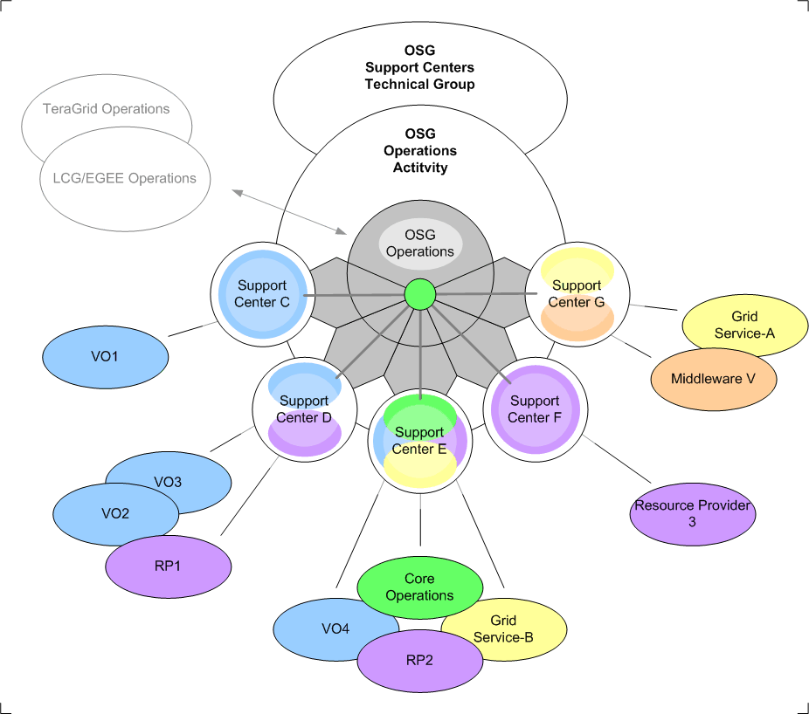
Operations Model in OSG

Slide 43
Ticket Routing in OSG
User in VO1 notices problem at RP3, notifies their SC (1).
SC-C opens ticket (2) and assigns to SC-F.
SC-F gets automatic notice (3) and contacts RP3 (4).
Admin at RP3 fixes and replies to SC-F (5).
SC-F notes resolution in ticket (6).
SC-C gets automatic notice of update to ticket (7).
SC-C notifies user of resolution (8).
User confirms resolution (9).
SC-C closes ticket (10).
SC-F gets automatic notice of closure (11).
SC-F notifies RP3 of closure (12).
1
2
11
3
8
7
10
6
4
9
5
12
OSG infrastructure
SC private infrastructure

Slide 44
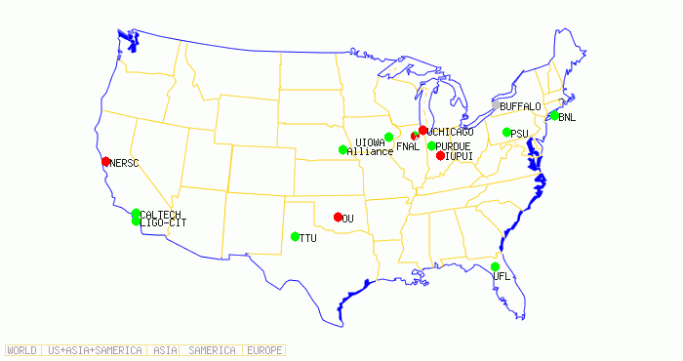
OSG Integration Test Bed
A grid for development of the OSG
You will use ITB sites in the exercises today
http://osg-itb.ivdgl.org/gridcat/index.php
FIUPG Site on OSG

Slide 45
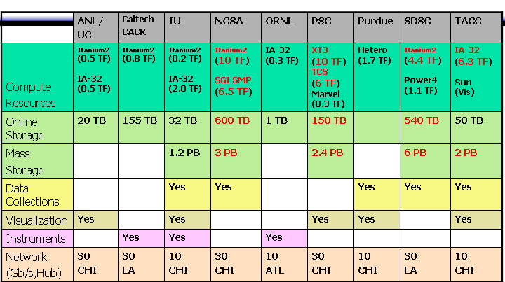
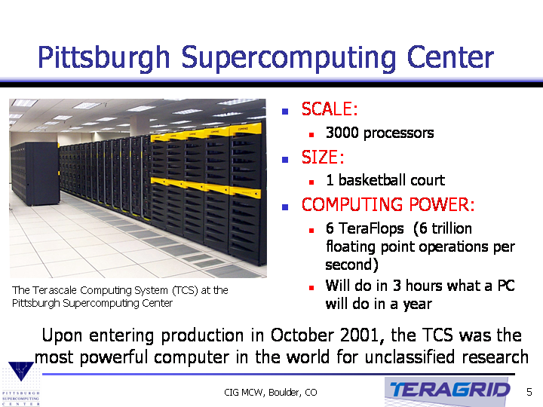
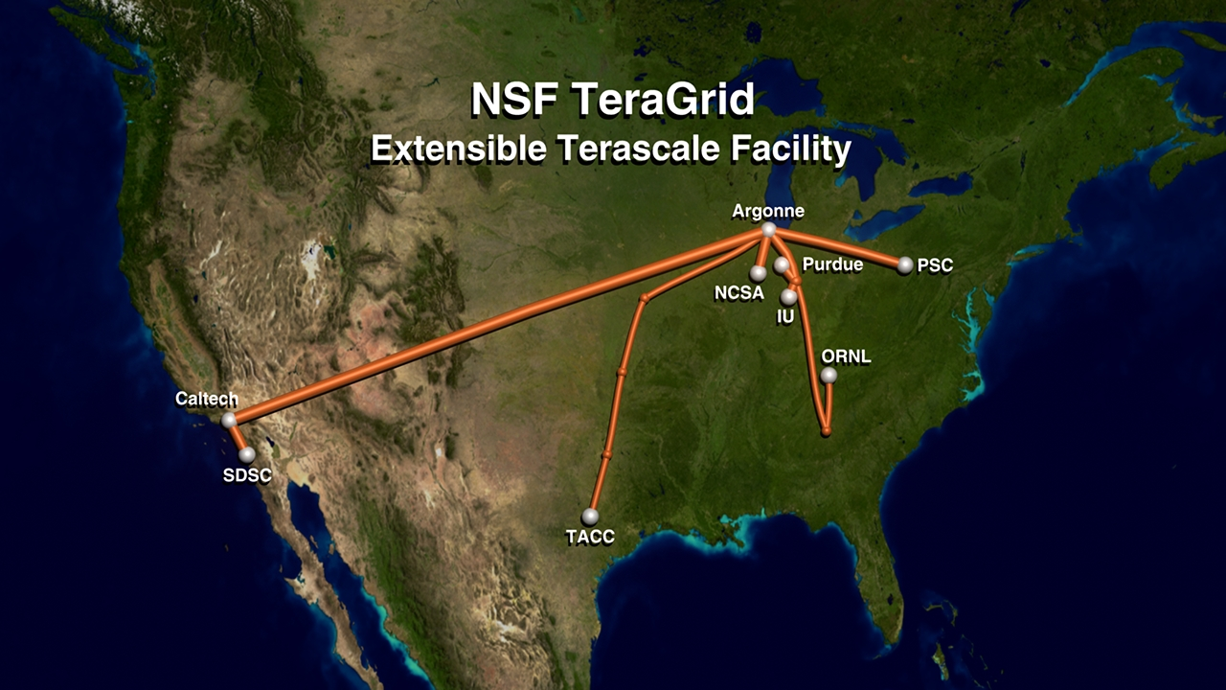
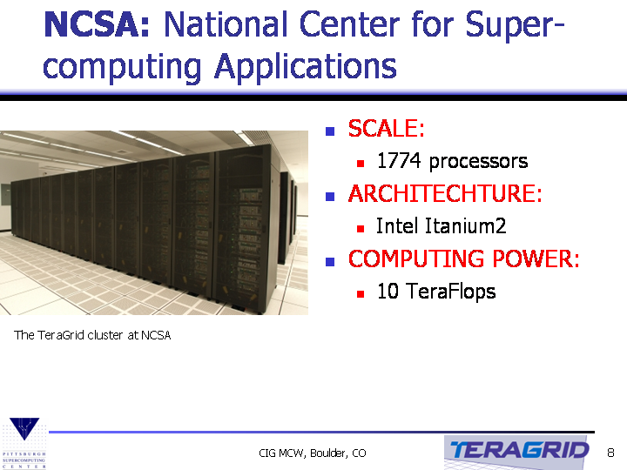
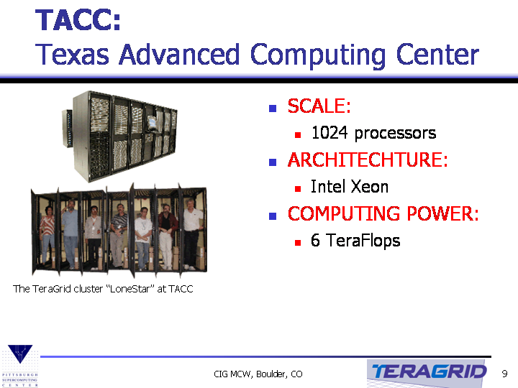
The TeraGrid
Slides courtesy of Jeffrey Gardner
& Charlie Catllet
“The world’s largest collection of supercomputers”

Slide 46
TeraGrid: A High Level View
User & Facilities Support
Help desk/Portal and ASTA
Grid Software and ENV Deployment
CTSS
Authorization, Accounting and Authentication
TG Allocation and Accounting
Grid Monitoring and Information Systems
MDS4 & Inca

Slide 47
TeraGrid
Allocation
&
Accounting

Slide 48
TeraGrid Allocation
Researchers request “allocation of resource” through formal process
  Process works similarly as that for submitting a NSF grant proposal
  There are eligibility requirements
    US faculty member or researcher for an non-profit organization
    Principle Investigators submits CV
    More…
  Description of research, requirements etc.
  Proposal is peer reviewed by allocation committees:
    DAC: Development Allocation Committee
    MRAC: Medium Resource Allocation Committee
    LRAC: Large Resource Allocation Committee

Slide 49
Authentication, Authorization & Accounting
TG Authentication & Authorization is automatic
  User accounts are created when allocation is granted
  Resources can be accessed through:
    ssh: via password, ssh keys
    Grid access: via GSI mechanism (grid-mapfile, proxies…)
  Accounts created across TG sites users in allocation
Accounting system is oriented towards TG Allocation Service Units (ASU)
  Accounting system is well defined and monitored closely
  Each TG sites is responsible for its own accounting

Slide 50
TeraGrid
Monitoring and Validation

Slide 51
TeraGrid and MDS4
Information providers:
  Collect information from various sources
    Local batch system; Torque, PBS
    Cluster monitoring; ganglia, Clumon…
    Spits out XML in a standard schema (attribute value pairs)
Information is collected into local Index service
Global TG wide Index collector with WebMDS
Site1
Site2
PBS
GT4 Container
GT4 Container
Torque
WS-
GRAM
WS-
GRAM
Clumon
MDS4
Index
MDS4
Index
Ganglia
TG Wide
Index
WebMDS
Application
Application
Browser
Browser

Slide 52
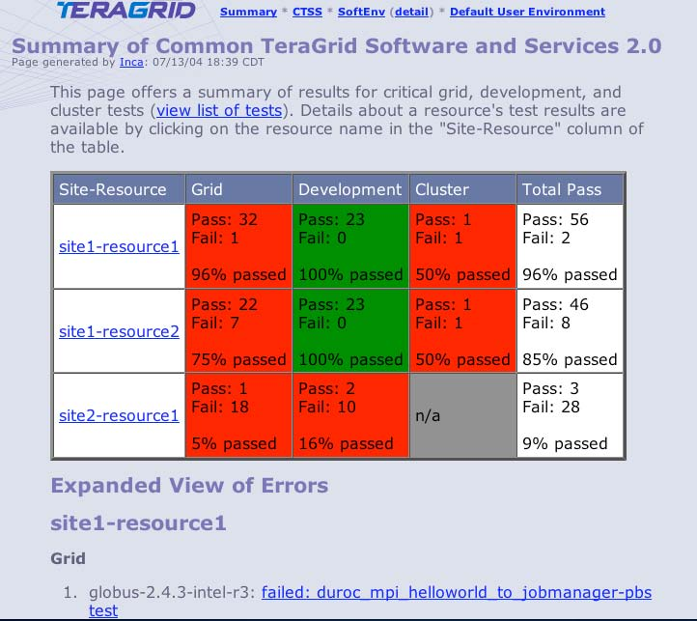
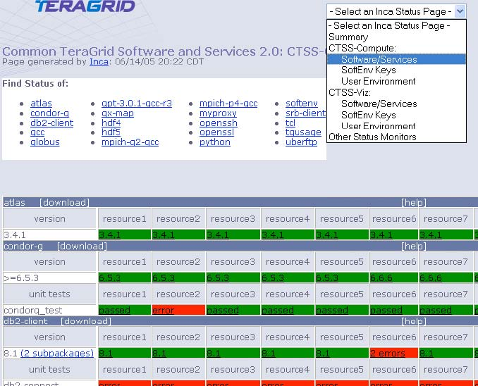
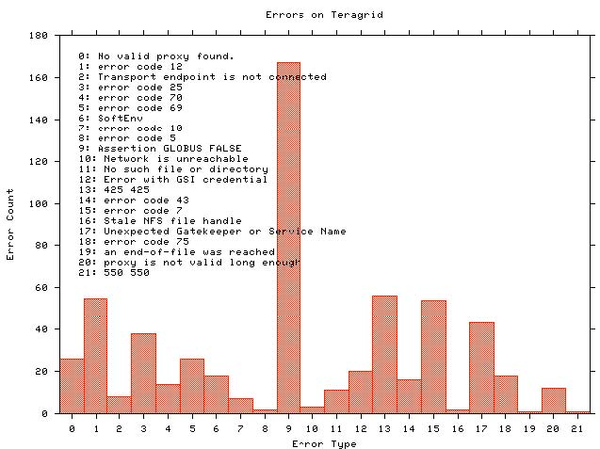
Inca: TeraGrid Monitoring…
Inca is a framework for the automated testing, benchmarking and monitoring of Grid resource
  Periodic scheduling of information gathering
  Collects and archives site status information
  Site validation & verification
    Checks site services & deployment
    Checks software stack & environment
  Inca can also site performance measurements

Slide 53
TeraGrid
Grid Middleware & Software Environment

Slide 54
The TeraGrid Environment
SoftEnv: all software on TG can be accessed via keys defined in $HOME/.soft
SoftEnv system is user configurable
Environment can also be accessed at run time for WS GRAM jobs
You will be interacting with SoftEnv during the exercises later today

Slide 55
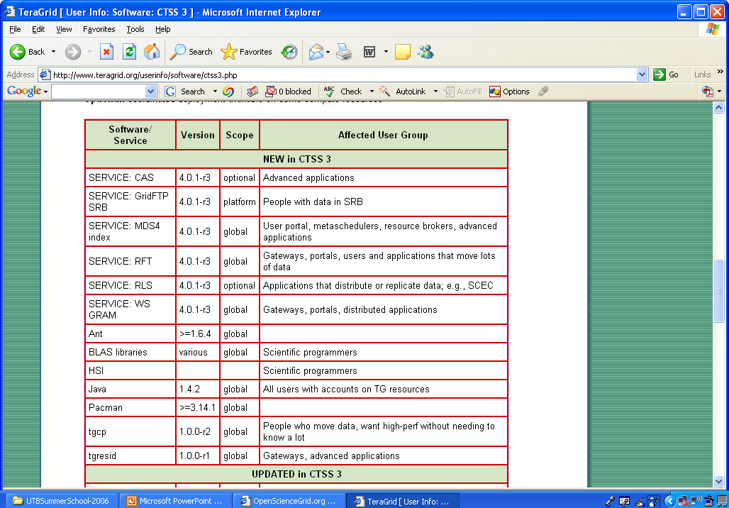
TeraGrid Software: CTSS
CTSS: Coordinated TeraGrid Software Service
  A suite of software packages that includes globus toolkit, condor-g, myproxy, openssh…
  Installed at every TG site

Slide 56
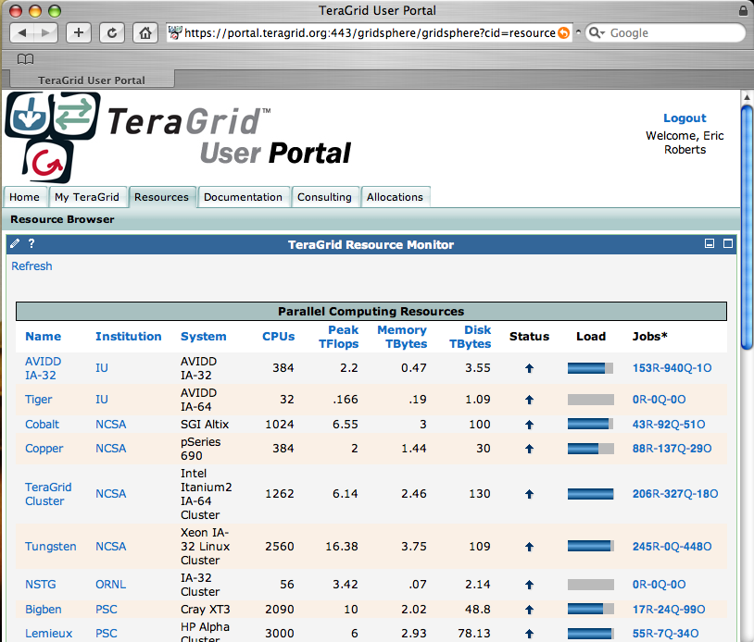
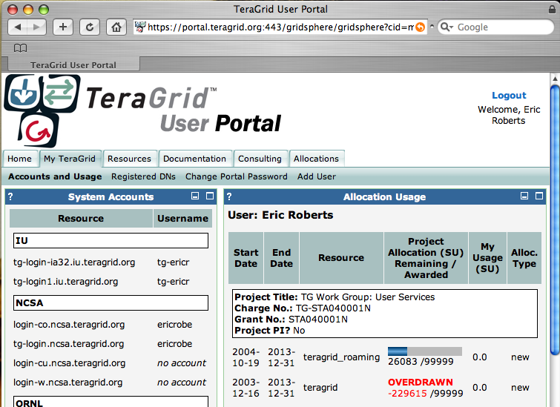
TeraGrid User & Facility Support
The TeraGrid Help desk help@teragrid.org
  Central location for user support
  Routing of trouble tickets
TeraGrid portal:
  User’s view of TG
    Resources
    Allocations…
  Access to Docs!

Slide 57
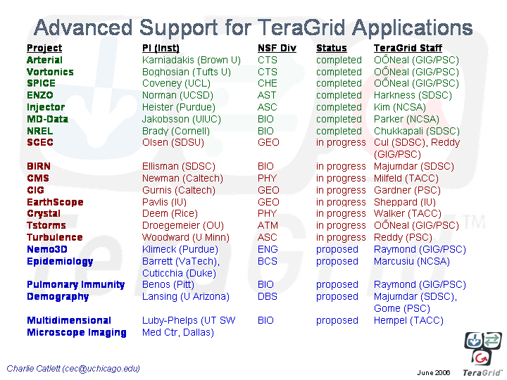
TeraGrid’s ASTA Program
Advanced Support for TeraGrid Application
  Help application scientists with TG resources
  Associates one or more TG staff with application scientists
    Sustained effort
    A minimum of 25% FTE
  Goal
    Maximize effectiveness
    of application software &
    TeraGrid resources

Slide 58
Topics Not Covered
Managed Storage
Grid Scheduling
More

Slide 59
Managing Storage
Problems:
  No real good way to control the movement of files into and out of site
    Data is staged by fork processes!
    Anyone with access to the site can submit such a request and swamp the server
  There is also no space allocation control
    A grid user can dump files of any size on a resource
    If users do not cleanup sys, admin have to intervene
These can easily overwhelm a resource

Slide 60
Managing Storage
A Solution: SRM (Storage Resource Manager)
Grid enabled interface to put data on a site
  Provides scheduling of data transfer requests
  Provides reservation of storage space
Technologies in the OSG pipeline
  dCache/SRM (disk cache with SRM)
    Provided by DESY & FNAL
    SE(s) available to OSG as a service from the USCMS VO
  DRM (Disk Resource Manager)
    Provided by LBL
    Can be added on top of a normal UNIX file system
$> globus-url-copy srm://ufdcache.phys.ufl.edu/cms/foo.rfz \
gsiftp://cit.caltech.edu/data/bar.rfz

Slide 61
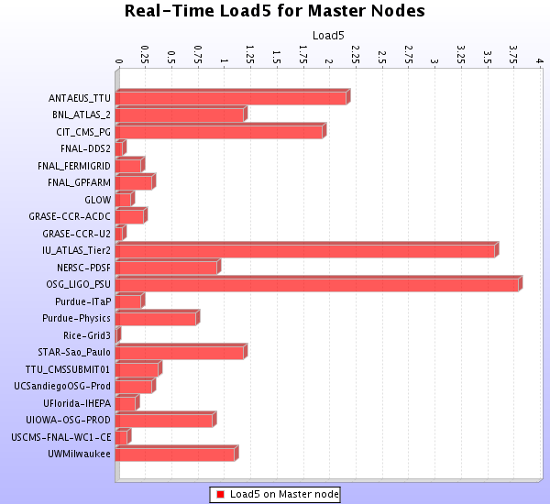


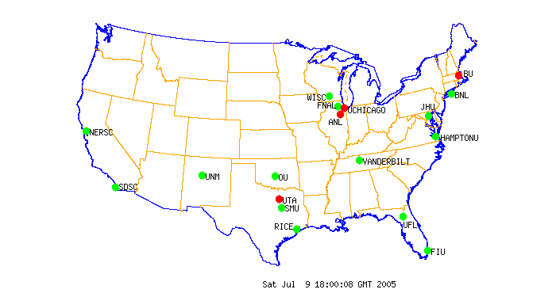



Grid Scheduling
The problem: With job submission this still happens!
Why do I have to do this by hand? @?>#^%$@#
Why do I have to do this by hand?
?
User Interface
VDT Client
Grid Site A
Grid Site X
Grid Site B

Slide 62
Grid Scheduling
Possible Solutions
  Sphinx (GriPhyN, UF)
    Work flow based dynamic planning (late binding)
    Policy based scheduling
    More details ask Laukik
  Pegasus (GriPhyN, ISI/UC)
    DAGman based planner and Grid scheduling (early binding)
    More details in Work Flow
  Resource Broker (LCG)
    Match maker based Grid scheduling
    Employed by application running on LCG Grid resources

Slide 63
Much Much More is Needed
Continue the hardening of middleware and other software components
Continue the process of federating with other Grids
  OSG with TeraGrid
  OSG with LHC/EGEE, NordiGrid…
Continue to synchronize the Monitoring and Information Service Infrastructure
Improve documentation

Slide 64
Conclude with a simple example
Log on to a User Interface;
Get your grid proxy “logon to the grid” grid-proxy-init
Check OSG MIS clients
  To get list of available sites: depends on your VO affiliation
  To discover site specific information needed by your job ie,
    Available services: hostname, port numbers
    Tactical storage location: $app, $data, $tmp, $wntmp
Install your application bins at selected sites
Submit your jobs to selected sites via condor-G
Check OSG MIS clients to see if jobs have completed
Do something like this:
If [ 0 ] then
echo “Have a coffee (beer, margarita…)”
else
echo “its going to be a long night”
fi

Slide 65
To learn more:
The Open Science Grid top level page
  http://www.opensciencegrid.org
The TeraGrid top level page
  http://www.teragrid.org
The TeraGrid portal
  https://portal.teragrid.org/gridsphere/gridsphere
The globus website
  http://www.globus.org
The iVDGL website
  http://www.ivdgl.org
The GriPhyN website
  http://www.griphyn.org

Slide 66
The End

Slide 67
Data Transfers @ the TG
Gridftp is available at all sites:
  Provides:
    GSI on control and data channels
    Parallel streams
    third party transfers
    Stripped
  Each TG sites has 1 to several dedicated GridFTP enabled servers
TeraGrida sites are equiped with various gridftp clients
    globus-url-copy
      Standard globus gridftp clients (see lectures)
    uberftp
      interactive GridFTP client. supports GSI authentication, parallel file transfers.
    tgcp
      wrapper for globus-url-copy (optimized tcp buffer sizes…parallel streams…)
      Interfaced with RFT (Reliable Transfer Service), performs third party transfers make sure files gets to destination see lectures?

Slide 68
Based on: Building, Monitoring and Maintaining a Grid
Jorge Luis Rodriguez
University of Florida
jorge@phys.ufl.edu
June 26-30, 2006

