Slide 1
Grid Security

Slide 2






Typical Grid Scenario
Resources
Users
Notes:
Large resources
Shared across various domain
User pool
Restrict access to the resource, yet allow for collaboration

Slide 3
What do we want from security?
Identity
Authentication
Privacy
Integrity
Authorization
Single sign-on
Delegation

Slide 4
Identity & Authentication
Each entity should have an identity
  Who are you?
  Example: Unix login name
Authentication:
  Prove your identity
  Stops masquerading imposters
Examples:
  Passport
  Username and password

Slide 5

Privacy
Medical Record
Patient no: 3456
Notes:
- Real life: sensitive data : caBig cancer research; proprietary data.

Slide 6
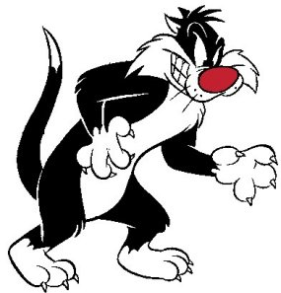

Integrity
Run myHome/rm –f *
Run myHome/whoami

Slide 7
Message Protection
Sending message securely
Integrity
  Detect whether message has been tampered
Privacy
  No one other than sender and receiver should be able to read message

Slide 8
Authorization establishes rights to do actions
What can a particular identity do?
Examples:
  Are you allowed to read this file?
  Are you allowed to run a job on this machine?
  Unix read/write/execute permissions
Must authenticate first
  Authentication != authorization

Slide 9
Single sign on
Log on once
  Type password once
Use any grid resource without typing password again

Slide 10

Delegation
Notes:
Long running jobs
Jobs require access to different things

Slide 11
Delegation
Resources on the grid can act as you
Example: Execution jobs can transfer files
Delegation can be restricted
  For example: Delegation only valid for a short period of time

Slide 12
Solutions using cryptography

Slide 13
Cryptographic Keys, the building block of cryptography, are collections of bits
The more bits that you have, the stronger is the key
Public key cryptography has two keys:
  Public key
  Private key
0 1 0 1 0 0 1 1 1 0
1 0 1 1 1 1 0 1 1 1
Notes:
Keys are building blocks
256 bits key is stronger than 128 bits
Computing things using larger key also takes more time.
Most algorithms are well established and tools have been already developed for performing the computations

Slide 14

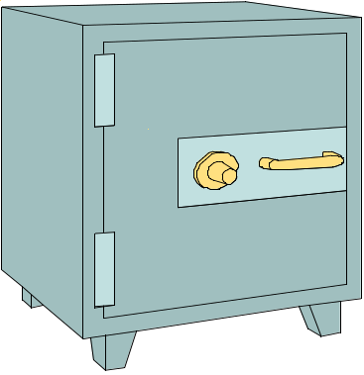
Encryption takes data and a key, feeds it into a function and gets encrypted data out
Encrypted data is, in principal, unreadable unless decrypted
<data>
Encryption
Function
Notes:
Data is treated as bit streams.

Slide 15
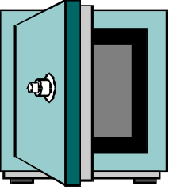
Decryption feeds encrypted data & a key into a function and gets the original data
Encryption and decryption functions are linked
Decryption
Function
<data>
Notes:
Decryption again is a mathematical function of taking the encrypted data and key and getting original data
If you encrypt with a particular algorithm, you want to decrypt with the same one

Slide 16
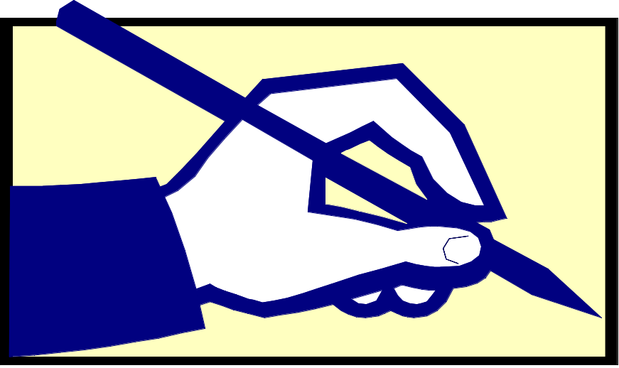
Digital Signatures let you verify aspects of the data
Who created the data
That the data has not been tampered with
Does not stop other people reading the data
  Combine encryption+signature
Notes:
Generated and sent with the message

Slide 17
Public Key Infrastructure (PKI) provides Identity
X.509 certificate
  Associates an identity with a public key
  Signed by a Certificate Authority
Owner
Notes:
Provides a owner tag
Any entity that possess the private key, assumes that entity. So if you have my private key, you are me as far as PKI fabric is concerned.

Slide 18

Certificates are similar to passports or identity cards
State of Illinois
Name
Issuer
Public Key
Validity
Signature
John Doe
755 E. Woodlawn
Urbana IL 61801
State of
Illinois
Seal
BD 08-06-65
Male 6’0” 200lbs
GRN Eyes
Valid Till: 01-02-2008

Slide 19
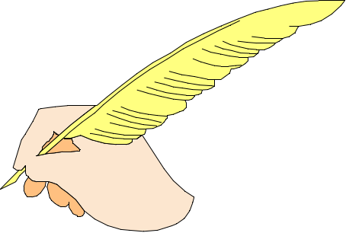
Certification Authorities (CAs) sign certificates
CAs are small set of trusted entities
CA certificates must be distributed securely
Name
Validity
Public Key
Issuer?

Slide 20
Each CA has a Certificate Policy (CP)
The Certificate Policy states:
  To whom the CA will issue certificates
  How the CA identifies people to whom it will issue certificates
Lenient CAs don’t pose security threat because resources determine the CAs they trust.

Slide 21
Grid Security Infrastructure (GSI) allows users & apps to securely access resources
Based on PKI
A set of tools, libraries and protocols used in Globus
Uses SSL for authentication and message protection
Adds features needed for Single-Sign on
  Proxy Credentials
  Delegation

Slide 22
In GSI, each user has a set of credentials they use to prove their identity on the grid
Consists of a X509 certificate and private key
Long-term private key is kept encrypted with a pass phrase
  Good for security, inconvenient for repeated usage

Slide 23
GSI Proxy credentials are short-lived credentials created by user
Short term binding of user’s identity to alternate private key
Same identity as certificate
Stored unencrypted for easy repeated access
Short lifetime in case of theft
Notes:
Motivation:
- Encrypted private key requires some warm body,
- long term credential – prevent theft.
Same identity as the certificate proxy is created off
New key pair signed by your certificate
Clock synchronization issues

Slide 24
GSI: Single Sign-on
Single sign-on
  Uses proxies
  Type in password once, make a proxy with no password
Features:
  Allow easy repeated access to credentials
  Limit risk of misuse on theft
  Allow process to perform jobs for user

Slide 25
GSI delegation allows another entity to run using your credentials
Other entity gets a proxy with your identity
Other entity can run as you
  only for limited time
  for specific purpose
For example, a compute job might want to transfer files on your behalf.

Slide 26
Authorization
Types
  Server side authorization
  Client side authorization
Examples
  Self authorization
  Identity authorization

Slide 27
Gridmap is a list of mappings from allowed DNs to user name
"/C=US/O=Globus/O=ANL/OU=MCS/CN=Ben Clifford” benc
"/C=US/O=Globus/O=ANL/OU=MCS/CN=MikeWilde” wilde
Commonly used in Globus for server side
ACL + some attribute
Controlled by administrator
Open read access

Slide 28
MyProxy
Developed at NCSA
Credential Repository with different access mechanism (e.g username/pass phrase)
Can act as a credential translator from username/pass phrase to GSI
Online CA
Supports various authentication schemes
  Passphrase, Certificate, Kerberos

Slide 29
MyProxy: Use Cases
Credential need not be stored in every machine
Used by services that can only handle username and pass phrases to authenticate to Grid. E.g. web portals
Handles credential renewal for long-running tasks
Can delegate to other services

Slide 30
Lab Session
Focus on tools
  Certificates
  Proxies
  Gridmap Authorization
  Delegation
  MyProxy

Slide 31
The presentation was based on: Grid Security
Rachana Ananthakrishnan
Argonne National Lab

