Slide 1
Security in the OSG
Queen Elizabeth II
Sovereign of the Royal Family Order of King George V
Buckingham Palace

Slide 2
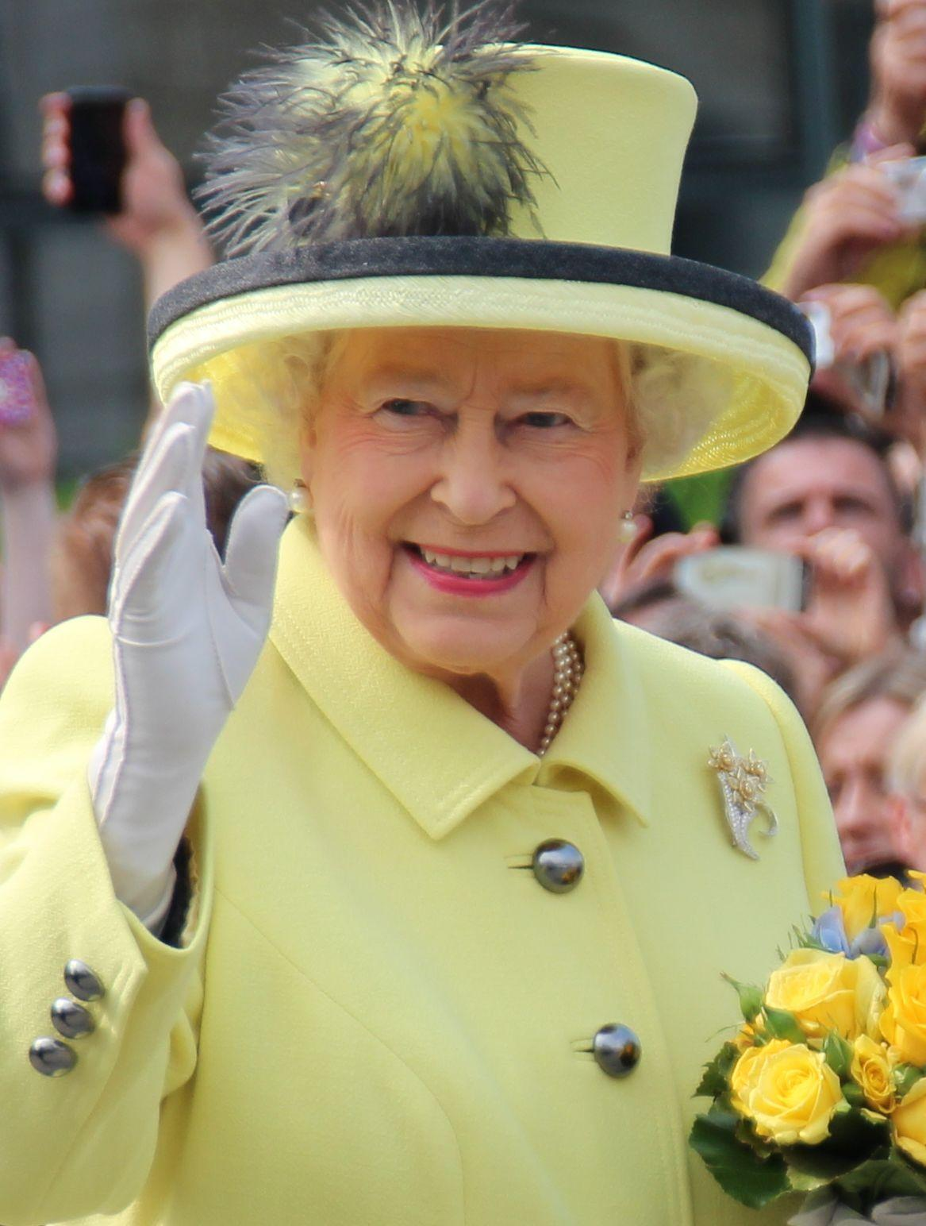
The Real Queen?
Nope, she’s a decoy to protect against threats to the Crown

Slide 3
Security in the OSG
Brian Lin
OSG Software Team
University of Wisconsin - Madison
blin@cs.wisc.edu

Slide 4
What is Identity?
It’s who you are and provides a means of accountability.

Slide 5
What is identity?
Identification as proof of identity
In the real word: photos, driver’s license, passport, etc.
On the Internet: usernames, certificates

Slide 6
How Do You Trust Someone?
Why didn’t you trust me when I said I was Queen Elizabeth II?

Slide 7
How do you trust someone?
Prior knowledge/experience
Appeal to authority
Chain of trust
Varying levels of trust

Slide 8
1.
Authentication
Trusting identification

Slide 9
Authentication
Do you trust who I say I am?
What about forged identities?
Username + password, shared secret (public key cryptography)
Authentication often goes both ways

Slide 10
2.
Authorization
Trusting identities

Slide 11
Authorization
Do I trust your identity?
Do I trust you enough to give you root?
Authorization describes the privilege level of an identity

Slide 12
3.
Security in the OSG
Hey, that’s the name of the talk!

Slide 13
Security in the OSG
Certificate based
Transparent
VOs vet users
Admins vet machines

Slide 14
4.
Is Your Data Secure?
On a shared computer...

Slide 15
Is Your Data Secure?
Every participant in the OSG is vetted but…
You are using a shared computer
Take basic precautions (i.e. no world-writeable files)
Sensitive data (e.g. HIPAA)? HTC may not be for you

Slide 16
Credits
Special thanks to all the people who made and released these awesome resources for free:
Presentation template by SlidesCarnival
Photographs by Unsplash & Death to the Stock Photo (license)

Slide 17
Thanks!
Any questions?

