Slide 1
OSG Software
Miron Livny
University of Wisconsin-Madison
Open Science Grid Joint Oversight Team Meeting
February 20th 2007

Slide 2
Software Activities
Package the Virtual Data Toolkit
  Requires local building and testing of all components
  Tools for incremental installation
  Tools for verification of configuration
  Tools for functional testing
Integration of the OSG stack
  Verification Testbed (VTB)
  Integration Testbed (ITB)
Deployment of the OSG stack
  Build and deploy Pacman caches

Slide 3
VDT Stack => OSG Stack
Input from stakeholders and OSG directors
Test on OSG Validation Testbed
VDT Release
OSG Integration Testbed Release
OSG Production Release

Slide 4
Main Software Concerns
How quickly (and at what FTE cost) can we patch the OSG stack and redeploy it?
  Critical for security patches
  Very important for stability and QoS
How dependable is our software?
  Focus on testing (at all phases) and careful adoption of new software
Functionality of our software
  Close consultation with stockholders
Impact on other cyber-infrastructures
  Critical for interoperability

Slide 5
(evolving) List of Metrics
Software deployment metrics:
  # of sites using VDT
  # of sites part of OSG
  Origin of downloads?
  Versions in use
  Platforms in use
  Which services are deployed at a site?
  How many VOs supported at each site?
Software development metrics:
  How often are releases?
  How many “changes” occurred in each version?
  How many bugs fixed in each version?
  Activity on source code repository (# of commits)
  # of tests run
  # of tests that failed
  % coverage of tests
Software support metrics
  # of support tickets?
  Amount of discussion on mailing lists
  Average time a ticket is open
  Average time between emails on ticket
  % of time supporting different software packages
  Who is submitting tickets (broken down by person, VO, etc), how many?

Slide 6
Review: What is the VDT?
A collection of software
  Grid software (Condor, Globus, VOMS, dCache, GUMS, Gratia, and more…)
  Virtual Data System (Origin of the name “VDT”)
  Utilities
The basis for the OSG software stack
An easy installation
  Goal: Push a button, everything just works
  Two methods:
    Pacman: installs and configures it all
    RPM: installs some of the software, no configuration
A support infrastructure

Slide 7
Why have the VDT?
Everyone could download the software from the providers…
But the VDT:
  Figures out dependencies between software
  Works with providers for bug fixes
  Provides automatic configuration
  Packages it
  Tests everything on 15 platforms (and growing)

Slide 8
Software Providers
The VDT doesn’t write software, but gets it from providers
  Condor Project
  Globus Alliance
    Globus, MyProxy, GSISSH
  EGEE
    VOMS, CEMon, Fetch-CRL…
  OSG Extensions
    Gratia
  Various open source projects
    Apache, MySQL, and many more

Slide 9
Example: VOMS
VOMS can authorize people in a VO
VOMS has a web interface
We:
  Install Tomcat
  Install Apache
    Built with Globus SSL
    Patched so GSI pass-through to Apache works
  Install VOMS
  Install VOMS Admin
  Install Perl modules needed by VOMS Admin
  Install MySQL and set up database (with command-line tool)
  Configure all software
  Configure rotation of log files
  Work with EGEE to provide support for VOMS

Slide 10
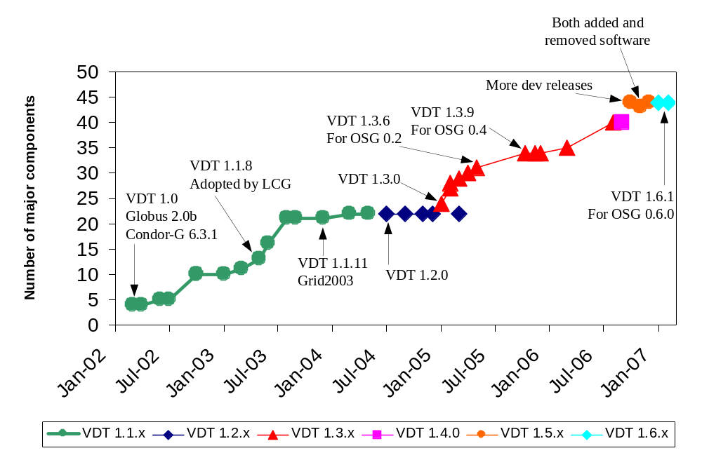
How much software?

Slide 11
Current Release: VDT 1.6.1
Basis for OSG 0.6.0
OSG 0.6 “requests”:
  Accounting software (Gratia)
  Storage (dCache)
  Better support for updating software
  Better system for controlling services that are running
  Better reporting of supported VOs
  Lots of updated software
  Support for new platforms (Scientific Linux 4…)

Slide 12
Building the VDT
We support 15 platforms
  Debian 3.1
  Fedora Core 3
  Fedora Core 4 (x86, x86-64)
  Fedora Core 4 (x86-64)
  RedHat Enterprise Linux 3 AS (x86, x86-64, ia64)
  RedHat Enterprise Linux 4 AS (x64, x86-64)
  ROCKS Linux 3.3
  Scientific Linux Fermi 3
  Scientific Linux Fermi 4 (x86, x86-64, ia64)
  SUSE Linux 9 (IA-64)
We build ~35 components on 8 platforms
  Builds are reused on multiple platforms
  Using NMI Build and Test

Slide 13
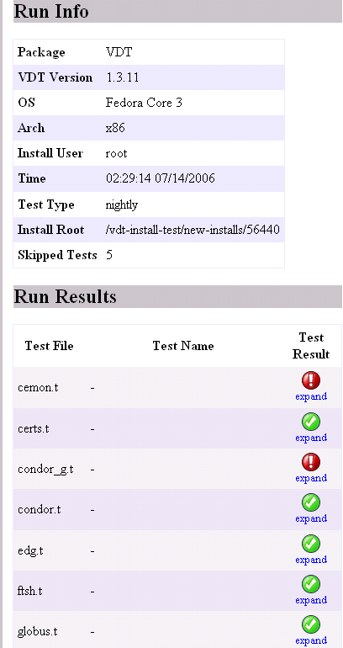
… Making a VDT release
Requires at least one week of testing on VDT testbed
Requires sign-off by OSG Validation Testbed
Run nightly tests on each supported platform until they are clean

Slide 14
… Making Int. Testbed Release
Add configuration
Package subsets of VDT software
  Compute Element
  Storage Element
  Worker-node Client
  Submit-host Client
Deploy on testbed
Test services
Test middleware interoperability
Test functionality and scalability
Application validation

Slide 15
Challenges we face
How should we smoothly update a production service?
  In-place vs. on-the-side
  Preserve old configuration while making big changes.
  As easy as we try to make it, it still takes hours to fully install and set up from scratch
How do we support more platforms?
  It’s a struggle to keep up with the onslaught of Linux distributions
  AIX? Mac OS X? Solaris?
Fedora Core 6
Fedora Core 4
BCCD
RHEL 3
Fedora Core 3
RHEL 4

Slide 16
More challenges
Distributed creation of VDT
  Now we have funding for people to add support for new storage resource management systems (d-Cache, DRM, etc)
  These people are not at UW-Madison
Improving testing
  We care about interactions between the software: “When using a VOMS proxy with Condor-G, can we run a GT4 job with GridFTP transfer, keeping the proxy in MyProxy, while using PBS as the backend batch system…”
Some people want native packaging formats
  RPM
  Deb

Slide 17
Progress since September 2006
Progress includes:
  Several new releases
  Improved security response time
  Integration of the Fermi storage VDT group
  Improved community interaction
Details on following slides

Slide 18
New Releases Since September
New release policy
  Integration testbed only gets stable releases.
  The old “development” releases were pretty darn stable already
  We make development releases more often, to get feedback from the community
Three stable releases
  1.4.0 (October 2006) Recasting of 1.3.11 development release
  1.6.0 (December 2006) Initial release for OSG 0.6.0
  1.6.1 (January 2007) Bug fix release for OSG 0.6.0
    1.6.0 and 1.6.1 were heavily tested by OSG Validation testbed
    This validation produced releases of much higher quality
Three development releases
  Leading towards VDT 1.6.0 for OSG 0.6.0
  Monthly basis: October, November, December

Slide 19
Security Updates
On September 7th, released Globus security update
  Patches for three versions of the VDT
  Took nearly 4 weeks to release: too slow!
In February, released another Globus security update
  Update prepared for release in 3 days: much better!

Slide 20
New Storage VDT group
1.5 FTE at Fermilab for storage in VDT
Challenge: VDT team is now distributed
  We have weekly meetings
  We are learning to distribute the operations of the VDT (ticket system, access to VDT web site, etc.)
Progress:
  dCache now available from VDT
  Based on dCache from DESY, but with scripts to simplify install

Slide 21
Users of the VDT
VDT is used by:
  LCG/EGEE
  TeraGrid (moving towards common builds by spring 2007)
  APAC (Australia)
Increasing acceptance of VDT

Slide 22
Work with community (1/2)
VDT active in integration and validation testbeds
  The new validation testbed is awesome
    Very responsive group of people
    They work hard to test a release in a variety of environments before it goes to the world
    Result: Slightly slower releases, but higher quality

Slide 23
Work with community (2/2)
VDT is active in:
  Security group discussions
  Executive Team Plus
  Executive Board
  Globus security committee
  EGEE EMT meetings
    Close contact to ensure interoperability
}
Interaction with providers and consumers

Slide 24
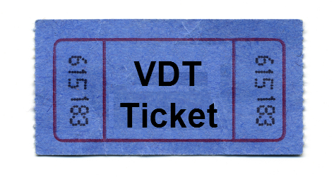
Support
VDT ticket system
  160 new “interesting” tickets since September 2006
    Interesting means not spam or announcement
Response speed could be better
  We’re still ramping up effort: 3rd FTE was just hired, 4th coming
  We expect response time to improve
  There should be more tickets: many issues are handled without creating a ticket. It’s hard to get a count of how many: personal email, instant messaging, and community mailing lists all contribute.

Slide 25
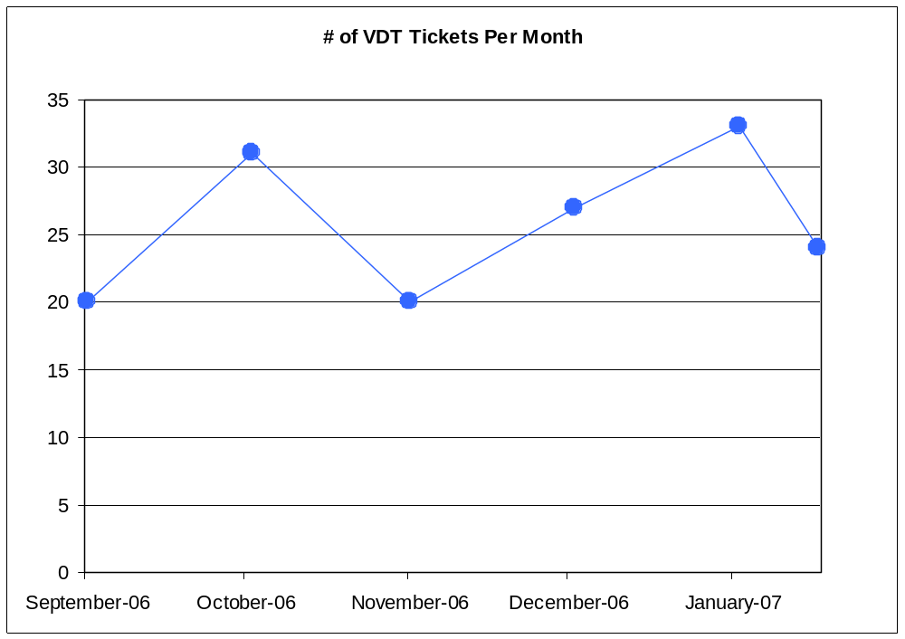
VDT Tickets Per Month
Only two weeks of
data in February

Slide 26
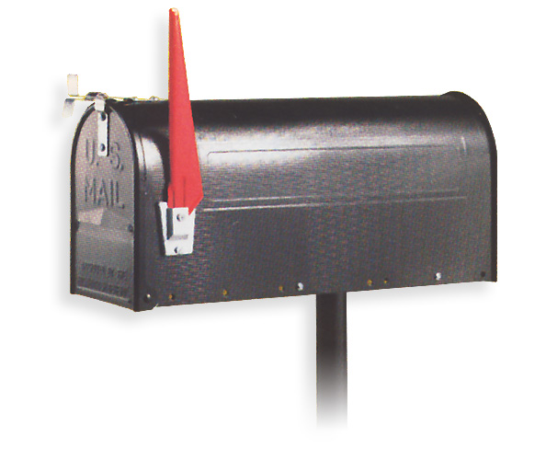
Mailing lists
VDT discussion mailing list
  Not very active: 5-10 messages a month that aren’t announcements from VDT staff
Most VDT discussion happens in community mailing lists:
  OSG integration testbed
  OSG validation testbed
  OSG executive team plus
  …

