Slide 1
OSG Security
Don Petravick
4/24/07

Slide 2
OSG Security News
Bob Cowles at JSPG
JSPG released new Grid Site Security Policy. Need EB sign-off. OSG needs to tailor to local conditions.
Starting on VO Policy.
Attended recent PKI workshop.
new hire at Fermilab, Mine Altunay, expected to start in July.

Slide 3
Proceeding with Implementing Controls and Assessments in the Security Plan
Task Title | Control Implementation | Control Status | Work | Time | Type | ST&E Status | ST&E Work
Roles and Responsibilities | Org chart published and filled out | Done | Small | 6 months | E | Done | small
Awareness for OSG Managers | Awareness materials created, containing all necessary information | Done | Large | Yearly | E | Done - OSG Document 573
Computer Security Lifecycle Meeting | Meeting notes archived | Done | Small | Yearly | E | Done - on Listserv | small - weekly, medium - integrated
Briefing of the Executive Board | Executive Board Meeting Minutes archived | Done | Small | Yearly | E | Done - Minutes on Twiki | small
Risk Assessment | Write Risk Assessment | Done | Large | Yearly | E | Done - OSG Document 440 | small
Regular OSG Core Security Phone Conference | Archive minutes | Done | Small | Yearly | E | Done - on Listserv | small - weekly, medium - integrated
Security Briefing at Consortium Meetings | Archive briefings and discussion material | Done | Small |  | E | Done - Minutes on Twiki | small

Slide 4
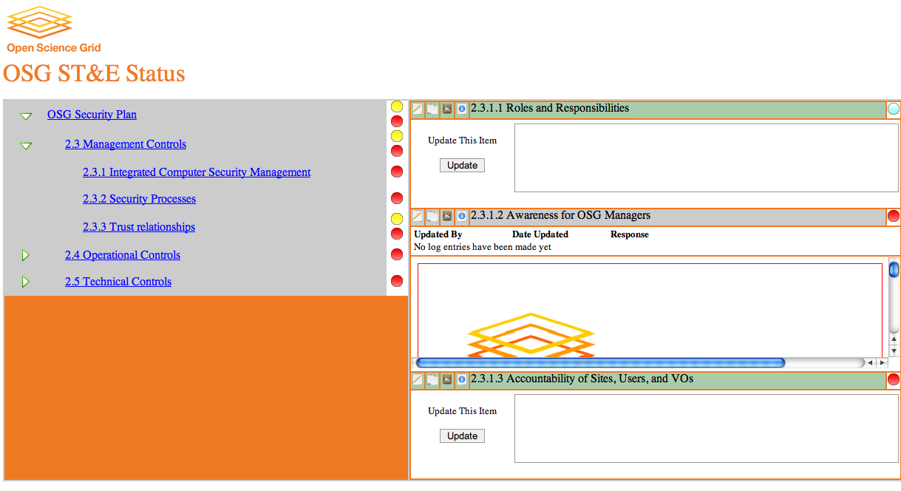
& Using Fermilab ST&E Tool https://ste.opensciencegrid.org/

