Slide 1



Introducing SVOPME,
A Scalable Virtual Organization Privileges Management Environment
(VO’s Perspective)
Tech-X Corporation
Fermi National Accelerator Laboratory
Contacts:
Nanbor Wang nanbor@txcorp.com
Gabriele Garzoglio garzogli@fnal.gov

Slide 2
What are VO Privileges?
Virtual Organizations:
Grid Sites:
VOs use shared resources
VOs need to define resource usage policies for different users within the VOs
  Example 1: Production team members submit jobs with higher priority
  Example 2: Software team members can write to disk area for software installations but others can’t
However, VOs do not manage/configure Grid sites
Grid sites provide resources
Grid sites don’t define VOs’ usage policies
Grid sites enforce and manage user privileges
Grid sites do not allow others (such as VO admins) to change the site configurations
Site and VO Challenge: Enforcing heterogeneous
VO privileges on multiple Grid sites to provide uniform
VO Policies across the Grid
(ad hoc solution: verbal communication)

Slide 3
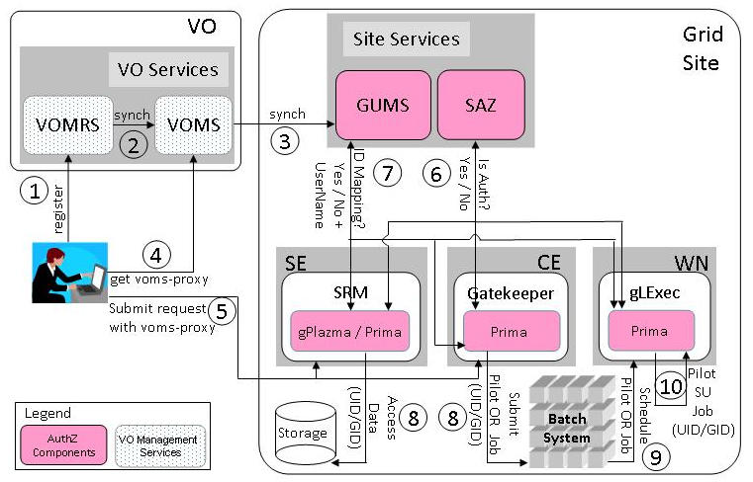
State-of-the-Art
User Privilege Management
VO Services manage only VO groups and roles, and user memberships.
A VO passes only information about groups and roles to sites.
GUMS maps a user (with group/role membership) to a local ID.
Privileges management and enforcement points are scattered at different places, using mechanisms provided by the resources. This can be as straightforward as setting the permissions to certain directories. Grid sites manage and control these configurations. They involve tweaking GUMS and all the local resources configurations.
The OSG Authorization Infrastructure
Notes:
Look up these acronyms EGEE, LCAS, LCMAPS, SCAS

Slide 4
Motivations of SVOPME
Address scalability
With the growth in Grid usage, both the numbers of VOs and Grid-sites increase
Propagating privilege policies by verbal communication between VO and Grid site admins no longer scales
SVOPME fills the gap by
  Providing the tools and infrastructure to help
    VOs express their policies
    Sites support VOs
  Reuse proven administrative solutions – we adopt common system configuration patterns currently in use in major grid sites
USATLAS
CMS
STAR
…
CompBioGrid
Fermilab
LIGO
SDSS
iVDGL
FERMIGRID
CMS-T2
ASGC
GPFARM
STAR-BNL
UC-ATLAS
LIGO-MIT
UCSDT2

Slide 5
SVOPME Helps VO’s Propagate Privilege Policies to Grid Sites
Site Privilege
Policies
SVOPME aims to replace the verbal interaction with automated workflows
SVOPME provides a policy editor to make this easy
We predefine a set of policy types VOs can use to build their intended privilege policies
Editor checks for conflicting policies
Policies are documented in XACML format, no ambiguity
Allow programmatic verification of policies
Grid sites’ policies can be verified against those of VOs’
Propagate
VO Privilege
Policies
Verify
Site
Configurations
SVOPME
Concept
Diagram
Synthesize
Configuration
Recommendations
SVOPME can provide recommendations to site configurations for better VO supports

Slide 6
Advantages of SVOPME
VOs
Sites
No need to run ad-hoc jobs to figure out what policies are enforced and what not
Provides templates to define commonly used policies
Automates most of the communication with Sites that support the VO
Provides the basis for the negotiation of privileges at sites that provide opportunistic access
Sites can advertise and prove that a VO is supported
Sites that want to support a VO have a semi-automated mechanism to enforce the VO policies
Privilege enforcement remains responsibility of the Site, informed by formal VO policy assertions

Slide 7

SVOPME Currently Support These Types of Policies (VOs can define)
Account Type Policy: Run job from Group(G) and Role(R) using Pool (unique)/ Group (shared) accounts.
Account Mapping Policy: Must have accounts for all users in Group (G) and Role(R) (may be pool accounts or Group accounts).
Relative Priority Policy: Jobs from Group (G1) and Role (R1) should have higher priority than those from user of Group (G2) and Role (R2).
Preemption Policy (Batch system): Jobs from Group (G) and Role (R) should be allowed to execute for n consecutive hours without preemption.
Package Installation Policy (Storage): Allow Group (G) and Role (R) to install software in $OSG_APP (assuming there is NO space reserved for any VO)
Unix Group Sharing Policy (Batch system): Accounts belonging to /Group/Role=A and /Group/Role=B must share the same unix Group ID
File Privacy Policy (Storage): Files Privacy Policy: Users belonging to /Group/Role=A expect privacy for their files
Job Suspension Policy (Batch system): Do not suspend / resume jobs submitted from /Group/Role=A
Disk Quota Policy (Storage): Assign disk quota of X GB and Y MB to accounts mapped to /Group/Role=A

Slide 8
SVOPME Architecture Overview
VO
SVOPME Application
VO Privilege Policy Editor
Creates/Edits
XACML VO Privilege Policies
XACML VO Requests
XACML Document
Uses
VO Administrator
Text Document
Grid Site
Uses
Synthesizes
XACML Effective Site Access Policies
Uses
Policy Comparer
Grid Probe
Crawls
Policy Advisor
Storage Elements
Apply
changes
Refers
to
Generates
Computing Elements
Suggested Changes
Compliance Report
Site Administrator

Slide 9
SVOPME VO Release
VO package can be obtained from: https://ice.txcorp.com/trac/svopme/attachment/wiki/Download/svopme_vo.tar.gz
Installation should be pretty straightforward
We are ready to help in any areas
  Installation
  Configuration
  Defining privileges
Detailed Instructions for VO: https://ice.txcorp.com/trac/svopme/wiki/VoInsts

Slide 10
SVOPME VO Tools
VOMS Server
VO
Retrieves VO Groups/Roles
VOMS Client
Uses
VO Privilege Policy Editor
Creates/Edits
XACML VO Privilege Policies
XACML VO Requests
Uses
VO Administrator
Reads
Time-stamped Zip Archieves
Comparer Client
Uses Latest
Creates
Request Archiver
Invokes
Published via
VO HTTP Server
Comparer services
hosted at Grid sites

Slide 11
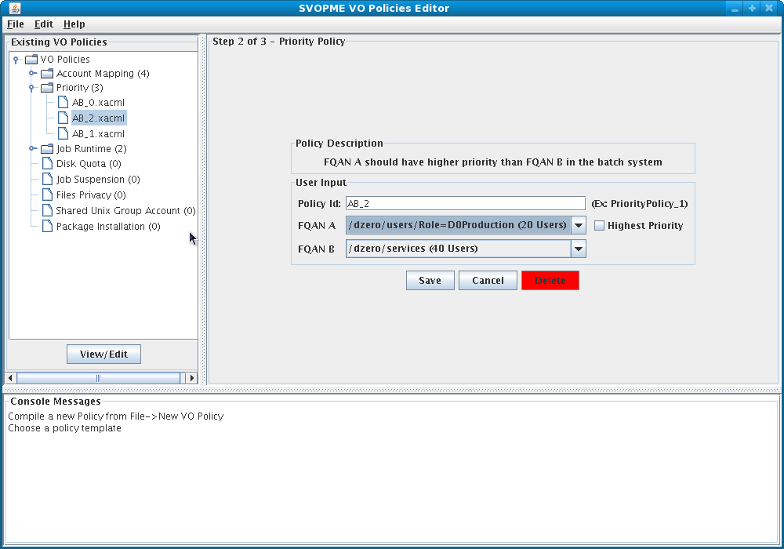
VO Policy Editor Screenshot

Slide 12
XACML VO Policy Editor
(Create, Edit and Manage Policies)
Currently provide a GUI editor
Environment for manage all the policies of a VO
The VOMS client obtains information about all the Group/Role and the number of users from the VOMS server on VO editor’s behave.
Support for new policy types can be added relatively easily.
Reject redundant and contradicting policies

Slide 13
VO Policy Data Management Tools
The Editor stores the policies and verification requests under pre-configured directories
Request Archiver collects and zips up verification requests into time-stamped zip files
  Can be used by sites to examine their compliance
  Time-stamped request zip archives are made available to site via a simple web page
  Sites can scan the page and determine the latest version
VO admins and users can use Comparer Client to contact and check a site’s support to VO policies

Slide 14
SVOPME Grid-Site Release
Grid-site package are downloaded and installed separately
We will explain how SVOPME works on a site
  But not installation and operation details
Currently, SVOPME is available on FermiGrid’s Integrated Testbed (ITB)
We can make it available at more sites

Slide 15
Mechanism for Synthesizing
Grid Site Privilege Policies
Grid Compute Element Probe
Intermediate Config Info
Policy Builder
Synthesizes
XACML Effective Site Access Policies
Disk Storage Element Probe
“Grid Probe” in a nutshell
  Policy building and configuration crawling functions are separated
  Depending on the target privilege, different info is necessary: there are multiple crawling executables
  Invoked by different cron tasks with diff privileges
  Dump the info as simple text files at a specific directory
  Allow site-specific probes
Configuration checked
  Condor/GUMS config
  Disk quota/directory permissions
Policy Builder
  Parses the intermediate configuration info
  Synthesizes the effective privilege policies of a site into XACML policies

Slide 16
Analyzing Site Configurations
VO Request Retriever
  Checks if the local VO verification requests is up-to-date
  Cache the new verification requests if needed
Policy Comparer and Advisor
  Test compliance by testing the verification requests one-by-one
  Since all requests and policies are based on our XACML profiles, reports and advises can be derived
VO HTTP Server
Checks timestamp
XACML VO Verification Requests
VO Request Retriever
Uses
XACML Effective Site Access Policies
Uses
Policy Comparer Web Service
Policy Advisor
Generates
Suggested Changes
Compliance Report

Slide 17
VO/Grid Policies Comparer
Example output:
[java] VO/Grid Grid Accounts Policy Comparison
[java] ---------------------------------------
[java] /TECHX/Role=User is mapped to 1 account(s) on the Grid site. Passed!
[java] No Account Mapping Policies for /TECHX/VISITORS were found on the Grid site.
Policy Comparer Grid Service
  Allow VO users to check privilege policy compliance at a site
  Instead of cached verification requests, users supply a list of verification requests related to policies of interests
  SVOPME provides a policy comparer client as part of the VO tools
  Currently only provide text reports – should provide a mechanism for further automate the information gathering

Slide 18
VO/Grid Policies Advisor
Provide advice for the Grid site administrator on what amendments need to be done on the Site; such that the Grid site complies with the VO policies
Example output:
  VO requested 3 accounts for VISITORS role via VO policies
  Site-policies derived from GUMS do not match
[java] VO/Grid Grid Accounts Policy Advices
[java] ------------------------------------
[java] No matching Grid Accounts Policy was found for /TECHX/VISITORS on the Grid site. Create a mapping in GUMS config such that /TECHX/VISITORS be mapped to at least 3 account(s)
[java] TECHX/Role=VO-Admin mapped to 1 account(s) (techxVOadmin) on the Grid site, is not suffient enough. Needs to be mapped to atleast 3 accounts.

Slide 19
Experiments on FermiGrid’s Integrated TestBed
Using “Dzero” and “Engage” VO’s privileges as a real-world examples
Validation requests are copied over to the site (FGITB) using the “Retriever” tool
Two different probes run with different privileges
“Engage” VO will continue to expand and incorporate other smaller sub-VO’s
Was able to detect several anomalies
  Enhanced disk quota probes – multiple filesystems
  Re-wrote quota/filesystem probe to use python – easier for admins to examine
  Detected one missing account mapping
  Legacy pool account configurations
Separating probes allows easy adaption to site with unconventional confiurations

Slide 20
Conclusions
SVOPME ensure uniform access to resources by providing an infrastructure to propagate, verify, and enforce VO policies at Grid sites
We are soliciting interested VO’s and sites to deploy SVOPME in a production environment
We love to hear your comments and suggestions
https://ice.txcorp.com/trac/svopme/wiki/WikiStart

