Slide 1
Plans, Management, Metrics,
Ruth Pordes
Fermilab
Open Science Grid Joint Oversight Team Meeting
February 20th 2007

Slide 2
OSG’s role
The Goals:
  Meet the needs and schedules of the Scientific Collaborations as presented & agreed by their management and oversight.
  Ensure effective integrated stakeholder distributed systems.
  Get the most return - both today and for the future - across the sum of investments.
The Environment:
  Vertical integrated Science/Community Systems.
  Horizontal effective & coherent resuable common infrastructure.
Among the Challenges:
  Provide common software/infrastructure useful to existing as well as new (not yet engaged) users systems
  Choose the most effective areas to contribute worth.
  Show benefit to goals of 6 program offices.

Slide 3
Joint Project Challenge
☺
User Science Codes and Interfaces
Applications
VO Middleware
Biology
Portals, databases etc
HEP
Data and workflow management etc
Astrophysics
Data replication etc
OSG Release Cache:
OSG specific configurations, utilities etc.
☺
Virtual Data Toolkit (VDT)
core technologies + software needed by stakeholders:many components shared with EGEE
Infrastructure
Core grid technology distributions:
Condor, Globus, Myproxy: shared with TeraGrid and others
☺
Existing Farms, Storage, Networks

Slide 4
Measures of Success?
Goal to make effective end-to-end systems - on target and on schedule.
  We have little to no control over and science software and diverse developments in the collaborations.
  Need to demonstrate that value added by sharing is greater than the overheads.
Sociological challenges as well as technical:
  Need to maintain organizational structure of an open inclusive consortium.
  Need to ensure commitment of staff in 16 institutions where non-OSG peers compete for salary increases and career paths.

Slide 5
Outline
SciDAC Expectation deliverables.
Planning & Deliverables
Effort
Management & Tracking
Metrics
Response to OSG proposal Reviewers concerns

Slide 6
“SciDac Expectations” Deliverables
Project Management
OSG Year 1 Project Plan (2006-12)
OSG Management Plan. (2006-05)
Open Source Software
SOWs include text about “Source code” developed by the project.
The VDT includes licence information from each software product showing the open source nature of the contributions.
OSG Metrics document (in draft form) OSG Document 541.

Slide 7
Web Presence
The OSG communications and administration staff have special responsibility for the web presence for OSG, but all coordinators have responsibility in their own areas:
  Web portal (http://www.opensciencegrid.org) for overview and communication, project overview, research plan, publications, presentations, interactions, progress reports,
  OSG Twiki based collaborative documentation area where all activity and technical information.
  Managed Document Repository for the Project and Consortiums reference documentation including security, agreements and policies. The document librarian is Marcia Teckenbrock marcia@fnal.gov
  VDT documentation.
SciDAC Outreach Center: David Skinner has agreed to attend the upcoming OSG All Hands meeting in March.

Slide 8
Reporting & Communication
Reporting:
Overview of OSG in 6 slides: OSG Document 506.
OSG Six-Month Project progress report.
Communication
There is a monthly OSG newsletter.
We contribute to International Science Grid this Week.
There are a plethora of mail lists.
Meetings:
OSG PI and Executive Director attended the February SciDAC-2 kickoff meeting.
OSG Security and Policy Officers attended the DOE Open Cybersecurity workshop and submitted a blueprint for OSG Security.

Slide 9
General areas of support across SciDAC and NSF:
(note: management supported by both)
ASCR | Security: Policy & Operations Software & Testing: VDT, Storage. Interoperability, Troubleshooting & Integration; Education & Training: | Computer Science areas: Distributed Computing, Security for Open Science, Software Testing, Deployment and configuration of services, Workforce development.
DOE HEP | Extensions. Application/Users support. Communications. Storage Services. Security. Technical writing.
DOE NP | Deputy Executive Director with specific responsibilities for operational security, integration and collaboration with ESNET.
NSF MPS | Operations & Troubleshooting. Engagement. Extensions. VDT, Application/Users support. Outreach & Training. iSGTW editor. Communications
NSF OCI | Engagement
OISE | Travel and Stipends for young faculty and student collaboration with Scandinavia

Slide 10
Planning & Deliverables

Slide 11
How we plan
High level overall goals/milestones for the 5 years in Proposal and Project Executive Plan.
Annual Project Plan gives details of deliverables for the year. Project Plan itself is a deliverable for the beginning of each year.
Work on N+1year planning starts 1/2 way in year N
  From Dec 2006 we have been planning our input to the Year 2 work (e.g. (Nuclear Physics Xrootd support; use of SciDAC-2 center deliverables; what about physics analysis?).
Other planning tools
  Software Releases: gather stakeholder requirements, make more detailed schedules.
  Stakeholder Production Runs: Council accepts and Project responds to VO “run requests” which will take attention to meet.
  “Thinking” gathering from Blueprint Meetings.
  Tracked sub-project plans especially in Extensions area.
Continuously adjust short term plans based on experience, feedback and problems.

Slide 12
Timeline & Milestones (preliminary: sent to SciDAC 10/06)
Contribute to Worldwide LHC Computing Grid LHC Event Data Distribution and Analysis
LHC Simulations
Support 1000 Users; 20PB Data Archive
Contribute to LIGO Workflow and Data Analysis
LIGO data run SC5
Advanced LIGO LIGO Data Grid dependent on OSG
STAR, CDF, D0, Astrophysics
CDF Simulation
CDF Simulation and Analysis
D0 Reprocessing
D0 Simulations
STAR Data Distribution and Jobs 10KJobs per Day
+1 Community
+1 Community
+1 Community
+1 Community
+1 Community
+1 Community
+1 Community
+1 Community
+1 Community
Additional Science Communities
2006
2007
2008
2009
2010
2011
Facility Security : Risk Assessment, Audits, Incident Response, Management, Operations, Technical Controls
Plan V1
1st Audit
Risk Assessment
Audit
Risk Assessment
Audit
Risk Assessment
Audit
Risk Assessment
Facility Operations and Metrics: Increase robustness and scale; Operational Metrics defined and validated each year.
Interoperate and Federate with Campus and Regional Grids
VDT and OSG Software Releases: Major Release every 6 months; Minor Updates as needed
VDT 1.4.0
VDT 1.4.1
VDT 1.4.2
…
…
…
…
OSG 0.6.0
OSG 0.8.0
OSG 1.0
OSG 2.0
OSG 3.0
…
VDT Incremental Updates
dCache with role based authorization
Accounting
Auditing
Federated monitoring and information services
VDS with SRM
Common S/w Distribution with TeraGrid
Transparent data and job movement with TeraGrid
EGEE using VDT 1.4.X
Transparent data management with EGEE
Extended Capabilities & Increase Scalability and Performance for Jobs and Data to meet Stakeholder needs
SRM/dCache Extensions
“Just in Time” Workload Management
VO Services Infrastructure
Integrated Network Management
Improved Workflow and Resource Selection
Data Analysis (batch and interactive) Workflow
Work with SciDAC-2 CEDS and Security with Open Science
2006
2007
2008
2009
2010
2011
Project start
End of Phase I
End of Phase II

Slide 13
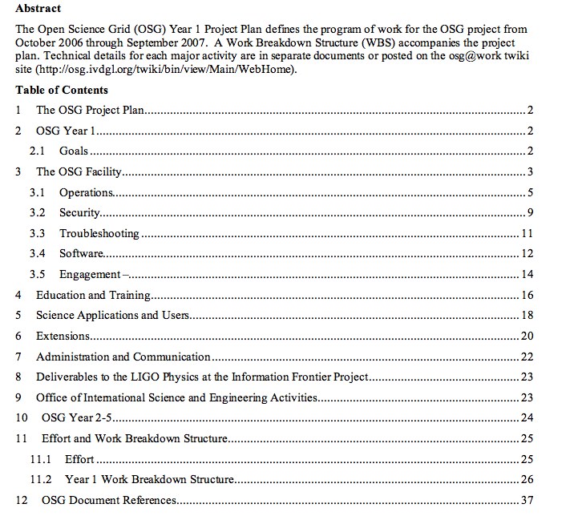
OSG Plan for Year 1
High Level Reportable Milestones
Other milestones internal to the project
Full WBS & more detailed area and project plans owned by the technical leads.
We are by no means there yet in assessment, sub-project plans, and plan adjustments - we know we need to iterate.

Slide 14
Year 1 Agency Reportable Milestones - from the Project Plan & WBS
WBS | Name | Date
1.1.1.2 | Define Operational Metrics for Year 1 | 1/1/07
1.1.3.1.1 | Release Security Plan | 1/1/07
1.1.5.2.3 | Release OSG 0.6.0 | 2/27/07
1.1.6.2.4 | Production use of OSG by one additional science community | 3/31/07
1.1.5.3.2 | OSG-TeraGrid software using common Globus and Condor releases. | 4/2/07
1.3.2.2.4 | Complete deployment and registration of 15 Storage Resources using srm/dCache from VDT. | 6/10/07
1.1.5.2.4 | Release OSG 0.8.0 | 8/15/07
1.1.1.5 | Report on Operational Metrics for Year 1 | 9/1/07
1.1.6.2.5 | Production use of OSG by a 2nd additional science community | 9/28/07
Draft under review
√
Provisioning and final testing in progress
√
ITB starting tests now
*
* includes: Storage Resource Manager V2.2, “just in time job scheduling”; site validation;

Slide 15
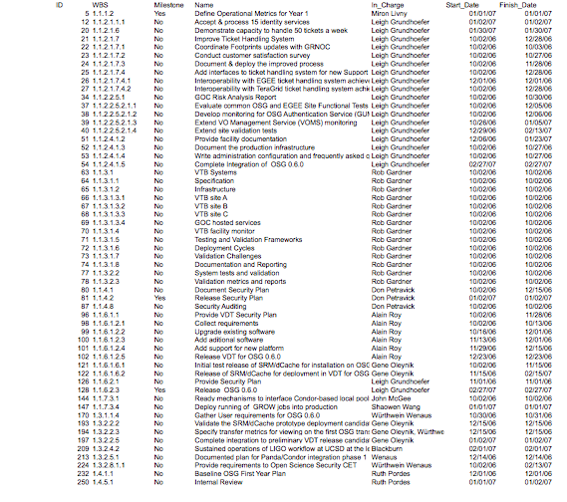
WBS tasks with end dates before 2/28/07.
Update next task for ED/Project Associate after JOT.
*
*
*
*
*
*
*
Individual security plans included in larger OSG security plan.
Deliverables not met: *
*

Slide 16
More details of deliverables to date
Ready mechanisms to interface Condor-based local pools to OSG infrastructure | 10/02/06
Testing and Validation Frameworks | 10/02/06
GOC Risk Analysis Report | 10/30/06
Gather User requirements for OSG 0.6.0 | 10/31/06
Initial test release of SRM/dCache for installation on OSG sites | 11/15/06
Document & deploy the improved process | 11/28/06
Interoperability with EGEE ticket handling system achieved | 12/01/06
Baseline OSG First Year Plan | 12/01/06
Evaluate common OSG and EGEE Site Functional Tests | 12/05/06
Develop monitoring for OSG Authentication Service (GUMS) | 12/06/06
Documented plan for Panda/Condor integration phase 1 | 12/14/06
Validate the SRM/dCache prototype deployment candidate | 12/15/06
Specify transfer metrics for viewing on the first OSG transfer aggregation prototype. | 12/15/06
Release VDT for OSG 0.6.0 | 12/19/06
Release Security Plan | 01/02/07
Accept & process 15 identity services | 01/02/07
Complete integration to preliminary VDT release candidate | 01/02/07
Internal Review | 01/02/07
Extend VO Management Service (VOMS) monitoring | 01/05/07
Provide facility documentation | 01/23/07
Demonstrate capacity to handle 50 tickets a week | 01/30/07
Sustained operations of LIGO workflow at UCSD at the level of 25 jobs for one week. | 02/01/07

Slide 17
WBS for the rest of Year 1
~200 tasks.
Many are ongoing operational tasks with end date “end of year” which will be renewed. Included for tracking purposes.
Will be reviewing this also and proposing changes for EB/Finance Board in April.
Will also start on Year 2 plans as we get feedback from project and users.

Slide 18
Science Milestones Year 1(from WBS)
LIGO: Binary Inspiral Analysis runs on OSG (see first milestone reported) | Warren Anderson | 6/15/07
ATLAS: Validation of OSG infrastructure and extensions in full-chain production challenge. | Jim Shank | 6/15/07
CMS: Full support for opportunistic use of OSG resources for MC production and data processing. | Lothar Bauerdick | 6/15/07
STAR: Migration of >80% of simulation to OSG | Jerome Lauret | 6/15/07
CDF: Full use of OSG for MC | Ashutosh Kotwal | 6/15/07
D0: Full use of OSG sites for D0 reprocessing in 2007 (in progress 2/1/2007) | Brad Abbott | 6/15/07
SDSS: Fit all spectra beyond data release 5, QSO fitting project (+now DES simulations/data transfer) | Chris Stoughton | 6/15/07
All have demands on the OSG infrastructure.
- All same date because at the time better estimates were not available.
- Again: general work being done towards these goals - final specific plans at March All Hands meeting.

Slide 19
LIGO
Analysis-support milestones well on track.
LIGO Computing Committee decisions communicated to OSG through:
  PI of the PIF (Patrick Brady) on the Executive Board. Has attended and presented at both meetings to date.
  Kent Blackburn, OSG Resources Co-manager.
  Warren Anderson who is an active member of the OSG Council.
Physics at the Information Frontier (PIF) Identity & Authorization Deliverables (agreed to in the letter to the agencies in June 2006):
  Final requirements given to OSG at end of Jan 2007; Project forming across LIGO (Warren, Murali), VO Services External Project (Gabriele Garzoglio) + OSG Extensions (0.5 FTE effort from Fermilab) + ESNET (Mike Helm). Reporting to Security Activity (Doug Olson + Todd Tannenbaum). Well defined project plan tracked within OSG.
VDT packaging/workload management: Bi-weekly LIGO Data Grid (LDG) - OSG software meetings.
LIGO 2007 milestone to define their next generation Workload Management System (WMS) system. OSG working with LIGO to develop a common beneficial solution.
Identifying SciDAC-2 data management technologies that can be incorporated into the LIGO Data Replication system (LDR).

Slide 20
OSG delivers to the US LHC & WLCG
Torre has given specifics of US LHC-OSG deliverables.
MiIestones agreed through:
  Tier-1 Representatives on the Executive Board - Ian Fisk, Michael Ernst;
  US S&C management on Council - Jim, Lothar.
  Applications co-coordinators who are part of US LHC S&C management.
  OSG membership on WLCG Management Board. Deliverables and milestones brought back to OSG ET.
WLCG deliverables:
  Tier-0 to Tier-1 throughput milestones are outside OSG scope.
  Automated accounting reports: With with OSG external project.
  SRM V2.2 deployment: part of VDT/Extensions program.
US LHC deliverables:
  Additional deliverables for throughput at Tier-2s, interoperability and availability services.
  OSG provides ongoing distributed facility operations and software support.

Slide 21
US LHC Tier-2 & Tier-3s
US LHC Tier-2 milestones depend on OSG infrastructure for
  Job submission and execution (successful throughput)
  Site Validation tests (Availability)
  Information Services (Interoperability)
  Storage Services
Detailed planning to assign effort at beginning of March:
  some deliverables well advanced e.g. Information Services;
  Some deliverables less well understood e.g. Site Validation tests.
Tier-3s for both ATLAS and CMS defined as supported by OSG.
  First US LHC Tier-3 meeting co-located with OSG All hands in March.
To OSG Tier-3s are like “any other site” with special needs for Interoperation as part of WLC and Schedule to meet commissioning and analysis expectations.

Slide 22
STAR
Meeting between OSG and Nuclear Physics (NP) management - STAR, GLue-X, ALICE - in December:
Identified inefficiencies in STAR production which would compromise the June deliverable.
  Since then Troubleshooting team has been working closely with STAR on the problems (more in Miron’s talk) and so far identified issues across NERSC file systems, storage implementation, BNL data ingest.
Needs of NP identified, a joint letter written to agencies:
  OSG evaluating impact of inclusion in VDT and support for ROOT/XROOTD.
  Plan exists for ALICE and Glue-X collaboration with OSG (pending funding).
  Will reevaluate STAR interest in object-based data access as the data model of OSG evolves.

Slide 23
Sloan Digital Sky Survey (SDSS),
Dark Energy Survey (DES)
SDSS application inefficiencies due to
  Lack of managed storage on OSG: Will be addressed with OSG 0.6.0 deployment.
  Lack of consistency in environment on sites: Currently one of OSG main focus areas.
DES main s/w infrastructure effort is at NCSA and on TeraGrid. European sites (e.. Spain) on EGEE.
  Tests between OSG (FermiGrid) and NCSA (TeraGrid) in progress.

Slide 24
Office of Science & Engineering (OISE)
3 separate deliverables:
  Collaboration with Nordic Data Grid Facility on common services.
  Collaboration with IceCube for science analyses that move jobs and data between US and Scandinavia
  Participation - students, faculty- in International Grid School in Sweden in July.

Slide 25
Management & Effort

Slide 26
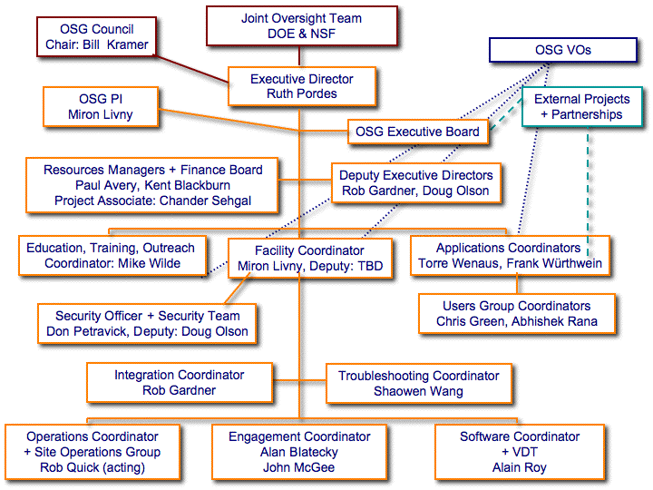
Organization Chart
1/2 or full time staff in place
Not funded by the Project
Need to hire

Slide 27
Overcommitment Issues?
Project can only suceed if management has expertise , experience, and respect in the community --- essential in such a complex matrixed environment.
Coordinators within the Facility have sufficient experience and expertise to “run on their own” for most things.
We are hiring “staff to the management” with 1.0 FTE commitment apiece.
Hiring people with enough experience and quality to do this takes time and effort as well.
We already see benefit from “depth” of institutional groups of which the managers are a part.

Slide 28
Ongoing Follow Up & Replanning
Weekly 1 hr Executive Team:
  Address feedback from usage.
  Go through near term and longer term deliverables.
  Taken decisions for adjusting plans.
  Brief written report to Council.
Every 6 weeks several hour Executive Board:
  Status and requirements from External Projects including LIGO, US LHC.
  Stimulates offline follow up on identified issues.
Weekly/Biweekly technical areas feed into ET, EB meetings: Operations, Facility, Integration, Security, Troubleshooting.

Slide 29
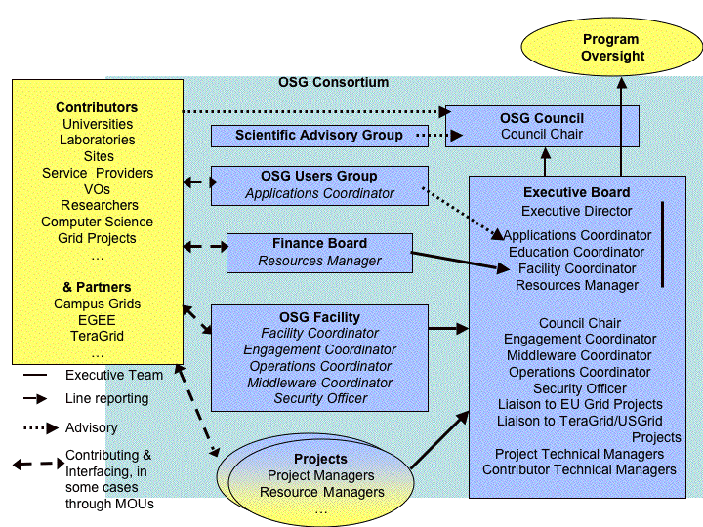
Consortium, Project relationship
Contributors
Project

Slide 30
Consequences of ongoing ramp up of effort?
OSG 0.6.0 release “to the wire” because of lack of testing effort.
Executing the security plan waiting for Security hire.
Metrics definition and analysis needs Deputy Facility Coordinator effort.
Site coordination and availability testing for WLCG needs suffering from Operations Coordinator departure and lack of full operations team.

Slide 31
Metrics

Slide 32
Metrics 2006-2007
“Define Year 1 Operational Milestones” 1/1/07 not yet met. Document in review last week..
Late guidance very useful (thank you Bill!). The advisory sub-committee on ASCR metrics draft report provides a relevant view for further discussion.
You will see an ongoing discussion between Miron and myself.
Separates metrics into two categories:
  Control which have specific goals which must be met.
  Observed which are used for monitoring and assessment activities.

Slide 33
Control Metrics and their State - today:
Goal in Year1 to measure and understand baselines.
Miron will say more, everything not yet completely aligned!
Control Metric (Class) | Measure
User Satisfaction | Survey Users. In July. Who do we mean as the users? Leaders of stakholder organizations, those who have the most VOMS calls etc. After the science milestones. Give options from 5-1.
Student/Educator Surveys (User Satisfaction) | Survey grid school attendees.
Impact on Science (User Satisfaction) | Number of acknowledged publications depending on OSG
System Availability | CPUhours/day; % success of VO jobs.
Ticket Resolution (Problem response time) | Chart of length of time to close tickets (need to ensure customer satisfied and not just “can’t do it)
Security Alert time line (Problem response time) | Chart of length of time to close tickets (need to ensure customer satisfied and not just “can’t do it)
Milestones met (Problem response time) | Project management milestones met to date
Meeting the Grid vision (capability contribution) | CPUs hours/day on resources not owned by the VO.
Positive Reference to OSG in new proposals (capability contribution) | Number of Support Letter requests

Slide 34
Initial actions towards Acknowledgements
Soliciting Publications & Agreement with collaboration leaders to Cite OSG Use.
Suggested text used once to date:
"This research was done using resources provided by the Open Science Grid, which is supported by the National Science Foundation and the U.S. Department of Energy's Office of Science."

Slide 35
Operational Metrics
More detail in Miron’s talk:
  A long list of operational metrics are possible.
  We are developing and deploying basic probes and storing the measurements.
  Must include ideas of “goodput” rather than “throughput”.
  Address the success rates of the Applications and gather the information they see.
It is a challenge and requires ongoing attention and work: included in job description of the deputy facility coordinator.

Slide 36
Assessment & analysis of measurements
Daily reports from accounting. Requirement that Stakeholders and Sites must provide accounting information.
Operations metrics presented at Facility meetings.
Assessment every six weeks at Executive/Finance Board meetings.
Will publish information from web site.

Slide 37
Reporting and Tracking Progress
Reports reference the project plan and checkpoints:
  Weekly Executive Director report to the Council.
  Monthly individual written reports on Twiki.
  Monthly reporting on WBS progress from WBS owners.
  Quarterly institutional PI reports.
  Quarterly area coordinator (ie those on the organizational chart) reports.
  (Semi-annual?) Report of Progress to date submitted to agencies on 2/8/2007.
We have a layered status/progress reporting plan for OSG
  a pre-determined plan for gathering key project data
  good access to the state of the project on a timely basis.

Slide 38
Summary
We have initial plans and tracking in place.
We have agreement from the participants of how activities are defined, managed and reported.
We have considered the proposal reviewers concerns.
Defining and reporting metrics needs careful thought and this is in progress.

