Slide 1
OSG Production Report
OSG Area Coordinator’s Meeting
Nov 17, 2010
Dan Fraser

Slide 2
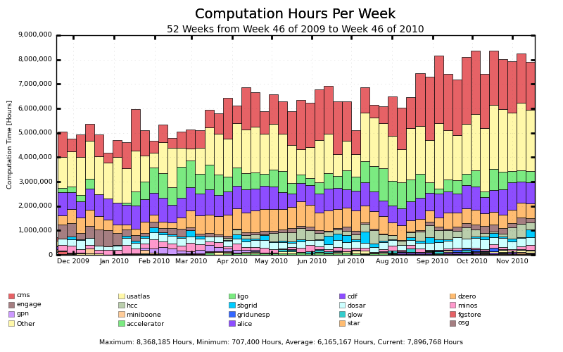
Overall Production

Slide 3
OSG Display
OSG delivered across 80 sites
In the last 24 Hours:
732,000 Jobs
1,114,000 CPU Hours
121,000 Transfers
805 TB Transferred
In the last 30 Days:
13,088,000 Jobs
36,099,000 CPU Hours
50,860,000 Transfers
29,726 TB Transferred
In the last Year:
152,016,000 Jobs
332,227,000 CPU Hours
493,663,000 Transfers
204,653TB Transferred
Status at 11:50 AM http://display.grid.iu.edu

Slide 4
Some Production Examples…
Effort from the entire team
  Tracking and solving BDII Issues
    One BDII can no longer handle the entire load
      Plan to add more BDIIs into round-robin
      Plan to upgrade to BDII v5
      Stress testing; consistency verification; VM testing (problems)
      Patched by GOC
    General CERN BDII Instabilities (often detected by OSG)
    BNL dropping out of CERN BDII
      Turned out to be a GigaPOP issue at Indiana
  SL5 Kernel vulnerability patch
  GOC now using Puppet for s/w management
  Atlas critical alarm against T1 dCache system
    Verification of alarm process

Slide 5
Updated View from Production
New VOs can quickly come up to speed (with handholding)
  LSST capable of getting >60k hours/day
Pilot factory running at SDSC now supporting multiple VOs
  CMS, HCC, SBGrid/NEBioGrid
  GlueX, IceCube, Glow (setup but not really used yet)
Opportunistic storage is the #1 problem
  A very difficult problem
  No OSG solution on the horizon.
  CMS and Atlas experimenting with an Xrootd based data access strategy using “transparent remote streaming and data caching” to create a more “global” system (Brian)
  It could eventually have some implications for OSG …

