Slide 1
Security in the OSG
Kanye West aka Ye aka Yeezy aka Yeezus
Getting Out Our Dreams Music, Inc.
Los Angeles, CA

Slide 2
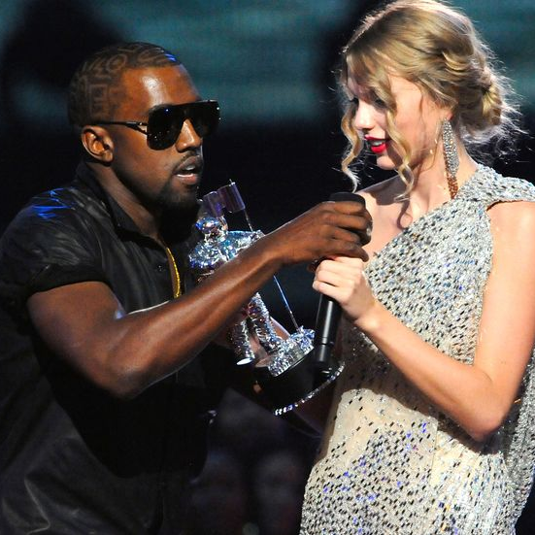
The Real Kanye?
Nope, he’s a decoy that lets me concentrate on making dope music
Source: http://lensng.com/wp-content/uploads/2016/07/mgid-ao-image-mtv.jpg

Slide 3
Security in the OSG
Brian Lin
OSG Software Team
University of Wisconsin - Madison

Slide 4
What is Identity?
What is identification?

Slide 5
What is identity?
Identification as proof of identity
In the real word: (paparazzi) photos, SSN, driver’s license, passport, etc.
On the Internet: usernames (kanye_stan_9432), certificates

Slide 6
How Do You Trust Someone’s Identity?
Why didn’t you trust me when I said I was Kanye West?

Slide 7
How do you trust someone?
Prior knowledge/experience
Appeal to authority
Chain of trust
Varying levels of trust

Slide 8
#1: Authentication
Trusting identification

Slide 9
#1: Authentication
Do you trust who I say I am?
What about forged identities?
Username + password, shared secret (public key cryptography)
Authentication online often goes both ways

Slide 10
#2: Authorization
Trusting identities

Slide 11
#2: Authorization
Do I trust your identity?
Do I trust you enough to give you root?
Authorization describes the privilege level of an identity

Slide 12
#3: Security in the OSG
Hey, that’s the name of the talk!

Slide 13
#3: Security in the OSG
Certificate-based
Transparent with OSG Connect
VOs vet users
Admins vet machines
Certificate revocation of bad users/machines

Slide 14
#4: Is Your Data Secure?
On a shared computer...

Slide 15
#4: Is Your Data Secure?
Every participant in the OSG is vetted but…
You are using a shared computer
Take basic precautions (i.e. no world-writeable files)
NO sensitive data (e.g. HIPAA)

Slide 16
Thanks!
Questions?

