Slide 1
OSG -
Education, Training and Outreach
OpenScienceGrid.org/Education
OpenScienceGrid.org/About/Outreach
eot@OpenScienceGrid.org

Slide 2
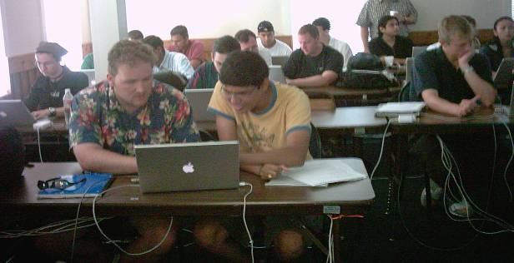
OSG EOT Mission
Organize and deliver training for OSG
  OSG End Users
  Site Administrators
  Support new communities / VOs joining OSG
Engage young people in (e)Science and CS
  Primary focus: graduate students and faculty
  Promote and train in interdisciplinary collaboration
Reach out
  To under-represented communities
    Engage and assist minority students and minority serving institutions by providing resources and opportunities.
  internationally
    Strengthen and assist emerging, underserved regions of strategic importance to form bonds to US science and Grid communities
    Focus (for outreach) is on Latin America and Africa
    OISE focus on engagement in Europe and Asia

Slide 3
2008-09 Workshop Program www.opensciencegrid.org/workshops
Midwest Grid School, Chicago, September 2008 (3 days)
Site administrator workshop, Clemson, March 2009 (1 day);
New Mexico Grid School, April 2009 (3 days)
North Carolina Grid School, April 2009 (2 days).
Others …

Slide 4
Self-paced / online instruction
opensciencegrid.org/OnlineGridCourse
Flexible roadmaps for navigating the material
Lectures and labs
Access to online community to provide support
Online support

Slide 5
Cooperation with EGEE
International Schools on Grid Computing
  OSG as co-organizer for ISSGC’07/08 and ISSGC’09
  International Summer School on Grid Computing www.issgc.org
    sponsor students to attend the International Summer school
  Joint lectureships and material sharing / development efforts
  Content sharing

Slide 6
Education VO
Interested in getting started with OSG ?
Join OSGEDU VO
  Use OSG resources
  Contribute resources
Wiki, email lists, follow-up discussions
  Support, engagement
  Postings of opportunities for students

Slide 7
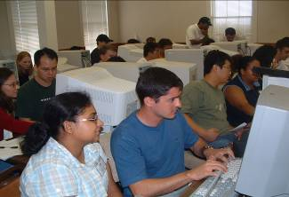
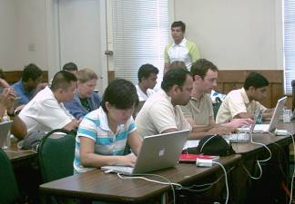
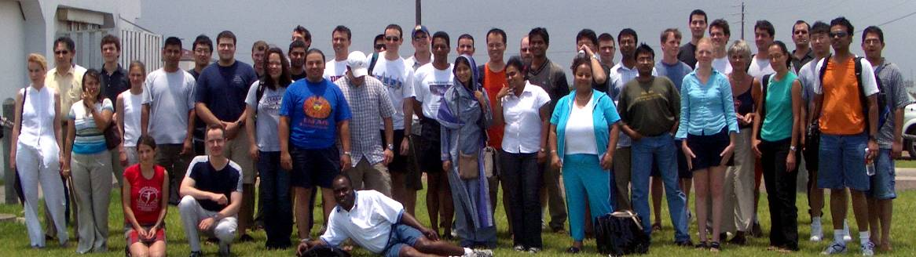
Students
2004-2009 facts:
Important demographic
– 50% science apps – 50% computer science.
Broad range of sciences represented
– from HEP to Earth Systems
Encourage collaboration

Slide 8
Participants’ domains
Computer Science
Image processing
Communications
Networking
Physics
Astrophysics
High Energy Nuclear Physics
Optical Networks
Theoretical solid state physics
Atomic Physics
Computational Physics
Chemistry
Computational Chemistry
Molecular Dynamics & Simulation
Applied Mathematics
Geosciences
Engineering
Materials Science
Quantum theory
…and others …

Slide 9
Next steps after ISSGC09
Continue with grid computing
  Apply to your own projects
  Stay in touch with grid community and OSG
  Take OSG online course or attend workshop
  Discuss your project needs with our Engagement team
  Make progress …

Slide 10
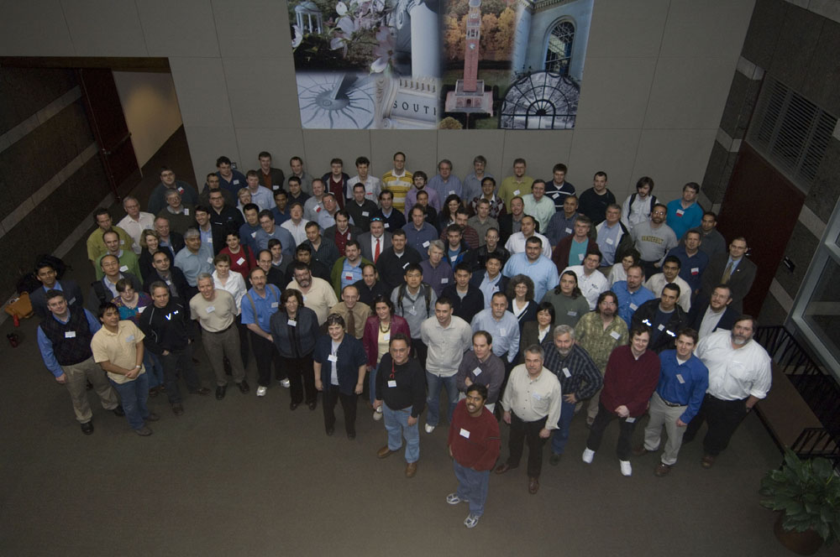
This is us: http://www.opensciencegrid.org

