Slide 1
PanDA-based
GRID Workload Management
Maxim Potekhin
(presenting for BNL Physics Applications Group)
Brookhaven National Laboratory
North Carolina Grid School
April 22-23, 2009
RENCI

Slide 2
Panda Intro
The Panda (Production ANd Distributed Analysis) system has been developed since summer 2005 to meet challenging requirements of ATLAS Collaboration for a large scale, data-driven workload management system for production and distributed analysis.
Since September 2006 Panda has also been a principal component of the US Open Science Grid (OSG) program in just-in-time (pilot-based) workload management. In October 2007 Panda was adopted by the ATLAS Collaboration as the sole system for distributed processing production across the Collaboration.

Slide 3
Panda Intro
In addition to serving the needs of Atlas community, Panda has also been used by scientists from other disciplines, such as a group of researchers at National Institute of Health. Work is under way to make Panda more accessible to smaller research groups by simplifying API and creating better Web-based interfaces.
Since its commissioning, Panda has processed a large number of jobs (~10⁸) on dozens of sites around the world. In addition to the production workflow, there are thousands of analysis jobs run daily.
Current metrics indicate 10⁴-10⁵ jobs running at any given time, with 10⁵-10⁶ jobs complete in a 24 hrs period, with the amount of data processed is of the order of 30TB.

Slide 4
Panda Intro
Central for Panda is the concept of Pilot-based workload management. Similar approach has been used in other large-scale projects (CMS, LHCb and others).
In the following slides, we will consider differences between the direct and Pilot-based job management.

Slide 5
Direct Job Submission (without Panda)
Site A
Site B
Site C
Advantage:
the user can employ the OSG software stack straight out of the box without having to deploy any extra layers (which, however, may not be easy)

Slide 6
Direct Job Submission (cont’d)
Site A
Site B
Site C
Disadvantages:
need to interface and manage diverse and heterogeneous processing resources
absence of a system-wide view of job status and progress
lack of uniform and integrated data management
hard to control latencies and failure modes inherent in generic in job submission (critical for analysis)
etc…

Slide 7



Panda Pilot-based job management: the concept
Site A
Site B
Pilot submission
Web Server Hosting Payload Jobs
Pilot Scheduler
Job Description Request
Live Pilot Job
Job Description Dispatch
Panda Server
Job Request
Job Description
User client
(…next slide)

Slide 8
Panda Pilot-based job management: the concept
Panda’s Pilot Framework for Workload Management
Workload jobs are assigned to successfully activated and validated Pilot Jobs (lightweight processes which probe the environment and act as a ‘smart wrapper’ for payload jobs), based on Panda-managed brokerage criteria. During this process, the Pilot “dials in” using an outgoing HTTPS connection to the server.
This 'late binding' of workload jobs to processing slots prevents latencies and failure modes in slot acquisition from impacting the jobs, and maximizes the flexibility of job allocation to resources based on the dynamic status of processing facilities and job priorities.
The pilot also encapsulates the complex heterogeneous environments and interfaces of the grids and facilities on which Panda operates. The users do not need to concern themselves with intricacies of Grid interface – Panda presents them with a unified mode of access to Grid resources.

Slide 9
Panda Pilot-based job management: the concept
Job Submission
Jobs are submitted via a client interface where the jobs sets, associated datasets, input/output files etc can be defined. Jobs received by the Panda server are placed in the job queue, and the brokerage module to prioritizes and assigns work based on job type, available resources, data location and other criteria.
The payload is not stored on the Panda server - it is defined as a URL from which it can be retrieved, thus improving the scalability and ease of management by the users. To communicate with the Panda and payload servers, the Pilot needs to be capable of outbound HTTP connectivity from the Worker Node on which it is run.

Slide 10
Panda Pilot-based job management: the concept
What Panda doesn’t solve
It is still necessary to build and make provisions for deployment of the executable, binaries and other resources for the specific target platforms. This can be alleviated by using virtualization, which goes beyond the topic of this presentation.

Slide 11
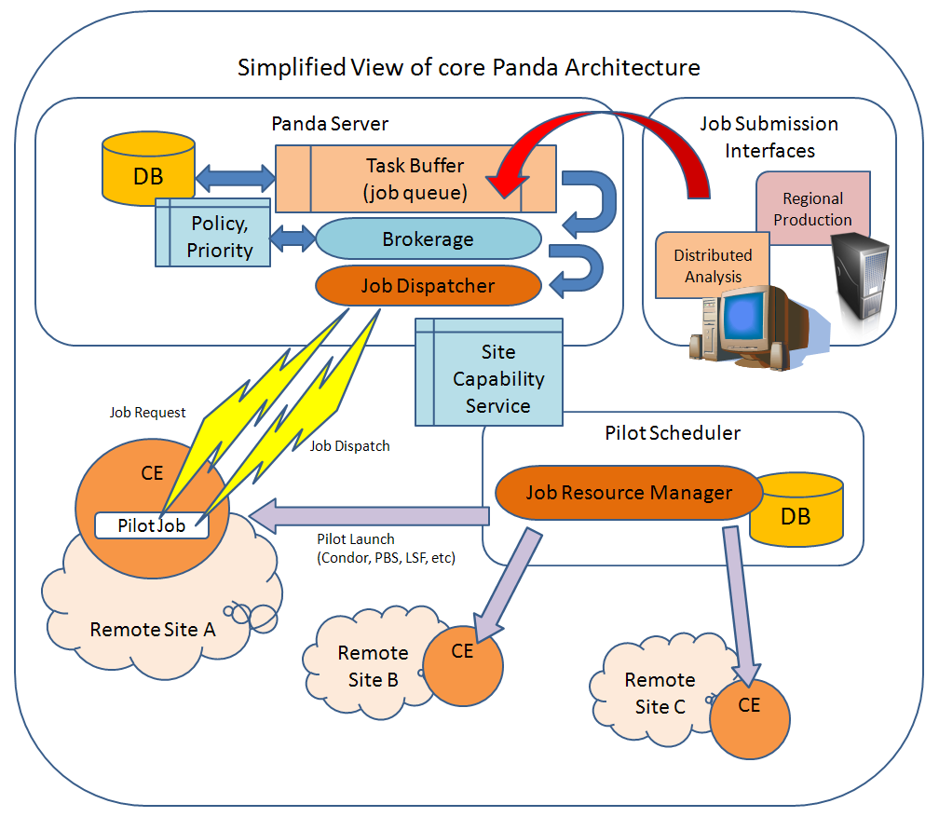
Panda Architecture

Slide 12
Panda Monitoring
Panda monitoring system is a separate component based on the Apache server, which allows the users and operators to have a comprehensive view of execution flow across multiple sites, and of many aspects of the job progress through the system. One has the capability to “drill down” into job execution detail.
Such details include, for example, log files produced by the pilots, number of running jobs according to various criteria, start and completion time etc.

Slide 13
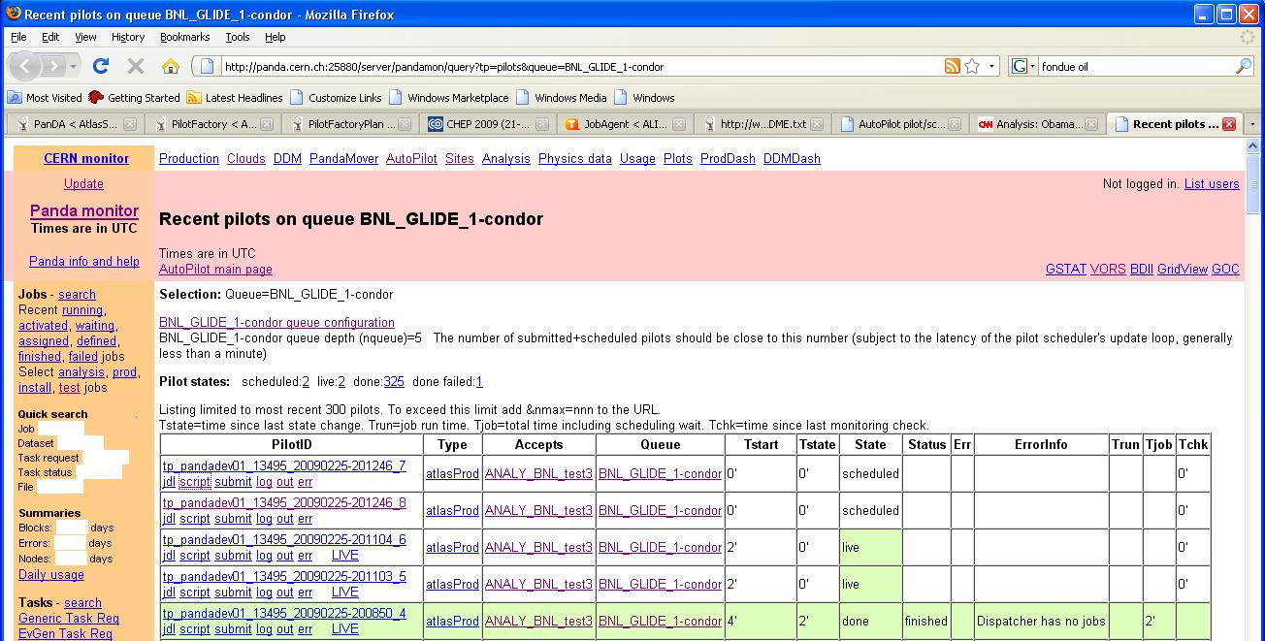
Panda Monitoring
A sample screenshot of the Panda monitoring system:

Slide 14
Panda Pilot-based job management
Submission of Pilot Jobs
Panda makes extensive use of Condor (particularly Condor-G) as a Pilot job submission infrastructure of proven capability and reliability. Pilots are submitted via Pilot Schedulers (Generators), which are typically run by administrators of the Virtual Organization wishing to submit jobs to Panda. Submission rate is regulated by the number of job requests queued in the server, thus eliminating creation of unused pilots and waste of resources.
Other principal design features
Through a system-wide job database, a comprehensive and coherent view of the system and job execution is afforded to the users.
Integrated data management is based on the concept of ‘datasets’ (collections of files), and movement of datasets for processing and archiving is built into the Panda workflow. Asynchronous and automated pre-staging of input data minimizes data transport latencies
Panda is based on the industry-standard Apache server and therefore renders itself to well understood performance tuning and scalability enhancing procedures. Its security is based on standard Grid tools (such as X.509 certificate proxy-based authentication and authorization)

Slide 15
Summary
Panda presents a coherent, homogeneous interface to distributes Grid resources to the user, in both production and analysis situation. It mitigates effects of job submission latency and isolates the user from many failure modes that may exist in Grid job submission scenario. It interfaces both automated production submission systems and requests from individuals.
In addition, it provides integrated data movement capabilities and extensive monitoring tools to users and operators. It has proved itself as a stable and scalable system, capable of addressing computing needs of a large and global organization, as well as of smaller research teams.
We welcome participation of researchers outside of High Energy and Nuclear Physics (which so far have been the main driver for the project).

