Slide 1
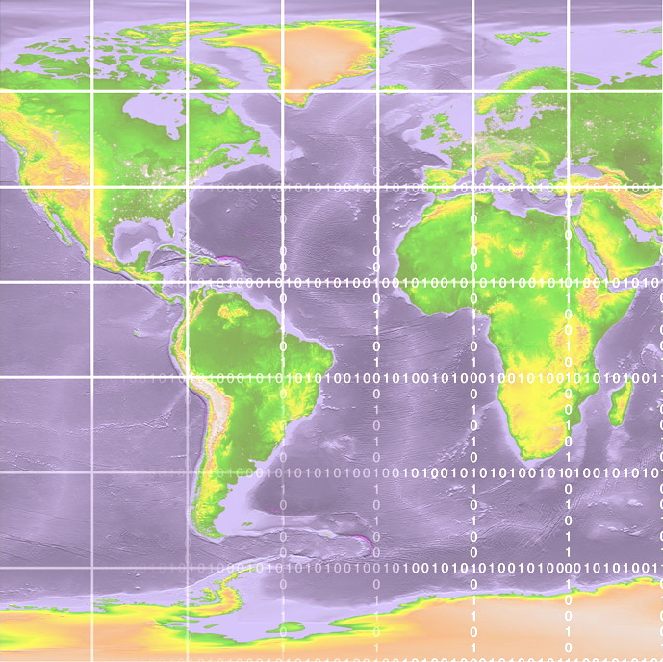
OSG Production releases: OSG Production Patches Urgent and Critical
Rob Quick
Senior Analyst/Programmer - Grid Technologies
Indiana University
Notes:
Yeah that’s me…

Slide 2
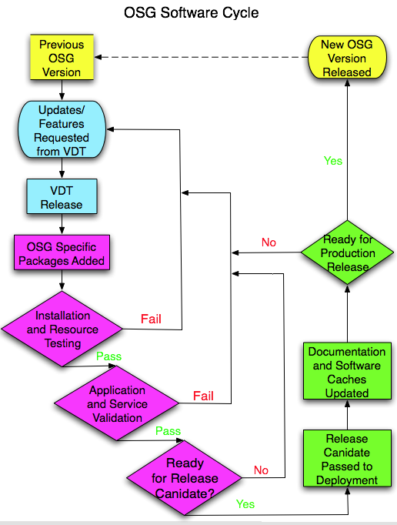
OSG Software Release Cycle
Production
VDT
ITB
Provisioning
Production

Slide 3
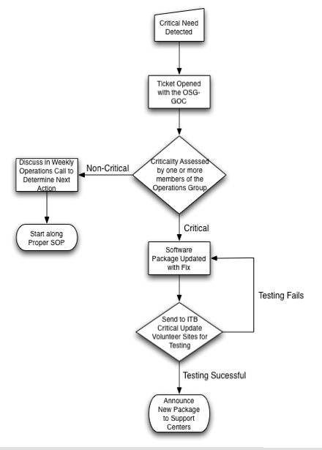
Critical Production
Updates
Assessment of Criticality
Update
Packaging
Testing
Release to Production OSG

Slide 4
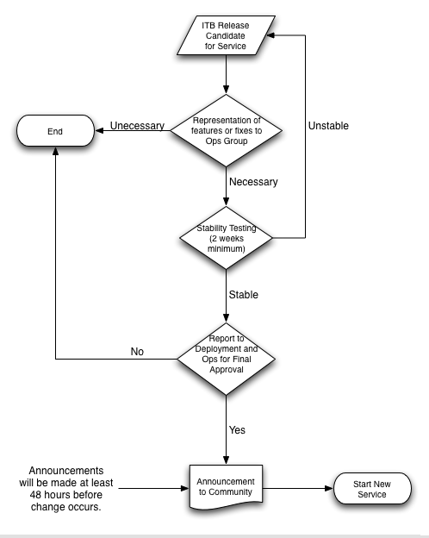
Standard Service
Update
Ops Representation
Testing Period
Announcement
Service Activation

