Slide 1
OSG Area Coordinators
Network Monitoring Update: January 27 2016
Shawn McKee

Slide 2
Networking Area Goals Year 4
We will put the OSG network datastore into production. Data from all registered perfSONAR instances in OSG and WLCG will be continuously gathered and reliably stored.
Done as of September 14, 2015 and announced. (But issues…)
The USATLAS and USCMS sites will be used to demonstrate a robust network monitoring infrastructure from OSG. We will use the data collected to identify networking issues between USATLAS and/or USCMS sites and document how we resolve those issues.
In progress (60%). Problems with OU, Langston and UM identified and fixed using OSG perfSONAR dashboard and metrics. See concerns later
Jan 22: ATLAS reported transfer problems between Germany and Canada, suspecting network issues. perfSONAR was used to identify a real network issue…fixed in 1 day by Canarie
We will produce Release 1.0 of the datastore API providing access to all the perfSONAR metrics we gather: traceroute, bandwidth, latency and packet-loss. In addition this API may contain additional derived and transformed data as requested by our client users.
In progress (55%). Starting from Esmond. Publishing to AMQ
Need to revisit in light of recent MQ interruptions.

Slide 3
Networking Stretch Goals Year 4
We will create a network cost-matrix (rows: sources, columns: destinations) containing estimated bandwidth values between our USATLAS and USCMS sites.
In progress (60%): Jorge Batista and Ilija Vukotic are working with me on producing a bandwidth estimate using Mathis’s Formula (which relates packet-loss and round-trip-time to bandwidth)
We will prototype various alarming and alerting components for use in OSG
15% Options being thought out. In the PuNDIT satellite project and MadAlert. Have Check_MK/OMD rule-based notifications too

Slide 4
Key Initiatives in Network Area
Improving perfSONAR-PS toolkit for OSG
Track adoption at http://grid-monitoring.cern.ch/perfsonar_coverage.txt
Soichi has well developed prototype of mesh-config
OSG modular dashboard service / OSG network service
Lots of problems since start of 2016. Meeting today to discuss issues and solutions.
Outreach and community interaction
Working with LHCb on integrating pS metrics.
Ongoing meetings/interactions with perfSONAR developers (Shawn attends weekly meetings)
PuNDIT testing on perfSONAR testbed in OSG.
ATLAS sites jamboree presentation tomorrow.

Slide 5
Recent Accomplishments
MadAlert initial version ready : http://madalert.aglt2.org/madalert/index.html
OSG perfSONAR published to CERN Active MQ bus being used by both ATLAS and LHCb
OSG perfSONAR data pipeline into ElasticSearch providing an Analytics Platform
http://cl-analytics.mwt2.org:5601
Soichi has finalized beta version of new mesh-config
Continued documentation updates for v3.5, network debugging and OSG datastore operations guide
Improvements to OMD/Check_mk probes including a transition to ETF (WLCG Experiments Test Framework) are ready to start deploying.

Slide 6
Project Update: MadAlert
Recap: Gabriele Carcassi (original author of GUMS) is working with me at Michigan on a new project for one of our OSG Networking Goals: alerting on problems
Updates since last time
GUI improvements and fixed minor bugs
http://madalert.aglt2.org/madalert/diff.html
Much to do to create an alerting system with proper notfications
Will be integrated with ESnet’s next MaDDash

Slide 7
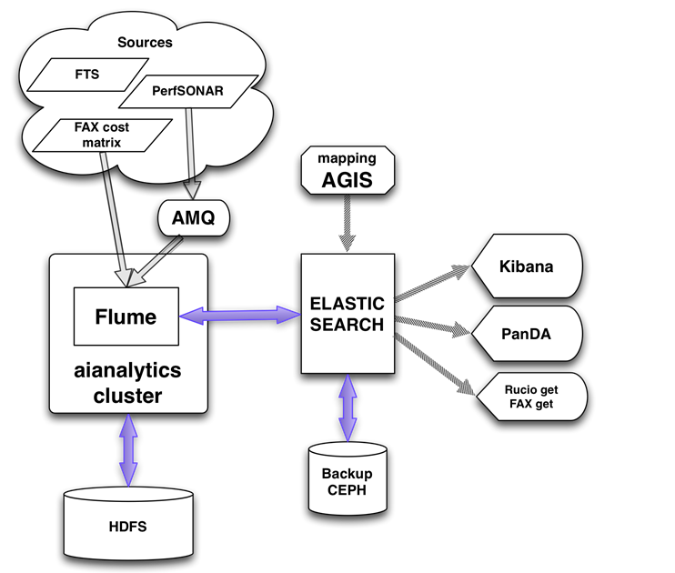
ATLAS perfSONAR Data Analytics
Ilija Vukotic has ATLAS analytics pipeline using OSG network metrics in place
See talk from today’s throughput meeting https://docs.google.com/presentation/d/1hnKjcE3FJjgSHTFhM2XfVpASZRT4UsbdEiW5L0yEOCU/edit?usp=sharing

Slide 8
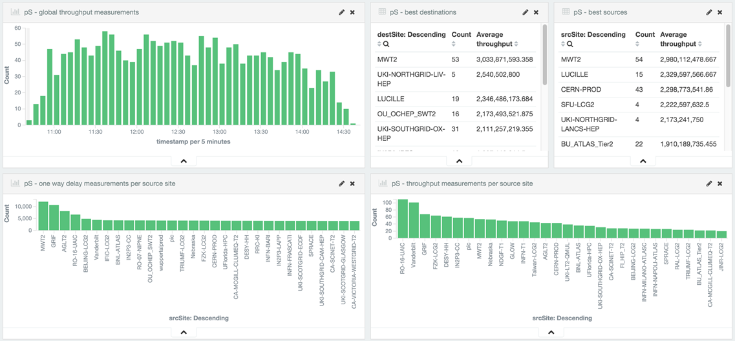
ElasticSearch Analytics
Example for perfSONAR
http://cl-analytics.mwt2.org:5601/app/kibana#/dashboard/perfSONAR

Slide 9
New Standalone Mesh-Config
Soichi, with debugging help from Andy Lake, Marian Babik and I, has prepared a new standalone mesh-config
https://ps-test.sca.iu.edu/meshconfig/
Can be installed outside OIM
Target is Universities or VOs who want to create and manage their own meshes
OSG Goal is to replace the mesh-config currently in OIM. Soichi has provided a roadmap to operations

Slide 10
Known Issues in OSG Networking
OSG datastore is too fragile.
Maintenance/reboots seem to break the system
Fixes are lost or not properly persisted
Problem diagnosis not very timely
Monitoring not sufficient to identify root causes
Message bus pipeline interruptions can cause clients to lose data
If publishing stops for a while, clients can crash. When publishing restarts data can be missed.
Recovery from datastore service interruptions takes too long. After extended downtime, querying for data from the downtime is taking longer than the downtime to catch up.

Slide 11
Top Concerns
OSG Network Datastore is still primary concern
Even though it is production, every time we make any change we seem to hit issues that require a bit of work to track-down and fix. Fixes aren’t properly persisted?
Today’s meeting is trying to address this
Adding additional check_mk monitoring should help
Deploy SSDs stragegically?
We need to also continue to update our living operations document: http://tinyurl.com/z7c9azb
Still pending: must address the data migration process.
How do we move “older” data off the primary system and onto a new location while retaining some means of access? Waiting for process from Esnet…
Getting better engagement from US LHC sites. Need to work on likely network issues but need some partners.

Slide 12
Questions or Comments?
Thanks!

Slide 13
URLs of Relevance
OSG Network Datastore Documents
Operations https://docs.google.com/document/d/1l144BSo-88M0cLMMjKcKMIE-Q5s21X-w3lYl-0Pn_08/edit#
SLA https://twiki.grid.iu.edu/bin/view/Operations/PSServiceLevelAgreement
Network Documentation https://www.opensciencegrid.org/bin/view/Documentation/NetworkingInOSG
perfSONAR adoption tracking: http://grid-monitoring.cern.ch/perfsonar_coverage.txt
Deployment documentation for both OSG and WLCG hosted in OSG (migrated from CERN)
https://twiki.opensciencegrid.org/bin/view/Documentation/DeployperfSONAR
ATLAS Analytics: http://cl-analytics.mwt2.org:5601/
Mesh-config in OSG https://oim.grid.iu.edu/oim/meshconfig
Beta Mesh-config: https://ps-test.sca.iu.edu/meshconfig/
MadAlert: http://madalert.aglt2.org/madalert/diff.html
perfSONAR homepage: http://www.perfsonar.net/

