Slide 1
Troubleshooting Your Jobs
Brian Lin
OSG Software Team
University of Wisconsin - Madison

Slide 2

The grid is your oyster!
Source: https://upload.wikimedia.org/wikipedia/commons/8/80/Pac...

Slide 3
The grid is your oyster!
...if you can get it to work.
Source: https://upload.wikimedia.org/wikipedia/commons/8/80/Pac...

Slide 4
General Troubleshooting
Held
Idle
Running
Complete
Submit file
Suspend
Suspend
Suspend
History file
‹#›

Slide 5


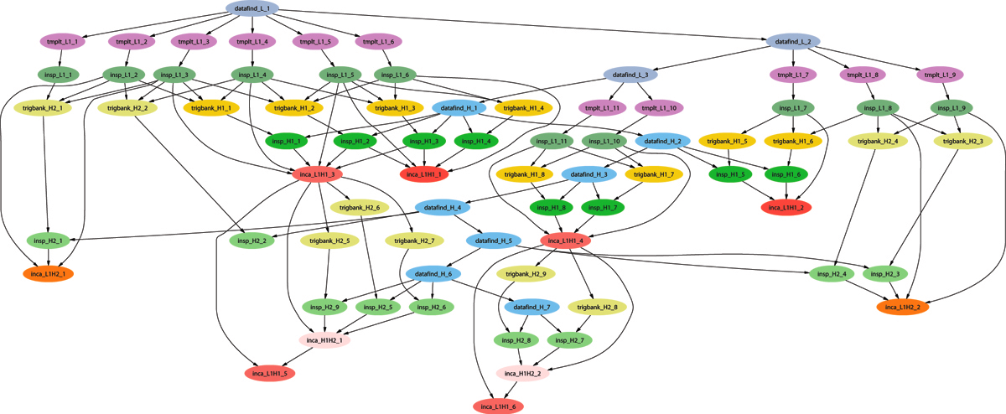
General Troubleshooting
Example of a LIGO Inspiral DAG
‹#›
Notes:
‹#›

Slide 6
General Troubleshooting
What result do you want? i.e. identifying the problem
Where can I find information about my problem?
Repeat 1) and 2)
Stuck here? Verify your assumptions
How do I fix the problem?
‹#›

Slide 7
Why can’t I submit my job?
$ condor_submit sleep.sh
Submitting job(s)
ERROR: on Line 2 of submit file:
ERROR: Failed to parse command file (line 2).
‹#›

Slide 8
Why can’t I submit my job?
$ condor_submit sleep.sh
Submitting job(s)
ERROR: on Line 2 of submit file:
ERROR: Failed to parse command file (line 2).
Huh? You’ve tried to submit something that wasn’t your submit file.
Solution: Submit your .sub file!
‹#›

Slide 9
Why can’t I submit my job?
$ condor_submit sleep.sub
Submitting job(s)
ERROR: Can't open "/cloud/login/blin/school/inptu_data" with flags 00 (No such file or directory)
Submitting job(s)No 'executable' parameter was provided
ERROR: I don't know about the 'vanila' universe.
ERROR: Executable file /bin/slep does not exist
‹#›

Slide 10
Why can’t I submit my job?
$ condor_submit sleep.sub
Submitting job(s)
ERROR: Can't open "/cloud/login/blin/school/inptu_data" with flags 00 (No such file or directory)
Submitting job(s)No 'executable' parameter was provided
ERROR: I don't know about the 'vanila' universe.
ERROR: Executable file /bin/slep does not exist
Huh? There are typos in your submit file.
Solution: Fix your typos! Condor can only catch a select few of them.
‹#›

Slide 11
Why can’t I submit my job?
$ condor_submit sleep.sub
Submitting job(s)
ERROR: Invalid log file: "/cloud/login/blin/htcondor-ce/sleep/sleep.log" (No such file or directory)
ERROR: Can't open "/cloud/login/blin/htcondor-ce/sleep/sleep.out" with flags 01101 (No such file or directory)
ERROR: Invalid log file: "/etc/sleep.log" (Permission denied)
ERROR: Can't open "/etc/sleep.out" with flags 01101 (Permission denied)
‹#›

Slide 12
Why can’t I submit my job?
$ condor_submit sleep.sub
Submitting job(s)
ERROR: Invalid log file: "/cloud/login/blin/htcondor-ce/sleep/sleep.log" (No such file or directory)
ERROR: Can't open "/cloud/login/blin/htcondor-ce/sleep/sleep.out" with flags 01101 (No such file or directory)
ERROR: Invalid log file: "/etc/sleep.log" (Permission denied)
ERROR: Can't open "/etc/sleep.out" with flags 01101 (Permission denied)
Huh? Condor can’t write the output, error, or log files.
Solution: Create the necessary directories, change the permissions of your directories, or choose a new location for your files!
‹#›

Slide 13
Why can’t I submit my DAG?
Errors appears in *dagman.out files instead of STDOUT or STDERR:
07/25/16 17:14:42 From submit: Submitting job(s)
07/25/16 17:14:42 From submit: ERROR: Invalid log file: "/home/blin/sleep/sleep.log" (No such file or directory)
07/25/16 17:14:42 failed while reading from pipe.
07/25/16 17:14:42 Read so far: Submitting job(s)ERROR: Invalid log file: "/home/blin/sleep/sleep.log" (No such file or directory)
07/25/16 17:14:42 ERROR: submit attempt failed
‹#›

Slide 14
What are my jobs up to?
$ condor_q -help status
JobStatus codes:
1 I IDLE
2 R RUNNING
3 X REMOVED
4 C COMPLETED
5 H HELD
6 > TRANSFERRING_OUTPUT
7 S SUSPENDED
‹#›

Slide 15
Why are my jobs idle?
$ condor_q -better 460834
460834.000: Run analysis summary. Of 12460 machines,
12460 are rejected by your job's requirements
0 reject your job because of their own requirements
0 match and are already running your jobs
0 match but are serving other users
0 are available to run your job
WARNING: Be advised:
No resources matched request's constraints
Suggestions:
Condition Machines Matched Suggestion
--------- ---------------- ----------
1 ( TARGET.Memory >= 134217728 ) 0 MODIFY TO 1000064
‹#›

Slide 16
Why are my jobs still running?
$ condor_q
-- Schedd: learn.chtc.wisc.edu : <128.104.100.43:9618?...
ID OWNER SUBMITTED RUN_TIME ST PRI SIZE CMD
14665.0 blin 7/25 18:19 0+23:00:03 R 0 0.3 sleep.sh
Solution: Use `condor_ssh_to_job <job ID>` to open an SSH session to the worker node running your job.
‹#›

Slide 17
Why are my jobs held?
$ condor_q -held
-- Schedd: fermicloud113.fnal.gov : <131.225.155.60:3573?...
ID OWNER HELD_SINCE HOLD_REASON 19.0 blin 7/14 15:07 Error from fermicloud113.fnal.gov: Failed to execute '/cloud/login/blin/school/sleep.sh': (errno=13: 'Permission denied')
14662.0 blin 7/25 18:05 Error from slot1_12@e163.chtc.wisc.edu: Failed to execute '/var/lib/condor/execute/slot1/dir_3090825/condor_exec.exe': (errno=8: 'Exec format error')
‹#›

Slide 18
Why are my jobs held?
$ condor_q -held
-- Schedd: fermicloud113.fnal.gov : <131.225.155.60:3573?...
ID OWNER HELD_SINCE HOLD_REASON 19.0 blin 7/14 15:07 Error from fermicloud113.fnal.gov: Failed to execute '/cloud/login/blin/school/sleep.sh': (errno=13: 'Permission denied')
14662.0 blin 7/25 18:05 Error from slot1_12@e163.chtc.wisc.edu: Failed to execute '/var/lib/condor/execute/slot1/dir_3090825/condor_exec.exe': (errno=8: 'Exec format error')
Huh? Condor couldn’t run your executable.
Solution: Set the executable bit on your executable (`chmod +x <filename>`) and/or add the missing shebang line at the top of the executable, e.g. ‘#!/bin/bash’.
‹#›

Slide 19
Why are my jobs held?
$ condor_q -held
-- Schedd: fermicloud113.fnal.gov : <131.225.155.60:3573?...
ID OWNER HELD_SINCE HOLD_REASON 19.0 blin 7/14 15:07 Error from fermicloud113.fnal.gov: Failed to execute '/cloud/login/blin/school/sleep.sh': invalid interpreter (/bin/bash) specified on first line of script (errno=2: 'No such file or directory')
‹#›

Slide 20
Why are my jobs held?
$ condor_q -held
-- Schedd: fermicloud113.fnal.gov : <131.225.155.60:3573?...
ID OWNER HELD_SINCE HOLD_REASON 19.0 blin 7/14 15:07 Error from fermicloud113.fnal.gov: Failed to execute '/cloud/login/blin/school/sleep.sh': invalid interpreter (/bin/bash) specified on first line of script (errno=2: 'No such file or directory')
Huh? There are carriage returns (^M) in your executable.
Solution: Use `vi -b <filename>` to see and delete the carriage returns (use ‘x’ to remove characters).
‹#›

Slide 21
Why are my jobs held?
$ condor_q -held
-- Schedd: fermicloud113.fnal.gov : <131.225.155.60:3573?...
ID OWNER HELD_SINCE HOLD_REASON 19.0 blin 7/14 15:07 Error from slot1_1@e026.chtc.wisc.edu: Job has gone over memory limit of 1 megabytes. Peak usage: 1 megabytes.
‹#›

Slide 22
Why are my jobs held?
$ condor_q -held
-- Schedd: fermicloud113.fnal.gov : <131.225.155.60:3573?...
ID OWNER HELD_SINCE HOLD_REASON 19.0 blin 7/14 15:07 Error from slot1_1@e026.chtc.wisc.edu: Job has gone over memory limit of 1 megabytes. Peak usage: 1 megabytes.
Huh? You’ve used too many resources.
Solution: Request more!
‹#›

Slide 23
Why are my jobs held?
Edit your jobs on the fly with `condor_qedit` and `condor_release`:
$ condor_qedit <job ID> <resource> <value>
$ condor_qedit <job ID> RequestMemory <mem in MB>
$ condor_qedit -const ‘JobStatus =?= 5’ RequestDisk <disk in KiB>
$ condor_qedit -const ‘Owner =?= “blin”’ RequestCpus <CPUs>
$ condor_release <job ID>
Or remove your jobs, fix the submit file, and resubmit:
$ condor_rm <job ID>
Add request_disk, request_mem, or request_cpus to your submit file
$ condor_submit <submit file>
‹#›

Slide 24
Why are my jobs held?
$ condor_q -held
-- Schedd: fermicloud113.fnal.gov : <131.225.155.60:3573?...
24.0 blin 7/14 16:12 Error from fermicloud113.fnal.gov: STARTER at 131.225.155.60 failed to send file(s) to <131.225.155.60:64130>: error reading from /var/lib/condor/execute/dir_24823/bar: (errno 2) No such file or directory; SHADOW failed to receive file(s) from <131.225.155.60:10507>
‹#›

Slide 25
Why are my jobs held?
Submit Node
Compute Node
Output
SHADOW
STARTER
Input
‹#›

Slide 26
Why are my jobs held?
$ condor_q -held
-- Schedd: fermicloud113.fnal.gov : <131.225.155.60:3573?...
24.0 blin 7/14 16:12 Error from fermicloud113.fnal.gov: STARTER at 131.225.155.60 failed to send file(s) to <131.225.155.60:64130>: error reading from /var/lib/condor/execute/dir_24823/bar: (errno 2) No such file or directory; SHADOW failed to receive file(s) from <131.225.155.60:10507>
Huh? Your job did not create the files that you specified in transfer_output_files.
Solution: Check for typos in transfer_output_files and/or add debugging information to your code.
‹#›

Slide 27
My jobs completed but...
The output is wrong:
Check *.log files for return codes or unexpected behavior: short runtimes, using too much or too few resources
Check *.err and *.out for error messages.
Submit an interactive job: `condor_submit -i <submit file>` and run the executable manually.
If it succeeds, does your submit file have the correct args? If yes, try adding ‘GET_ENV=True’ to your submit file.
If it fails, there is an issue with your code or your invocation!
‹#›

Slide 28
Troubleshooting DAGs
Check *.rescue* files (which nodes failed)
Check *.dagman.out (errors with job submission)
Check *.nodes.log (return codes, PRE/POST script failures).
If PRE/POST scripts failed, run them manually to see where they failed.
‹#›

Slide 29
Thanks!
Questions?

