Slide 1


Post ASP 2012: Protein Docking at the IU School of Medicine

Slide 2
Protein Docking with IU School of Medicine
SPLINTER - Structural Protein-Ligand Interactome
Used autodock-vina – “…open-source program for drug discovery, molecular docking and virtual screening…”
Frist run - docked ~3900 Proteins with 5000 Ligands for a total of ~19M docked pairs.
Submitted via command line to Condor using Pegasus on the OSG-XSEDE submission node
Infrastructure is set and new runs can be easily started

Slide 3
What does this look like? Executable Wrapper
#!/bin/bash
set -e
# Wrapper for Autodock Vina this shell script will import a receptor a ligand and the center coordinates
# and convert the output to a .mol2 format. Afterward it will remove the unnecessary files so only the
# .mol2 is returned
# Version 1.2 - Rob Quick - Added file clean up to streamline output
if [ $# -ne 5 ]; then
echo "Usage: vina "
exit 1
fi
chmod a+x vina
#Run vina
./vina --cpu 1 --receptor $1.pdbqt --ligand $2.pdbqt --center_x $3 --center_y $4 --center_z $5 --size_x 21 --size_y 21 --size_z 21 --out $1-$2.pdbqt
#Run pdbqt to mol2 conversion
./pdbqt2mol2.py $1-$2.pdbqt $2.mol2 $1-$2.mol2
#Get rid of unnecessary files
rm $1-$2.pdbqt
rm $1-$2.pdbqt-new
echo $HOSTNAME

Slide 4
What does this look like? Condor Submit File
Universe = vanilla
Executable = vina_wrapper.sh
Log = vina.log
Error = error/vina.err.$(Process)
should_transfer_files = YES
when_to_transfer_output = ON_EXIT
Output = output/3DLXA1-ZINC00260992.mol2
Arguments = 3DLXA1 ZINC00260992 11.923 26.684 0.672
transfer_input_files = /home/rquick/autodock_vina_1_1_2_linux_x86/bin/vina,/home/yx5/test/receptors/3DLXA1/3DLXA1.pdbqt,/home/yx5/test/ligands/pdbqt/ZINC00260992.pdbqt,/home/yx5/test/ligands/mol2/ZINC00260992.mol2,/home/yx5/pdbqt2mol2.py
Queue
Output = output/3DLXA1-ZINC02913596.mol2
Arguments = 3DLXA1 ZINC02913596 11.923 26.684 0.672
transfer_input_files = /home/rquick/autodock_vina_1_1_2_linux_x86/bin/vina,/home/yx5/test/receptors/3DLXA1/3DLXA1.pdbqt,/home/yx5/test/ligands/pdbqt/ZINC02913596.pdbqt,/home/yx5/test/ligands/mol2/ZINC02913596.mol2,/home/yx5/pdbqt2mol2.py
Queue
Output = output/3DLXA1-ZINC21637768.mol2
Arguments = 3DLXA1 ZINC21637768 11.923 26.684 0.672
transfer_input_files = /home/rquick/autodock_vina_1_1_2_linux_x86/bin/vina,/home/yx5/test/receptors/3DLXA1/3DLXA1.pdbqt,/home/yx5/test/ligands/pdbqt/ZINC21637768.pdbqt,/home/yx5/test/ligands/mol2/ZINC21637768.mol2,/home/yx5/pdbqt2mol2.py
Queue

Slide 5
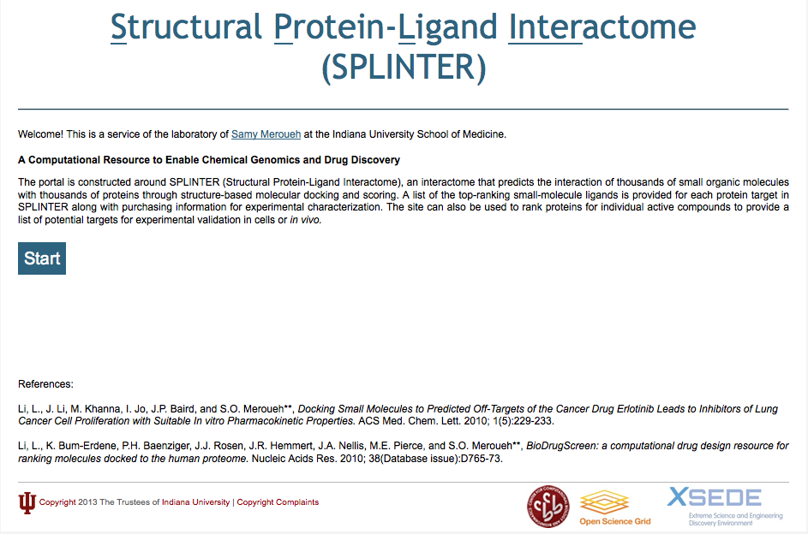
www.biodrugscreen.org

Slide 6
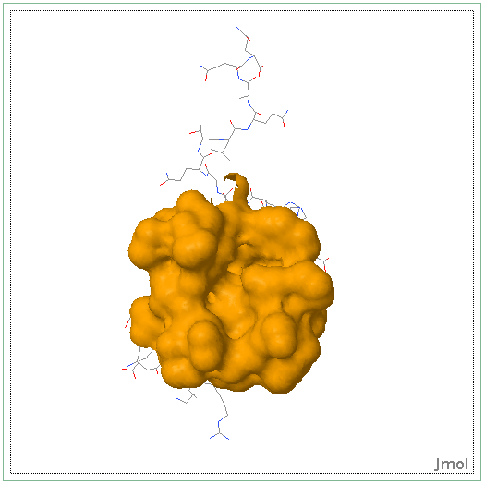
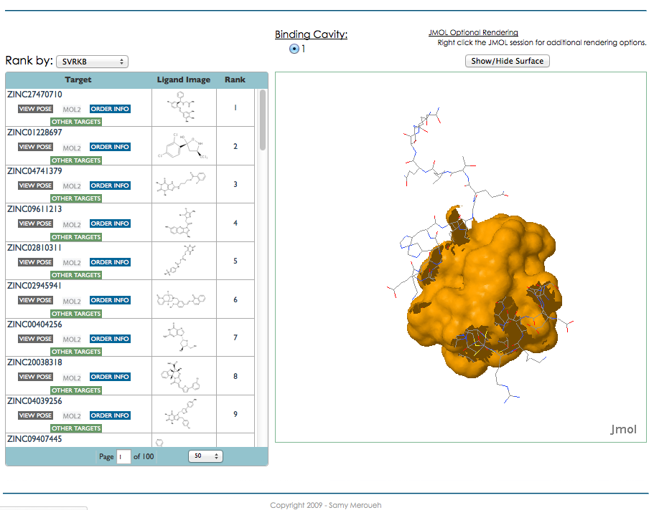
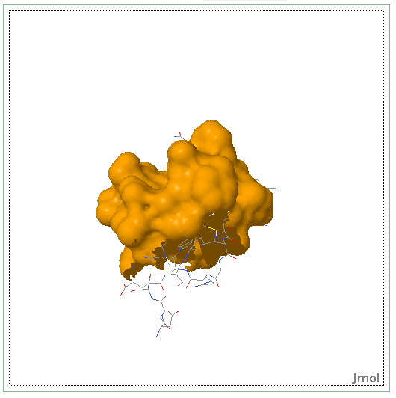
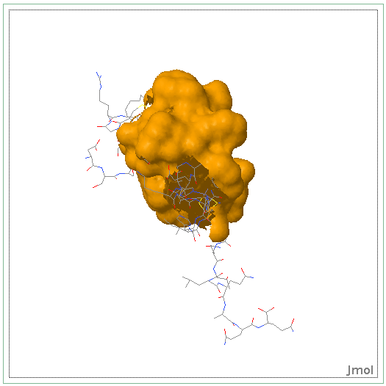
Various rotations of Protein CBFA2T1 (Cyclin-D-related protein) (Eight twenty one protein) (Protein ETO) (Protein MTG8) (Zinc finger MYND domain-containing protein 2)

Slide 7
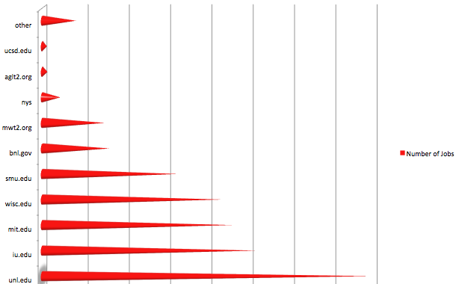
Where did these jobs run? First ~1M Jobs

Slide 8
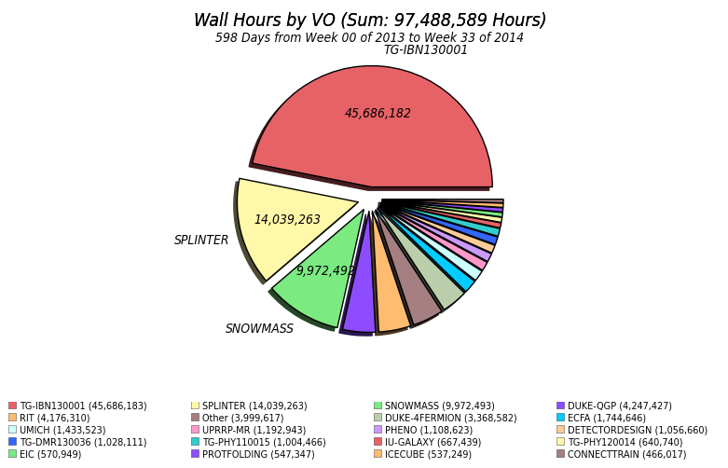
Some Numbers
Amazon S3 Computing $0.073/hour
$1.025M Compute Only
Data Transfer and Storage Not Included

Slide 9

Questions

