Slide 1

Network Area for OSG
Shawn McKee/University of Michigan
OSG Staff Planning Retreat
June 4th 2013

Slide 2
Outline
OSG Network Monitoring
Year 1 Goals and Key Accomplishments
Lessons Learned
Year 2 Plans
Completing and extending year 1
New focus areas
Discussion about WLCG Request
WLCG asks if OSG would provide perfSONAR-PS “dashboard” for WLCG use. Includes data collecting and storage
Summary, Questions, Discussion

Slide 3
OSG Network Monitoring Goals
We want OSG sites to have the ability to easily monitor their network status
Sites should be able to determine if network problems are occurring
Sites should have a reasonable “baseline” measurement of usable bandwidth between themselves and selected peers
Sites should have standardized diagnostic tools available to identify, isolate and aid in the repair of network-related issues
We want OSG VOs to have the ability to easily monitor the set of network paths used by their sites
VOs should be able to identify problematic sites regarding their network
VOs should be able to track network performance and alert-on network problems between VO sites

Slide 4
Year 1 Goals and Key Initiatives in Network Area
Year 1 of OSG Networking was primarily focused on getting network monitoring in place
Deploying perfSONAR-PS: Instrumenting OSG sites with standardized tools to gather network metrics
OSG Network Service: Gathering OSG network metrics centrally and making them available for users and applications
Network Documentation: Creating documentation for OSG user and VO managers to guide them in understanding and diagnosing network issues
GOAL: OSG becomes the “source” for networking information for its constituents, aiding in finding/fixing problems and enabling applications and users to better take advantage of their networks

Slide 5
Deploying perfSONAR-PS
First step for OSG networking is to get perfSONAR-PS deployed as broadly as possible and registered in OIM
As of August 2012 perfSONAR-PS v3.2 was not nearly as reliable or robust as needed to “push” sites to deploy
Target was a significantly improved version by early 2013
Release date for v3.3 finally set to March 1, 2013
Lots of fixes/improvements significantly delayed release (June 2013)
Currently we have 36 instances registered and deployed at 18 “sites”. (See http://myosg.grid.iu.edu/misccount/index?count_sg_1003=on&count_active=on&count_enabled=on )
More instances in place but not registered yet in OIM
This is obviously short of where we want to be. Expectation is that once 3.3 is out we can ‘push’ sites to deploy or upgrade quickly.

Slide 6
OSG Networking Service
OSG is building a centralized service for gathering, viewing and providing network information to users and applications.
Basis of this service is the follow-on to the original BNL dashboard project: https://github.com/PerfModDash
Recoding to create a modularized, scalable system which maintains all functionality from the original service
Progress has also been slower than expected (~0.5 developer)
Current version is “beta” level
Thanks to Soichi/Rob/Operations, OSG has this service up: target announcement date is June 11, 2013
Matrix View http://tinyurl.com/bpzbjrw
Host Status http://tinyurl.com/adbhv6n
Service will track instances registered in OIM and gather, store and eventually alert on network metrics

Slide 7
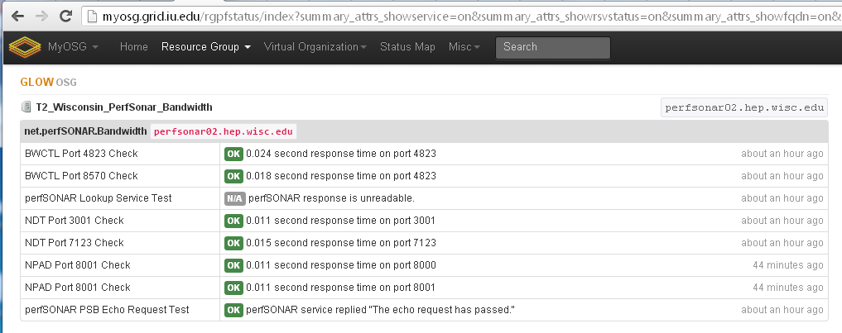
Example of “Beta” Service in OSG

Slide 8
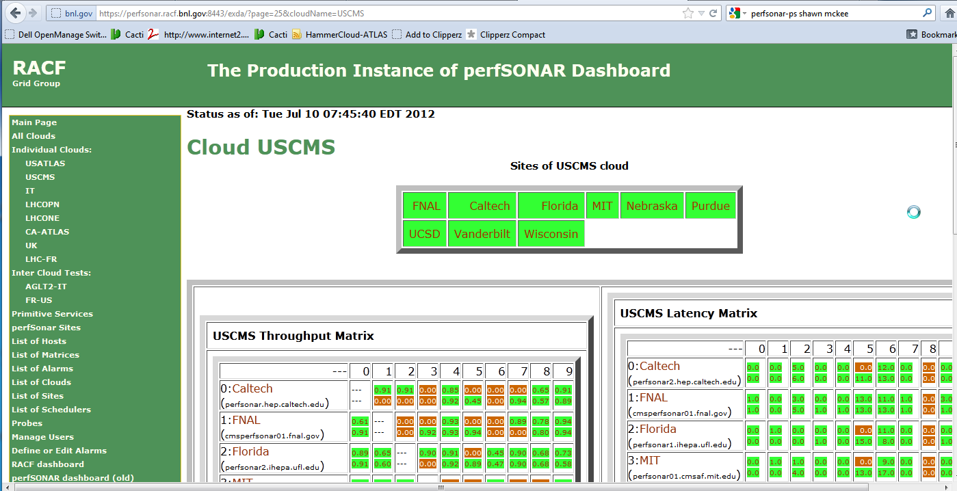

Example of Original Dashboard
“Primitive” service status
Other Clouds
See http://perfsonar.racf.bnl.gov:8080/exda/?page=25&cloudName=USCMS

Slide 9
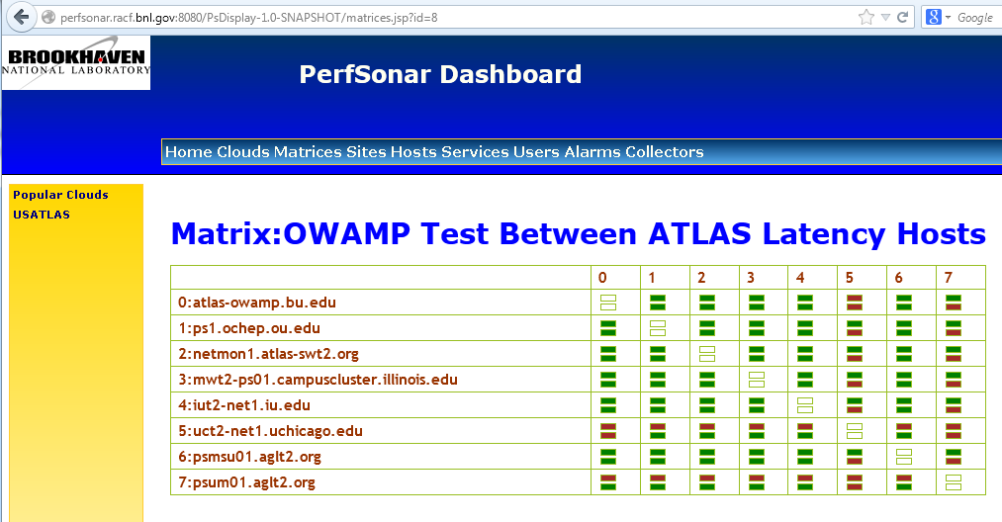
Example of “New” Dashboard
http://perfsonar.racf.bnl.gov:8080/PsDisplay-1.0-SNAPSHOT/matrices.jsp?id=8

Slide 10
OSG Network Documentation
Understanding, finding and fixing network problems or optimizing network usage can be complex. Documentation is critical to supporting OSG users and administrators
Set of OSG network pages in place at https://www.opensciencegrid.org/bin/view/Documentation/NetworkingInOSG
Draft network “triage” document for OSG users at: https://www.opensciencegrid.org/twiki/pub/Documentation/NetworkingTroubleShooting/20130204-OSG-Debug-SPM.docx
Looking for feedback. A “living” document, evolving as tools update.
OSG network client tools updated / tested for client RPMs:
https://www.opensciencegrid.org/bin/view/Documentation/Release3/NetworkPerformanceToolkit
Installation guide for perfSONAR-PS Toolkit in place at https://www.opensciencegrid.org/bin/view/Documentation/PerfSONARToolKit and https://www.opensciencegrid.org/bin/view/Documentation/RegisterPSinOIM
Will need tuning and updating after v3.3 is finally released

Slide 11
Achievement Summary Year 1
Significant improvements in perfSONAR-PS Toolkit:
Much more robust and resilient
Default configuration well tuned to our deployment environment
New feature: mesh-configuration allows centralized and federated management of tests and meshes
New feature: include capabilities to minimize typos/errors
OSG Network Service deployed in MyOSG/OIM
New OIM registration schema setup for perfSONAR-PS instances
Modular Dashboard project created and beta release out
License issues cleared (BSD) and source in GitHub
Much of the original functionality recreated in a scalable modular way
New documentation for users and admins in place
Guidance for debugging network issues, using OSG network tools and deploying OSG network infrastructure (toolkit)

Slide 12
Lessons Learned
Network issues can be “hard” to find/understand/fix, but most OSG users don’t care about networking until/unless they hit “network” problems or limitations.
Relying upon “outside” effort (and timelines) can be ‘expensive’ for our scheduling and planning ☹
Users drive improvements in community projects. We benefited from significant improvements in perfSONAR-PS from broad-scale testing and use.
Users don’t always contribute to community projects. Need to find ways to engage more interest/effort in PerfModDash
Hardening/improving broadly deployed software is time-consuming

Slide 13
Year 2 OSG Networking Plans
Two primary components:
Finishing Year 1 items
New efforts
Finishing Year 1
Complete deployment of perfSONAR-PS once v3.3 is out
Have 18 sites…need to extend to ~100
Improving the modular dashboard
Complete replication of ALL original features
Optimize resource use
Extend “client” API to best support evolving use-cases
Other areas for year 2
Optimize network metrics and collection
Enable alarming and problem analysis based upon network metrics
Improve tools and documentation from user perspective

Slide 14
Year 2 Overview
Year 1 was about enabling network monitoring within OSG while Year 2 will need to focus on improving and utilizing that monitoring
We need to better understand the relative value of the various metrics that we collect, optimize how and what we gather, and test and document their use in:
Localizing and diagnosing network problems
Identifying structural bottlenecks
Enabling higher level services to improve how our applications use the network.
An important task for year two is enabling effective alerting of network problems based upon the metrics gathered by the OSG network service

Slide 15
perfSONAR-PS Toolkit Tuning
The perfSONAR-PS Toolkit installations provide a means of obtaining “site” views of the network with standardized tests
How much testing is useful? We will need to carefully tune the tests to balance between our needs for the metrics and “overuse” of active test data on the network
The “mesh config” option developed in year 1 allows us to tune and tweak configurations quickly (~1 hour) across a the set of sites in each mesh. This will be leveraged to optimize the OSG mesh and test configurations.
The new “include” functionality will allow us to maintain the set of sites, tests and hosts with minimal redundancy.
Needs exploration to optimize how best to use this feature.
As “clients” for the data come online we will likely need to respond to their needs in terms of data tweaking

Slide 16
Alerting/Alarming for Network Issues
What most sites want is a tool that lets them know if there is a network problem (and ideally WHERE it is)
In year 2 we want to develop this capability for OSG sites
Primitive OSG perfSONAR-PS service monitoring is easy and we have Nagios-type plugins that check services
Much harder is deciding when network metrics gathered by perfSONAR-PS require an alert or alarm:
Is the change in metrics due to “normal” (heavy) network use or is there a new problem?
If there is a real problem, where is it located? This is critical because we should only alert someone if the problem is something they can fix or are responsible for…
Interesting project at Georgia Tech called Pythia (see Terena presentation https://tnc2013.terena.org/core/presentation/40 )
I talked with Warren and Constantine…they are interested in collaborating
Effort here needs to come from collaborators

Slide 17
OSG Network Service
For year 2 we need to continue implementing and improving the OSG network service with our goal of OSG becoming the “source” of network information for OSG sites in mind
The OSG service should provide an integrated GUI component that quickly visualizes test metrics (matrices by metric type)
The datastore should have a client API that meets the needs of OSG VO users AND applications
We need to ensure the service maintains scalability for OSG use-cases (See discussion about WLCG at end of talk)
As we gain experience with the service, and how users want to use the service, we should plan to incorporate what we learn into the service/software/API.
The Operations team has been/will be critical in this effort

Slide 18
Network Info and Documentation
As we make progress in improving perfSONAR-PS, the dashboard and OSG network services we need to maintain and expand our documentation.
For year 2 we additionally have Mike Blodgett/UWisc working on “Network Monitoring Capabilities Design”
Test and evaluate the network monitoring capabilities OSG provides, especially from the perspective of users and network technical support perspectives.
Provide feedback for the developers of the perfSONAR-PS toolkit, the PerfModDash GitHub project and the OSG network services
Suggest new features as appropriate to better serve users and technical network support personnel.
Add/update documentation, targeted at users and technical network support personnel, on utilizing the OSG network monitoring to identify, localize and expedite the repair of network problems.“
Document examples of successful use of OSG network tools

Slide 19
Year 2 Planning Summary
Finish providing broad-scale, standardized, reliable network metric gathering OSG-wide
Enable more effective network service in OSG (alarm/alert)
Continue to maintain and update network documentation and how-to’s
Incorporate networking advances (100G, SDN, various network projects) into OSG repertoire (tools, info, etc)
Document success/failure examples of troubleshooting OSG network issues – Need to learn from these.

Slide 20
WLCG Request Discussion
WLCG is planning to deploy perfSONAR-PS Toolkits at ALL WLCG Tier-1/Tier-2 sites worldwide once v3.3 is out
They also require a centralized service to collect, organize and make available perfSONAR-PS network metrics
Currently they have been using the original BNL dashboard (LHCOPN, LHCONE, various Tier-1 clouds (CA,IT,UK, FR)
The BNL dashboard is supposed to move to OSG once we complete replicating the capabilities in the modular dashboard and integrate within MyOSG
WLCG requests that OSG (as a WLCG member) provide the perfSONAR-PS dashboard for WLCG
We need to respond to the request and should discuss the benefits and costs here…

Slide 21
Providing WLCG perfSONAR Dashboard / Network Service in OSG
Advantages: As Chander noted it would be great to have OSG be the host of a very important WLCG service and dataset
Disadvantages: OSG would be the host of a very important WLCG service and dataset
Scale is that WLCG will deploy at ~150 sites with some overlap (~20) with OSG sites
Modular dashboard was designed to scale by “going wide” Add more collectors or datastores to handle increasing loads
We need to determine the costs and requirements involved
Good suggestion from Brian: don’t commit to anything yet, but actually try to run the service to gain sufficient experience to fully understand what is involved.
Let WLCG know we will test and provide an answer in ~3 months?

Slide 22
Discussion/Questions
Questions or Discussion?

Slide 23
Some References
OSG Networking https://www.opensciencegrid.org/bin/view/Documentation/NetworkingInOSG
perfSONAR-PS site http://psps.perfsonar.net/
OSG perfSONAR-PS Toolkit install guide https://www.opensciencegrid.org/bin/view/Documentation/PerfSONARToolKit
I2 Install/configuration guide: http://code.google.com/p/perfsonar-ps/wiki/pSPerformanceToolkit33
Modular Dashboard: http://perfsonar.racf.bnl.gov:8080/exda/
Tools, tips and maintenance: http://www.usatlas.bnl.gov/twiki/bin/view/Projects/LHCperfSONAR
LHCONE perfSONAR: https://twiki.cern.ch/twiki/bin/view/LHCONE/SiteList
LHCOPN perfSONAR: https://twiki.cern.ch/twiki/bin/view/LHCOPN/PerfsonarPS

