Slide 1

Miscellaneous Summaries
www.opensciencegrid.org
OSG Council Meeting
Westin Hotel, Chicago
August 5, 2008
Paul Avery
University of Florida
avery@phys.ufl.edu

Slide 2
Short Summaries on Three Topics
2008 NSF Annual Report
Science Advisory Board status
ISGTW report

Slide 3
2008 NSF Annual Report
Required for NSF to start process to get next year’s funds
  Due end of May, submitted July 18 (Paul & Chander)
  OSG Document 770-v2
  Will start earlier next year
  DOE report submitted in February (6 month offset)
Format: Word document + 3 pdf attachments (72 pages)
  Laid out exactly as in NSF FastLane pages for easy cut/paste
  Chander summarized reports provided by Area Coordinators
  Pubs: 5 general OSG + 20 (CDF & D0) on FastLane page
  Attachment 1: Research highlights (from main OSG page)
  Attachment 2: Facility usage by VOs and sites
  Attachment 3: Metrics (in response to Agency questions)
  (Attachment 4: Full Area Coordinator reports in posted version)
Copies sent to JOT and Science Advisory Board
  Speaking of which…

Slide 4
Science Advisory Board
Members
  Helene Armitrage (VP for S/W development, IBM)
  Ari Patrinos (President, Synthetic Genomics)
  David Schwartz (Life science faculty, Wisconsin)
  Barry Barish (LIGO, Caltech)
First meeting was June 2007
  3 of 4 members attended
  So we are overdue
Contacted them late July
  Sent URL of 2008 Annual Report
  Promoted having a meeting in the “Fall”: Oct. ? Nov?
  No mail for Patrinos, Armitage mail bounced from overflow
Proposal: add 2 new members
  Provide names at this meeting

Slide 5
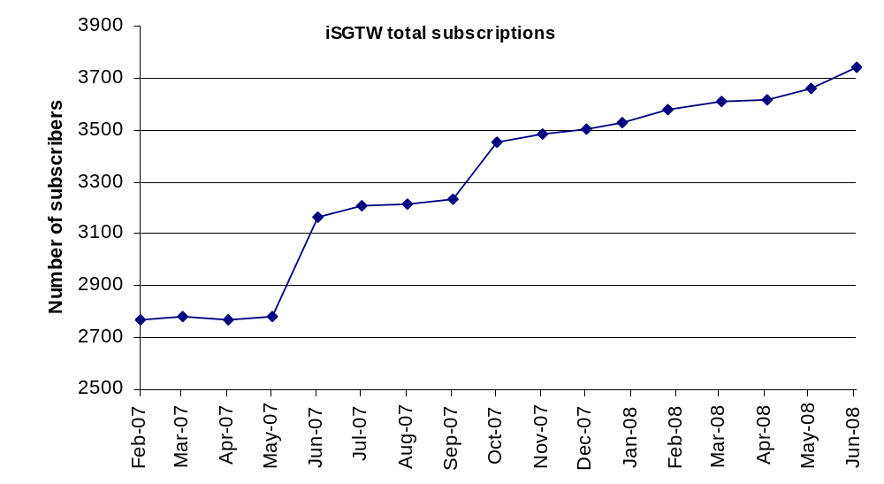
ISGTW: Statistics I (Subscribers)
Number of subscribers increasing, but slowly
EGEE meetings (free subscriptions)

Slide 6
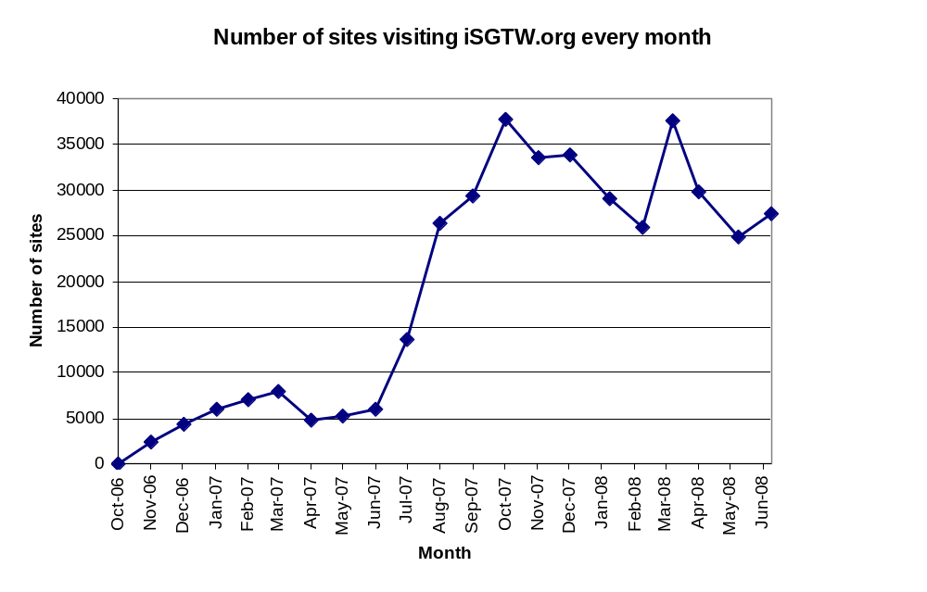
Statistics II: # Sites Visiting/month

Slide 7
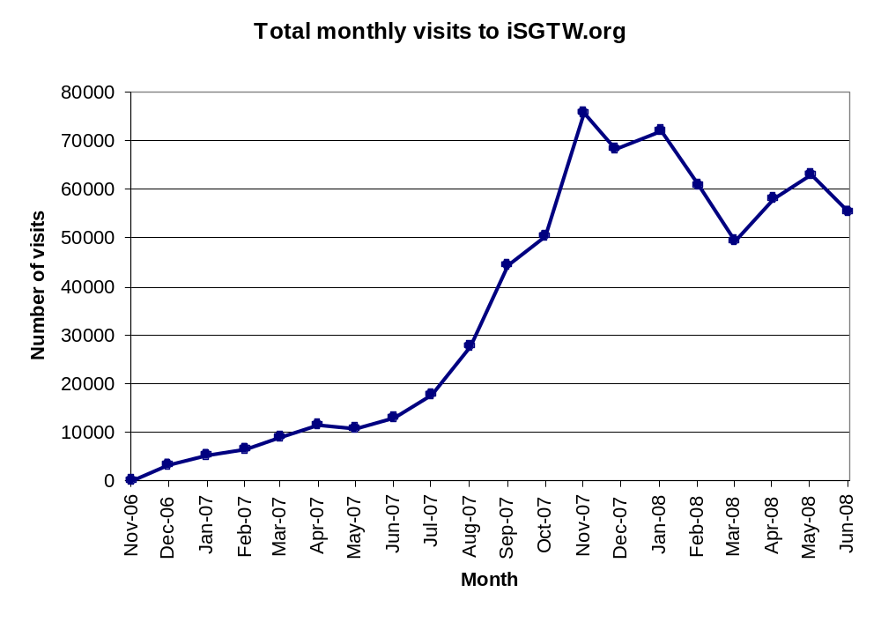
Statistics III: Total Visits/month

Slide 8
Evaluation of Statistics
All reported statistics come from Xenomedia
Active discussion about value of these measurements for measuring website progress
  Not clear what fluctuations mean
Possible new metrics
  Pages downloaded?
  Files downloaded?
  Others?
  Use more Google tools
We are “accepted” news source for Google
  Stories highlighted by Google bring more attention to iSGTW
Use of “Googleanalytics” to gauge impact of stories
  Surprising showing of June Grid Standards article (2 parts)

Slide 9
Other iSGTW Items
Adding “opt-out” subscriptions for other meetings
  Done at EGEE meetings
More involvement with computing side of LHC turn-on
  Behind the scenes stories, human drama
  Dedicated real estate on iSGTW home page for a few weeks: ticker w/ countdown to turn on; bloggers from Tier-1s, Tier-2s
  EU side: podcast with gridtalk in computer room, video from cooling room with Les R by magnet.
  US side: articles from BNL and FNAL about final preparations; story on Fermilab CMS remote control room

Slide 10
June Reader Survey
Survey every ~6 months since June 2007
Use “Zoomerang” survey tool ($$)
8 questions (2 new, 1 modified)
~11% response rate (223 / 2084)
Results shown on next page

Slide 11
1. How often do you visit the iSGTW website?
more than once a week |  | 17 | 8%
once a week |  | 72 | 34%
once every two weeks |  | 36 | 17%
once a month |  | 54 | 25%
hardly ever |  | 35 | 16%
Total |  | 214 | 100%
2. What is your profession?
Student |  | 10 | 5%
Industry |  | 9 | 4%
Scientist |  | 81 | 38%
IT Professional |  | 82 | 38%
Media |  | 4 | 2%
Funding body |  | 3 | 1%
Other |  | 25 | 12%
Total |  | 214 | 100%
3. Which grid projects are you involved in?
EGEE |  | 103 | 48%
OSG |  | 12 | 6%
GridPP |  | 7 | 3%
TeraGrid |  | 6 | 3%
Not involved in a grid project |  | 55 | 26%
Involved in other projects (specify) |  | 70 | 33%
4. Age group
<20 |  | 4 | 2%
21-30 |  | 55 | 26%
31-40 |  | 86 | 40%
41-50 |  | 36 | 17%
51-60 |  | 23 | 11%
>61 |  | 9 | 4%
Total |  | 213 | 100%

Slide 12
5. Gender
Female |  | 33 | 15%
Male |  | 180 | 85%
Total |  | 213 | 100%
6. Would you like to see articles that are:
longer |  | 32 | 15%
shorter |  | 18 | 8%
about the same length |  | 168 | 79%
But high readership on some long articles
7. Are there any particular subject areas you would like to see more coverage of, such as:
astronomy |  | 44 | 24%
grid security |  | 91 | 49%
biology |  | 36 | 19%
genomics |  | 32 | 17%
pharmaceutical research |  | 29 | 16%
earth science |  | 58 | 31%
atmospheric science |  | 34 | 18%
Other, please specify |  | 79 | 42%
8. Please mark the appropriate checkbox “little or no interest,” “some interest,” or “much interest” for each of the following categories:
grid technology |  | 133 | 79%
science research |  | 100 | 59%
humanities research |  | 37 | 22%
opinion |  | 32 | 19%
grid project profiles |  | 82 | 49%
profiles of people |  | 38 | 22%
interactive features (blog, forum, commentary, email to a friend) |  | 28 | 17%
educational resources |  | 67 | 40%
announcements |  | 49 | 29%
Other, please specify |  | 24 | 14%
Lots of HEP requested

Slide 13
Some Caveats
From the iSGTW editors:
In analyzing the results, however, we do see a need to take the responses with the proverbial grain of salt. For example, “interactive features” ranked near the bottom, but we know from observing the success of blogs on GridPP that these items are tremendously popular once they are in place.
(For that matter, the blogs and reader comments sections are some of the most popular items in on-line newspapers such as The Guardian). We suspect this may be a case of iSGTW readers commenting upon something that they have not tried yet. In that regard, it may be a situation similar to that of preferred story length, referred to in question 6 above.

Slide 14
ISGTW Funding
Mid-2007 1 FTE supported (Cristy Birne)
  50% OSG – 50% EGEE
  Based in Europe but arrangement to spend 50% of time traveling
  Expect roughly equal treatment of US-Europe
  But growing importance of Asia, South America, Africa, Australia
Now
  EGEE supports 1.5 FTE
  OSG has (temporarily) ~0.7 FTE (Anne Heavey)
  But this is cannibalizing resources
Looking for supplement
  Support 1.0 FTE for iSGTW
  Support from other sources, e.g. TeraGrid, etc.

