Slide 1
OSG Users Meeting/Workshop
OSG User Satisfaction Surveys
Current user issues and concerns
Chris Green
OSG User Support Coordination Group
OSG Executive Board Meeting
September 28, 2007

Slide 2
Outline
Examination of issues arising out of:
Users Meeting/Workshop organized at FNAL on July 26-27.
OSG User Satisfaction Surveys introduced in Quarter 2 of 2007.
Weekly User Group meetings and emails to the User Support Team.

Slide 3
OSG Users Meeting/Workshop
Issues; action

Slide 4
July’07 Users Meeting: Issues I
Storage management and data movement
Encourage SRM adoption and integration in workflows/applications by more VOs.
  Encouraged during contacts with VOs over validation for 0.8.0.
  LIGO is intending integrate SRM into their workflow subject to short-term effort constraints.
Investigate Squid usage for tasks suited for caching purposes.
  SQUID is packaged in 0.8.0 and installation is encouraged.
Improve procedural measures involved in deploying/using SRM based storage elements (dCache, BeStMan).
  Contacts with storage group ongoing. Tasks integrated into Y2 objectives.

Slide 5
July’07 Users Meeting: Issues II
Accurate advertisement of site capabilities
Critical for users and VOs to get precise estimates, and thus to make correct choices among sites on OSG.
  CEMon (and ReSS advertizing) default in 0.8.0; improvements to GIPs and GIP configuration.
OSG should define/clarify rules, sites must conform to them and advertise accurately; OSG should verify compliance.
  ReSS to add sanity checks on various attributes of ClassAds, adding results to ClassAd.
Reliable scratch, client tools and outbound network.
  Ongoing efforts by Ops to improve packaging and configuration of various tools; and diagnostics once problems are reported.
Distinguish between nominal and actual VO support.
  Ops working on checking for problems commonly affecting VO support (missing account, home dir).

Slide 6
July’07 Users Meeting: Issues III
Extending OSG support for MPI
More diverse science communities likely to need/require MPI.
  User Group working with CHARMM to utilize existing MPI capabilities in their application via the OSG.
OSG should investigate options that are available.
  Engagement and User Groups working with volunteer sites (Purdue, NERSC) to blaze a trail and identify any configuration / infrastructure changes that can or should be made.
  FNAL/Fermigrid investigating technical solutions to issues involving MPI and OSG including forwarding-node issues.

Slide 7
July’07 Users Meeting: Issues IV
Job and workload management
Use of pilot jobs and meta-scheduling is expected to increase.
Middleware options: gLExec, ReSS, Panda, VORS, GIP, BDII, etc.
Investigate procedural measures involved for sites to adapt to the changes.
  LIGO/Pegasus and ATLAS/Panda pursuing integration with gLExec.
  gLExec packaged with 0.8.0; ongoing efforts to ease configuration.

Slide 8
July’07 Users Meeting: Issues V
Documentation
Documentation Hub, work in progress by Anne and team.
Reorganization of information and webpages, with classification based on roles of intended readership (e.g., users, administrators) as well as function (e.g., storage, compute, security).
Resolve the problem of redundant and mutually inconsistent information including, but not limited to, documentation in TWiki and non-TWiki versions.
Improve search functionality in documentation.
  Work ongoing from Documentation team with input from sites, integration, Ops, trouble-shooting and User groups.

Slide 9
OSG User Satisfaction Surveys
Strategy; response; issues

Slide 10
User Satisfaction Surveys: Strategy
Goal-oriented and quarterly exercise, intended to engage in a direct dialog with VOs which derive science benefits from use of OSG resources.
We provide each VO with a dedicated page complete with monthly usage plots for the past quarter and a few survey questions. Usage plots are based on daily usage by site for a VO, as reported by Gratia accounting.
Plan
Engage all VOs
in a fast-paced
official dialog
VO feedback
reported to EB
for decisions
Action
Engage
Engage
Gather input
from OSG-EB
OSG-Accounting
Decisions
Decisions

Slide 11
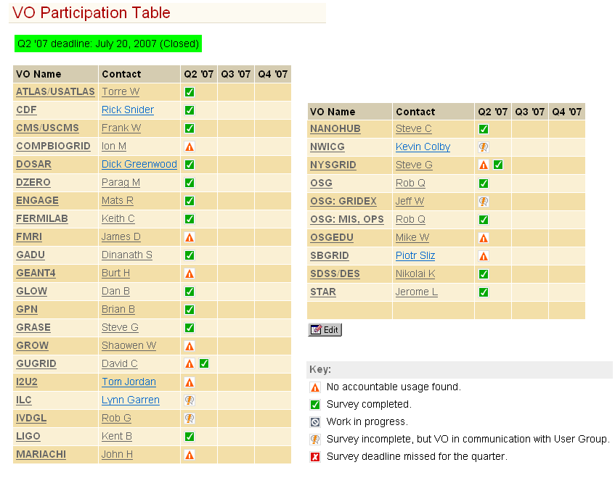
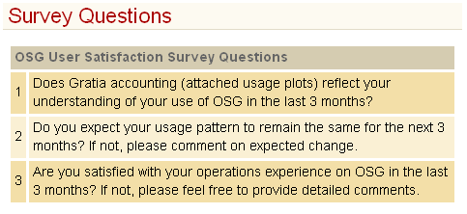
User Satisfaction Surveys: Response I
Overview

Slide 12
User Satisfaction Surveys: Response II
General observations
In general:
  sites making use of the OSG currently (according to Gratia) responded to the survey;
  Large number of one-word, "yes" answers to q3 suggest either most users are ecstatic or that VOs don't (yet?) consider a survey an efficient avenue to raise issues (common problem with surveys).
  Several VOs not making significant (or any) use of OSG at this time. Reasons cited included internal issues; no current need; and effort required to get started.

Slide 13
User Satisfaction Surveys: Issues I
D0:
  Desires improved advertising of site maintenance.
    GOC has a site maintenance page and encourages use as the opportunity arises.
  Definitely wants more sites in ReSS
    Improvements in 0.8.0.
    Active follow-up on deficient sites.
nanoHUB:
  Generally happy, but a couple of long term tickets "resolved" by site removing VO support.

Slide 14
User Satisfaction Surveys: Issues II
DES / SDSS
  Big discrepancy between advertised and actual site support.
Fermilab:
  Some frustration with lack of response to tickets reporting problems with VO support.
    Ongoing efforts by Ops to improve contacts with sites.
    OSG removing sites with unsatisfactory non-sponsoring VO support and/or support-request response times.

Slide 15
User Satisfaction Surveys: Issues III
LIGO:
  Technical problem with directory creation at some sites took a long time to resolve and hurt production.
    Resolved by interaction with sites
  Significant data movement requirements for its workflow; improvements needed in this area for LIGO to find it advantageous to increase its use of OSG.
    Long term plan to utilize SRM; short term VO effort deficit.

Slide 16
Other issues arising

Slide 17
Other issues arising I
Per-site overhead
Continuing grumbles about need for per-site negotiations on access / mappings, temporary SRM use. Too many by-hand gridmap files!
  Y2 efforts to improve storage availability and access.
  More evangelism on GUMS required!

Slide 18
Other issues arising II
Suspension and preemption of jobs
Raised at the first "Open agenda" meeting.
Some sites accept a job and then suspend almost immediately in favor of local jobs – job is "trapped". Such sites shunned by most VOs unless desperate.
Other sites operate preemption – job can run for multiple hours and then be preempted, throwing result away and dumping the job back on the local queue. Definitely sub-optimal for applications with significant run-times (~12h) or high IO:CPU ratios; connections with offsite services may time-out, causing intermittent job failures.
  Request authoritative negotiations with such sites to reach compromise on behalf of all VOS; suggest policies that do not preempt until after min(maxWallTime, siteThreshold), where siteThreshold is preferably not less than 10-12h. Advertisement of siteThreshold through ReSS?

Slide 19
Other issues arising III
Support of non-sponsoring VOs
Support of VOs with few or no sponsoring sites is still patchy at best; new VOs or subgroup mappings take a long time to propagate and often need negotiation.
  Movement by council on removal or sites with little VO support or unacceptable response times.
  Work by Ops towards more automatic VO configuration updates (will probably always be at least one manual step).
  Request work by site coordination group to encourage more support of non-sponsoring VOs, and prompt response to (and honoring of) new VO configuration / subgroup mapping requests; GUMS, GUMS, GUMS!

Slide 20
More Information: URLs
OSG Users Meeting/Workshop, July 26-27 at FNAL.
OSG User Satisfaction Surveys, Quarter 2 of 2007.
Draft Y2 plan.
VORS.

