Slide 1

Security in OSG
Tuesday afternoon
Igor Sfiligoi <isfiligoi@ucsd.edu>
University of California San Diego

Slide 2
Logistical reminder
It is OK to ask questions
  During the lecture
  During the demos
  During the exercises
  During the breaks
If I don't know the answer,
I will find someone who likely does

Slide 3
The Open Science Grid
The Open Science Grid is an organization promoting Distributed HTC
Its main focus is on enabling Grid computing in the USA

Slide 4

The Open Science Grid
The Open Science Grid is an organization promoting Distributed HTC
Its main focus is on enabling Grid computing in the USA
What is
Grid computing???

Slide 5

Grid and DHTC
Grid, as a form of DHTC, is about enabling computing on remote HTC clusters
Scheduler
Scheduler
Scheduler

Slide 6
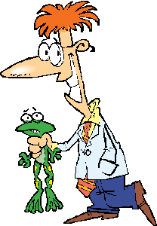
Single sign-on
Main contribution of Grid to DHTC is availability of single sing-on
  Users have a single identity on each and every Grid site
Hi. I am Ben
Hi. I am Ben
Hi. I am Ben

Slide 7
OSG Auth not password based
OSG not using password authentication
  For several reasons
For starters, it is effectively a
shared secret between
the user and the service provider
  And secrets stay secret only
  if few entities know it
  Imagine sharing passwords
  between 100s of site operators

Slide 8
Adding an intermediary
An alternative approach is to introduce a highly trusted intermediary
Have been used in real life for ages
  e.g. States as issuers of IDs/Passports

Slide 9
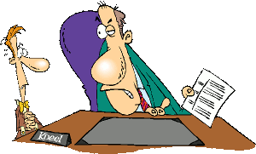
Adding an intermediary
An alternative approach is to introduce a highly trusted intermediary
Have been used in real life for ages
  e.g. States as issuers of IDs/Passports
  Getting the ID can be a lengthy process

Slide 10

Adding an intermediary
An alternative approach is to introduce a highly trusted intermediary
Have been used in real life for ages
  e.g. States as issuers of IDs/Passports
  Getting the ID can be a lengthy process,
  but using it is easy afterwards
Hi. Here is my ID
Hi. Here is my ID
Hi. Here is my ID

Slide 11
Adding an intermediary
An alternative approach is to introduce a highly trusted intermediary
Have been used in real life for ages
  e.g. States as issuers of Ids/Passports
  Getting the ID can be a lengthy process,
  but using it is easy afterwards
Chain of trust.
You are trusted because
the site trusts the issuer,
and the issuer trusted you.

Slide 12

Technical implementation
OSG uses the x.509 PKI
  A user gets a certificate file
  Issued by a Certification Authority (CA)
Like a real passport, a certificate
  Contains your name
  Has an expiration date
    Typically issued
    for one year
Yes, you will
have to renew
it ever year

Slide 13
Authentication vs. Authorization
Just because you can authenticate yourself, it does not mean you are authorized, too
  e.g. your passport tells who you are,
  but does not allow you to drive a car
x.509 PKI only covers authentication
  Tells the site who you are
We need a different mechanism for authorization

Slide 14
Adding a user type
Keeping a whitelist not an option
  Just too many users
Want to authorize on the type of user
  There should be just a few of them

Slide 15
Adding a user type
Keeping a whitelist not an option
Want to authorize on the type of user
  There should be just a few of them
Let's imitate real life again
  Think about passport vs driver's license
  Both tell a cop who you are
  (and to 1st approx. are issued by the same entity)
  But the driver's license tells him
  you are allowed to use a car, too
    “Class:C”

Slide 16
Virtual Organizations
In OSG, we reason in terms of
Virtual Organizations (VOs)
Each VO represents a user type, e.g.
  Physicist in the CMS LHC experiment
  User of the UW Madison campus
All users of a VO are to be considered equivalent
(there may be exceptions, but we will not delve into this)

Slide 17
VOMS Attributes
Technically, each VO runs a VOMS
  The VO keep the whitelist of its own users
A VOMS will extend a user certificate
  Adding an attribute certifying that
  the user belongs to this VO
This information is then used by the sites
A biologist
A biologist

Slide 18
OSG is x.509 based
Bottom line,
the OSG security infrastructure
is based on
VOMS-extended x.509 certificates

Slide 19

OSG is x.509 based
Bottom line,
the OSG security infrastructure
is based on
VOMS-extended x.509 certificates
But this morning
we used OSG without
any certificate!?!

Slide 20
OSG and overlays
When using DHTC overlays,
users don't need a certificate
  Since they do not directly talk to the sites
  The overlay system can use other ways to keep track of its users
The overlay administrator will use a certificate to provision resources
that joined the overlay system
  But this is not tied to any final user

Slide 21
OSG and overlays
When using DHTC overlays,
users don't need a certificate
  Since they do not directly talk to the sites
  The overlay system can use other ways to keep track of its users
The overlay administrator will use a certificate to provision resources
that joined the overlay system
  But this is not tied to any final user
So, I just
wasted 15 minutes
listening to
this talk???

Slide 22
OSG and overlays
When using DHTC overlays,
users don't need a certificate
  Since they do not directly talk to the sites
  The overlay system can use other ways to keep track of its users
The overlay administrator will use a certificate to provision resources
that joined the overlay system
  But this is not tied to any final user
No.
See next few slides.
So, I just
wasted 15 minutes
listening to
this talk???

Slide 23
Impersonation
Sometimes your jobs need to impersonate you
  For example
  to access
  remote data
Scheduler
Hi... ehm... I am Ben
Job

Slide 24
Impersonation
Sometimes your jobs need to impersonate you
  For example
  to access
  remote data
You can use
your certificate
for this
Scheduler
Job
More on this tomorrow.

Slide 25
Impersonation
Sometimes your jobs need to impersonate you
  For example
  to access
  remote data
You can use
your certificate
for this
Just as relevant
in an overlay
setup.
Scheduler
Job

Slide 26
More security considerations
There is much more than authentication and authorization to security
  But we don't have the time to cover everything
Just briefly
  Sharing of resources
  Privacy
  Acceptable conduct

Slide 27
Sharing of resources
Modern CPUs are many-core, so
  Very likely your job will be
  sharing the node with other jobs
No guarantee that there will be any protection between you and other jobs from users of the same VO
  But should be protected from other VOs
Limited OS level protections
  Act accordingly
  e.g. no file should be world writable

Slide 28
Privacy
By default, no privacy in OSG
  Assume all your files are publicly readable
If you need privacy, you will have to take explicit measures
  Both during network transfers, and
  For files on disk
Not trivial.
Think twice before
putting sensitive information
in OSG.

Slide 29
Acceptable conduct
Each OSG user is bound by its AUP
(Acceptable User Policy)
  And sites are allowed to have additional rules in place
In a nutshell
  Use only for the declared science purpose
No bitcoin mining!

Slide 30
Acceptable conduct
Each OSG user is bound by its AUP
(Acceptable User Policy)
  And sites are allowed to have additional rules in place
In a nutshell
  Use only for the declared science purpose
  Do not overload the system
Do not run multiple threads
if you were given
a single CPU.

Slide 31
Acceptable conduct
Each OSG user is bound by its AUP
(Acceptable User Policy)
  And sites are allowed to have additional rules in place
In a nutshell
  Use only for the declared science purpose
  Do not overload the system
  Do not attempt
  to circumvent security
    Even the one without
    technical enforcement
Reading
other users' files is
not acceptable

Slide 32
Acceptable conduct
Each OSG user is bound by its AUP
(Acceptable User Policy)
  And sites are allowed to have additional rules in place
If you misbehave
  At the very least, you will get a nasty email
  You may be banned from using OSG again
  Police will be called
  if you break the law
We like to help
scientists, but
there are limits.

Slide 33
Questions?
Questions? Comments?
  Feel free to ask me questions later:
  Igor Sfiligoi <isfiligoi@ucsd.edu>
Upcoming sessions
  Hands on session
  OSG and BOSCO lectures
  More hands on

Slide 34
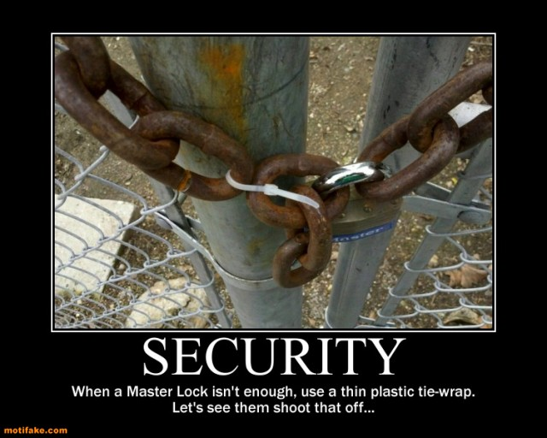
Security is tricky business

Slide 35
Copyright statement
Some images contained in this presentation are the copyrighted property of ToonClipart.
As such, these images are being used under a license from said entities, and may not be copied or downloaded without explicit permission from ToonClipart.

