Slide 1
OSG Project Report
Major Milestones & Progress
Discuss outcome of JOT Meeting
OSG External Projects
Agreements
Review Metrics/Site Usage

Slide 2
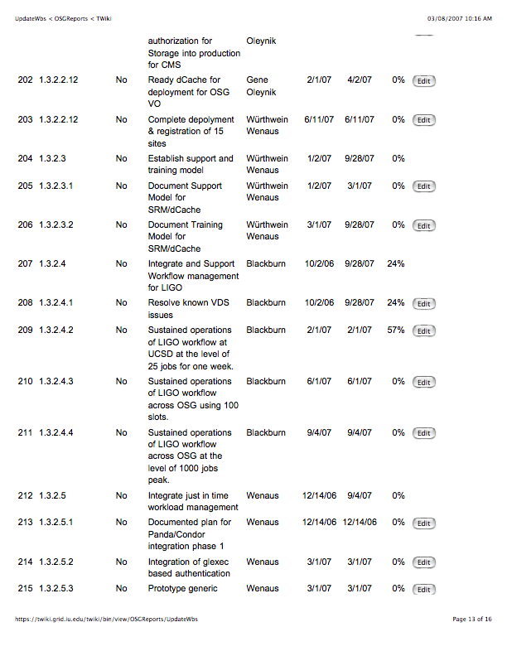
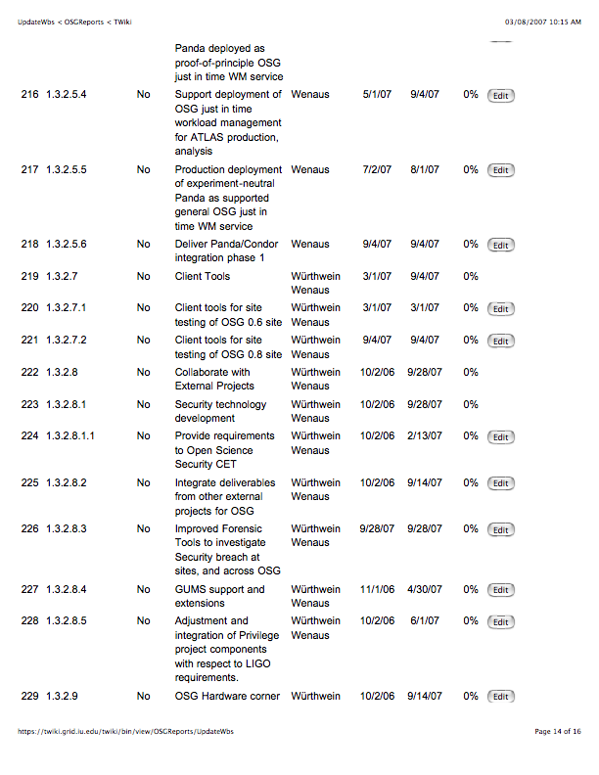
WBS baslined, updates starting

Slide 3
Year 1 Agency Reportable Milestones - from the Project Plan & WBS
WBS | Name | Date
1.1.1.2 | Define Operational Metrics for Year 1 | 1/1/07
1.1.3.1.1 | Release Security Plan | 1/1/07
1.1.5.2.3 | Release OSG 0.6.0 | 2/27/07
1.1.6.2.4 | Production use of OSG by one additional science community | 3/31/07
1.1.5.3.2 | OSG-TeraGrid software using common Globus and Condor releases. | 4/2/07
1.3.2.2.4 | Complete deployment and registration of 15 Storage Resources using srm/dCache from VDT. | 6/10/07
1.1.5.2.4 | Release OSG 0.8.0 To include SRM V2.2, support for just in time job scheduling; better site validation; | 8/15/07
1.1.1.5 | Report on Operational Metrics for Year 1 | 9/1/07
1.1.6.2.5 | Production use of OSG by a 2nd additional science community | 9/28/07
Draft under review
√
Released 3/5/07
√
First production run done; transitioning to final users.
√

Slide 4
Science Milestones for Year 1(from WBS)
LIGO: Binary Inspiral Analysis runs on OSG (see first milestone reported) | Warren Anderson | 6/15/07
ATLAS: Validation of OSG infrastructure and extensions in full-chain production challenge. | Jim Shank | 6/15/07
CMS: Full support for opportunistic use of OSG resources for MC production and data processing. | Lothar Bauerdick | 6/15/07
STAR: Migration of >80% of simulation to OSG | Jerome Lauret | 6/15/07
CDF: Full use of OSG for MC | Ashutosh Kotwal | 6/15/07
D0: Full use of OSG sites for D0 reprocessing in 2007 (in progress 2/1/2007) | Brad Abbott | 6/15/07
SDSS: Fit all spectra beyond data release 5, QSO fitting project (+now DES simulations/data transfer) | Chris Stoughton | 6/15/07

Slide 5
Outcome of the JOT
Expect mail from Committee.
Notes from Kent:
  Concerned about ramping up on personnel
  Need better presentation of non-HEP project
  Is there enough external oversight beyond Jot (doesn’t have enough cycles) Project this size usually has an external advisory (science advisory)
  JOT to plan external review
  JOT will work with/on metrics with feedback loop involving OSG
  ESNet, Internet2, etc. should be engaged.
  Would like to see even more user level talks
  metrics need to be crisply defined so that higher ups in the funding agencies have visibility
  Next big milestone: one year review
  Moishe impressed by how much we have done and impressed by how much more we have to do.

Slide 6
Executive Board External Projects (ex-officio on the Council):
Center for Enabling Distributed Petascale Science (CEDPS) | Jenny Schopf
Community Driven Improvement of Globus Software (CDIGS)/Globus | Dan Fraser
Condor | Todd Tannenbaum
dCache | Patrick Fuhrmann
Data Intensive Science University Network(DISUN) | Frank Würthwein
Disk Resource Manager (DRM) | Alex Sim
ESNET | under discussion
Internet2 | under discussion
LIGO Physics and the Information Frontier | Patrick Brady
OSG Accounting | Philippe Canal
OSG Privilege/Authorization | Gabriele Garzoglio
UltraLight/advanced networks | Frank Lingen
U.S. LHC + US representation to the WLCG | Michael Ernst, Ian Fisk,

Slide 7
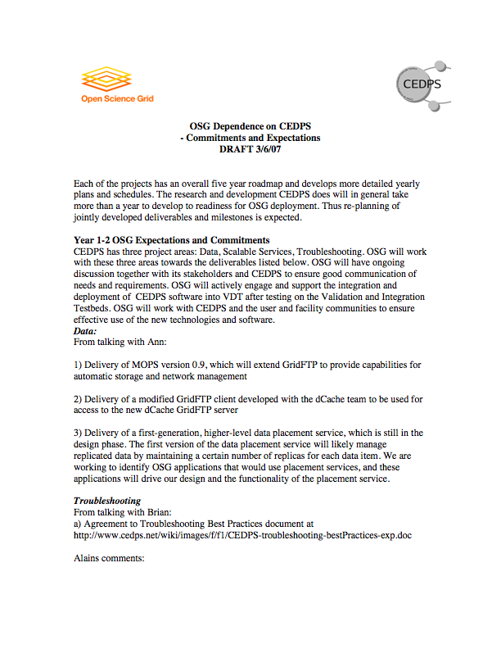
SciDAC-2 External Projects “special” first is CEDPS

Slide 8
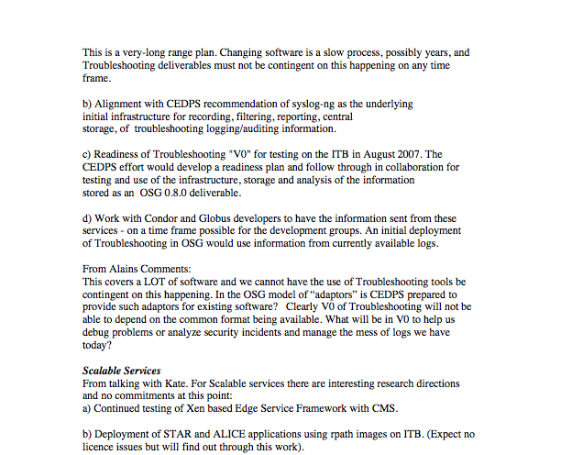

Slide 9
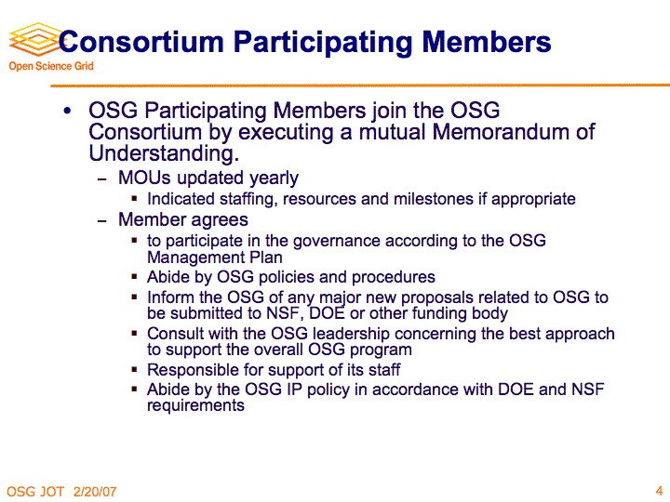
Agreements - Council?
Bill Kramer’s talk to the JOT:

Slide 10

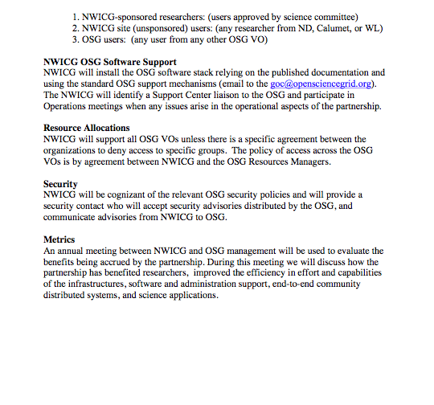
Agreements - Partners?

Slide 11
(evolving) List of Metrics
Software deployment metrics:
  # of sites using VDT
  # of sites part of OSG
  Origin of downloads?
  Versions in use
  Platforms in use
  Which services are deployed at a site?
  How many VOs supported at each site?
Software development metrics:
  How often are releases?
  How many “changes” occurred in each version?
  How many bugs fixed in each version?
  Activity on source code repository (# of commits)
  # of tests run
  # of tests that failed
  % coverage of tests
Software support metrics
  # of support tickets?
  Amount of discussion on mailing lists
  Average time a ticket is open
  Average time between emails on ticket
  % of time supporting different software packages
  Who is submitting tickets (broken down by person, VO, etc), how many?

Slide 12
How much software?

Slide 13
VDT Tickets Per Month
Only two weeks of
data in February
160 “interesting” tickets so far. Average time to resolve a ticket: 18 days Median resolution time: 3 days

Slide 14
Integration (11/7-02/16) - From Miron
Nov 16 - focus on Gratia testing in ITB
- VTB cache created, based on VDT 1.5.1
Nov30 - what to do with the ITB? expect VDT 1.6.0 in a couple weeks
- focus on gratia probe testing on at least 6 sites
Dec 7 - VTB based on VDT 1.5.2
Dec 14 - VTB based on VDT 1.5.2 installed, tested on three sites
- continued Gratia testing in ITB
Dec 21 - VTB testing of VDT 1.6.0
Jan 2 - VTB testing of VDT 1.6.0 continues;
- Prep VTB cache for VDT 1.6.1
Jan 9 - VTB testing pre-VDT 1.6.1 (OSG attributes/config, Gratia squid, CEMon+BDII all on table) on 5 sites
Jan 18 - Continued VTB testing; CEMon to BDII problems surface
Jan 24 - ITB 0.5.2 based on VDT 1.6.1 - deployed on 13 sites
Feb 1 - CEMon memory leak issue, BDII aggregator issues, others...
- work begins on VDT 1.6.1a
Feb 6 - VTB testing of VDT 1.6.1a starts
- on ITB VO app testing
Feb 13 - VDT 1.6.1 cache offline
Feb 16 - Start upgrade of ITB 0.5.2 based on VDT 1.6.1 with all known issues addressed

Slide 15
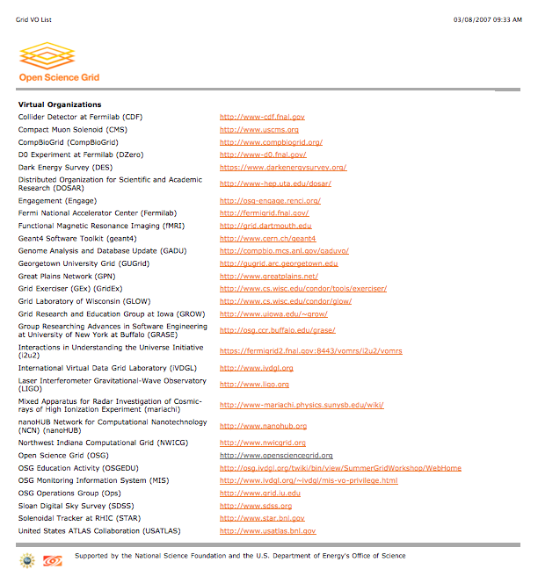
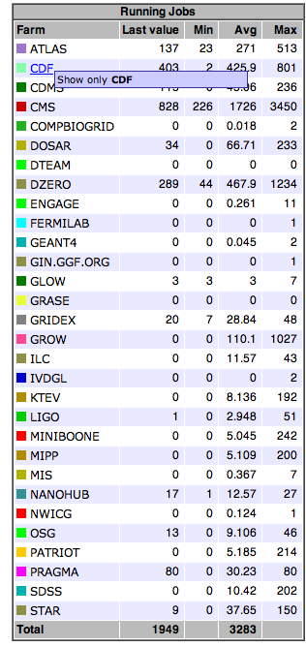
Registered VOs

Slide 16
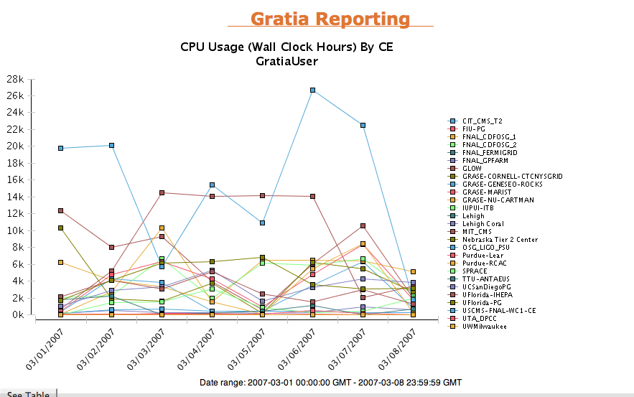

Slide 17
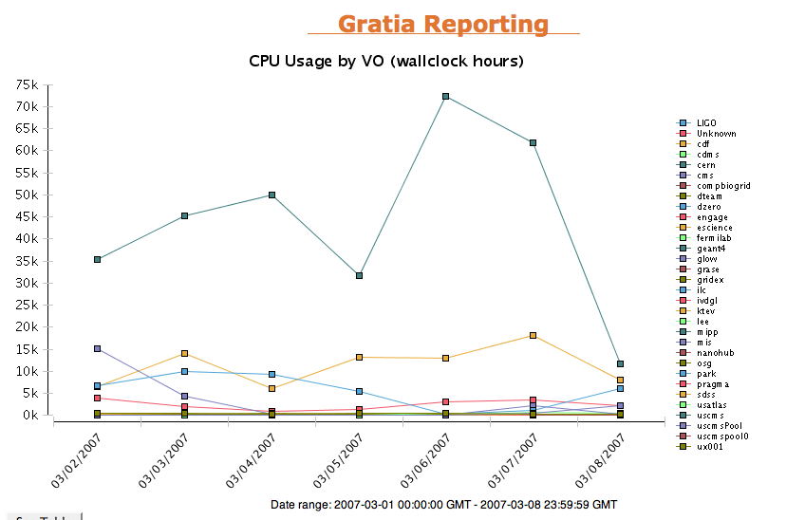

Slide 19
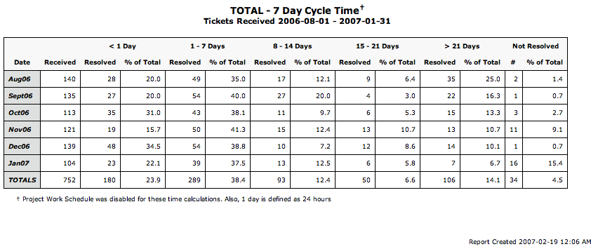
Ticket Metrics

Slide 20
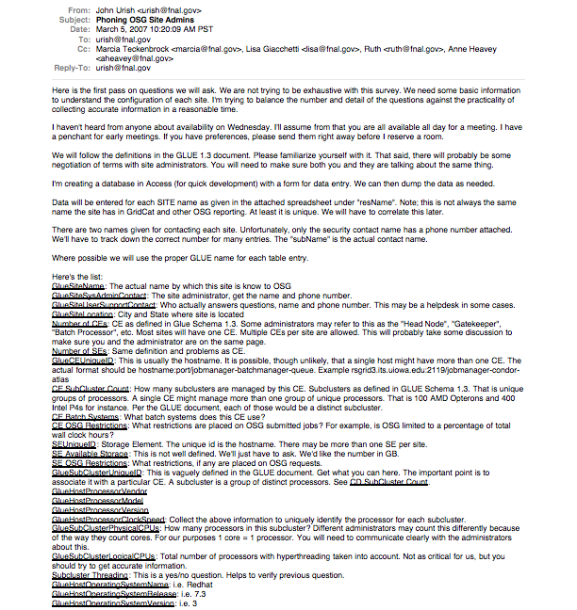
Site Survey

Slide 21
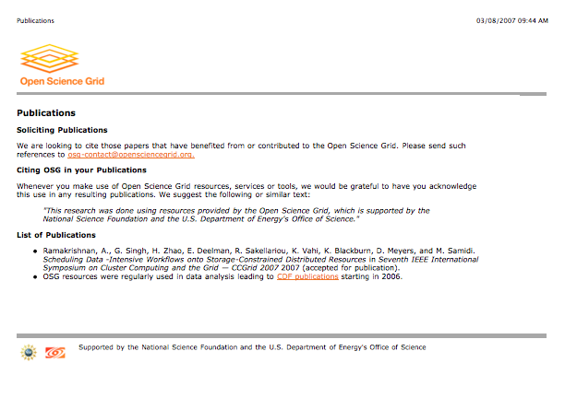
Science Benefits… how?

Slide 22
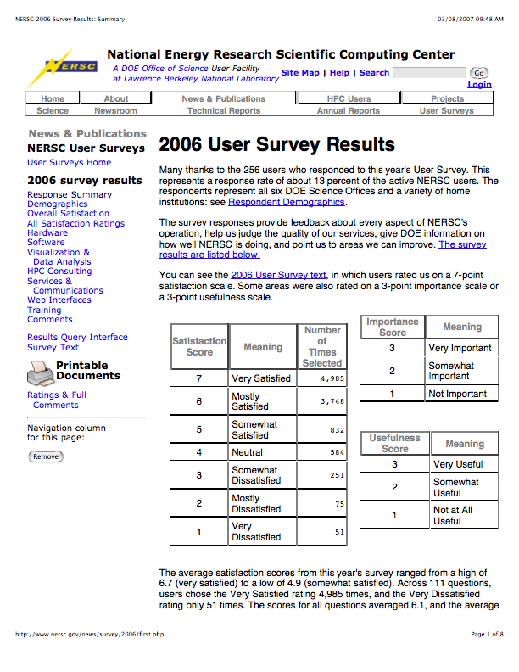
User Survey

