Slide 1
OSG Area Coordinators
Network Monitoring Update: March 30 2016
Shawn McKee

Slide 2
Networking Area Goals Year 4
We will put the OSG network datastore into production. Data from all registered perfSONAR instances in OSG and WLCG will be continuously gathered and reliably stored.
Done as of September 14, 2015 and announced.
The USATLAS and USCMS sites will be used to demonstrate a robust network monitoring infrastructure from OSG. We will use the data collected to identify networking issues between USATLAS and/or USCMS sites and document how we resolve those issues.
In progress (80%), more later on alerting and engaging
We will produce Release 1.0 of the datastore API providing access to all the perfSONAR metrics we gather: traceroute, bandwidth, latency and packet-loss. In addition this API may contain additional derived and transformed data as requested by our client users.
In progress (75%). Starting from Esmond. Publishing to AMQ
What use-cases are not (yet) well served by current API?

Slide 3
Networking Stretch Goals Year 4
We will create a network cost-matrix (rows: sources, columns: destinations) containing estimated bandwidth values between our USATLAS and USCMS sites.
In progress (70%): Jorge Batista and Ilija Vukotic are working with me on producing a bandwidth estimate using Mathis’s Formula (which relates packet-loss and round-trip-time to bandwidth).
We will prototype various alarming and alerting components for use in OSG
35% Options being thought out in the PuNDIT satellite project and MadAlert.
NEW: Implementing Check_MK/OMD rule-based notifications in progress

Slide 4
Key Initiatives in Network Area
Improving perfSONAR-PS toolkit for OSG
Track adoption at http://grid-monitoring.cern.ch/perfsonar_coverage.txt
Mesh-config standalone from Soichi in final testing
OSG dashboard service / OSG network service
Has been operating OK in the last few weeks.
Latency of results is a concern (time to show up in mesh) but depends upon use-cases
Outreach and community interaction
Working with WLCG on new networking initiatives
CHEP abstract submitted, HEPiX presentation in April
Presentation at the All-hands meeting
Ongoing meetings/interactions with perfSONAR developers (Shawn attends weekly meetings)

Slide 5
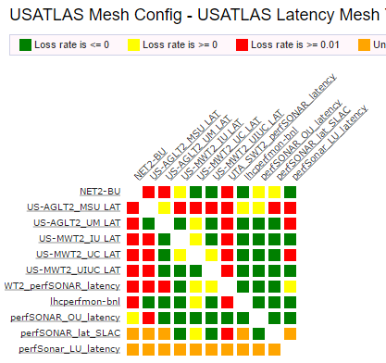
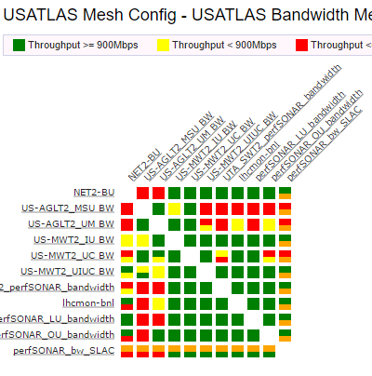
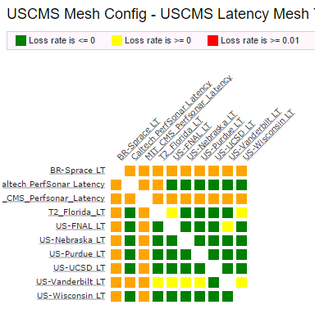
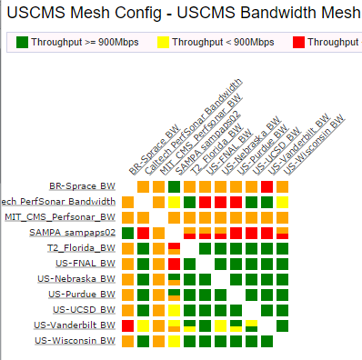
Mesh Status: USATLAS & USCMS
From ~noon today
Latency meshes are hyperlinked to GUI

Slide 6
Recent Accomplishments
Analytics platform with perfSONAR data deployed and operating. Used by ATLAS and LHCb so far
http://cl-analytics.mwt2.org:5601
Soichi has finalized beta version of new mesh-config
Documentation updates for v3.5.1 released March 3, clarifications and updates to the OSG datastore operations guide
Debugging various networking issues
Problems between CERN and Portugal Tier-1 used perfSONAR to identify overloaded link. Fixed: adding 10G
Problems getting data to (US)CMS site in Brazil. Bad ESnet connection/route found and fixed
Problems from Caltech to FNAL under investigation (ticket included me yesterday).

Slide 7
Items Underway
CHEP abstract submitted that will include OSG networking
HEPiX presentation proposed for April meeting
Reorganization of WLCG related efforts at CERN
New document proposing network related efforts being drafted
http://tinyurl.com/wlcg-net-plans
Upcoming perfSONAR annual developers face-to-face meeting May 10-11
PuNDIT targeting initial version/demo then
Revising the OSG/WLCG bandwidth testing
One big mesh with 28 day cadence will be redone to 2 (or more) meshes with 20 hour cadence
Need more timely bandwidth results.
Node services currently reset nightly which interferes with scheduling beyond >24 hours
Soichi has a well developed standalone mesh-config being tested.
Will require a “private” lookup service for OSG and WCLG to allow controlled access to perfSONAR registration information
Planning a new CLI tool to help debugging and diagnosis of network problems.
Will directly query perfSONAR toolkit MAs to extract additional details not currently stored in the central MA
Will automate “standard” data gathering that is currently tedious and error prone
Will also exercise our current API to the datastore
Alerting is the next big target

Slide 8
Standalone Mesh-Config
Soichi has an almost final version for testing at https://ps-test.sca.iu.edu/meshconfig/
Can be installed outside OIM
Target is Universities or VOs who want to create and manage their own meshes
OSG Goal is to replace the mesh-config currently in OIM. Soichi has provided a roadmap to operations
Uses information the toolkit publishes to the global perfSONAR lookup service
Complication is that we need to make available “private” registration information in a perfSONAR lookup service…can’t be “public”
Solution?: create a private version of the lookup service
Would need to be hosted somewhere; OSG?

Slide 9
Alerting on Obvious Problems
As I have noted many times, alerting on potential network issues is fraught with many problems about who to notify and when
The central OSG datastore is giving us measurements for all sites and paths, some of which have fairly clear indications of problems that are associated with specific sites
Sites having large packet loss to or from many other sites
Site experience low bandwidth to or from many other sites
In these cases we would like to notify the specific “site” about the problem including
Information about the problem (why it is “bad”)
Common causes of the problem (what to check)
Where to go for follow-on help
We are working on augmenting our check_mk monitoring infrastructure to create contacts from perfSONAR emails and OIM and GOCDB emails
Once suitable contacts are configured (and automatically updated when the sources change) we intend to enable “alert” emails for “obvious” problems
May take some tuning for when to send email and how often.

Slide 10
Top Concerns
Using our data effectively. Now that we have a rich dataset we need to get problems found and fixed.
Datastore infrastructure still not as reliable and responsive as we want it to be.
Monitoring needs tuning to better identify problems that impact the performance of the system
Reconfiguration to use SSDs still needs exploring
Getting better engagement from US LHC sites. Need to work on likely network issues. Goal is to use new alerting to help engage and motivate sites and users.
Address the data migration process.
How do we move “older” data off the primary system and onto a new location while retaining some means of access? Still waiting for process from ESnet…

Slide 11
Questions or Comments?
Thanks!

Slide 12
URLs of Relevance
OSG Network Datastore Documents
Operations https://docs.google.com/document/d/1l144BSo-88M0cLMMjKcKMIE-Q5s21X-w3lYl-0Pn_08/edit#
SLA https://twiki.grid.iu.edu/bin/view/Operations/PSServiceLevelAgreement
Network Documentation https://www.opensciencegrid.org/bin/view/Documentation/NetworkingInOSG
perfSONAR adoption tracking: http://grid-monitoring.cern.ch/perfsonar_coverage.txt
Deployment documentation for both OSG and WLCG hosted in OSG (migrated from CERN)
https://twiki.opensciencegrid.org/bin/view/Documentation/DeployperfSONAR
ATLAS Analytics: http://cl-analytics.mwt2.org:5601/
Mesh-config in OSG https://oim.grid.iu.edu/oim/meshconfig
Beta Mesh-config: https://ps-test.sca.iu.edu/meshconfig/
MadAlert: http://madalert.aglt2.org/madalert/diff.html
perfSONAR homepage: http://www.perfsonar.net/

