Slide 1
OSG Project Manager Report for
OSG Council Meeting
October 14, 2008
Chander Sehgal

Slide 2
Current Key Initiatives
End-of-Year2 analysis of WBS and disposition plans for incomplete items
End-of-Year2 financial status & analysis
Year3 Statements of Work & Budget
Begin Preparation for DOE/NSF OSG Review in Jan/Feb 2009
Support and enable the transition to the new OSG organization plan

Slide 3
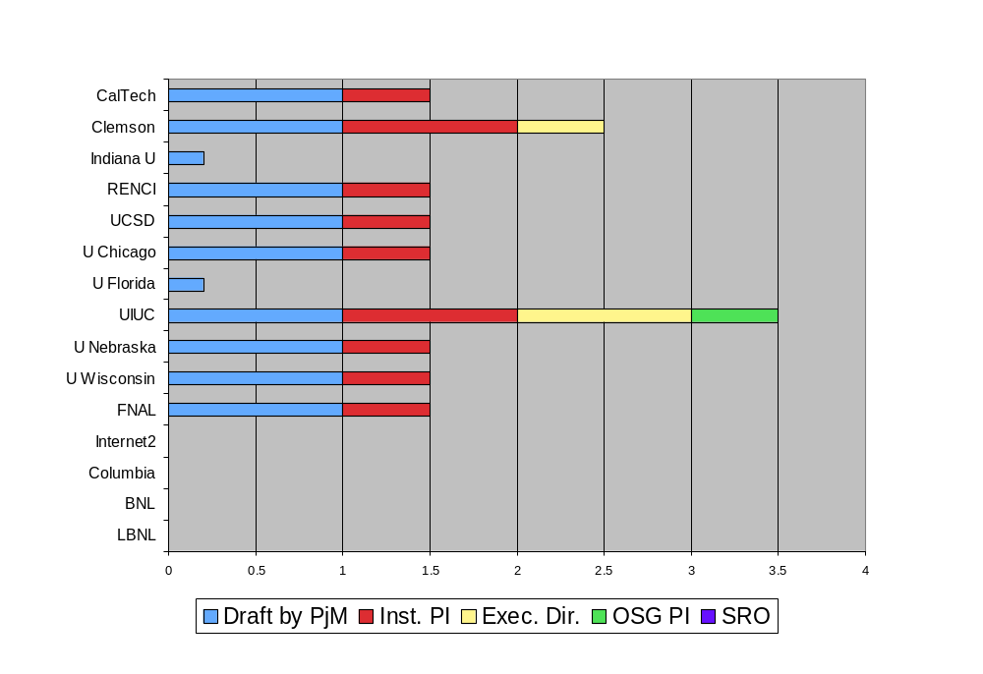
OSG Year3 SOW Status

Slide 4
Joint Oversight Team
DOE & NSF
OSG PI: Miron Livny
OSG Co-PIs: Paul Avery, Kent Blackburn, Ruth Pordes
OSG Council
Chairs: Paul Avery, Kent Blackburn,
Executive Team
Executive Director, Ruth Pordes
Technical Director, Miron Livny,
Project Manager Chander Sehgal,
Production Coordinator: TBD
Major Account Managers to US ATLAS, US CMS, LIGO
Extensions /Applications
Torre Wenaus, Frank Würthwein
Resources Manager: Bill Kramer
Staff & iSGTW
Software Tools
Alain Roy, Mine Altunay
Extensions Effort
OSG Facility
Software + VDT : Alain Roy, (Storage: Tanya Levshina)
User Communities:
VOs,
Site Administrators
Security Officer: Mine Altunay; Deputy: Doug Olson
Integration & Site Coordination: Rob Gardner
Operations: Rob Quick
Discuss Today
VOs : Abhishek Rana, Britta Daudert
Education, Training: Alina Bejan
E4CI
CI-Team
Project
Engagement: John McGee; Campus Grids: Sebastien Goasguen
Sept 2008

Slide 5
OSG VOs Group
New function in year3
Bring Focus to “at large VOs”
  Ease the process for new VOs to join OSG
  Help existing VOs to improve use of OSG
Increased staff attention by removing work from this group associated with CMS, ATLAS, & LIGO
Coordinators: Abhishek Rana (UCSD)
Britta Daudert (Caltech)

Slide 6
VOs Group year3 Work Plan
1.4 | VOs
1.4.1 | Organize and coordinate an ‘At large’ Consortium Stakeholder Forum, working with ‘at large’ VOs in making effective use of the OSG infrastructure.
1.4.1.1 | Monitor value delivered to "at large VOs" and undertake improvement campaigns, as needed
1.4.1.2 | Organize meetings and conferences to enable communication
1.4.1.3 | Serve as conduit for security information to all ‘at large’ stakeholders
1.4.1.4 | For planning new OSG software releases, solicit and collect requirements from ‘at large’ stakeholders. Assist in planning of new software features with Project Management and VDT/Middleware teams.
1.4.1.5 | For validation of a new incremental OSG release, organize and coordinate execution of “stakeholder pre-release validation”.
1.4.2 | Provide a first stage of sustainment for newly engaged VOs.
1.4.3 | Provide opportunistic storage to the "at large" VOs

