Slide 1
OSG Finance Board
26 April 2007
Paul Avery
Kent Blackburn
Chander Sehgal

Slide 2
Outline
Year1
  SOW Status
  Budget Allocation & Usage
  Mid-year Budget Update (DOE Budget, Rollover)
  Staff Changes (Indiana, Iowa➔UIUC/NCSA)
  Change Request Process
  Status Reporting and WBS Update Process
Year2
  Planning Dates/Meetings
  Key Factors to be addressed
  Master Schedule for year2 Planning

Slide 3
OSG Year1
Resource Management
Accomplishments / Status

Slide 4
Year1: SOW Update
Funding subcontract from UW-Madison to Institutions is triggered by completion of signed-off SOW
Funding received by National Labs directly from DOE is aligned with Work Program via the SOW process
Lessons from year1 process
  Overall approval process too labor intensive and slow
  Open Source licensing added to SOW language
  Questions about IP; restrictions on use
  Approval at SRO stage complicated
  Liability for payment contingent on funding from NSF/DOE
For year2, need to improve process to enable faster approval to permit more timely transfer of funds to the various institutions
  Use parallel or joint action by principals in approval chain
  WBS is master “living document” driving work program; SOW is a “snapshot” of commitments at start of year

Slide 5
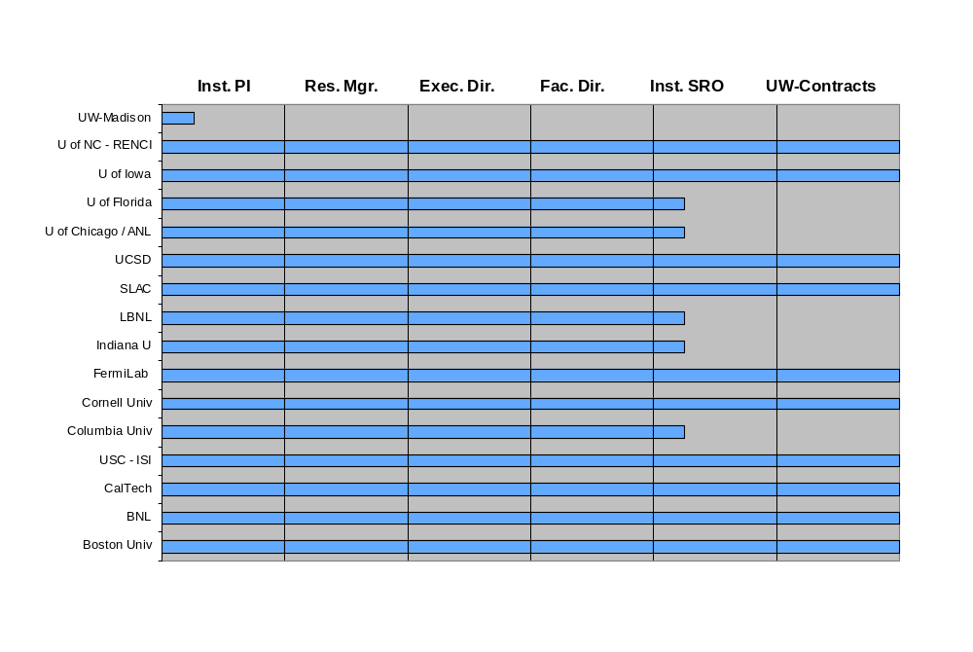
Status of OSG Year1 SOWs
20 April 2007
x
31 Jan 2007
x
x
x
24 Apr 2007
x
15 Dec 2006
x
x
x
24 Apr 2007
x
24 Apr 2007
x
x
x
5 Jan 2007
x
x
x
x
Progress on the Signature Trail
X = Status on Dec 13, 2006

Slide 6
Year1: Open SOW Issues
Five SOWs awaiting SRO signature
  3 just recently moved to this stage
  U-Chicago approval slowed by
    signature authority issues due to NSF + DOE funding
    Many questions to be addressed (22 emails since Apr 01)
  Columbia University stalled due to unknown issues
UW-Madison own SOW still in draft form
  Draft submitted to PI on 1/31/07
  Responsibility delegated to acting deputy (Todd)
At present, only 76% of “subcontract” allocations of funds has been accomplished (see next chart) due to delays in SOW approval process (4 institutions still not funded)

Slide 7
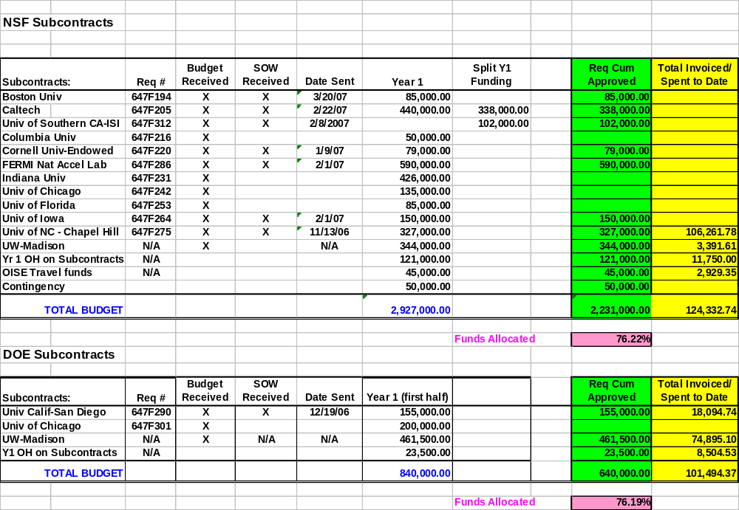
Year1: Subcontract Status
20 April 2007

Slide 8
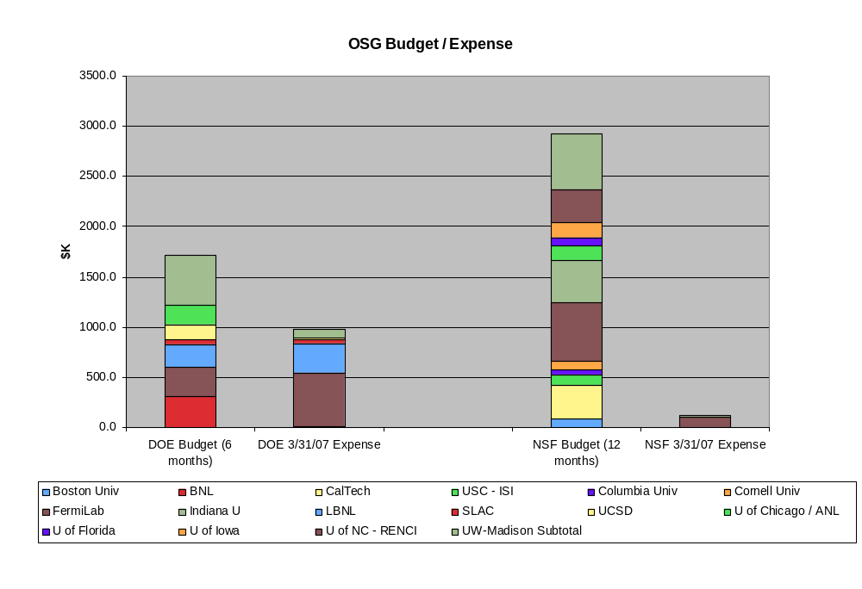
Year1: OSG Expenses As Of
31 Mar 2007

Slide 9
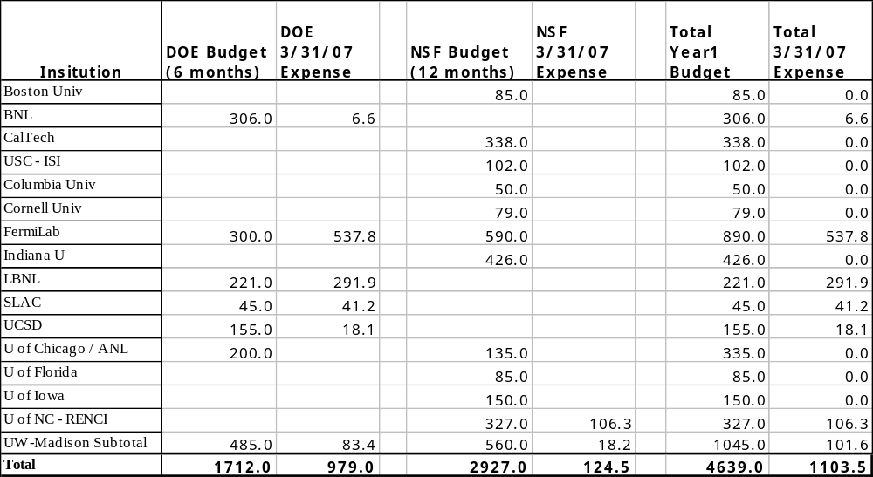
Year1: OSG Expenses As Of
31 Mar 2007

Slide 10
Year1: Mid-year Budget Update
NSF
  “Rollover” of funds needs to be assured based on current UW-Madison subcontract language. Resolution certainly possible via “no cost extension”; awaiting guidance from UW-Madison on most pragmatic (least effort) path
DOE
  UW-Madison received full year2 amount of $1417K on April 20, 2007
  Per Glen Crawford: “We supplied HEP funding for the OSG lab work in the April financial plan. The amounts were based on the funding profile determined last year when the project was originally funded. These are: $604k BNL, $592k FNAL, $244k LBNL….. I think NP and ASCR funding will be provided in May….”
  Need to verify schedule and amounts for NP and ASCR year2 funding
  Need to understand $8K (less) discrepancy in HEP funds for each of 3 labs
  Need to address increased overhead rates at FNAL (are there others?)

Slide 11
Year1: Institutions/Staffing Changes
OSG Operations staffing issue (due to movement of L. Grundhoefer) at Indiana
  New work/staff agreements in-place
  New SOW in-progress thru approval process
  New multi-year budget draft created (see next chart)
U-Iowa staff (Shaowen Wang plus others) moving to U-Illinois/NCSA
  Terminate Iowa subcontract as of 6/30/07
  New draft SOW for UIUC/NCSA in progress; to be effective 7/1/2007 to 9/30/2007 ($32,500)
  New multi-year budget draft created (see next chart)
Caltech staff “rollover” almost resolved
  New “overhead rates” by SRO office stimulated loss of 2 people
  1st replacement on-roll; 2nd replacement imminent

Slide 12
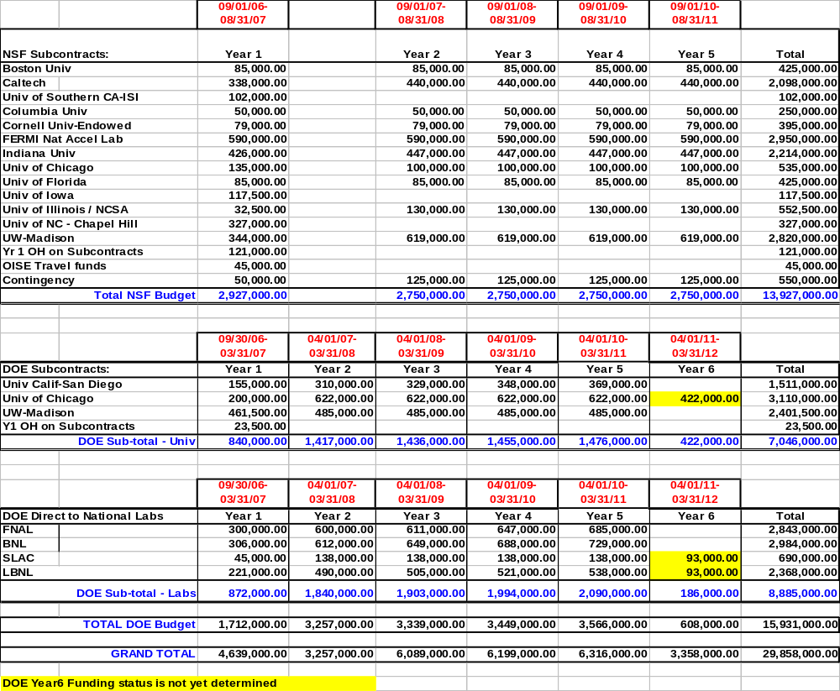
Updated 5-year OSG Budget Based on Year1 Project Changes (subject to further change via Year2 Planning)

Slide 13
Year1: Change Control Process
Two changes executed thru defined process; both involved milestone changes
Approval process updated based on process execution experience (OSG DocDB 523-v2 and 538-v3); two options now exist
  Approval via signature routing
  Approval via review at Executive Team meeting
Expect to initiate more after review of latest WBS update inputs

Slide 14
Year1: Reporting
Work Accomplishments
Project agreement to provide monthly individual effort reports, quarterly Institutional PI reports, and quarterly area coordinators reports
OSG Twiki updated to permit “structured” input reporting
  Monthly WBS Update
  Quarterly PI reports
  Quarterly Area Coordinator Reports
Timely submission of updates and reports within OSG needs attention
  Periodic project management review meetings
    Earlier visibility into WBS late and upcoming milestones
    Trigger for action (change control, reporting, etc.)
    Enable culture change toward “project execution mechanisms”
  Align WBS planning detail to project management/tracking intent

Slide 15
OSG Year2
Resource Management
Planning

Slide 16
Year2: Key Planning Meetings
June 7 AM Top Level Year2 Planning
June 11-14 Area Coordinator Planning
July 24 AM Review 3 level WBS, Program of Work & Budget
August 17 OSG Council

Slide 17
Year2: Planning Considerations
Execution on year1 Work Program
Internal Considerations
  Flat budget profile
  Budget for equipment
  Budget for travel
  Staffing gaps that still exist from year1
External Considerations
  Better understanding of funding agency requirements (e.g. focus on metrics, etc.)
  Inputs from Experiments & Science Communities
  Inputs/agreements with external projects
Other inputs ……

Slide 18
Year2: Planning Proposal
High-level Milestones
What | Who | When
Update high level year2 goals from original proposal via input from Science communities, funding agencies, and external projects; document updated view of year2 high level requirements/goals | Executive Team | May 15 to June 1
Allocate High-level goals to OSG Area Coordinator Team (and PIs, as needed); deploy to area coordinators | Executive Team | June 7 AM Meeting
Develop 2 to 3 layer WBS (w/definitions) and resource estimates (spanning the matrixed team across various institutions) to accomplish OSG Year2 High-level Goals | Area Coordinators (and PIs) | June 11-22
Capture all the Area Coordinator work plans into unified WBS and develop year2 budget proposal | Resource Managers | June 25-July 13
Offline Review, Discussion, & Iteration of WBS and year2 budget proposal | All PIs | July 16-23
Baselined view of Year2 Goals, high-level WBS, and Budget Plan | Executive Board | July 24 AM Meeting
Prepare year2 SOW drafts with assistance from Project Associate | PIs, Exec. Director, Project Associate | August 1-31
Review year2 Plan | OSG Council | August 17 Meeting
Finalize WBS in MS Project and prepare year2 project plan document | Exec. Director, Project Assoc., Resource Mgrs | September 4-30
Start SOW Approval Process | All | September 4

Slide 19
Questions and
Discussion

