Slide 1



Open Science Grid
John McGee – mcgee@renci.org
Renaissance Computing Institute
University of North Carolina, Chapel Hill
Notes:
1

Slide 2

Computational Science is a critical component of discovery, and its importance is growing
http://www.nitrd.gov/pitac/reports/20050609_computational/computational.pdf

Slide 3
HTC vs. HPC
High Throughput Computing (HTC)
simple serial jobs, mote carlo, parameter sweep
complex workflows with data and/or job dependencies
ensembles of small node count MPI jobs
must be able to express the work in a highly portable way
cannot care about exactly where pieces are executed
do not have SSH access to resources; many implications
must be able to respect the community rules of a shared infrastructure; “plays well with others”
remarkable scaling opportunities

Slide 4
HTC vs. HPC
High Performance Computing (HPC)
top N computational scientists in the world
many important problems simply cannot be solved any other way
what does it take to successfully develop or run models at 256, or 512+ node parallelism?
what percentage of researchers that can benefit from computational science can realistically do this today?
how does grid /distributed computing fit with large scale HPC applications?

Slide 5
Where do researchers go for services?
PI owned and operated cluster
Campus Condo Computing
Departmental Cluster
Campus Research Computing
Campus Condor Pool
Regional Grids (eg NWICG)
Communities of Practice (NanoHub, GridChem, etc)
Open Science Grid: DOE/NSF, opportunistic access
TeraGrid: NSF, competitively awarded allocations
DOE ASCR: INCITE awards
Commercial Cloud service providers
There must be more … what have I missed? where is NIH?

Slide 6
Where do researchers go for services?
Answer: wherever they can get it, with the least amount of pain
PI owned and operated cluster
Campus Condo Computing
Departmental Cluster
Campus Research Computing
Campus Condor Pool
Regional Grids (eg NWICG)
Communities of Practice (NanoHub, GridChem, etc)
Open Science Grid: DOE/NSF, opportunistic access
TeraGrid: NSF, competitively awarded allocations
DOE ASCR: INCITE awards
Commercial Cloud service providers
There must be more … what have I missed? where is NIH?
How many different:
service interfaces
software stacks
policy frameworks
identities per researcher
…
where is The National Cyberinfrastructure?

Slide 7
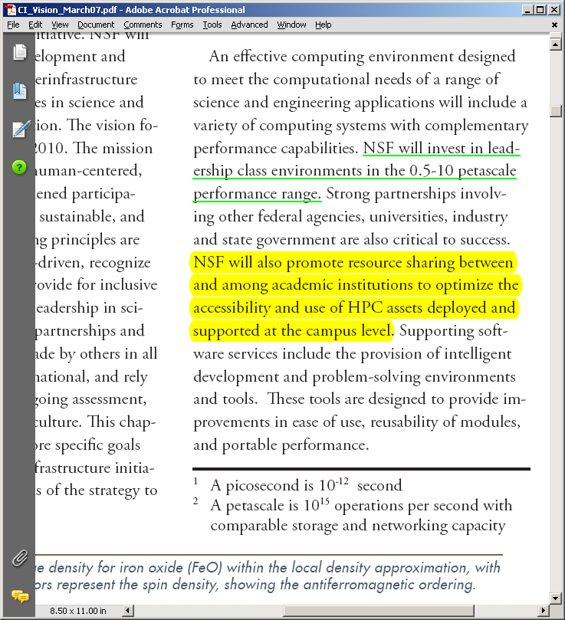
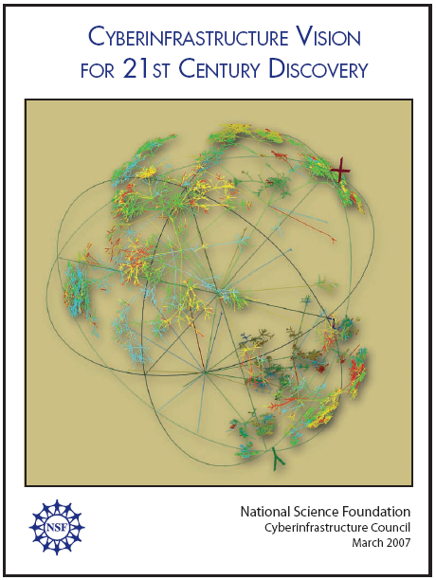

Slide 8
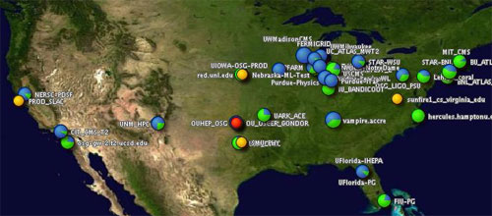
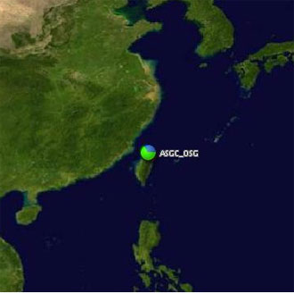
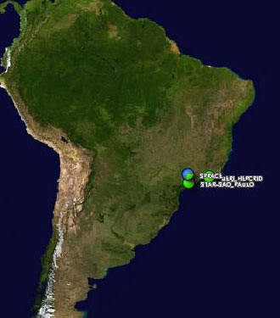
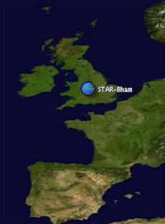
The Open Science Grid
A framework for large scale distributed resource sharing
addressing the technology, policy, and social requirements of sharing
OSG is a consortium of software, service and resource providers and researchers, from universities, national laboratories and computing centers across the U.S., who together build and operate the OSG project. The project is funded by the NSF and DOE, and provides staff for managing various aspects of the OSG.
Brings petascale computing and storage resources into a uniform grid computing environment
Integrates computing and storage resources from over 80 sites in the U.S. and beyond

Slide 9
Context: Evolution of Projects
iVDGL
(NSF)
GriPhyN
(NSF)
Trillium
Grid3
OSG
(DOE+NSF)
PPDG
(DOE)
1999
2000
2001
2002
2003
2004
2005
2006
2007
2008
2009

Slide 10
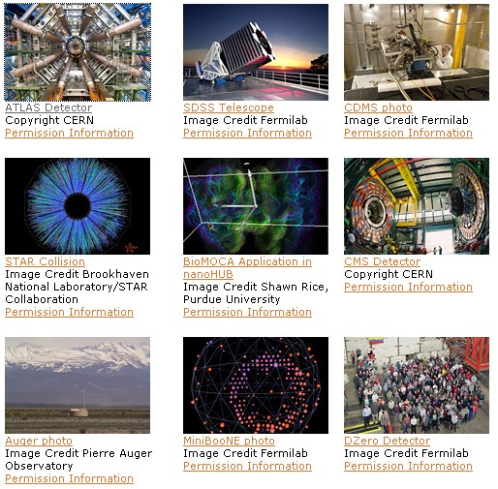
Using OSG Today
Astrophysics
Biochemistry
Bioinformatics
Earthquake Engineering
Genetics
Gravitational-wave physics
Mathematics
Nanotechnology
Nuclear and particle physics
Text mining
And more…

Slide 11
Why should my University facilitate (or drive) resource sharing?
Enables new modalities of collaboration
Enables new levels of scale
Democratizes large scale computing
Sharing locally leads to sharing globally
Better overall resource utilization
Funding agencies care about this
At the heart of the cyberinfrastructure vision is the development of a cultural community that supports peer-to-peer collaboration and new modes of education based upon broad and open access to leadership computing; data and information resources; online instruments and observatories; and visualization and collaboration services.
Arden Bement CI Vision for 21st Century introduction
Notes:
11

Slide 12
OSG Engagement Mission
Help new user communities from diverse scientific domains adapt their computational systems to leverage OSG
Facilitate University Campus CI deployment, and interconnect it with the national community
Provide feedback and new requirements to the infrastructure providers

Slide 13
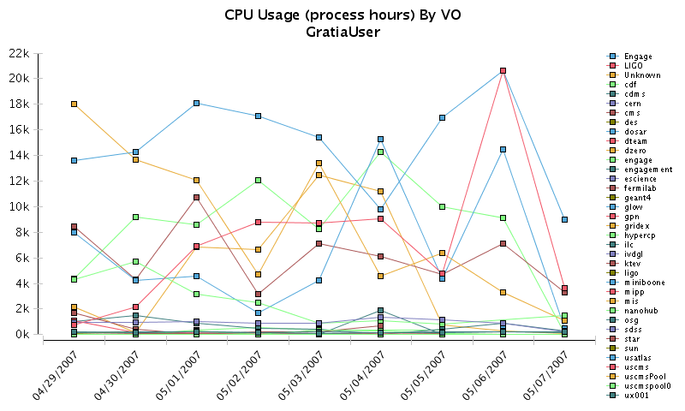
Date range: 2007-04-29 00:00:00 GMT - 2007-05-07 23:59:59 GMT

Slide 14
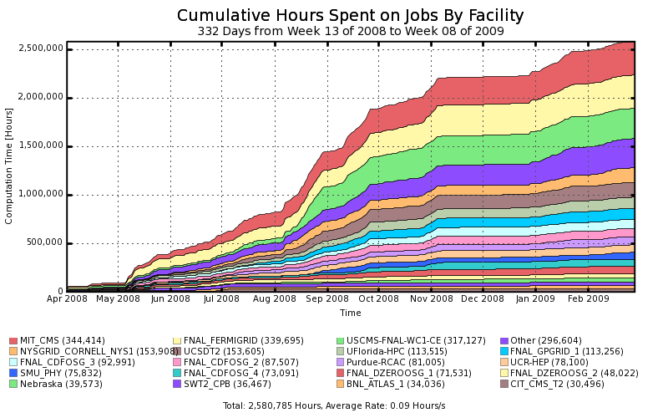
Engaged Users Activity

Slide 15
Questions?
OSG Engagement VO https://twiki.grid.iu.edu/twiki/bin/view/Engagement/WebHome
engage-team@opensciencegrid.org
Notes:
15

Slide 16
E N D

