Slide 1
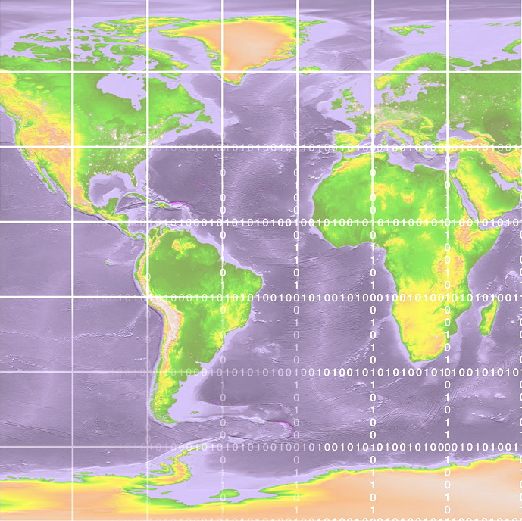
Day 1: Session 2
OSG Production releases: OSG Production Patches Urgent and Critical
Notes:
Yeah that’s me…

Slide 2
OSG Software Cycle
Versioning (New Twiki Page Created)
Installation Party with New Production Release
Installation Instructions do not cover how to back out if there is a problem
Version diffs for pacman caches

Slide 3
Critical/Security Updates
Blacklist for site not updated
Sites by default on list until they contact GOC/SC saying they are fixed… or checked programmatically

Slide 4
VOMS/GUMS Setup
No action items

