Slide 1
Blueprint Meeting Notes
Feb 20, 2009

Slide 2
Feb 17, 2009
Authentication Infrastrusture
Federation = {Institutes} U {CA} where both entities can be empty
TODO1: when we remove a CA, what is the procedure in OSG to follow? Is this written anywhere?
TODO2: how site admins can measure the health of their sites? OSG should provide a checklist!
TODO3: CA audits. How much effort and planning? Estimate the effort and start with Purdue CA auditing. Mine and Jim will make a trip to Purdue for the nanoHub collaboration. The audit will not be called an audit but a review of the CA. we will look for reasons to remove the CA.
TODO4: which CAs we trust with our core services? Which CAs our core services recognize? Is this identical to our acceptance of CAs policy or is there a subset?
TODO5: what would happen if a Vo stops trusting a CA? how is this propagated in OSG?
TODO6: write down the procedure to include a new CA which is used by a VO in OSG
Should the VO trust the federation or the CA?
Decision on whether to experiment with TeraGrid Shib testbed. By discussing and analyzing the conceptual work we are already making a contribution.
  Our short term contribution will be TODO: exploring why InCommon authentication information is not enough to grant IGTF accredited certificates to end users. Currently, IGTF accredited Shibboleth CAs vet the end user identity in additional mechanisms. Our request to InCommon and IGTF is to explore ways such that an accredited ShibCA would not have to do additional identity vetting
In terms of Frank’s requirement of installing on CAs that are used by a VO
  The problem with this is to discover the service certificates used by a VO.
  We already have means to find out which user certificates are issued by which CAs
  TODO7: for users that do not have matching CAs, automate ticket generation process
  VO needs a place to declare why their job failed due to unrecognized CAs. Hen we can create VO-based CA packages to distribute.
  A typical problem is a WN trying to connect to the gridFTP server run by the VO. If the WN did not have the CA cert installed, WN connection will be aborted by the FTP server. This is because application is trying to bring its own trust domain on top of the WN
  TODO8 a blueprint meeting on logging capability in OSG. This is requested to ED

Slide 3
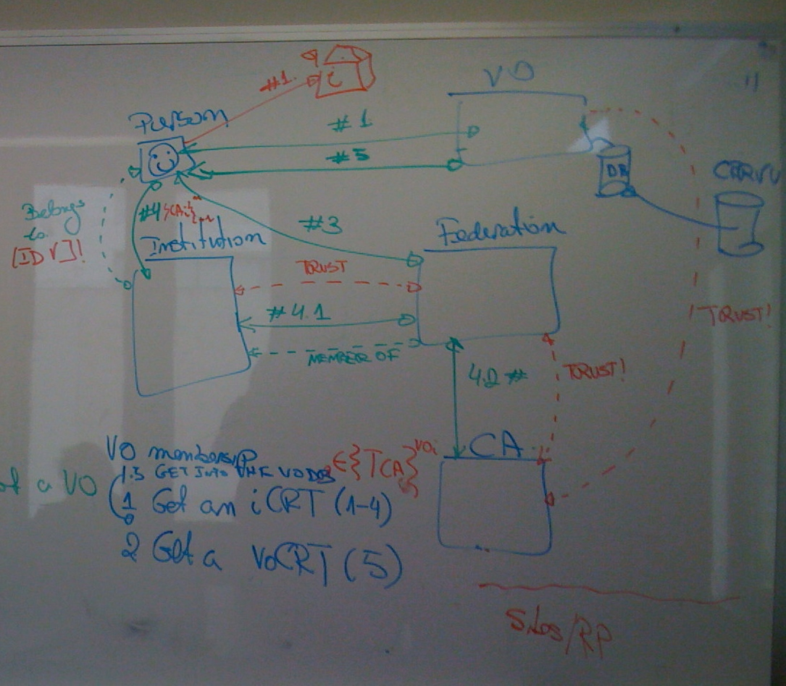

Slide 4
WN
GridFTP
Utility
job
url_copy
-
-
-
*CA
CAs
Bring your own CA ?
In terms of Frank’s requirement: we are not sure even if we implemented this right away, he would be able to use it. Because his sites are bound to respect WLCG policy of installing all IGTF CAs. Frank earlier asked for identifying the CAs that are actively used and only installing those.
TODO9: ask Frank if he is still asking for this requirement. Given CRL failures are no longer critical errors and installed CAs are checked against the GOC distribution, he may give up on this requirement.
  Even if this requirement stays valid, security team will nto start implementing until Ruth arranges the VOs to register their services with OSG
TODO7 still remains valid.

Slide 5
Feb 18, 2009
TODO10: Security threat model.
On the discussion of requiring voms proxy or plain proxy
  How many of our sites use GUMS and how many uses flat gridmapfiles. Is the security information included in information services sufficient?
  There is no VO complaining on this so far
  Users can be mapped into different identities because a site uses flat map files and another uses gums. However, we have not heard any user complaints yet. Why?
  Until we hear complaints, we will only check what type of security information is published in information services
On the operational question of who is responsible for ensuring security infrastructure is up and running
  Things that are not a threat to our infrastructure and production are not monitored by the security team; they will be monitored by operations team. Security team’s operations are restricted to threats to our security infrastructure
  TODO11: list what constitutes the operational duties performed by security team
OSG provides an important service to the community in obtaining certificates. OSG security team provides the RA service.
TODO12: Include audit of RA flow in ST&E list. Perform an audit of the RA flow.
  Explain how GOC acts as an RA and document the services performed by OSG RA and GOC.
TODO13: Understand OSG sites’ requirements regarding to the identity vetting process during the certificate issuance.
TODO14: understand the affect of a compromise or outage at DOEGrids CA.
  TODO15: Explore having voms-proxies tied to the the user’s original certificate may be useful in such outages to keep production going for a short while.
  During the outage, there won’t be any new certs issued by the CA or by the VOMS server. - TODO16: test whether we can revoke 2500 certs all at once. If we can ban them via CRL checks. Perform tests with a student.
CA compromise
Recovery start

Slide 6
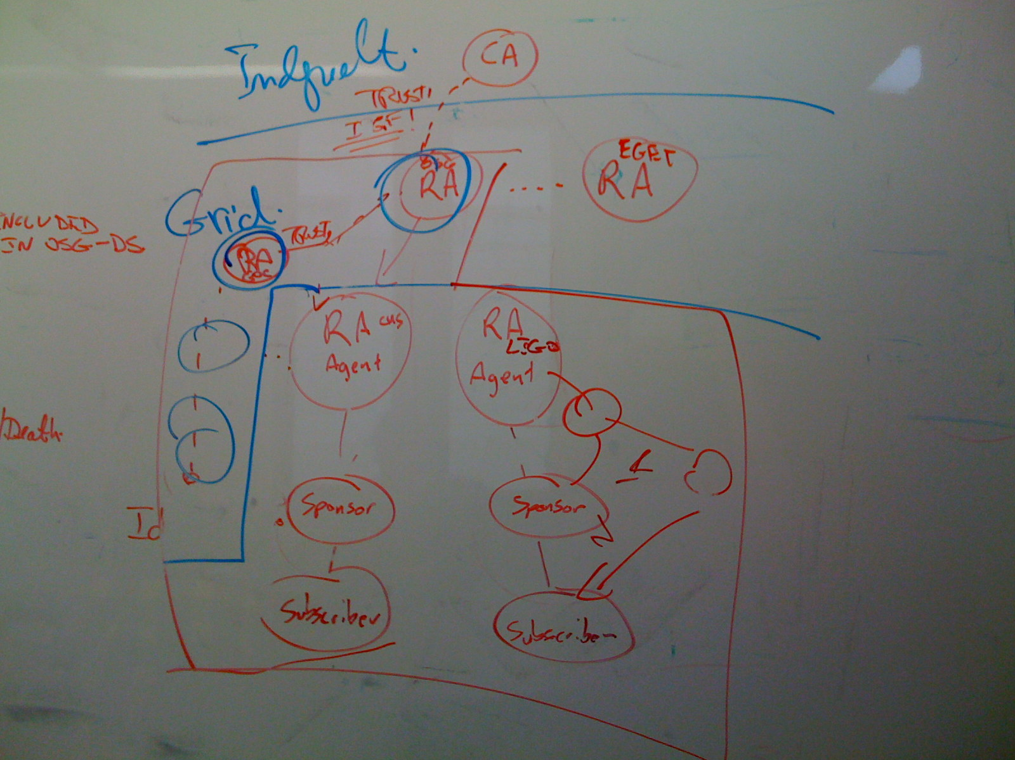

Slide 7
On the Banning Tool
  TODO17: write a design document. That explains
    The weakness or inherent risks of our design
    Push vs pull model and the paradigm shift that it brings if we go along with push model
    Whether applying banning after the authentication step is too late or not
TODO18: Explore providing CRLs to sites as a service. The benefit of this is to monitor which sites are downloading their CRLs. The log files of the service would tell us which sites have already downloaded or not. Instead of asking sites to run RSv probes and sends us results, this would be an easier way to monitor site’s due diligence.
TODO19: Ask Miron and Ruth to examine and go through each incident post mortem report.
TODO20: Write procedures on what makes a site get kicked out of OSG. Which operational requirements are necessary to meet in order to stay as an OSG site. E.g. GOC has the rule of “3-calls-missed-you-are-out”. What is it that security’s three strike’s rule?
On the software security
  Which vulnerability examining tools to purchase, who will look at the tool’s results?

