Slide 1
High Throughput
Computing (HTC)

Slide 2
The words of
Koheleth son of David king in Jerusalem

Slide 3
The words of Koheleth son of David, king in Jerusalem ….
  Only that shall happen
  Which has happened,
  Only that occur
  Which has occurred;
  There is nothing new
  Beneath the sun!
Ecclesiastes Chapter 1 verse 9

Slide 4
In 1983 I wrote a Ph.D. thesis –
“Study of Load Balancing Algorithms for Decentralized Distributed Processing Systems”
http://www.cs.wisc.edu/condor/doc/livny-dissertation.pdf

Slide 5
BASICS OF A M/M/1 SYSTEM
Expected # of customers is 1/(1-ρ), where (ρ = λ/μ) is the utilization
λ
When utilization is 80%,
you wait on the average 4 units
for every unit of service
μ

Slide 6
BASICS OF TWO M/M/1 SYSTEMS
When utilization is 80%,
you wait on the average 4 units
for every unit of service
λ
λ
When utilization is 80%,
25% of the time a customer is
waiting for service while
a server is idle
μ
μ

Slide 7
Wait while Idle (WwI) in m*M/M/1
1
m = 20
m = 10
Prob
(WwI)
m = 5
m = 2
0
0
Utilization
1

Slide 8
Claims for “benefits” provided by Distributed Processing Systems
P.H. Enslow, “What is a Distributed Data Processing System?” Computer, January 1978
  High Availability and Reliability
  High System Performance
  Ease of Modular and Incremental Growth
  Automatic Load and Resource Sharing
  Good Response to Temporary Overloads
  Easy Expansion in Capacity and/or Function

Slide 9
Definitional Criteria for a Distributed Processing System
P.H. Enslow and T. G. Saponas “”Distributed and Decentralized Control in Fully Distributed Processing Systems” Technical Report, 1981
  Multiplicity of resources
  Component interconnection
  Unity of control
  System transparency
  Component autonomy

Slide 10
Multiplicity of resources
The system should provide a number of assignable resources for any type of service demand. The greater the degree of replication of resources, the better the ability of the system to maintain high reliability and performance

Slide 11
Component interconnection
A Distributed System should include a communication subnet which interconnects the elements of the system. The transfer of information via the subnet should be controlled by a two-party, cooperative protocol (loose coupling).

Slide 12
Unity of Control
All the component of the system should be unified in their desire to achieve a common goal. This goal will determine the rules according to which each of these elements will be controlled.

Slide 13
System transparency
From the users point of view the set of resources that constitutes the Distributed Processing System acts like a “single virtual machine”. When requesting a service the user should not require to be aware of the physical location or the instantaneous load of the various resources

Slide 14
Component autonomy
The components of the system, both the logical and physical, should be autonomous and are thus afforded the ability to refuse a request of service made by another element. However, in order to achieve the system’s goals they have to interact in a cooperative manner and thus adhere to a common set of policies. These policies should be carried out by the control schemes of each element.

Slide 15
“ … Since the early days of mankind the primary motivation for the establishment of communities has been the idea that by being part of an organized group the capabilities of an individual are improved. The great progress in the area of inter-computer communication led to the development of means by which stand-alone processing sub-systems can be integrated into multi-computer ‘communities’. … “
Miron Livny, “ Study of Load Balancing Algorithms for Decentralized Distributed Processing Systems.”,
Ph.D thesis, July 1983.

Slide 16
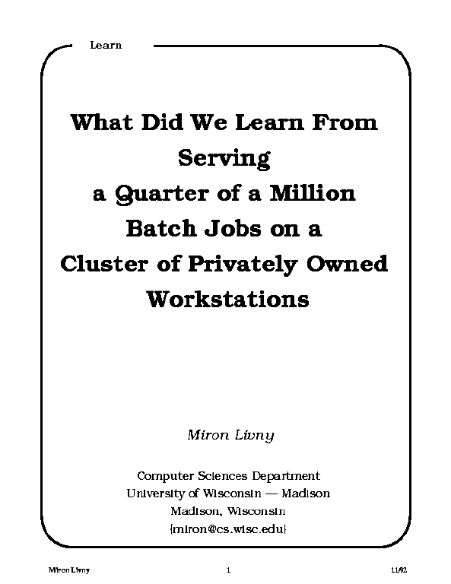
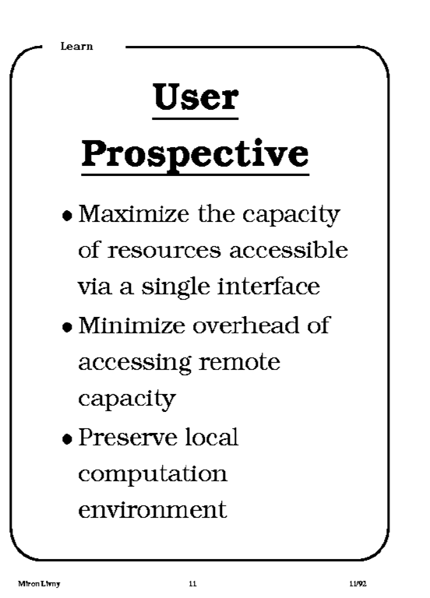
1992

Slide 17
High Throughput Computing
We first introduced the distinction between High Performance Computing (HPC) and High Throughput Computing (HTC) in a seminar at the NASA Goddard Flight Center in July of 1996 and a month later at the European Laboratory for Particle Physics (CERN). In June of 1997 HPCWire published an interview on High Throughput Computing.

Slide 18
Why HTC?
For many experimental scientists, scientific progress and quality of research are strongly linked to computing throughput. In other words, they are less concerned about instantaneous computing power. Instead, what matters to them is the amount of computing they can harness over a month or a year --- they measure computing power in units of scenarios per day, wind patterns per week, instructions sets per month, or crystal configurations per year.

Slide 19
High Throughput Computing is a
24-7-365 activity
FLOPY ≠ (60*60*24*7*52)*FLOPS

Slide 20
Obstacles to HTC
(Sociology)
(Education)
(Robustness)
(Portability)
(Technology)
Ownership Distribution
Customer Awareness
Size and Uncertainties
Technology Evolution
Physical Distribution

Slide 21
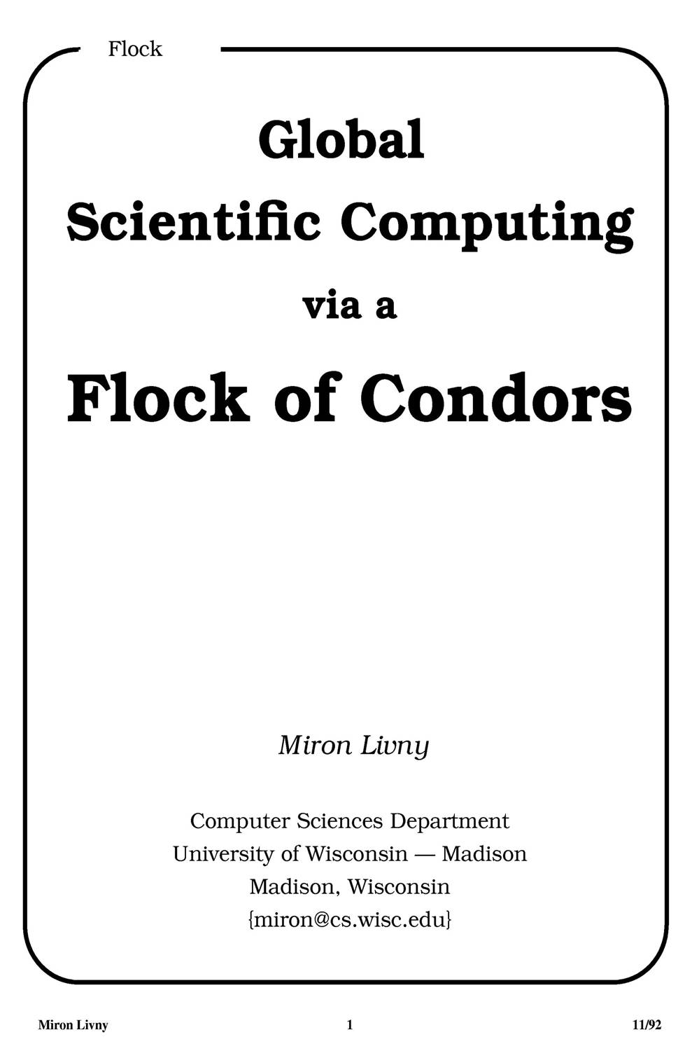
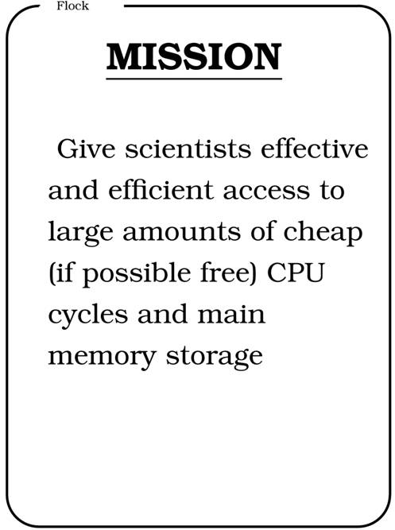
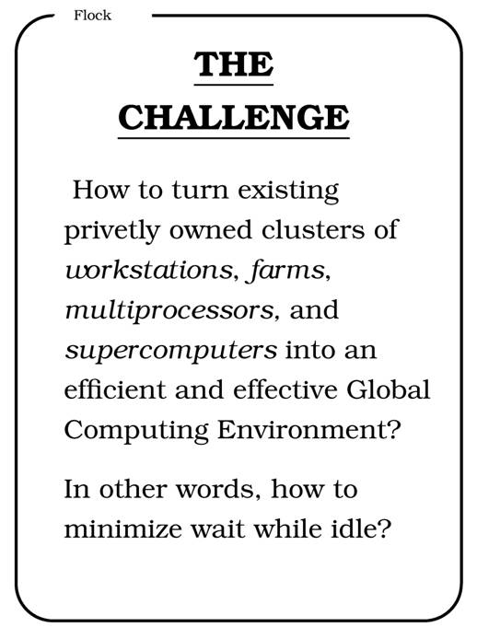
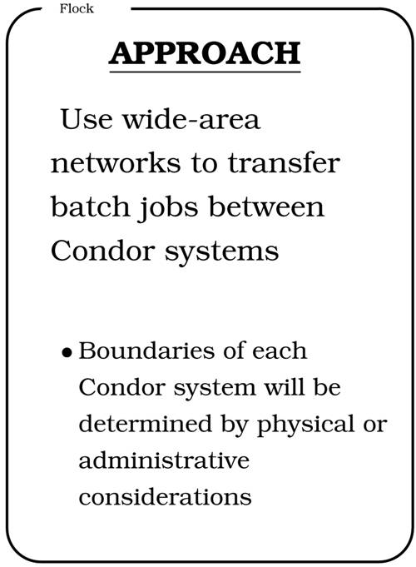
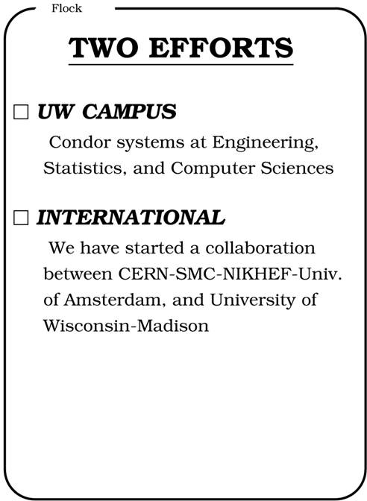
CERN 92

Slide 22

The Grid: Blueprint for a New Computing Infrastructure
Edited by Ian Foster and Carl Kesselman
July 1998, 701 pages.
The grid promises to fundamentally change the way we think about and use computing. This infrastructure will connect multiple regional and national computational grids, creating a universal source of pervasive and dependable computing power that supports dramatically new classes of applications. The Grid provides a clear vision of what computational grids are, why we need them, who will use them, and how they will be programmed.

Slide 23
“ … We claim that these mechanisms, although originally developed in the context of a cluster of workstations, are also applicable to computational grids. In addition to the required flexibility of services in these grids, a very important concern is that the system be robust enough to run in “production mode” continuously even in the face of component failures. … “
Miron Livny & Rajesh Raman, "High Throughput Resource Management", in “The Grid: Blueprint for
a New Computing Infrastructure”.

Slide 24
WWW
Grid
Client
Master
Server
Worker

Slide 25
The NUG30 Quadratic Assignment Problem (QAP)
Solved!
(4 Scientists +
1 Linux Box)
30
i=1
30
j=1
∑
∑
a_{ij}b_{p(i)p(j)}
min
p∈∏

Slide 26
NUG30 Personal Grid …
Managed by one Linux box at Wisconsin
Flocking: -- the main Condor pool at Wisconsin (500 processors)
-- the Condor pool at Georgia Tech (284 Linux boxes)
-- the Condor pool at UNM (40 processors)
-- the Condor pool at Columbia (16 processors)
-- the Condor pool at Northwestern (12 processors)
-- the Condor pool at NCSA (65 processors)
-- the Condor pool at INFN Italy (54 processors)
Glide-in: -- Origin 2000 (through LSF ) at NCSA. (512 processors)
-- Origin 2000 (through LSF) at Argonne (96 processors)
Hobble-in: -- Chiba City Linux cluster (through PBS) at Argonne
(414 processors).

Slide 27
Solution Characteristics.
Scientists | 4
Workstations | 1
Wall Clock Time | 6:22:04:31
Avg. # CPUs | 653
Max. # CPUs | 1007
Total CPU Time | Approx. 11 years
Nodes | 11,892,208,412
LAPs | 574,254,156,532
Parallel Efficiency | 92%

Slide 28
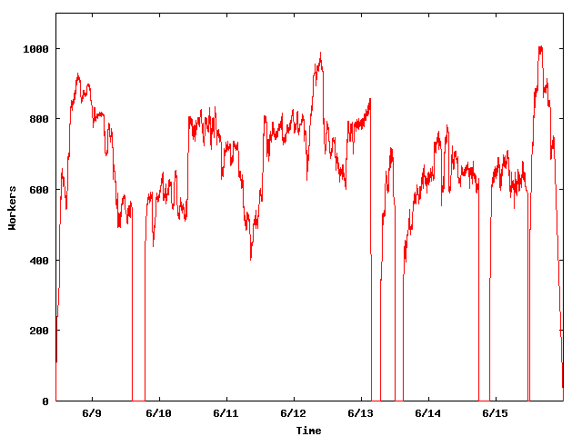
The NUG30 Workforce
System
Upgrade
Condor crash
Workers
Application
Upgrade

Slide 29
Being a Master
Customer “delegates” task(s) to the master who is responsible for:
  Obtaining allocation of resources
  Deploying and managing workers on allocated resources
  Delegating work unites to deployed workers
  Receiving and processing results
  Delivering results to customer

Slide 30
Master must be …
Persistent – work and results must be safely recorded on non-volatile media
Resourceful – delegates “DAGs” of work to other masters
Speculative – takes chances and knows how to recover from failure
Self aware – knows its own capabilities and limitations
Obedience – manages work according to plan
Reliable – can mange “large” numbers of work items and resource providers
Portable – can be deployed “on the fly” to act as a “sub master”

Slide 31
“ … Grid computing is a partnership between clients and servers. Grid clients have more responsibilities than traditional clients, and must be equipped with powerful mechanisms for dealing with and recovering from failures, whether they occur in the context of remote execution, work management, or data output. When clients are powerful, servers must accommodate them by using careful protocols.… “
Douglas Thain & Miron Livny, "Building Reliable Clients and Servers", in “The Grid: Blueprint for a New Computing
Infrastructure”,2nd edition

Slide 32
Resource Allocation
(resource -> customer) vs.
Work Delegation
(job -> resource)

Slide 33
Delegate work
Delegate work
Delegate work
W
R
W
R
Allocate Resource
Allocate Resource
Allocate Resource

Slide 34
Resource Allocation
A limited assignment of temporary “ownership” of a resource offered by a provider to a requestor
  Requestor is charged for allocation regardless of actual consumption
  Requestor may be given the right to allocate resource to others
  Provider has the right and means to revoke the allocation
  Allocation is governed by an “agreement” between the provider and the requestor
  Allocation is a “lease” that expires if not renewed by the requestor
  Tree of allocations

Slide 35
Work Delegation
An assignment of a responsibility to perform a task
  Delegation involved a definition of these “responsibilities”
  Responsibilities my be further delegated
  Delegation consumes resources
  Delegation is a “lease” that expires if not renewed by the assigner
  Can form a tree of delegations

Slide 36
In Condor we use a two phase matchmaking process to first allocate a resource to a requestor and then to select a task to be delegated to this resource

Slide 37

MatchMaker
Match!
Match!
Wi
Wi
Wi
Wi
I am S and am looking for a resource
I am D and I am willing to offer you a resource
MM
S
Claim Resource
D
W3
Delegate Work

Slide 38
Overlay Resource Managers
Ten years ago we introduced the concept of Condor glide-ins as a tool to support ‘just in time scheduling’ in a distributed computing infrastructure that consists of recourses that are managed by (heterogeneous) autonomous resource managers. By dynamically deploying a distributed resource manager on resources allocated (provisioned) by the local resource managers, the overlay resource manager can implement a unified resource allocation policy.
In other words, we use remote job invocation to get resources allocated.

Slide 39
Application/Portal
Condor
MM
C-app
Local
SchedD (Condor G)
MM
Cloud/Grid Interfaces
MM
MM
MM
SchedD
(Condor C)
SchedD
(Condor C)
SchedD
(Condor C)
MM
MM
LSF
EC2
Condor
Condor
StartD
(Glide-in)
StartD
(Glide-in)
StartD
(Glide-in)
Remote
C-app
C-app
G-app
C-app
G-app
C-app
G-app

Slide 40
How can we accommodate an unbounded need for computing and an unbounded amount of data with an unbounded amount of resources?

